Slide 1
House Higher Education Finance and Policy Committee
Justin Terrell | Executive Director

Slide 2
Mission of the Council
The Minnesota Legislature empowered the Council for Minnesotans of African Heritage to ensure that people of African heritage fully and effectively participate in and equitably benefit from the political, social, and economic resources, policies and procedures of the State of Minnesota. Generally, the Council is charged with the responsibility of:
Advising the Governor and the Legislature on issues confronting People of African Heritage;
Advising the Governor and the Legislature on statutes, rules and revisions to programs to ensure that Black people have access to benefits and services provided to people in Minnesota;
Serving as a liaison to the federal government, local government units and private organizations on matters relating to People of African Heritage in Minnesota;
Implementing programs designed to solve problems of People of African Heritage when authorized by statute, rule or order; and
Publicizing the accomplishments of People of African Heritage and their contributions to the state.
See MINNESOTA STATUTES 15.0145 ETHNIC COUNCILS

Slide 3
Structure of the Council
The Council is made up of:
11 members from the African Heritage Community appointed by the Governor
4 sitting legislative members appointed by leadership in the State House and Senate
4 Paid Staff
Executive Director
Office Manager
Outreach Coordinator
Legislative Coordinator

Slide 4
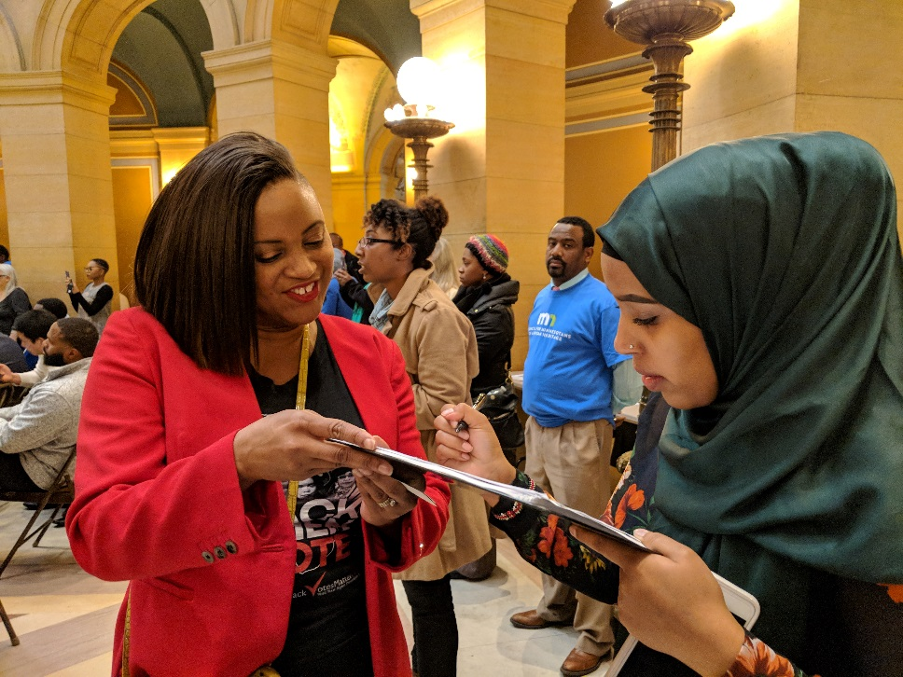
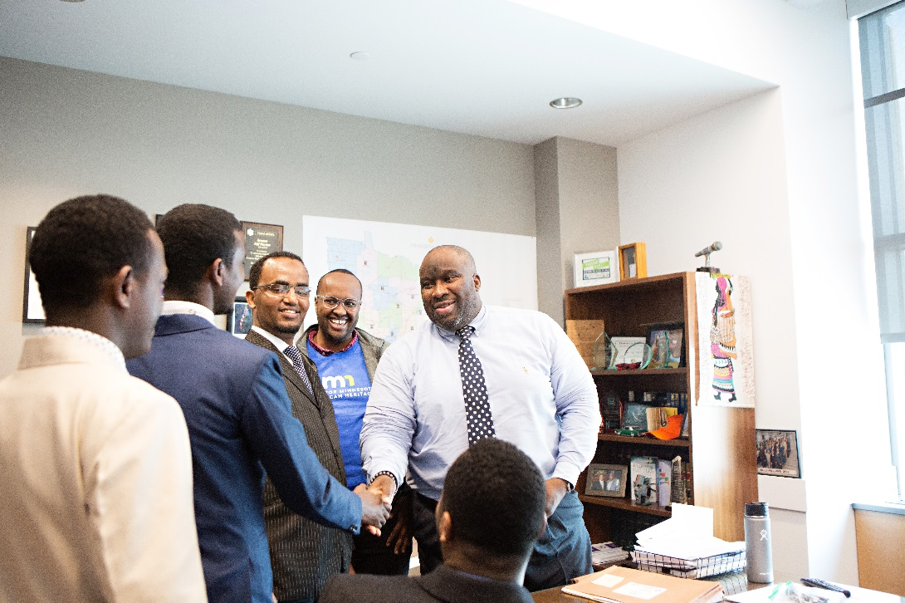
The Work of the Council
Engage our constituents through statewide outreach efforts
Work with the community and lawmakers to advance a legislative agenda that address the needs of the African Heritage community.

Slide 5
2018 Leg Agenda
Priority Bills
Restoration of Voting Rights (Hearing in the House)
African American Family Preservation Act (Press Conference with national attention)
Teachers of Color and American Indian Teachers (Hearing in the House)
Domestic Violence and Sexual Assault Prevention Fund (No action taken)
Action taken by the Governor
OIS Thurman Blevins
Veto of Anti Protest Bill

Slide 6
2019 Leg Agenda
Priority Bills
Restoration of Voting Rights
African American Family Preservation Act
Black Immigration (Drivers Licenses for All and DED/TPS)
Additional Areas of Focus
Housing
Workforce and Economic Development
Healthcare for All
Education
Transportation
Criminal Justice Reform

Slide 7
2019 Leg Agenda Criteria
Must be led by people of African Heritage
Must have a statewide impact
Must have people of African Heritage actively connected to the policy and effort

Slide 8
2018 Outreach Efforts
Developed relationships in the Twin Cities, Saint Cloud, Duluth and Rochester
Sponsored and cohosted 50+ events around the state
Mobilized over 300 constituents to the Capitol during session
Built a statewide network that started at 500 to over 2,000

Slide 9
2019 Outreach Efforts
Develop leadership groups in the Twin Cities, Saint Cloud, Duluth, Rochester and Brooklyn Park/Center
Sponsor and cohost events with orgs led by constituents
Survey on issues
Annual Meeting in Fall 2019
Mobilize 500 constituents to the Capitol this Session

Slide 10
Day on the Hill
African Heritage Day on the Hill
Tuesday, February 26th, 2019
2 pm – 4pm in the Capitol Rotunda
Keynote from AG Ellison
Partnership with NPHC

Slide 11
Challenges facing the community

Slide 12
Black/African-American Minnesotans are concentrated in the 7-county metro
In 2017:
80% of all Black/African American Minnesotans lived in the 7-county metro
44% lived in Hennepin County
36% lived in Minneapolis and St. Paul
Source: U.S. Census Bureau, American Community Survey

Slide 13
The increase held for all major race groups
Source: U.S. Census Bureau, American Community Survey

Slide 14
Since 2011, poverty rates have declined for all major race groups
Source: U.S. Census Bureau, American Community Survey

Slide 15
Unemployment gaps have narrowed, large differences remain in the share participating in the labor force
Source: U.S. Census Bureau, American Community Survey

Slide 16
Full-Time Employment with Higher Earnings (> $35,000) Grew for Workers in all Major Race Groups. continued
Source: U.S. Census Bureau, American Community Survey
.
Notes:
Full-time, year-round workers are those who usually worked 35 hours or more per week for 50 to 52 weeks in the past 12 months.

Slide 17
Full-Time Employment with Higher Earnings (> $35,000)
Source: U.S. Census Bureau, American Community Survey
.
Notes:
Full-time, year-round workers are those who usually worked 35 hours or more per week for 50 to 52 weeks in the past 12 months.

Slide 18
Higher Education
Disaggregate Data
Access and Affordability
Increase Teachers of Color and American Indian Teachers

Slide 19
Teachers of Color and American Indian Teachers (TOCAIT)

Slide 20
Thoughts About Policy
The way things are is not an accident
People-made problems can be solved by people

Slide 21
Questions
Justin Terrell | Executive Director

Slide 22
Thank You See you at Day on the Hill!
Justin Terrell Executive Director
Justin.Terrell@state.mn.us
651-356-1820

