Slide 1
Children’s Mental Health

Slide 2
Mental Illnesses

Slide 3
Mental Illnesses in Children

Slide 4
Mental Illnesses in Children
70% of youth in juvenile justice systems have at least one mental health condition and at least 20% live with a serious mental illness.
Child Mind Report: Nearly 50% of youth will have had a diagnosable mental illness at some point during childhood. Of those diagnosed, 22 percent will have a serious impairment. Only 7.4% of those kids will get treatment

Slide 5
Mental Illnesses in Children
Over one-third (37%) of students with a mental health condition age 14­–21 and older who are served by special education drop out
An estimated 6,000 youth are homeless on any given night and 57% have significant mental health issues
Suicide is the 10th leading cause of death in the U.S., and the 2nd leading cause of death for people aged 10–34.

Slide 6
Student Survey
One in five showed signs of depression in the previous two weeks
Percentage of 9th grade students who reported long-term mental health, behavioral or emotional problems lasting six months or more rose from 12.5% in 2013 to 17.3% in 2016.
Percentage of 11th grade students receiving treatment rose from 8.8% to 13.2%

Slide 7
Suicide
Percentage of 11th graders seriously considering suicide went from 9.7% to 12%.
In 2016, 9 youth between the ages of 10-14 and 39 youth between the ages of 15-19 completed suicide
In 2011, the first time in 24 years, teen suicide rate was higher than teen homicide rate
Suicide rate up in all ethnic groups with Native America youth with highest rate

Slide 8
Mental Illnesses in Children
Prevalence rate is increasing – in US and in other countries – England, France, Ireland, Australia, Canada
For children, ages 0-17, there was a 56% increase in mental health Emergency Department visits in greater Minnesota and a 40% increase in the metro area. The state went from 9,946 pediatric Emergency Department visits in 2007 to 19,368 visits in 2016.

Slide 9
Why an Increase?
Toxic stress due to living in poverty, homelessness or housing instability
Social media – builds anxiety, contributes to feeling lonely, leads to sleep deprivation, lower self esteem
14% more likely to be depressed
8th graders with heavy use increase risk of depression 27%
Teens who spend 3 hrs a day or more on electronic devices more likely to have a risk factor for suicide

Slide 11
Children’s Mental Health System
Early Identification
Child and teen check-ups
Social emotional screening early childhood
Screening in primary care (12 different screening tools). The percentage of children ages 12-18 screened in 2017 was 73% up 33 percentage points from 2015.
Training of teachers (2 hours plus 1 hour suicide prevention) and foster care providers
Youth MH First Aid training for people working with youth

Slide 12
Children’s Mental Health System
Treatment and Services
Early childhood mental health consultation
Primary care, pediatrician, consultation
Outpatient therapy by a mental health professional
Case management
Respite care
Children’s Therapeutic Services and Supports
In-reach
Virtual behavioral health homes
Youth ACT teams
CADI Waivers, PCAs
Mobile crisis and stabilization
Day treatment
Partial hospitalization
Therapeutic foster care
Residential treatment, PRTF
Hospital

Slide 13
School-Linked Mental Health Grants
Grants to mental health providers who co-locate in the schools
Bill private & public insurance, grants for students who are un/underinsured & for services you can’t bill
Build the capacity of the school to support all children
50% had never been seen before & 50% had a serious mental illness, addresses disparities

Slide 14
School-Linked Mental Health Grants
Collaboration with school support personnel, builds on PBIS triangle
Firewall between education and health care records,
2015 served 14,277 children in 273 districts and 872 school buildings
2017 served 16,284 children in 288 districts and 953 school programs
New grant projections: 325 districts and 1169 school programs. No reported sites in Lake of the Woods and Lincoln county
$11 million a year

Slide 15
School-Linked Grants
Five Intermediate School Innovation Grants were awarded in 2018
Working with three mental health providers
Goal of improving clinical outcomes for students, helping students to return to their home school district, reversing the disproportionate impact on students of color, and providing support and training for school staff and parents.
$4.9 million over the next two years.

Slide 16
Mental Health Workforce
Mental Health Professionals:
Psychiatric nurse
Clinical social worker
Psychologist
Psychiatrist
Marriage and Family Therapist
Licensed Professional Clinical Counselor
Mental health practitioners:
MH behavioral aides, Family Peer Specialists

Slide 17
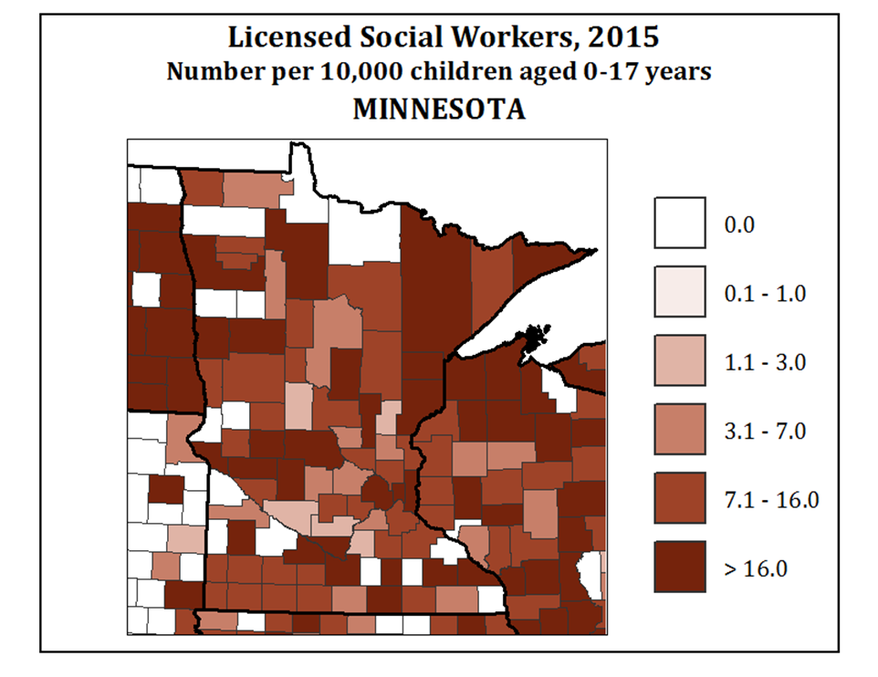
Workforce Shortages

Slide 18
Build It
Build on what we know works
School-linked, respite, CTSS, Youth ACT
Address loss of Federal Medicaid funding for most of the state’s children’s residential funding
Enforce mental health parity
Address workforce issues

Slide 19
Contact Information
NAMI Minnesota
1919 University Avenue, Suite 400
651-645-2948
1-888-NAMI-HELPS
www.namimn.org
January 2019

