Slide 1
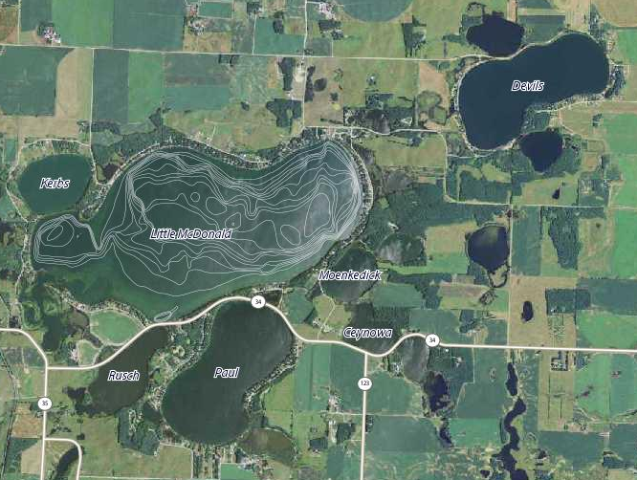
Historic flooding in Otter Tail County

Slide 2
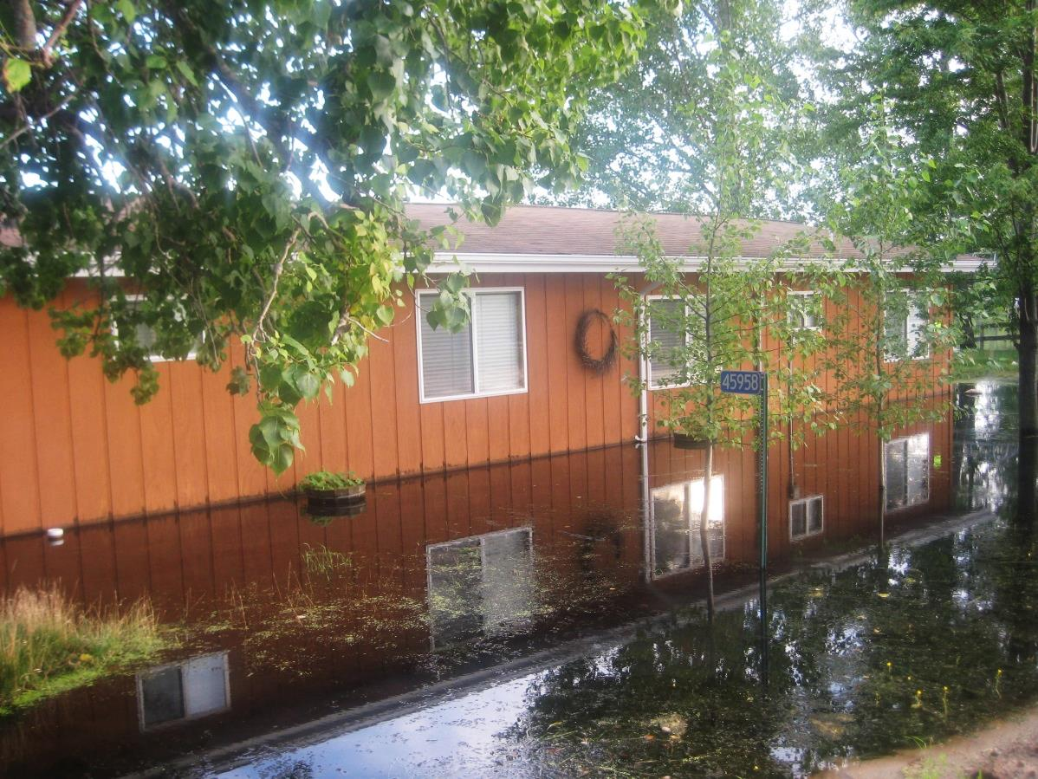
Overview
Extent of flooding
Options investigated
Proposed solution

Slide 3
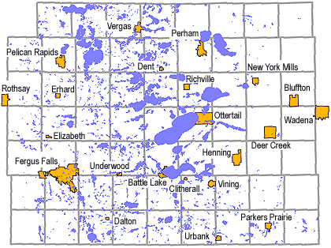
Otter Tail County
1000+ lakes
Severe flooding occurring in the region
Record-breaking ground water levels

Slide 4
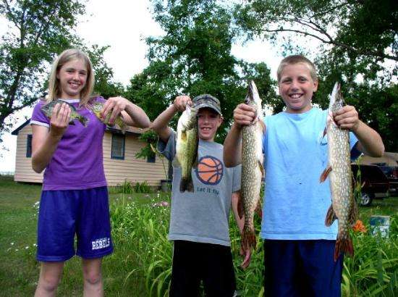
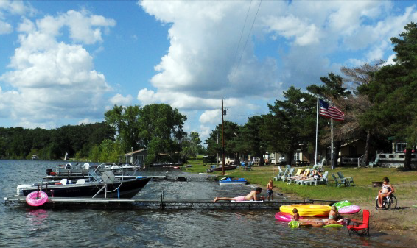
Perham/Dent Region
Threatened by flooding:
the cleanest lakes in MN
the fastest job growth in the State
the economy, housing, farming, & tourism

Slide 5
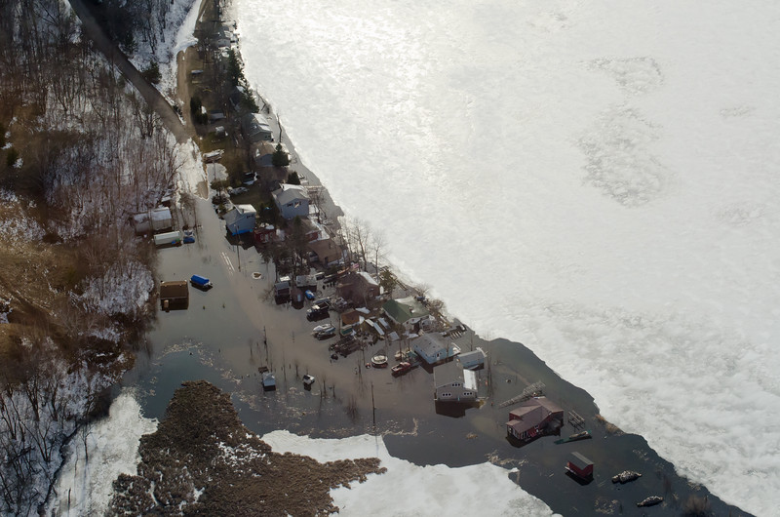
Possible Causes for the flooding
Little McDonald, Kerbs, Paul & Devils Lake are surrounded by roads and a railroad bed which prevents natural drainage.
Ground water levels are at an all-time high
Precipitation trend - expected to continue

Slide 6
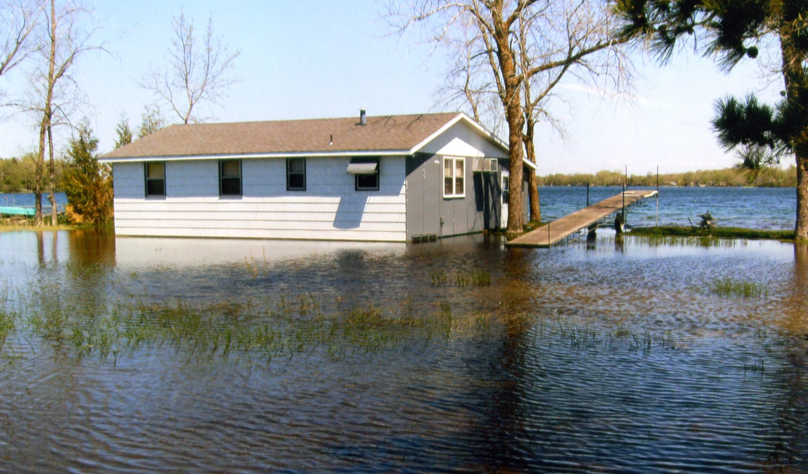
Homes built 75 feet away from these lakes are surrounded by water
1975
2011

Slide 7
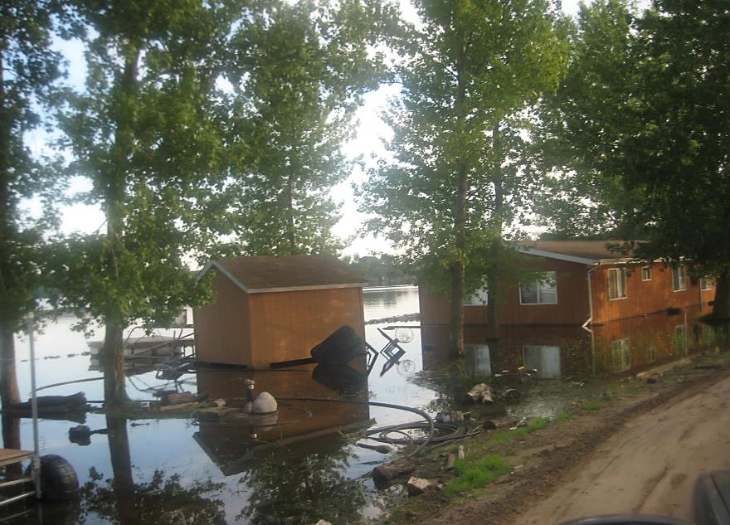
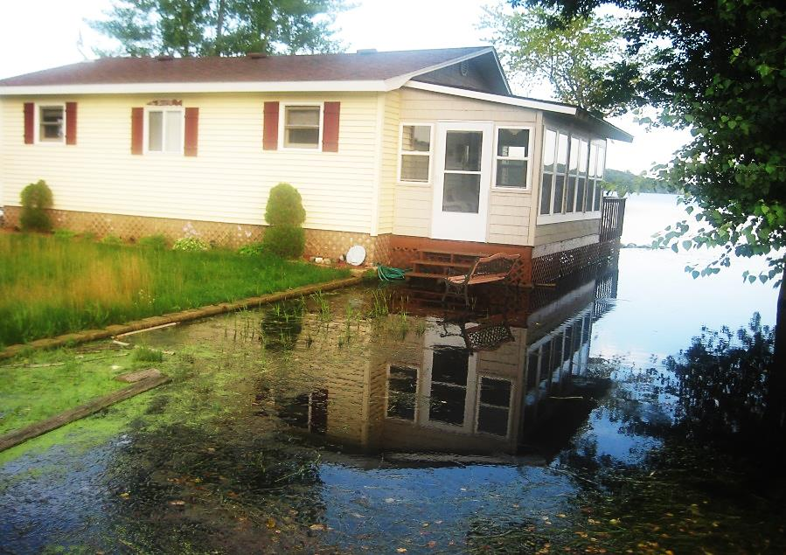
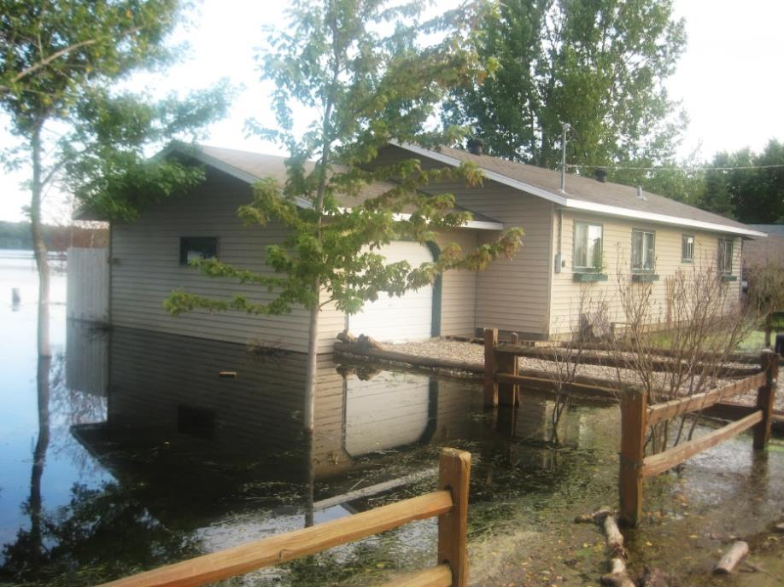
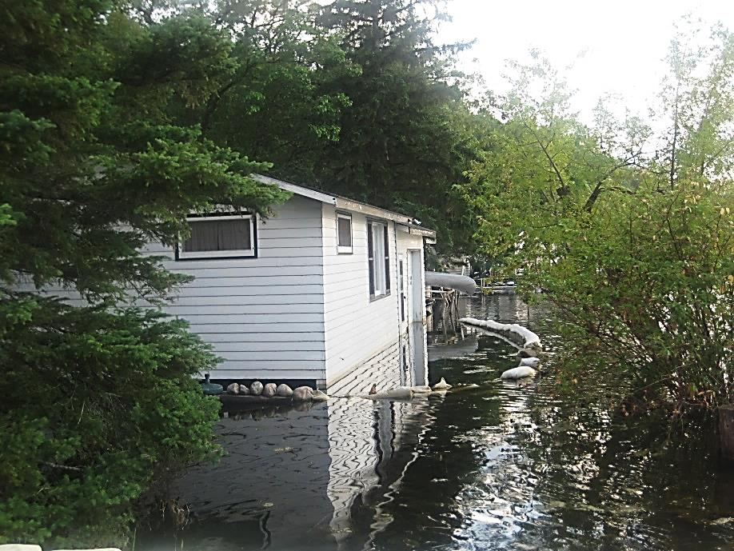
20 homes lost; 122 more threatened

Slide 8
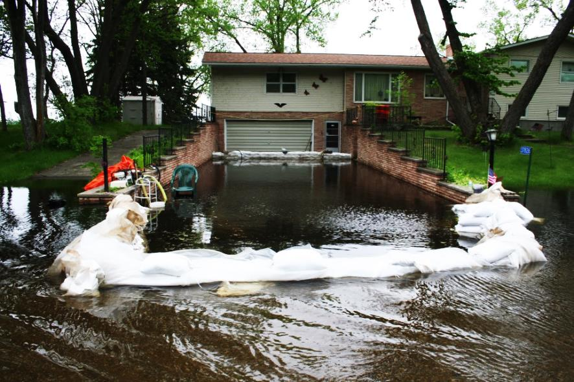
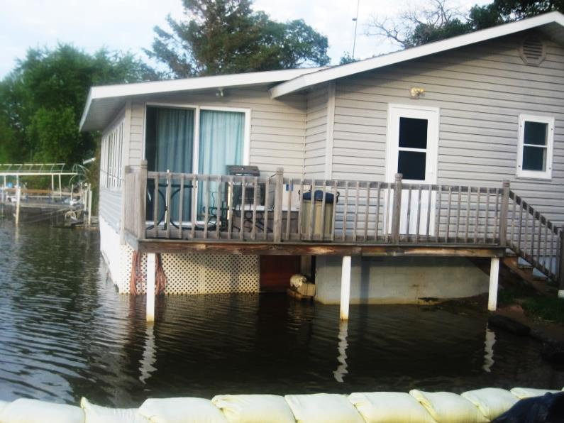
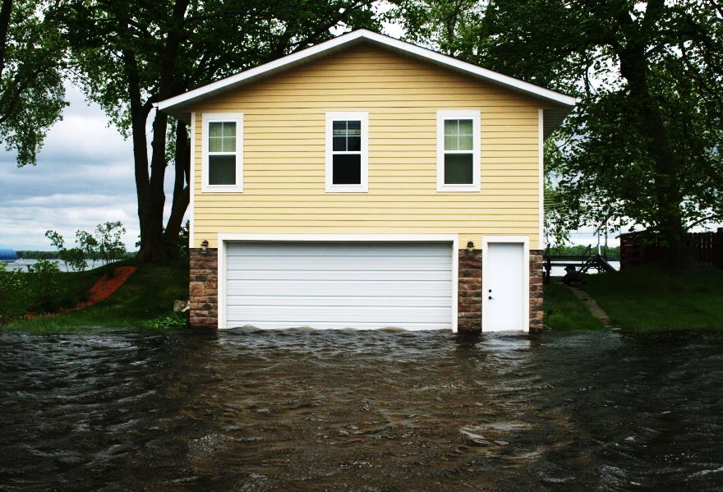
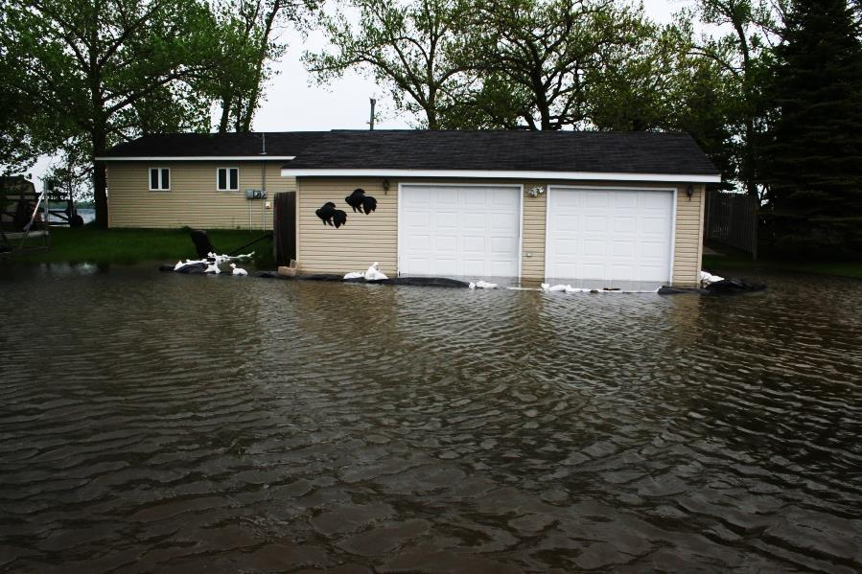
Seniors are losing their retirement homes and incomes

Slide 9
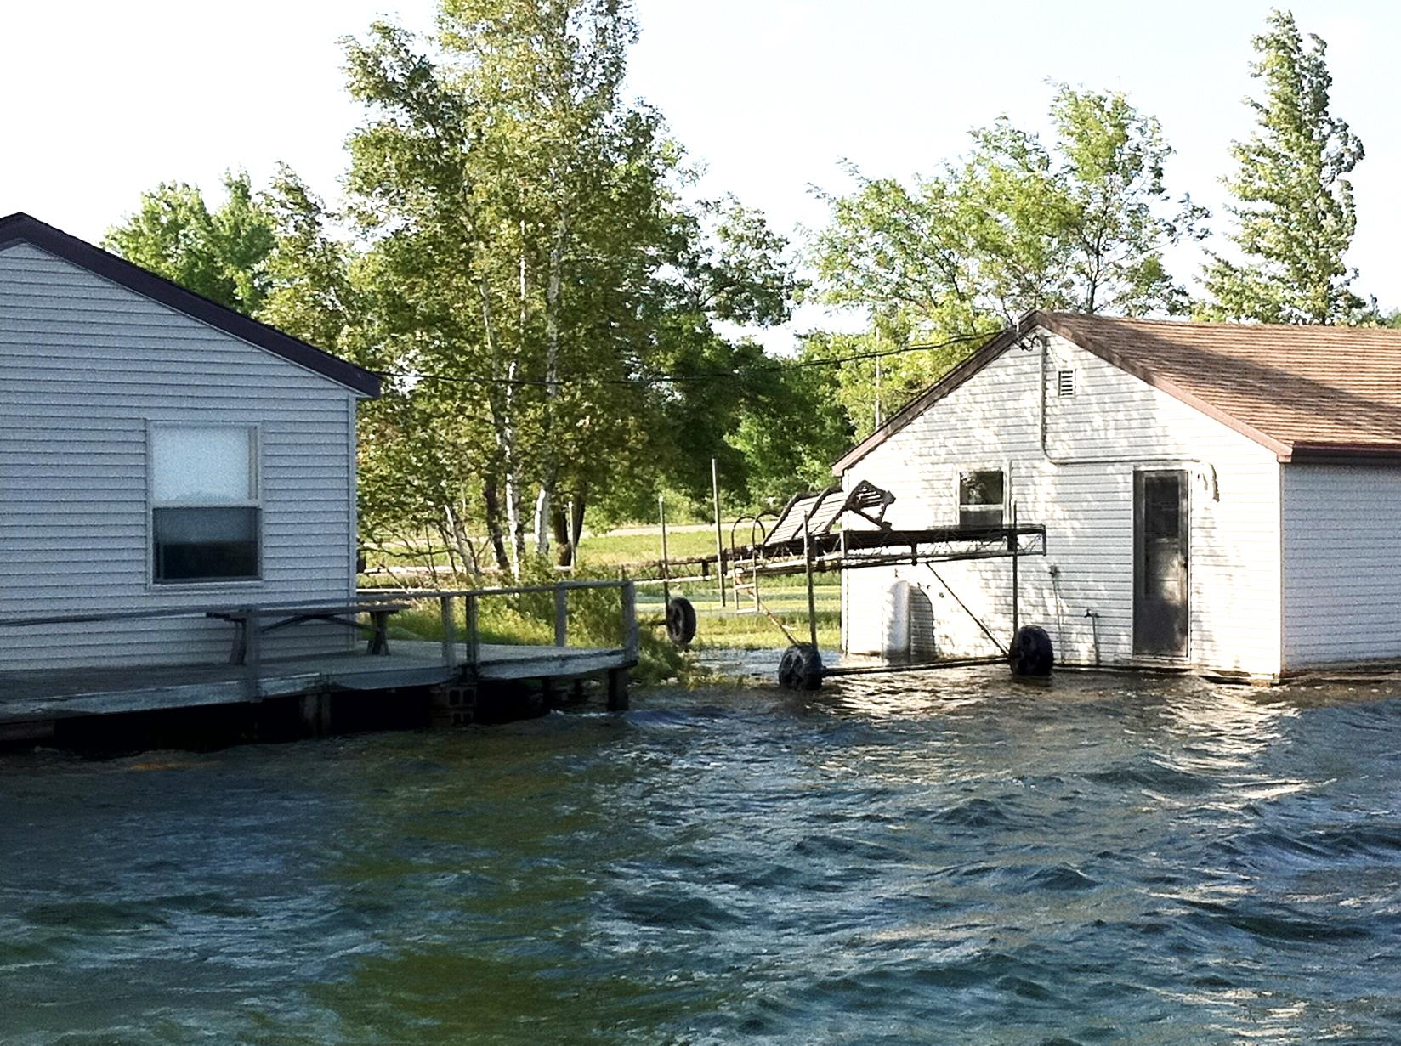
One resort is closed, another is threatened

Slide 10
DNR had to close 2 out of the 4 boat landings Remaining ones are crowded & dangerous
Lakes are inaccessible to the public
One of the open boat landings

Slide 11
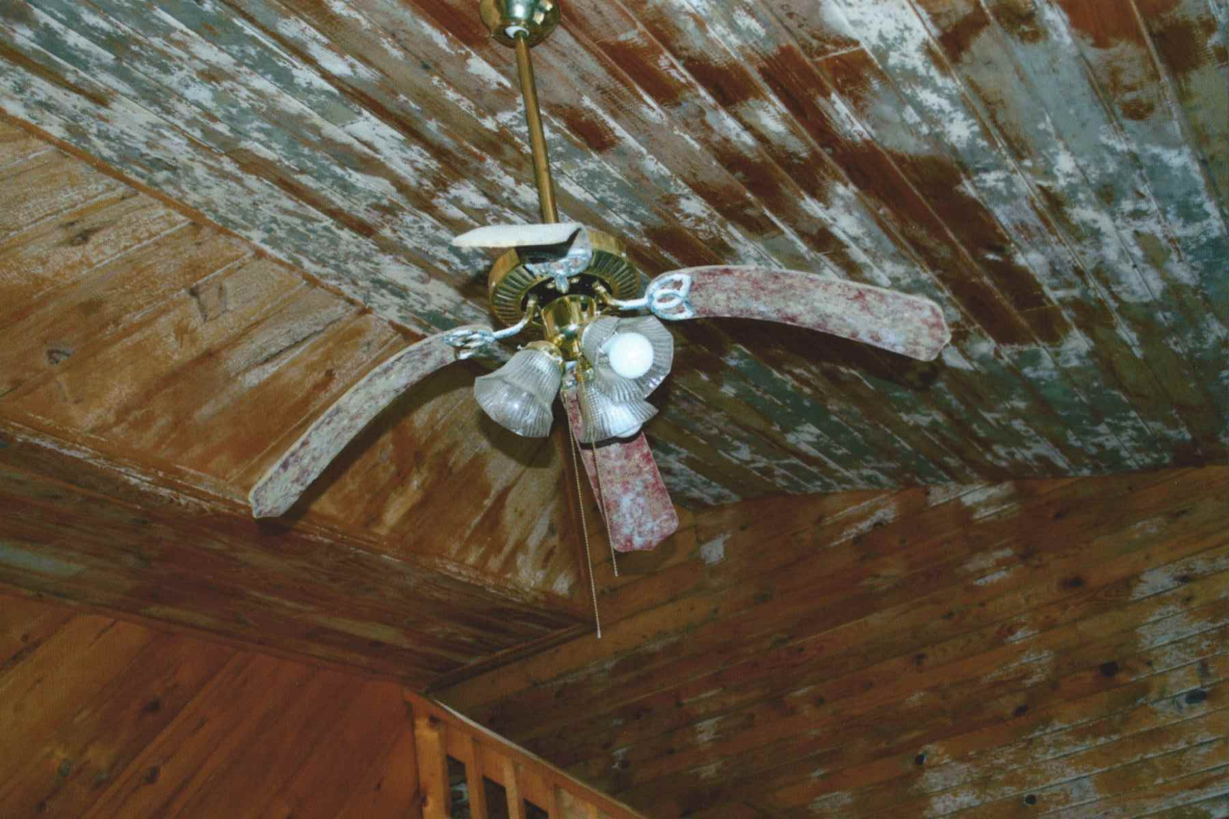
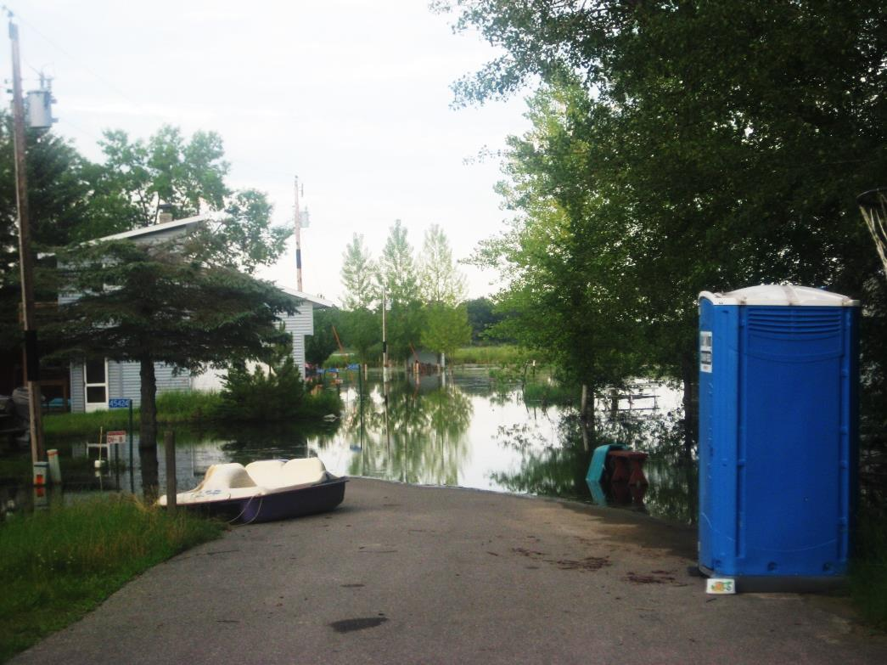
Public Health endangered
56 Septic Systems condemned or compromised
40 Wells too close to these septic systems
Homes filled with mold

Slide 12
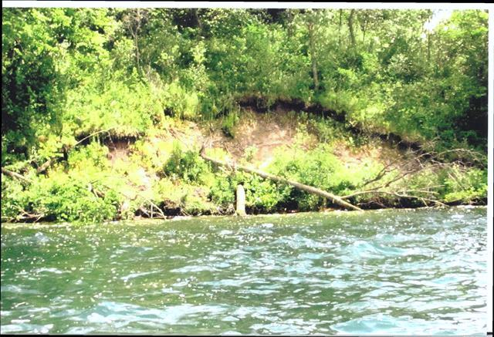
Environment at risk
MN’s cleanest lakes are being destroyed
Massive shoreline erosion
Phosphorus increasing from decaying trees

Slide 13
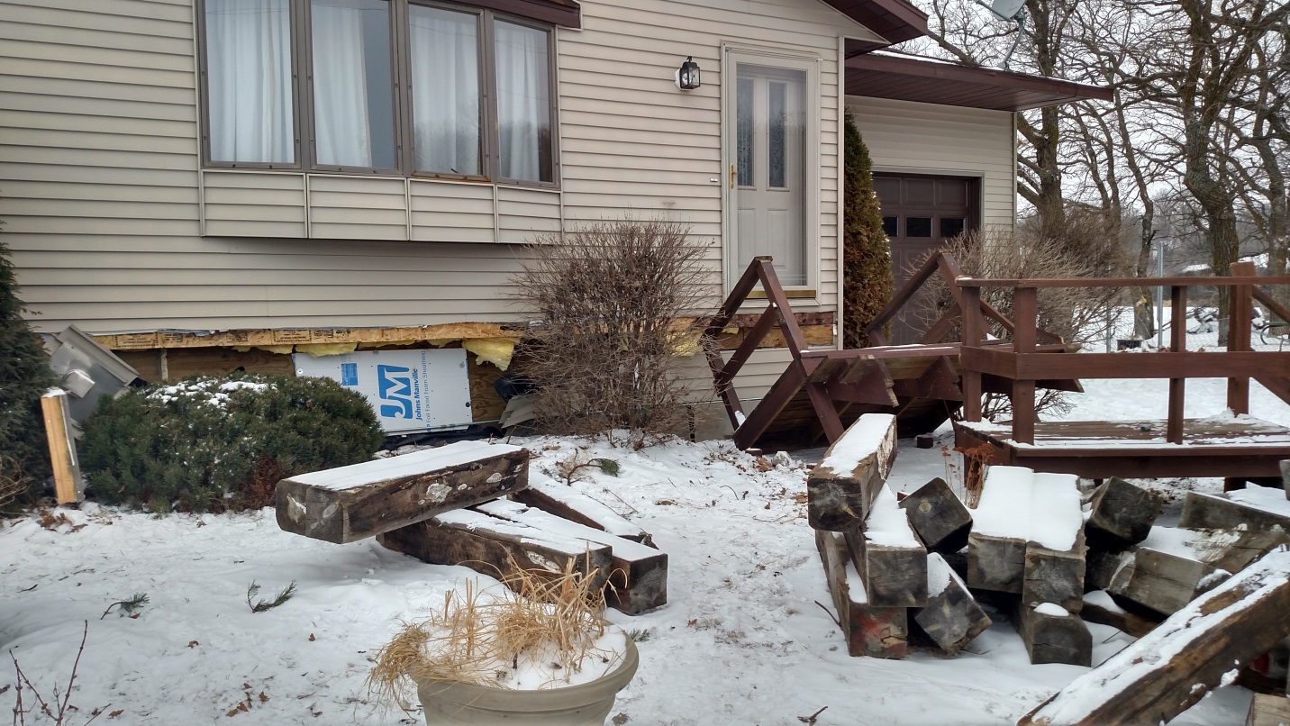
Economic Cost to flooding
Property values lost 16 million (EMV) in 2011
This year’s EMVs will drop even more
Residents have already spent $9.3 million
Townships & Utilities have spent $1 million

Slide 14
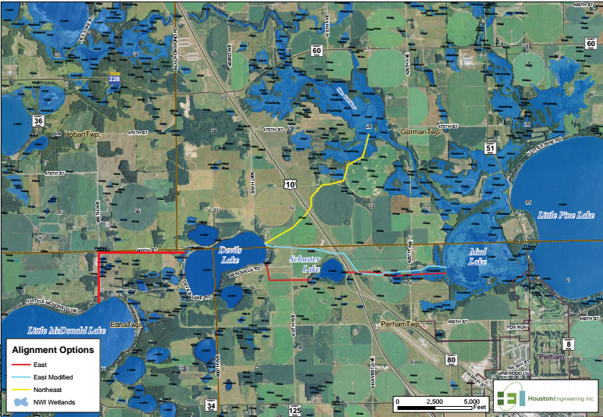
Searching for Options
We have spent a decade and $700,000 trying to solve this problem. Many routes and options have been explored.

Slide 15
Waiting is NOT an Option
Currently, an additional $5 million is needed to repair damages; if water levels rise as expected, this damage figure could quadruple
35 % of all remaining homes (122 more homes) will be lost if lake levels rise another 1 – 2 feet – resulting in $29 million loss
Overland flooding will increase infrastructure damage – place additional financial strain on utilities and governments – and expose other lakes to aquatic invasive species

Slide 16
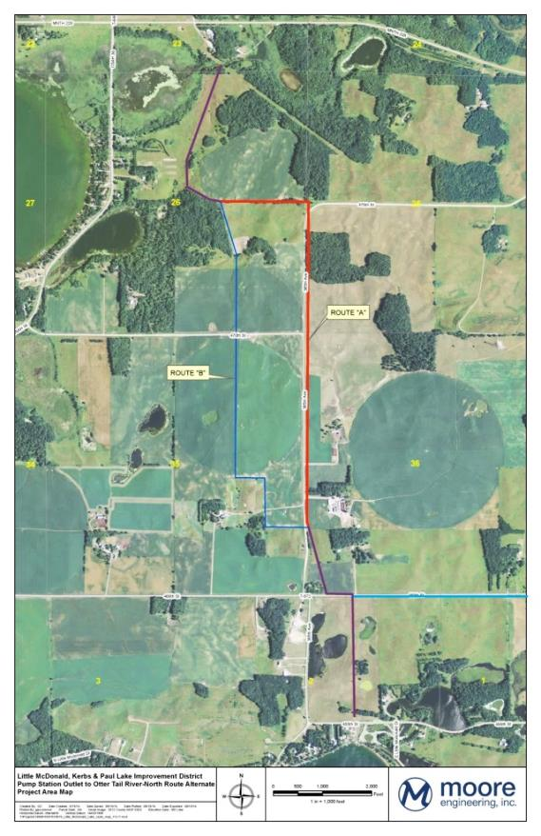
Proposed Solution
A venting system to safely move water from all of the affected lakes to the Otter Tail River
Will pump only when downstream neighbors can handle extra water
Costs less than other options
Similar venting systems have
been successful on other lakes
Provides comprehensive
regional solution

Slide 17
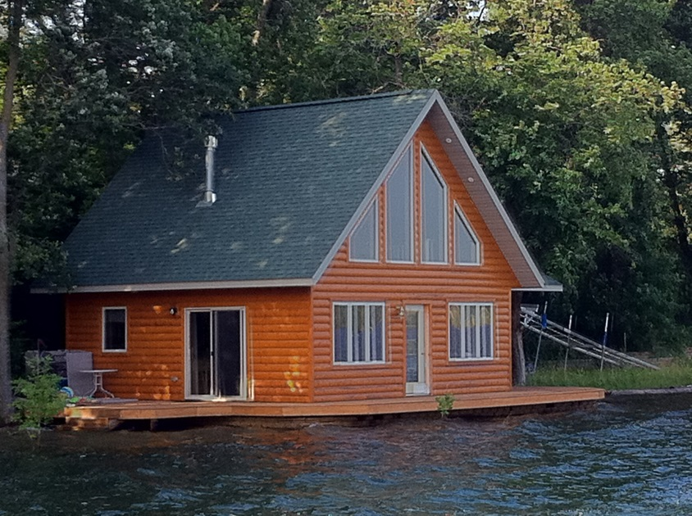
Proposed Solution
Venting System costs:
$10.8 million to construct
$150,000 - $200,000 to
operate/year
Asking State for $10 million appropriation
Residents have already spent $9.3 million
and need to spend $5 million more in repairs
Residents are willing to pay operating costs

