Slide 1
Impact of Alzheimer’s Disease in Minnesota Broadening the Research Agenda to Meet the Challenge
Steve Waring DVM, PhD, FACE
Senior Research Scientist
Essentia Institute of Rural Health
Duluth, MN

Slide 2
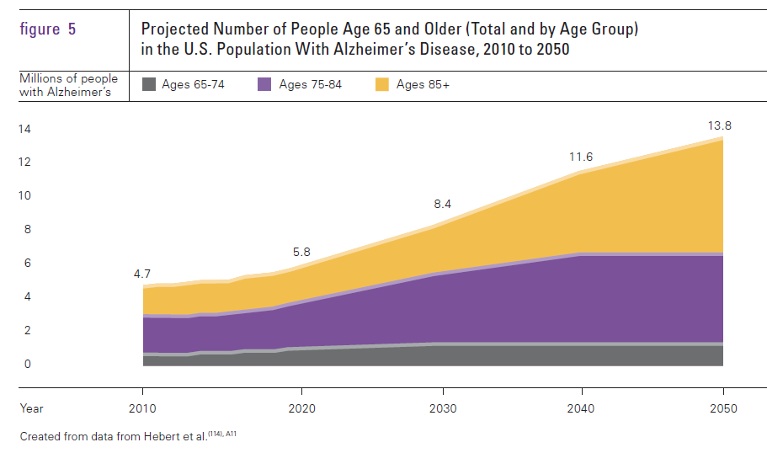
Epidemiology of Alzheimer’s Disease Projected US Prevalence: 2010 - 2050
Alz Facts and Figures 2014
Notes:
2

Slide 3
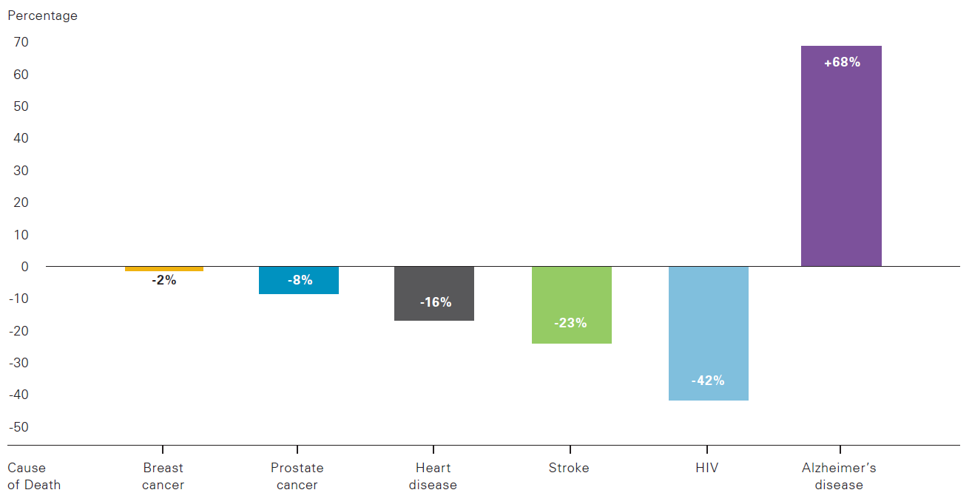
Epidemiology of Alzheimer’s Disease US Mortality: 2010
6th leading cause of death in US
Deaths = 83,494 (CDC) to 600,000 (CHAP*)
died “from”
died “with”
SOURCE: Alzheimer’s Association Facts and Figures, 2014
* CHAP=Chicago Health and Aging Project

Slide 4
Impact of Alzheimer’s Disease in Minnesota Baby Boomer Effect 2010-2050
By 2030, more than 1 in 5 Minnesotans will be an older adult, including all the Baby Boomers.
MN.GOV 2014

Slide 5
Impact on Alzheimer’s Disease in Minnesota Projected Prevalence: 2010-2050
180,200
184,000
140,600
101,500

Slide 6
Economics of Alzheimer’s Disease: Research Spending vs Cost of Care (US)
NIH funding on research vs total cost of care, 2013
 | Research | Cost* | Ratio Research : Cost of Care
Alzheimer’s | 0.5 | 214.1 | 1:428
Cancer | 5.8 | 125 | 1:22
Heart Disease | 2.1 | 109 | 1:52
HIV/AIDS | 3.1 | 16.3 | 1:5
2025 Goal – prevention and treatment for AD
“…without quadrupling research funding to $2 billion a year, that goal is virtually remote.” Robert Egge, VP Public Policy, Alz Association
* Sources: Alzheimer’s (Alz Report 2014; Cancer (IOM report, 2013) Heart disease (CDC); HIV (CDC)

Slide 7
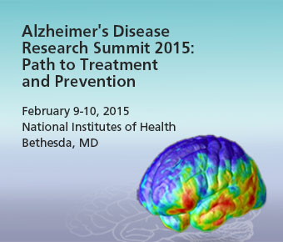
Roadmap for Alzheimer’s Research: What we knowWhat we need to know
Changing Trajectories
Preclinical
Modifying risk
Delay onset
Prevention
Clinical
Preserve function
Improve quality
Aging in place

Slide 8
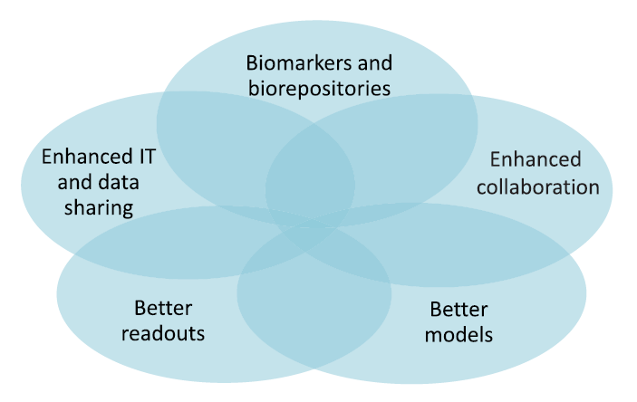
Reducing the Impact of Alzheimer’s Disease Broadening the Research Roadmap
Feldman et al 2014
Shared output
Working Groups
Basic research
Early development/translational
Prevention trials
Public/private interface
Increased likelihood of success when overlap maximized
Notes:
8

Slide 9
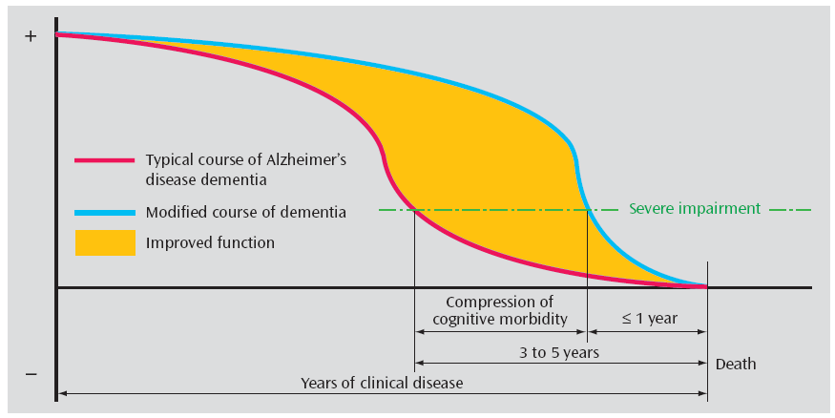
Prevention of Alzheimer’s Disease Compressing morbidity - Prevention by delay
Interventions to delay onset, slow progression
Becker et al. Am J Psy 2007
 | Prevalence | Impact of 5% Reduction (number of individuals less)
 |  | Annual | 5-year
US | 5 million | 250,000 | 1.25 million
MN | 100,000 | 5,000 | 25,000

Slide 10
We don't stop playing because we grow old;
we grow old because we stop playing
George Bernard Shaw

