Slide 1

Notes:
Inform participants that in this workshop session they are going to begin talking about the Developmental Relationships Framework, a new resource that Search Institute has created through multiple years of research to help strengthen developmental relationships in young people’s lives.

Slide 2
Young People in High-Stress Families With DR vs.
Young People in High-Stress Families Without DR
9x more likely to report they have a strong sense of purpose
21x more likely to report they can manage their emotions
13x more likely to report they persevere though difficulty
5x more likely to report they are socially responsible
Source: Search Institute studies

Slide 3
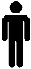
EACH ADDITIONAL
DEVELOPMENTAL RELATIONSHIP
IS LINKED TO LOWER LEVELS OF:
Notes:
Use this slide to show how the more developmental relationships a young person experiences, the less likely they are to report using alcohol and/or tobacco in the past month, and the less likely they are to report having attempted suicide.
Explain to participants that developmental relationships are not only linked to positive behaviors and competencies (as shown on the previous slide), but they are also linked to fewer negative behaviors, as shown on this slide.
In this sample, the rates of these behaviors were low; hence the low averages.
The data presented on this slide are means. We are comparing outcomes for youth who report different numbers of developmental relationships in their lives (i.e., mean comparisons). In this slide, only the means for youth who report no developmental relationships and those who report five developmental relationships are reported.
For the purpose of these analyses, a participant was considered to “have” a developmental relationship with a person when they reported they were experiencing four of the five developmental relationship elements often or very often.

Slide 4
EACH ADDITIONAL
DEVELOPMENTAL RELATIONSHIP
IS LINKED TO STATISTICALLY SIGNIFICANT HIGHER LEVELS OF:
Notes:
Use this slide to make the important point that Search Institute’s studies are showing that the more developmental relationships young people experience, the more likely they are to develop vitally important social and emotional skills.
This slide shows that the more developmental relationships a young person experiences, the more likely they are to also report higher levels of: caring, responsibility, social-emotional skills, and planning and decision-making skills.
For all of these concurrent social-emotional outcome measures: Each additional developmental relationship was linked to statistically significant increases in the outcome. That is, youth with two DRs had statistically significant higher levels of each of the outcomes than those with one DR, and three DRs more than those with two DRs, and four DRs more than those with three DRs, etc.
Interpretation Example: Look at the green line for responsibility, youth who reported no developmental relationships had a responsibility score of 3.72 and youth with 5 developmental relationships had a responsibility score of 4.44.
The data presented on this slide are means. We are comparing outcomes for youth who report different numbers of developmental relationships in their lives (i.e., mean comparisons). In this slide, only the means for youth who report 0 developmental relationships and those who report 5 developmental relationships are reported.
It is important to note that – for each of these outcomes – the association between the number of developmental relationships reported and outcomes scores was linear. That is, each additional developmental relationship is associated with slightly higher outcome scores.
All of the outcomes were measured on 5-point Likert-type scales ranging from 1 (less like the young person) to 5 (more like the young person).
For the purpose of these analyses, a participant was considered to “have” a developmental relationship with a person when they reported they were experiencing 4 of the 5 developmental relationship elements often or very often.

Slide 5
Relationships, Academic Motivation, and Academic Outcomes
Developmental Relationships
Source: The DREAM Project (Developmental Relationships Enhance Academic Motivation), ongoing Search Institute research
GPA
Academic Motivation

Slide 6

A Study/Story of the Power of Relationships
7th graders (12-13 years old) wrote essays on their personal heroes
N = 88 middle school students with “B” or “C” grades
52% female, 48% male
22 African-American students and 22 White students = a total of 44 students in the 7th grade class
Study repeated two consecutive years = 88 students total
Teachers all White
Sources:
Yeager, Cohen, Purdie-Vaughns, Brzustoski, Garcia, Apfel, Master, Hessert, & Williams. (2013). Breaking the Cycle of Mistrust: Wise Interventions to Provide Critical Feedback Across the Racial Divide. Journal of Experimental Psychology: General, 143, 804-824, doi: 10.1037/a0033906.
Yeager, D. S., Purdie-Vaughns, V., Hooper, S. Y., & Cohen, G. L. (2017). Loss of Institutional Trust Among Racial and Ethnic Minority Adolescents: A Consequence of Procedural Injustice and a Cause of Life-Span Outcomes. Child Development , 88 (2), 658-676.
Yeager, Dahl, & Dweck (2018). Why Interventions to Influence Adolescent Behavior Often Fail But Could Succeed. Perspectives on Psychological Science, 13(1), 101-122.

Slide 7
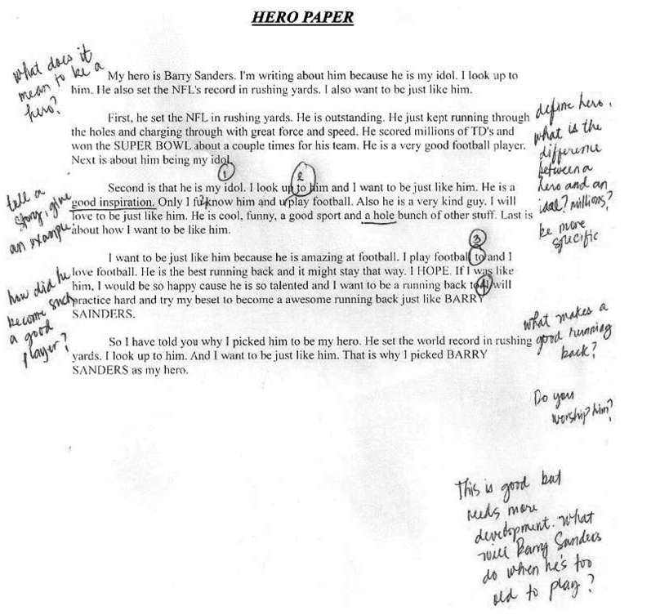
An Example Essay

Slide 8
Randomly Assigned Messages on Post-It Notes
Neutral Expectations Message
High Expectations Message
“I’m giving you these comments so that you’ll have feedback on your paper.”
“I’m giving you these comments because I have very high expectations and I know you can reach them.”

Slide 9
Results:
Revising the essay one week later
 | Neutral Expectations Message | High Expectations Message
White Students
African-American Students
62%
87%
17%
72%
Notes:
Click through the animations on this slide to reveal the different impact that the High Expectations message had on the decisions that White and African-American students made about revising the essays.
Explain to participants that although the High Expectations message increased the number of White students who chose the revise the essay, the increase was not statistically significant. This is due to the fact that the study included such a small sample of both White and African-American students.
However, the increase in the percentage of African-American students who chose to revise the essay after receiving the High Expectations message was statistically significant.

Slide 10

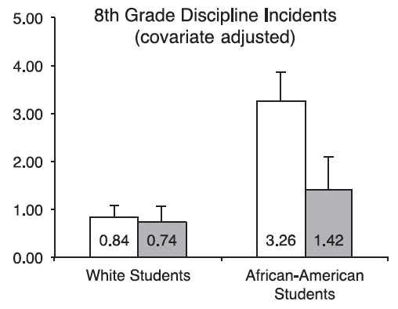
After the Post-It Note: 8th Grade Discipline 1 Year Later
Source: Yeager, D. S., Purdie-Vaughns, V., Hooper, S. Y., & Cohen, G. L. (2017). Loss of Institutional Trust Among Racial and Ethnic Minority Adolescents: A Consequence of Procedural Injustice and a Cause of Life-Span Outcomes. Child Development , 88 (2), 658-676.
Notes:
Use this slide to tell participants that in a subsequent study, the researchers followed the students who got the Post-It Note messages in 7th grade into the following year.
As can be seen on this slide, the African American students who got the High Expectations message were significantly less likely to have discipline problems in school the following year.

Slide 11
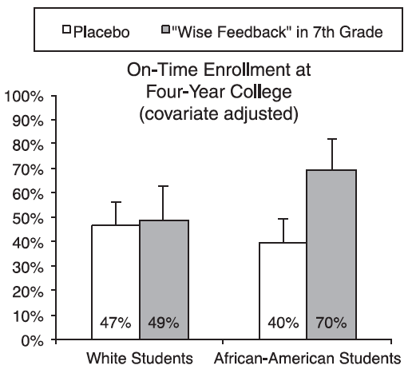
5½ Years Later: College Enrollment
Source: Yeager, D. S., Purdie-Vaughns, V., Hooper, S. Y., & Cohen, G. L. (2017). Loss of Institutional Trust Among Racial and Ethnic Minority Adolescents: A Consequence of Procedural Injustice and a Cause of Life-Span Outcomes. Child Development , 88 (2), 658-676.
Notes:
Use this slide to show participants that the African American students who got the High Expectations message actually enrolled in college at significantly higher rates than the students who got the neutral message more than five years later.

Slide 12
16
%
OF YOUTH REPORT HAVING
5 DEVELOPMENTAL RELATIONSHIPS
with their parents, siblings, friends, teachers, and a program leader
Image created by David Courey for the Noun Project
Notes:
Use this slide to make the point that some young people experience numerous developmental relationships in their lives.
The slide shows that when a large sample of middle and high school students were asked about their relationships with parents, siblings, friends, teachers, and program leaders, 16% reported they had developmental relationships with ALL five of these people.
For the purpose of these analyses, a participant was considered to “have” a developmental relationship with a person when they reported they were experiencing 4 of the 5 developmental relationship elements often or very often.

Slide 13
44
%
OF YOUTH REPORT HAVING
2-4 DEVELOPMENTAL RELATIONSHIPS
with their parents, siblings, friends, teachers, or a program leader
Image created by David Courey for the Noun Project
Notes:
Use this slide to make the point that many young people have multiple developmental relationships in their lives, though not as many as the most “relationship rich” young people.
The slide shows that when a large sample of middle and high school students were asked about their relationships with parents, siblings, friends, teachers, and program leaders, 44% reported they had developmental relationships with 2-4 of those types of people. More specifically, 16% reported experiencing two developmental relationships, 15% reported experiencing three developmental relationships, and 13% reported experiencing four developmental relationships.
For the purpose of these analyses, a participant was considered to “have” a developmental relationship with a person when they reported they were experiencing 4 of the 5 developmental relationship elements often or very often.

Slide 14
18
%
OF YOUTH REPORT HAVING
ONE DEVELOPMENTAL RELATIONSHIP
with their parents, siblings, friends, teachers, or a program leader
Image created by David Courey for the Noun Project
Notes:
Use this slide to make the point that some young people report having one strong developmental relationship in their lives.
When a large sample of middle and high school students were asked about their relationships with parents, siblings, friends, teachers, and program leaders, 18% reported they had a developmental relationship with one of these people.
For the purpose of these analyses, a participant was considered to “have” a developmental relationship with a person when they reported they were experiencing 4 of the 5 developmental relationship elements often or very often.

Slide 15
22
%
OF YOUTH REPORT HAVING
ZERO DEVELOPMENTAL RELATIONSHIPS
with their parents, siblings, friends, teachers, or a program leader
Image created by David Courey for the Noun Project
Notes:
Use this slide and the following slides to illustrate the idea that there are many young people who do not experience developmental as often or as intensively as they could and perhaps should in order to promote positive youth development. In other words, there is both great need and great opportunity to strengthen relationships in any organization that serves young people.
This slide shows that when a large sample of middle and high school students were asked about their relationships with parents, siblings, friends, teachers, and program leaders, 22% - or 1 in 5 – reported they weren’t experiencing a developmental relationship with any of them.
For the purpose of these analyses, a participant was considered to “have” a developmental relationship with a person when they reported they were experiencing 4 of the 5 developmental relationship elements often or very often.

Slide 16
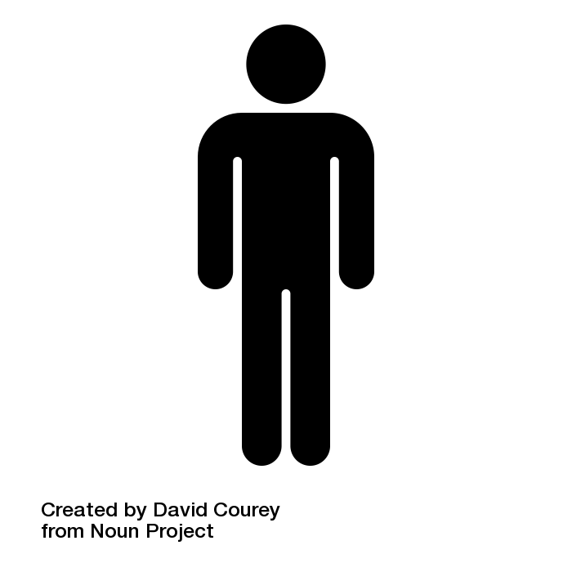
1
5
OUT
OF
YOUTH REPORT HAVING
NO DEVELOPMENTAL RELATIONSHIPS
Image created by David Courey from Noun Project
Notes:
Use this slide to reinforce the information included on the previous slide, which showed that 22% of young people say that they have NO developmental relationships with parents, siblings, friends, teachers, or program leaders.
If these data are representative of young people as a whole, it means that in any given group, 1 in 5 of the young people might not have a developmental relationship in their lives.
For the purpose of these analyses, a participant was considered to “have” a developmental relationship with a person when they reported they were experiencing 4 of the 5 developmental relationship elements often or very often.

Slide 17
The Relationship Gap
Source: Robert Putnam, Our Kids: The American Dream in Crisis, 2015, p. 216
Notes:
Tell participants that researchers at Search Institute are not the only ones who are finding evidence of a relationship gap in the lives of a significant number of young people in the United States today. For example, as this slide shows, researcher Robert Putnam of Harvard University analyzed a national survey of 1,109 young adults, ages 18 – 21, and found that one in three young adults did not have a sustained mentoring relationship of any kind (formal or informal) while growing up (ages 8 to 18).
In this study, Putnam uses the term “informal mentor” very broadly, to encompass not only young people who had mentors in formal mentoring programs such as Big Brothers Big Sisters, but also young people who had informal mentors in their extended families, at school, and in their communities. What Putnam and others call an ”informal” or “natural” mentor is closely related to what researchers at Search Institute and elsewhere call a developmental relationship.
This slide shows that young people who live in poverty (with the lowest SES, or socio-economic status) were much less likely that affluent young people (with the highest SES) to have had mentors (i.e. developmental relationships) in their lives. Note that about two-thirds of young adults from families with the highest income and education (64%) reported that they had informal or “everyday” mentors between ages 8 and 18. These included teachers, family friends, religious or youth program leader, coach, or counselor.
However, two-thirds of the young adults from families with the lowest income and education levels (62%) DID NOT have informal mentors while growing up (ages 8 to 18).
As noted on the slide, the source for these data is Putnam, 2015, pages 215-216.

Slide 18
Developmental Relationships and Family Income
Source: Robert Putnam, Our Kids: The American Dream in Crisis, 2015, p. 215
Notes:
This slide provides look at some of the data from Robert Putnam’s research that went into the relationship gap depicted on the previous slide. Here we see gaps in the experience of developmental relationships between affluent young people and young people who live in poverty. Here we can see that in most categories, the affluent young people report far more developmental relationships in their lives.
You may want to stop on this slide and ask participants to discuss potential reasons for the differences observed here in young people’s experience of developmental relationships based upon the socioeconomic status of their families.

Slide 19
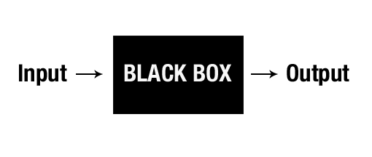
How do you build a developmental relationship?
Notes:
Use this slide to tell participants why Search Institute launched the multi-year and multimethod program of applied research that produced the Developmental Relationships Framework. Explain that while a large body of research and most people’s lived experience confirms that relationships are the drivers of youth development, many people don’t know how to build relationships that transform young people’s lives.
Explain that in 2013 Search Institute launched an effort to open the black box of developmental relationships to find out what happens in relationships that help young people grow from what they are (the Input on the side) to being and becoming their best selves (the Output on the slide).

Slide 20
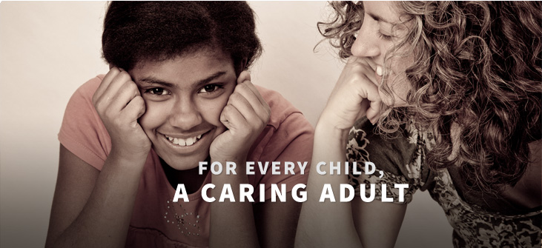
Going Beyond What’s Familiar
Notes:
Use this slide to tell participants that while both common sense and research tell us that caring is essential to help a young person develop, it is not sufficient. Young people also need to be challenged and experience other beneficial types of interaction in a developmental relationship.

Slide 21
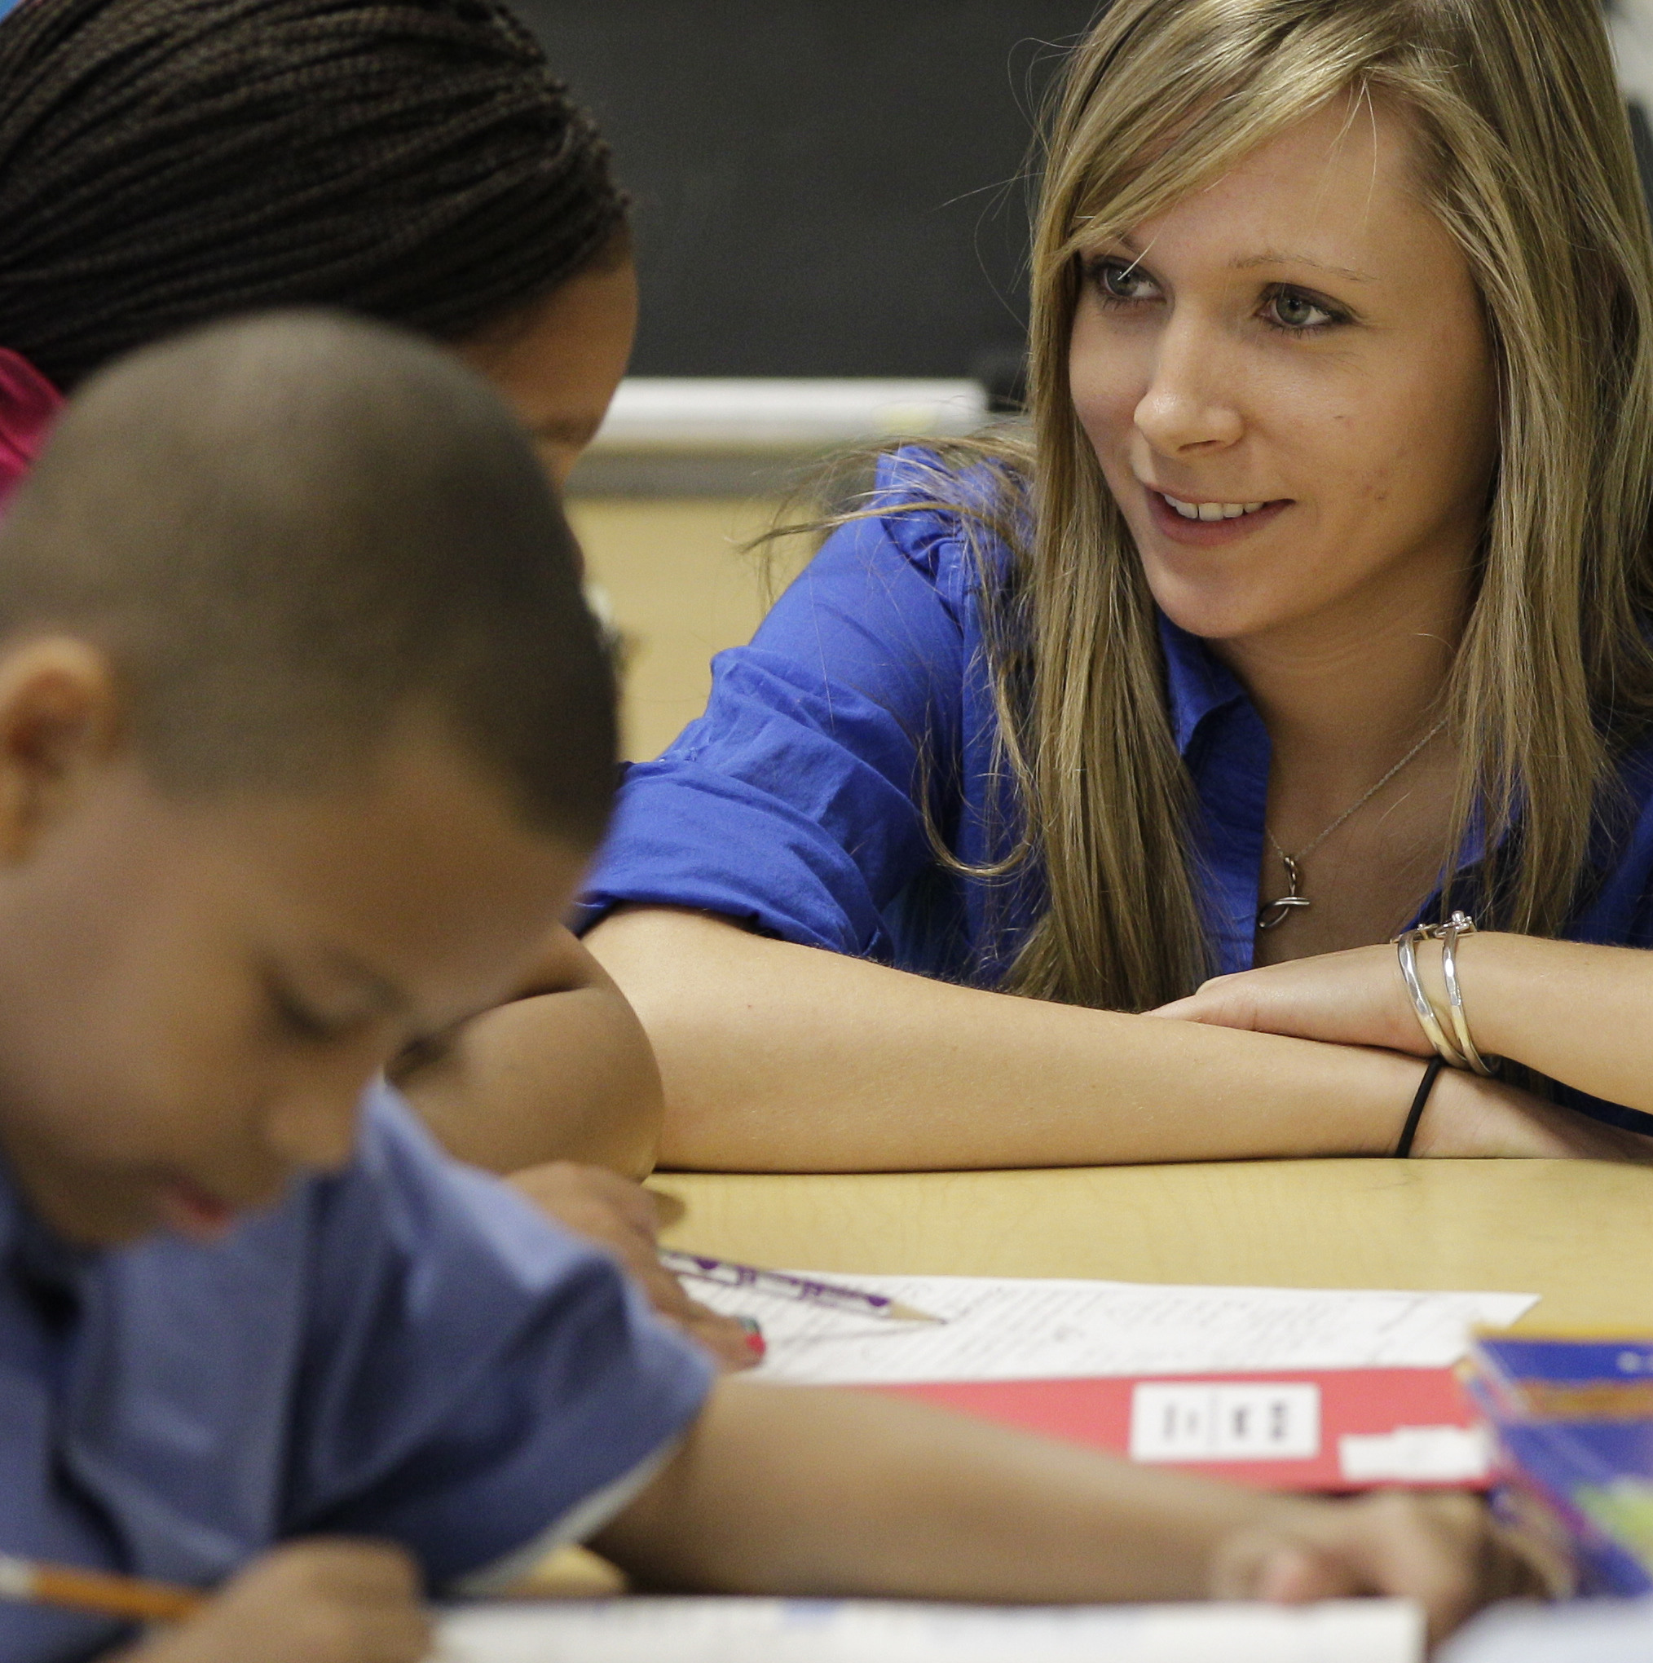
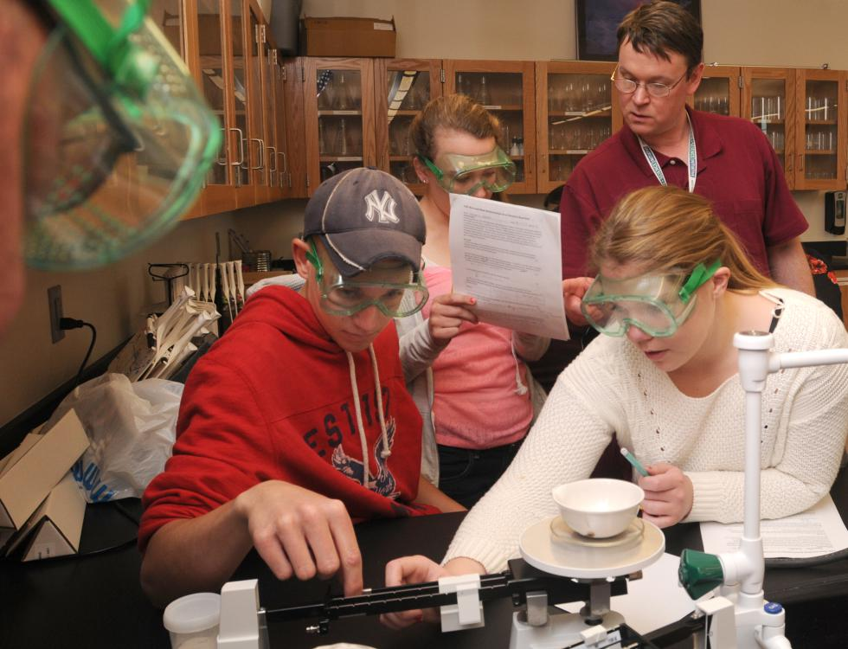


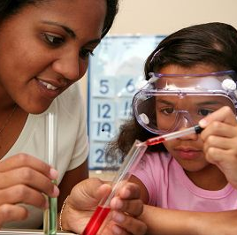
5 Elements of a Developmental Relationship
Express Care
Challenge Growth
Provide Support
Share Power
Expand Possibilities
Notes:
Use this slide to tell participants that Search Institute’s work has identified five key elements of a developmental relationship.
Tell participants that they can find a copy of the Developmental Relationships Framework in their Developmental Relationships Workbook.
Introduce the five elements using this slide.
Explain that in a truly developmental relationship these actions happen bi-directionally, that is, directed from the adult to the young person and from the young person to the adult. In a developmental relationship between a young person and an adult, however, it is the adult who takes the lead in these actions and expresses them most strongly, intentionally, and consistently.
You may want to note that Search Institute’s work on developmental relationships also extends to relationships among young people. Research on peer-to-peer relationships is in its early stages but is finding that the five elements of a developmental relationship also occur for young people.

Slide 22
“
Express Care
Show me that I matter to you.
I feel like he’s more like family, cause when I have issues in school or at home he gives me advice. I can trust him with what I say.
- Youth in After School Program
Be dependable Be someone I can trust Listen Really pay attention when we are together Believe in me Make me feel known and valued Be warm Show me you enjoy being with me Encourage Praise me for my efforts and achievements
”
Notes:
Use this slide to explain the element of Express Care.
The quote on the screen is from a focus group that Search Institute conducted as part of a recent study.

Slide 23
2. Challenge Growth
Push me to keep getting better.
“
The teachers that motivate me to do my best let me know it’s okay to make mistakes.
- Public School Student
Expect my best Expect me to live up to my potential Stretch Push me to go further Hold me accountable Insist I take responsibility for my actions Reflect on failures Help me learn from mistakes and setbacks
”
Notes:
Use this slide to explain the element of Challenge Growth.
The quote on the screen is from a focus group that Search Institute conducted as part of a recent study.

Slide 24
3. Provide Support
Help me complete tasks and achieve goals.
“
They help you feel more
comfortable doing the things that
are expected.
-Youth in an education/employment program
Navigate Guide me through hard situations and systems Empower Build my confidence to take charge of my life Advocate Stand up for me when I need it Set boundaries Put in place limits that keep me on track
”
Notes:
Use this slide to explain the element of Provide Support.
The quote on the screen is from a focus group that Search Institute conducted as part of a recent study.

Slide 25
4. Share Power
Treat me with respect and give me a say.
“
At first [the staff] were there to get us going and show us how to do stuff, but then, they stepped back and let us take over.
-Youth participant in a leadership camp
Respect me Take me seriously and treat me fairly Include me Involve me in decisions that affect me Collaborate Work with me to solve problems & reach goals Let me lead Create opportunities for me to act and lead
”
Notes:
Use this slide to explain the element of Share Power.
The quote on the screen is from a focus group that Search Institute conducted as part of a recent study.

Slide 26
5. Expand Possibilities
Connect me with people that broaden my world.
“
[The staff] helped me discover new things that I used to not like, such as school work and afterschool programs.
- Youth in an After School Program
Inspire Help me see new possibilities for my future Broaden horizons Expose me to new ideas and experiences Connect Introduce me to people who help me grow
”
Notes:
Use this slide to explain the element of Expand Possibilities.
The quote on the screen is from a focus group that Search Institute conducted as part of a recent study.

Slide 27
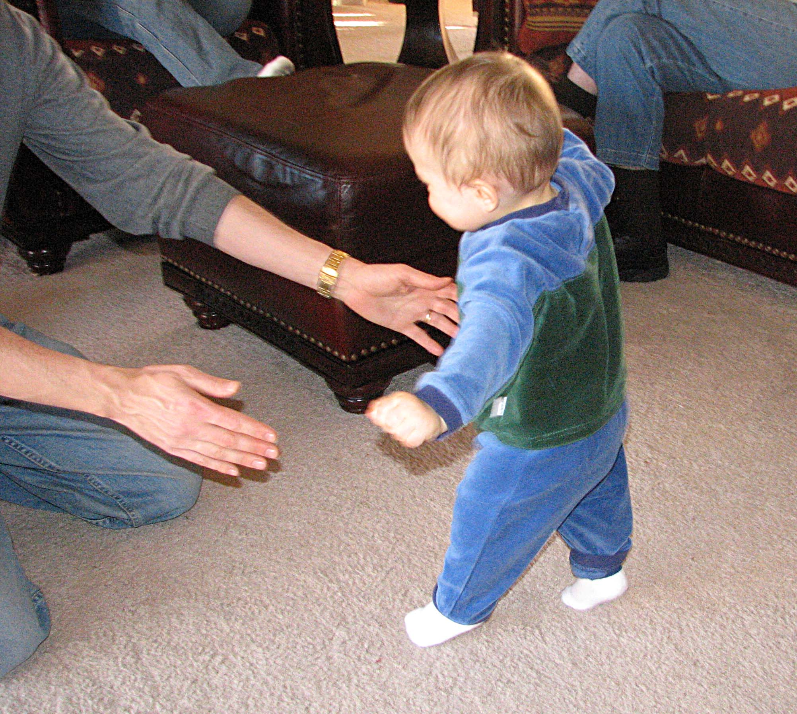
When all of the elements come together

Slide 28
Youth experience
developmental relationships differently
with their parents, siblings, friends, teachers, and program leaders
Notes:
Use variation on the previous slides to show how in their relationships with important people in their lives, young people experience different levels of the 5 elements of a developmental relationship.

Slide 29
Youth experience
developmental relationships differently
with their parents, siblings, friends, teachers, and program leaders
Notes:
Explain to participants that you are now going to review some findings from Search Institute’s studies to help them think and talk about how young people experience the Developmental Relationships Framework and how it is associated with important youth outcomes.
All of the data on the following slides come from the same study. Data come from 25,395 (49% female) public middle (grades 6-8; 42%) and high (grades 9-12; 58%) school students from an urban county in the western United States. The sample was: 34% Asian, 1% Black/African-American, 18% Hispanic or Latinx, 2% Native Hawaiian or Pacific Islander, 20% White, 19% multiracial, and 5% identified as another race/ethnicity. The sample was limited to youth who indicated they had a sibling (91% of the full sample).
Use this slide to make the point that young people experience the five elements of a developmental relationship differently with different people in their lives. After showing and discussing the slide, inform participants that because this slide is fairly complex, you are going to break the data down on several subsequent slides.
This slide illustrates the percentage of young people who experience each developmental relationship element across the primary relationships in their lives. The percentage displayed in this bar chart represents the percentage of participants who indicated they experienced each element often or very often with their parents, siblings, friends, teachers, and program leaders.
None of the bars in this chart reach 100%. That tells us that there were no developmental relationships elements that ALL youth – in this sample – experienced often or very often.

Slide 30
Two Ways to Build Developmental Relationships
Relationship Building Practices
Relational techniques
Make a task or situation more relational
Anytime, anywhere
Often unplanned and sometimes subconscious
Observable and learnable but hard to package
“I feel connected to you while we do the work of this program or class.”
Example: Indirect praise
Relationship Building Activities
Structured experiences
Strengthen personal connections
During time dedicated to relationships
Usually planned and scheduled
Observable, learnable, and easier to package
”I feel you know and value me independent of the work we do in this program or class.”
Example: Mapping Relationships Activity
Notes:
Begin the session by explaining that through the applied research projects that Search Institute has conducted around the United States, the organization has identified two related ways that adults who work with young people can build developmental relationships with them: relationship building practices and relationship building activities. Share with participants that truly relationship-rich youth-serving organizations seem to make use of both these approaches.
Use the animations on the slide to explain and contrast activities and practices.
You may want to illustrate the difference between practices and activities with the following hypothetical example from the world of education:
Imagine a large high school that implements a weekly advisory period in an effort to become a more caring and close knit community. During the advisory period, students participate in relationship building activities like those included in the Developmental Relationships Activity Book and also engage in informal conversations with teachers and other members of the school staff who serve as advisors.
Also imagine, however, that besides creating an advisory period the school does little else to strengthen relationships. The school does not, for example, launch an effort to use relationship building practices to make the teaching and learning that happens during academic classes more interactive and personalized.
Implementing relationship building activities without also implementing relationship building practices is a problem because while creating advisories might help students build stronger relationships with their advisors and the other students during the advisory period, advisories alone are unlikely to make the school a truly relationship-rich environment. While students might enjoy and benefit from the relationships they experience during advisory, if the classes in which they spend the majority of their time do not promote dialog, interaction, and connection, relationships will be the exception rather than the norm in students’ experience in school. In other words, receiving a shot of relationships during the advisory period is not likely to inoculate students against the harmful effects of negative or even neutral relationships in their classes, the hallways, the lunch room, and elsewhere.

Slide 31
The Key: Being Intentional
Before
“How will I build relationships when I do this work?”
During
“What I do right now will influence our relationship."
After
"How did that interaction influence our relationship? What do I want to do differently next time?"

Slide 32

But what if you aren’t with a kid very often or very long?
Notes:
Use this slide to convey the idea that not every relationship – much less every relational interaction – can or needs to encompass all five elements of a developmental relationship. Certainly, young people greatly benefit from relationships, such as with their parents, that are intensive and sustained and that include all five DR elements. We might call those relationships “high dose” developmental relationships. Search Institute’s ongoing work on developmental relationships is finding that such high dose developmental relationships have an extremely positive effect on youth development. We are also finding that those high dose developmental relationships can happen both within and beyond the family. When young people do not experience high dose developmental relationships often enough or intensively enough at home or when they are undergoing trauma or other adverse childhood experiences, equipping them with that type of high dose developmental relationship though mentoring programs or other intensive relational interventions requires more resources but is often a very good investment.
That said, high dose developmental relationships are not the only type of connection that helps young people overcome adversity. Low dose developmental relationships can also be very beneficial if many such relationships occur within a school, program, or another environment and their positive impact accumulates over time. A low dose developmental relationship might, for example, include only one or two of the elements of a developmental relationship, but if other relationships in the school or program provide young people with the other elements, positive youth development can be enhanced even in the absence of many high dose DRs.

Slide 33
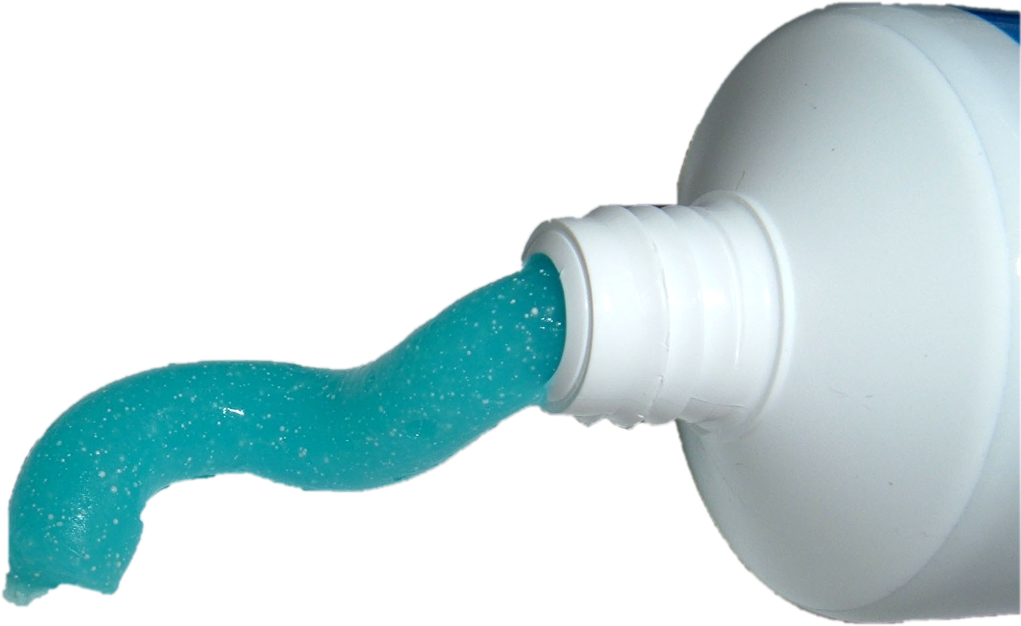
The Active Ingredient
Notes:
Use this slide to prompt a brief discussion of the idea that relationships are the indispensable active ingredient in programs that succeed with kids, especially those who are from marginalized communities and who must overcome barriers like poverty, racism, and discrimination
Ask participants to respond to the question Li and Julian posed in their article: is it impossible for programs and activities to succeed if they lack the active ingredient of relationships?
Encourage participants to share their ideas as part of this discussion but do not let it run too long because its primary purpose is to set the stage for the activity that follows.

Slide 34
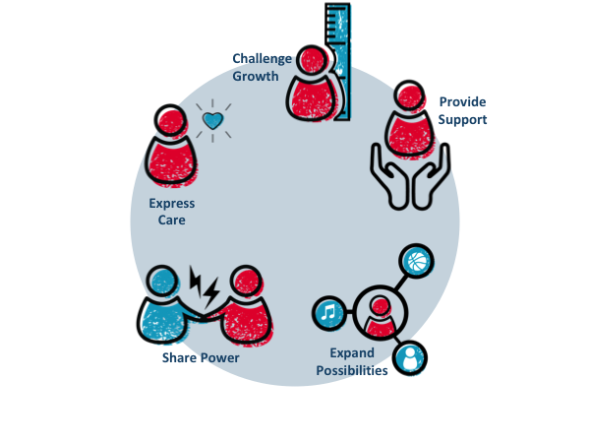
Thank you!
Notes:
Inform participants that in this workshop session they are going to begin talking about the Developmental Relationships Framework, a new resource that Search Institute has created through multiple years of research to help strengthen developmental relationships in young people’s lives.

