Slide 1
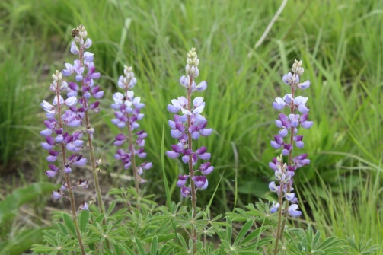
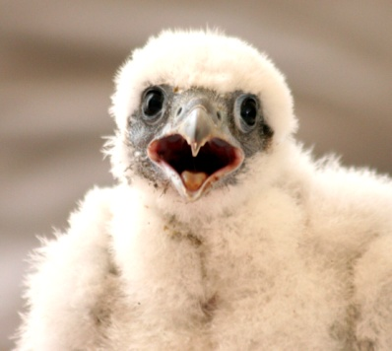
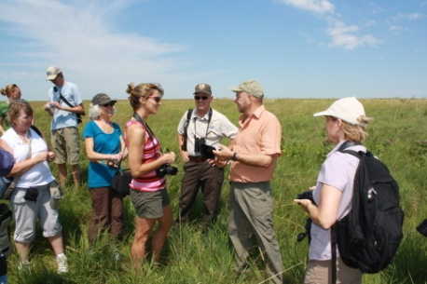
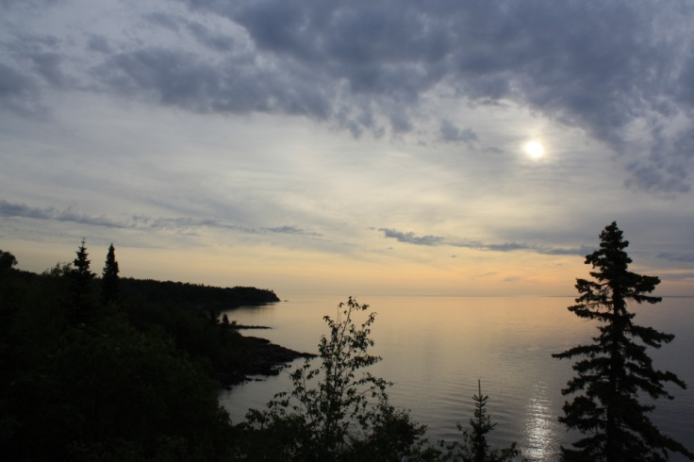

Legislative-Citizen Commission on
Minnesota Resources (LCCMR)
&
Environment and Natural Resources
Trust Fund

Slide 2


Legislative-Citizen Commission on Minnesota Resources (LCCMR)
(5) Representatives
(7) Citizens
(5) appointed by Governor
(1) appointed by Senate
(1) appointed by House
(5) Senators
LCCMR
17-members focused on protection, conservation, preservation, and enhancement of the state’s air, water, land, fish, wildlife, and other natural resources
Notes:
LCCMR is a 17 member commission make up of 5 state reps, 5 state senators, and 7 citizens– 5 of which are approinted by the Governor and 1 each from the house and the senate. Together

Slide 3
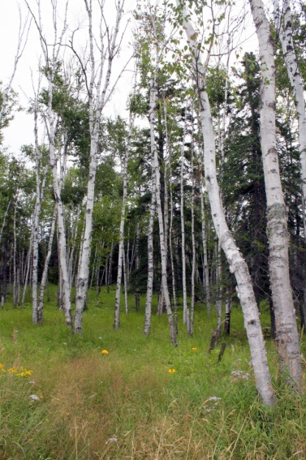
Environment and Natural Resources Trust Fund
MN’s first Constitutionally dedicated funding source for the environment and natural resources
Established in 1988
(77% approval)
40% of MN Lottery profits dedicated to it in 1990
(75% approval)
Lottery contribution re-affirmed until 2025 in 1998 (74% approval)
Notes:
Minnesota’s first constitutionally dedicated funding source for protection of environment and natural resources.
It was created in 1988 with passage of the constitutional amendment and then in 1990 another constitutional amendment dedicated 40% of lottery proceeds to the fund, but only until 2001. In 1998 they extended that until 2025.
Needs to be spent on projects of long term benefit to Minnesota’s environment
That is done by granting out up to 5.5% of

Slide 4

Environment and Natural Resources Trust Fund
Increasing
Value of Trust Fund
Annual MN Lottery
Contribution*
Annual Investment
Income**
Environment and
Natural Resources
Trust Fund
5.5%
Available
Annually
for
Projects
**Annual Lottery contribution is 40% of net Lottery profits, or more than 6¢ of every dollar spent on Lottery tickets.
**Investment income grows the Trust Fund at an average rate of approximately 7% of its principal balance each year.
Notes:
Money originates from combination of lottery contributions and investment income
Works like endowment – 5.5% of market value can be utilized each year

Slide 5
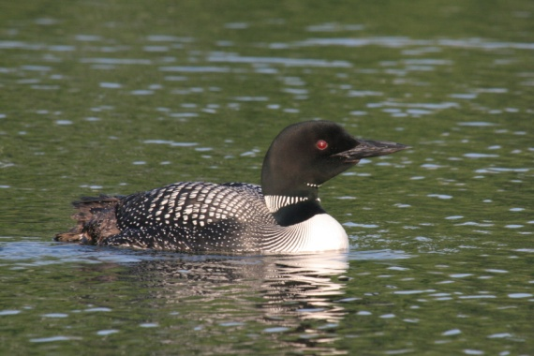
Minnesota Constitution Art. XI, Sec.14
Environment and Natural Resources Trust Fund
A permanent environment and natural resources trust fund is established in the state treasury.
Loans may be made of up to five percent of the principal of the fund for water system improvements as provided by law.
The assets of the fund shall be appropriated by law for the public purpose of protection, conservation, preservation, and enhancement of the state's air, water, land, fish, wildlife, and other natural resources.

Slide 6
2018 Minnesota Statutes Chapter 116P
Environment and Natural Resources Trust Fund
116P.08 TRUST FUND EXPENDITURES.
Subdivision 1.Expenditures.
(a) Money in the trust fund may be spent only for:
the reinvest in Minnesota program as provided in section 84.95, subdivision 2;
research that contributes to increasing the effectiveness of protecting or managing the state's environment or natural resources;
collection and analysis of information that assists in developing the state's environmental and natural resources policies;
enhancement of public education, awareness, and understanding necessary for the protection, conservation, restoration, and enhancement of air, land, water, forests, fish, wildlife, and other natural resources;
capital projects for the preservation and protection of unique natural resources;
activities that preserve or enhance fish, wildlife, land, air, water, and other natural resources that otherwise may be substantially impaired or destroyed in any area of the state;
administrative and investment expenses incurred by the State Board of Investment in investing deposits to the trust fund
administrative expenses subject to the limits in section 116P.09; and
to pay principal and interest on special appropriation trust fund bonds issued pursuant to section 16A.969 and other law.
(b) In making recommendations for expenditures from the trust fund, the commission shall give priority to funding programs and projects under paragraph (a), clauses (1) and (6). Any requests for proposals issued by the commission shall clearly indicate these priorities.

Slide 7
2018 Minnesota Statutes Chapter 116P
Environment and Natural Resources Trust Fund
116P.08 TRUST FUND EXPENDITURES.
Subd. 2.Exceptions.
Money from the trust fund may not be spent for:
purposes of environmental compensation and liability under chapter 115B and response actions under chapter 115C;
purposes of municipal water pollution control in municipalities with a population of 5,000 or more under the authority of chapters 115 and 116;
costs associated with the decommissioning of nuclear power plants;
hazardous waste disposal facilities;
solid waste disposal facilities; or
projects or purposes inconsistent with the strategic plan.
116P.03 TRUST FUND NOT TO SUPPLANT EXISTING FUNDING; APPROPRIATIONS.
(a) The trust fund may not be used as a substitute for traditional sources of funding environmental and natural resources activities, but the trust fund shall supplement the traditional sources, including those sources used to support the criteria in section 116P.08, subdivision 1. The trust fund must be used primarily to support activities whose benefits become available only over an extended period of time.

Slide 8
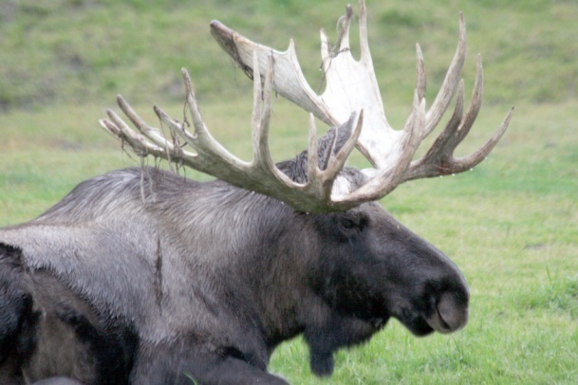
LCCMR Recommendations Process
Annual or biennial Request for Proposals
Open to anyone
Proposals are reviewed, evaluated, ranked, and discussed
Presentations to LCCMR
Research projects undergo scientific peer review
Top proposals recommended to legislature
Must be passed by legislature and signed by governor
Notes:
Competitive multi-step proposal and selection process:
Funded projects submit work plan for LCCMR approval
Projects report to LCCMR throughout project duration

Slide 9
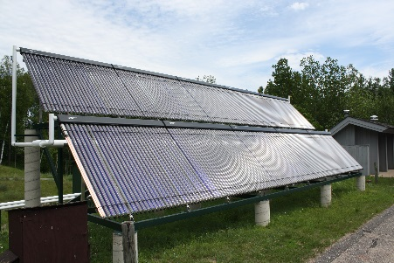
Project Evaluation Criteria
Funding Priorities
Multiple Benefits
Outcomes
Knowledge Base
Extent of Impacts
Innovation
Scientific/Technical Basis
Urgency
Capacity and Readiness
Leverage

Slide 10
2020 Request for Proposal
Funding priorities:
Foundational Natural Resource Data and Information
Water Resources
Environmental Education
Aquatic and Terrestrial Invasive Species
Air Quality, Climate Change, and Renewable Energy
Methods to Protect or Restore Land, Water, and Habitat
Land Acquisition for Habitat and Recreation
Small Projects (under $200,000)

Slide 11
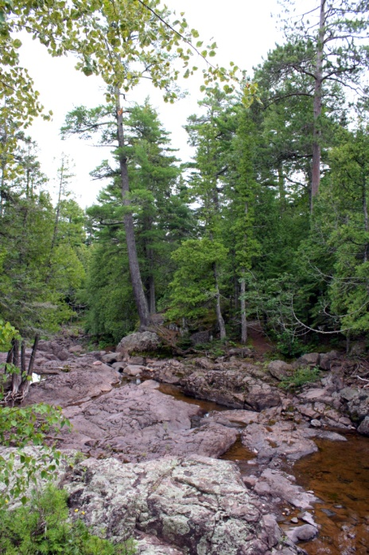
2020 Request for Proposal
Total funds available:
~$53 Million
Funding beginning:
July 1, 2020
Deadline to submit:
Monday, April 15, 2019
Draft proposals for review:
Friday, March 15, 2019

Slide 12
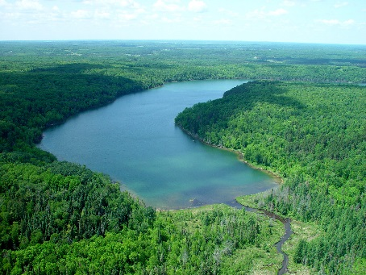
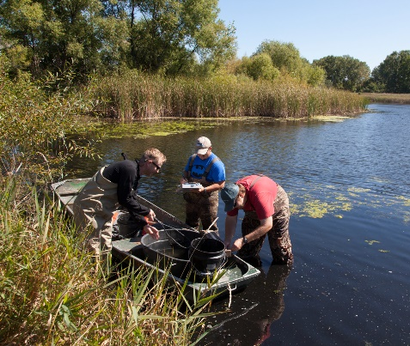
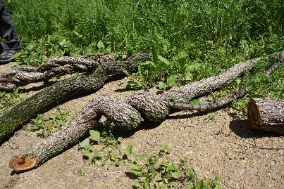
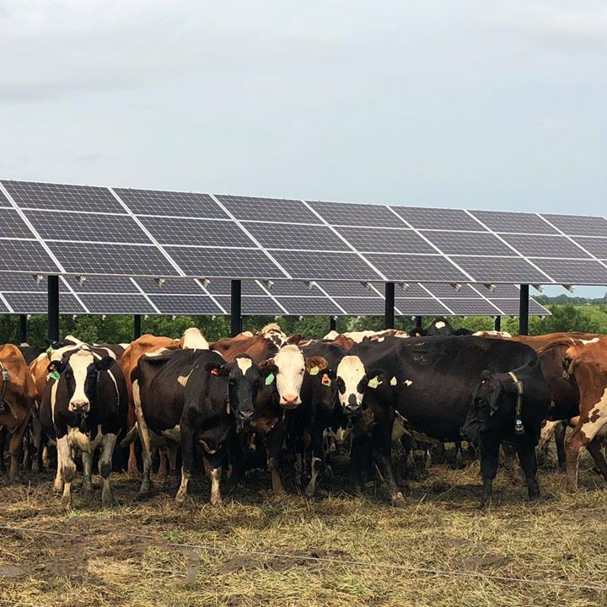
Environment and Natural Resources Trust Fund Project Examples
Clean, Renewable Energy for MN’s
Future
Notes:
The WCROC Fast Charger is the first in west central Minnesota with the next closest fast charger located in Monticello. The fast charger will soon be powered by 30 kW of solar PV. Using a fast charger, an electric car can be powered to 80% in 30 to 45 minutes whereas it takes approximately 48 hours to charge on a 110 wall outlet. The all-electric Chevy Bolt, which UMM and WCROC have in our fleets, has a range between 150 to 230 miles (depending on temperature with winter being at 150 miles). fast charger for electric vehicles at the University of Minnesota West Central Research and Outreach Center in Morris
Since 1991, the Trust Fund has provided ~$576 million in support to nearly 1,500 projects benefitting every county in the state.

Slide 13
Thank you!
http://www.lccmr.leg.mn
www.facebook.com/mnenrtf
www.twitter.com/mnenrtf
Email: lccmr@lccmr.leg.mn
Phone: 651 296-2406
Notes:
Good morning and congratulations to you all on this day of the Lottery! I am Becca Nash and as Adam mentioned I am the new staff Director of the Legislative- Citizen Commission on Minnesota Resources, which we call LCCMR for short. The Lottery and the LCCMR have shared a relationship for the past 28 years through their mutual connection to this amazing resource in Minnesota called the Environment and Natural Resources Trust Fund.
Before I tell you about the Trust Fund, I want to say a few words about the LCCMR because of the central role they play…

