Slide 1
Price of Government Overview
House Ways and Means
March 6, 2017

Slide 2
Price of Government Background
The Price of Government (POG) is a measurement used to describe the relative cost of state and local government
It is defined as total state and local revenues divided by total Minnesota personal income. It reflects how much of each dollar earned goes to support state and local government.
POG provides state-local finance transparency:
Compares revenues raised as a percent of Minnesota personal income
Breaks out revenue mix by type: income, sales, property and other taxes, as well as fees and other non-tax revenues
Share of revenues collected at state and local government levels
Prepared with state forecasts (MS 16A.103)

Slide 3
Price of Government Components – State and Local Revenue
Own Source Revenues – those collected directly by the state or local units
Taxes (state, local property taxes, local option taxes)
Non-Tax Revenues
Licenses and permits
Charges for services
Investment Earnings
Special assessments
Tuition (post-secondary)
Intergovernmental Revenues
State Aids, Local Aids, Federal Grants
POG Excludes – Enterprise revenues (i.e.. local utilities, liquor stores), pension revenues

Slide 4
Price of Government Components – MN Personal Income
Broad measure of Minnesota’s economic activity
Dollar value of personal receipts
Wage and salary disbursements
Proprietor’s income
Interest and dividends, rent income
Transfer payments (unemployment compensation, social security etc.)
Estimated by Bureau of Economic Analysis, US Department of Commerce
Projected by MMB economists using state and national econometric models

Slide 5
Price of Government Highlights State-Local Finances
In FY 2017, about 15.4 cents of every dollar will go for state and local services
Total “own source” revenues for FY 2017 will reach $45.0 billion
Excludes intergovernmental payments (Federal, State and Local)
Minnesota personal income will exceed $291 billion
Who collects the revenue:
State collects 63 percent of the total ($28.2 billion)
Cities, counties, towns, special districts collect 29 percent ($13.3 billion)
School districts raise 8 percent of the total ($3.4 billion)

Slide 6
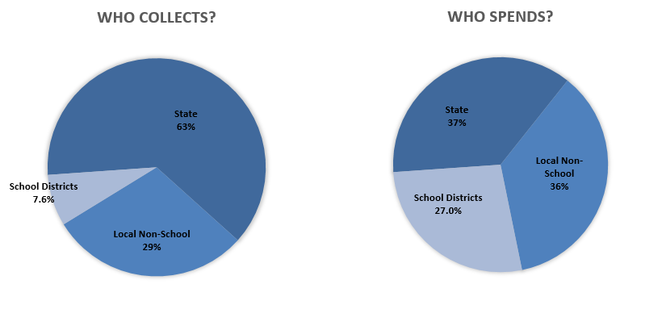
POG Shows State and Local Financial Relationship
November 2016 Fcst.

Slide 7
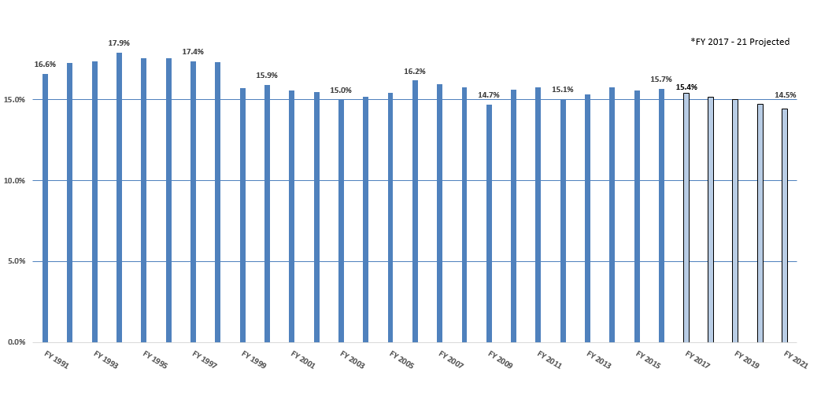
November 2016 Forecast POG
November 2016 Fcst.

Slide 8
POG Sensitive to Revenue and Personal Income Forecast
($ in billions) | State/Local Own Source Revenue |  | Minnesota Personal Income |  | Price of Government
 |  | % |  | %
 |  | Change |  | Change
FY 2003 | 25.6 |  | 167.0 |  | 15.4%
FY 2004 | 27.1 | 5.5% | 178.1 | 6.7% | 15.2%
FY 2005 | 29.1 | 7.4% | 188.3 | 5.7% | 15.4%
FY 2006 | 31.4 | 8.1% | 194.0 | 3.0% | 16.2%
FY 2007 | 32.8 | 4.5% | 205.9 | 6.1% | 15.9%
FY 2008 | 34.2 | 4.3% | 216.8 | 5.3% | 15.8%
FY 2009 | 33.6 | -1.9% | 228.1 | 5.2% | 14.7%
FY 2010 | 33.8 | 0.8% | 216.3 | -5.2% | 15.6%
FY 2011 | 35.6 | 5.4% | 225.9 | 4.4% | 15.8%
FY 2012 | 40.0 | 12.2% | 245.6 | 8.8% | 16.3%
FY 2013 | 39.2 | -1.9% | 255.6 | 4.1% | 15.3%
FY 2014 | 41.3 | 5.2% | 261.2 | 2.2% | 15.8%
FY 2015 | 42.7 | 3.6% | 274.5 | 5.1% | 15.6%
FY 2016 | 44.3 | 3.6% | 282.1 | 2.8% | 15.7%
FY 2017 | 45.0 | 1.6% | 291.8 | 3.4% | 15.4%
FY 2018 | 46.2 | 2.8% | 304.5 | 4.4% | 15.2%
FY 2019 | 47.9 | 3.7% | 318.8 | 4.7% | 15.0%
FY 2020 | 49.2 | 2.6% | 333.4 | 4.6% | 14.7%
FY 2021 | 50.3 | 2.4% | 348.2 | 4.5% | 14.5%
November 2016 Fcst.

Slide 9
POG Projected to Decline
($ in millions) | FY 2017 Fcst |  | FY 2021 Fcst
Income Tax | 11,083 |  | 13,456
Percent of Pers. Income | 3.8% |  | 3.9%
Sales Tax | 5,778 |  | 6,694
Percent of Pers. Income | 2.0% |  | 1.9%
Statewide & Local Property Tax | 9,261 |  | 10,808
Percent of Pers. Income | 3.2% |  | 3.1%
Other Taxes | 6,939 |  | 6,949
Percent of Pers. Income | 2.4% |  | 2.0%
Total Tax Revenues | 33,061 |  | 37,907
Percent of Pers. Income | 11.3% |  | 10.9%
Non-Tax Revenues | 11,898 |  | 12,424
Percent of Pers. Income | 4.1% |  | 3.6%
Total "Own Source" Revenues | 44,959 |  | 50,331
Percent of Pers. Income | 15.4% |  | 14.5%
MN Personal Income | 291,840 |  | 348,225
November 2016 Fcst.

Slide 10
Thank you!

