Slide 1
House Energy and Climate Finance and Policy Division
February 21, 2019
By: Peter Klein, VP Finance
Saint Paul Port Authority

Slide 2
SPPA Energy Financing Programs
Trillion BTU
Property Assessed Clean Energy (PACE)
Energy Savings Partnership (ESP)
Statewide
100% Financing
Immediate Positive Cash Flow

Slide 3
Minnesota’s PACE Programs
Property Assessed Clean Energy
Saint Paul Port Authority (MinnPACE)
Southwest Regional Development Commission

Slide 4
Qualifying Industries
Property Assessed Clean Energy
Commercial
Industrial/manufacturing
Multi-family housing (5+ units)
Agriculture
Nonprofit
Places of Worship

Slide 5
Niches for PACE
Property Assessed Clean Energy
Renewable Energy Projects
Multi-tenant Buildings
Senior Care Facilities

Slide 6
PACE Results
Property Assessed Clean Energy
188 Projects
$63,463,000 of Project Costs – 3rd in Nation
$4,753,000 Annual Savings
184,105,000,000 BTUs Saved Annually
90 Jobs Retained/Created
665 Construction Jobs Created

Slide 7
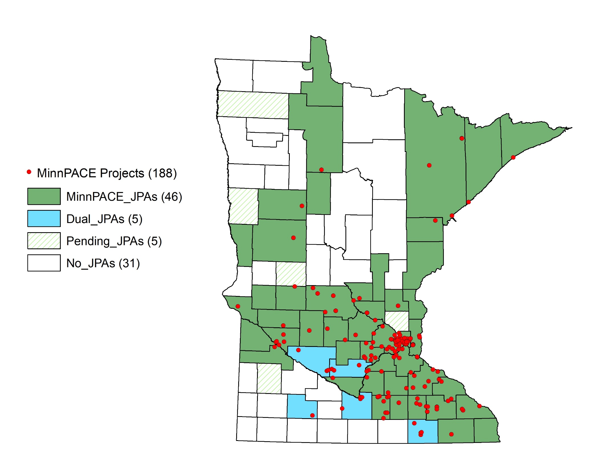

Slide 8
New Construction
Property Assessed Clean Energy
Current requested financing:
Total project costs $333,000,000
PACE financing $ 29,500,000
9 housing projects
3 hotel projects
2 non-profits
1 mixed used project

Slide 9
New Construction
Property Assessed Clean Energy
Why PACE?
Mortgage holder has maximized its lending limit
Added costs associated with becoming energy efficient
There is funding gap
The PACE assessment cannot be accelerated
Mortgage holder must approve the PACE assessment
Mortgage holder is in control
Improved construction value and cash flow

Slide 10
“MinnPACE allows us to sell more projects, install more systems, and in some cases it allows us to increase project size.”
-Eric Pasi
IPS Solar
Questions?
www.minnpace.com

