Slide 1
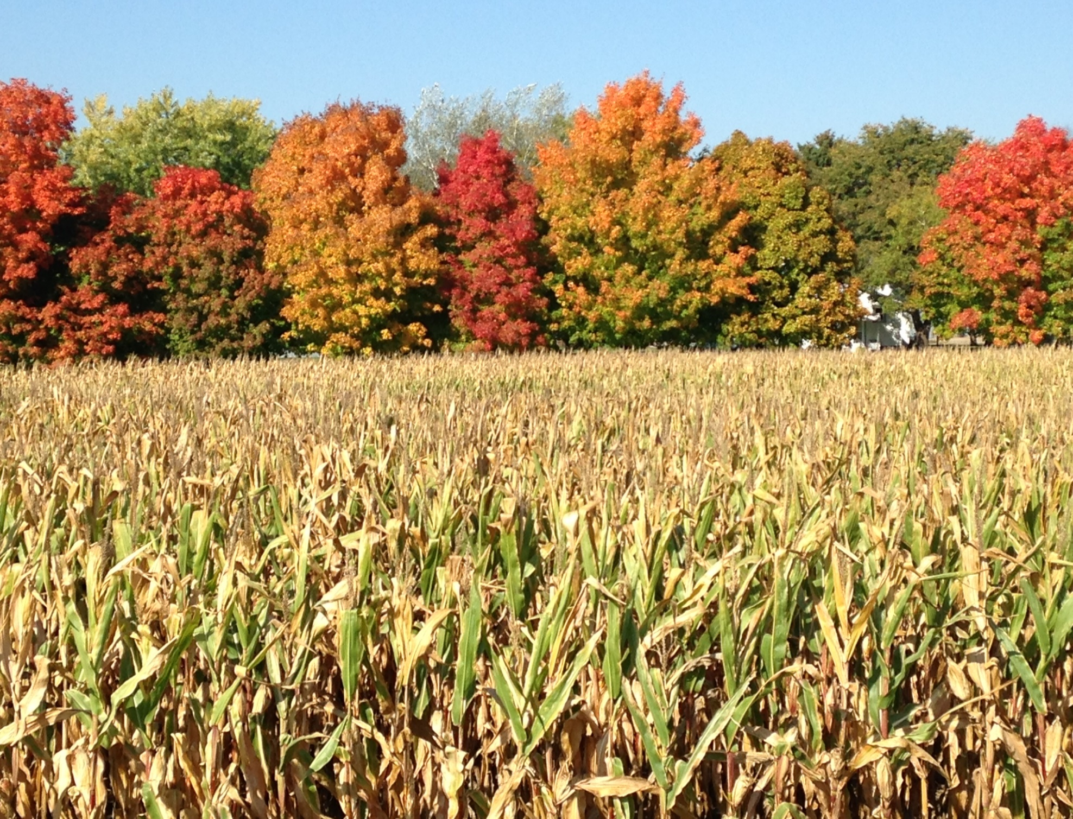
The State of Minnesota Rural Health 2015 ________________________________________ February 3, 2015 Minnesota Rural Health Association

Slide 2
The State of Minnesota Rural Health 2015
As rural communities in Minnesota pursue the triple aim of greater access to higher quality, more cost effective health care, along with improved health and wellness, they face many unique challenges compared to metro-area residents.

Slide 3
The State of Minnesota Rural Health 2015
Unique Challenges In Our Rural Communities
An increasingly older and lower income population which relies more heavily on public health care programs that pay below cost
An older and dramatically shrinking health care workforce (primary and specialty care) with fewer new providers to replace them
Hospitals, clinics, nursing homes and other providers under increasing financial stress - many having to close their doors
Limited access to dental, mental health, obstetrics and other specialty care
New health care requirements (EHR, Meaningful Use, value-based payment, quality measures, and more) but with fewer resources to achieve them
The need for access to a skilled healthcare workforce and data analytics

Slide 4
The State of Minnesota Rural Health 2015
Top Issues Impacting Rural Health
Healthcare Workforce Shortage
Access Challenges
Transportation
Broadband Shortage
Reimbursement Disparities
Hospitals, Clinics, Nursing Homes In Crisis

Slide 5
The State of Minnesota Rural Health 2015
Healthcare Workforce Shortage
The MN Medical Association (MMA), MN Hospital Association (MHA) and Minnesota Department of Health (MDH) all predict a physician shortage of between 800 to a few thousand in both primary and specialty care
Fewer medical students are choosing primary care
Lack of funding, facilities, faculty and the federal cap on residency slots are barriers to producing more rural health care providers
Recruiting challenges, including cost of recruiting, pay disparities, call rotations, spousal employment and others

Slide 6
The State of Minnesota Rural Health 2015
Healthcare Workforce Shortage
Population per physician in Minnesota:
Twin Cities metro – 297
Small town/Small rural – 674
Rural/Isolated – 2,043
Source: Minnesota Department of Health, Office of Rural Health and Primary Care

Slide 7
The State of Minnesota Rural Health 2015
Access Challenges
In addition to a growing shortage of primary care, the Minnesota Department of Health, Office of Rural Health and Primary Care, has identified lack of access to certain specialty care, including
Obstetrics
Mental health
Dental care
Language interpreters
Pharmacy / medication therapy management

Slide 8
The State of Minnesota Rural Health 2015
Transportation
Rural Minnesotans list access to transportation as their top concern, especially among seniors who often require door-to-door rides that public services cannot accommodate.
Volunteers are filling gaps in some rural communities while many more rural residents are simply too far from the transportation they need to remain healthy in-place.

Slide 9
The State of Minnesota Rural Health 2015
Broadband Shortage
Telemedicine, tele-mental health, tele-education, tele-monitoring, telephone apps and robotic assistance are all vital to extending quality, cost-effective care to rural communities
Major portions of rural Minnesota lack the broadband access necessary for tele-health and tele-medicine applications

Slide 10
The State of Minnesota Rural Health 2015
Reimbursement Disparities
Rural health care providers serve a disproportionately large number of residents who rely on public health care programs
Public programs (Medicare, Medicaid and others) often pay below cost and are increasingly reducing reimbursement
Despite a high percentage of Minnesotans with health insurance, many still face unaffordable deductibles and other barriers to covering health care costs

Slide 11
The State of Minnesota Rural Health 2015
Hospitals, Clinics, Nursing Homes In Crisis
Most hospitals in rural Minnesota operate in the red or with margins of less than 5 percent, making new health care reform requirements more difficult to afford.
The health care infrastructure in much of rural Minnesota is a web of small hospitals, clinics and nursing homes, often attached to the hospitals and often experiencing significant financial stress.
Many rural hospitals have financial margins too narrow or too low to support investments in critical plant and technological upgrades.

Slide 12
The State of Minnesota Rural Health 2015
Hospitals, Clinics, Nursing Homes In Crisis
Medicaid and Medicare reimbursement rates remain generally below actual costs of services provided, stressing rural providers that depend more heavily on reimbursements from public programs.
Many rural long-term care facilities are at risk of closure, affecting the health care safety net for the rural elderly.

Slide 13
The State of Minnesota Rural Health 2015
Achieving and Maintaining Health and Wellness
According to a study by the University of Wisconsin and the Robert Wood Johnson Foundation which ranked the overall health of Minnesotans by county, the worst health problems were found in rural parts of our state. Poor health outcomes were particularly concentrated in north central and northeastern Minnesota.

Slide 14
The State of Minnesota Rural Health 2015
HF 211/ SF 3
The Minnesota Rural Health Association (MRHA) appreciates and strongly supports HF 211/SF 3 and its effort to add rural mental health professionals, public health nurses, dental therapists, advanced dental therapists and nurses who work in hospital-based nursing homes to the state’s health professional education loan forgiveness program, because of the critical need for such providers in our rural communities.

Slide 15
The State of Minnesota Rural Health 2015
Thank you.
Minnesota Rural Health Association
Steve Gottwalt, Executive Director
P.O. Box 421 Waite Park, MN 56387 (952) 923-5265
www.mnruralhealth.org

