Slide 1
MnDOT Overview
House Transportation Committee
March 4, 2015

Slide 2
Selecting Highway Projects
Mark Gieseke, Director
MnDOT Office of Transportation System Management
Notes:
The Statewide Transportation Improvement Plan or STIP contains over 2000 projects. Every year MnDOT and its transportation partners select about 500 new projects to replace the ones that are completed.
In this presentation I will focus on three topic areas of project selection
First will be a description of Minnesota GO and the 50-year vision.
Second will be some examples of the criteria used in project selection.
Third will be a review of the process for selecting projects, including key decision points and opportunities for public input.

Slide 3
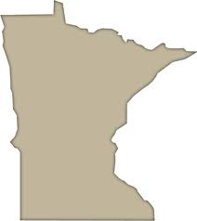
Minnesota GO: A Transportation Vision for Generations
Minnesota’s multimodal transportation system maximizes the health of people, the environment and our economy.
Notes:
Project selection, also called programming, begins with planning, and planning begins with a vision.
Minnesota’s vision for transportation for the future is captured in the Minnesota GO 50-year Vision. It is based on an understanding that transportation is a means to other ends, not an end itself. The Minnesota GO vision is: Minnesota’s multimodal transportation system maximizes the health of people, the environment and our economy.

Slide 4
From Vision to Plan to Program
Minnesota GO 50-year Vision
Statewide Multimodal Transportation Plan
Desired
Outcomes
Guiding
Principles
State Highway Investment Plan
Multimodal Objectives
Strategies
Mode-Specific Strategies & Guidance
Performance Measures & Performance-Based Needs
Investment Optimization
System Priorities & Definition
Notes:
In order to explain how projects are selected, it is necessary to start from the beginning of the process and the beginning of this process is establishing the vision.
The vision answers the question “what are we trying to achieve, not how will we do it”. The vision also articulates the guiding principle by which Minnesota will achieve its vision.
Leverage public investments to achieve multiple purposes
Ensure accessibility
Build to a maintainable scale
Ensure regional connections
Integrate safety
Emphasize reliable and predictable options
Strategically fix the systems
Use partnerships
The SMTP articulates policies and strategies to achieve the vision. The SMTP provides direction to all the modal and system plans, including the highway system. But the SMTP still does not identify specific projects.
MnSHIP uses the vision and the strategies of previous planning and turns those into highway specific strategies. MnSHIP provides the performance measures, performance goals, needs analysis, revenue assumptions and system priorities. MnSHIP describes how we will invest in highways and what outcomes we plan to achieve. MnSHIP provides the direction necessary to select projects.
When projects are selected, they are listed in a document called the 10-year work plan. The first four-years are detail in the Statewide Transportation Improvement Program (STIP). The 10-year list of projects is updated every year.
NOTES on MnDOT policy plan
Accountability, Transparency, and Communication
Make transportation system decisions through processes that are open and supported by data and analysis; provide for and support coordination, collaboration, and innovation; and ensure efficient and effective use of resources
Traveler Safety
Safeguard travelers, transportation facilities, and services. Apply proven strategies to reduce fatalities and serious injuries for all travel modes.
Transportation in Context
Make fiscally responsible decisions that respect and complement the natural, cultural, and social context, and integrate land uses and transportation systems to leverage public and private investments
Critical Connections
Identify global, national, statewide, regional, and local transportation connections essential for Minnesotans’ prosperity and quality of life;
develop and invest in lower cost, high benefit strategies as a first course of action to maintain and improve these connections; and
consider new connections
Asset Management
Strategically maintain and operate transportation assets; rely on system data, partners’ needs, and public expectations to inform decisions; put technology and innovation to work to improve efficiency and performance; and recognize that the system should change over time
System Security Reduce system vulnerability and ensure system redundancy to meet essential travel needs during emergencies

Slide 5
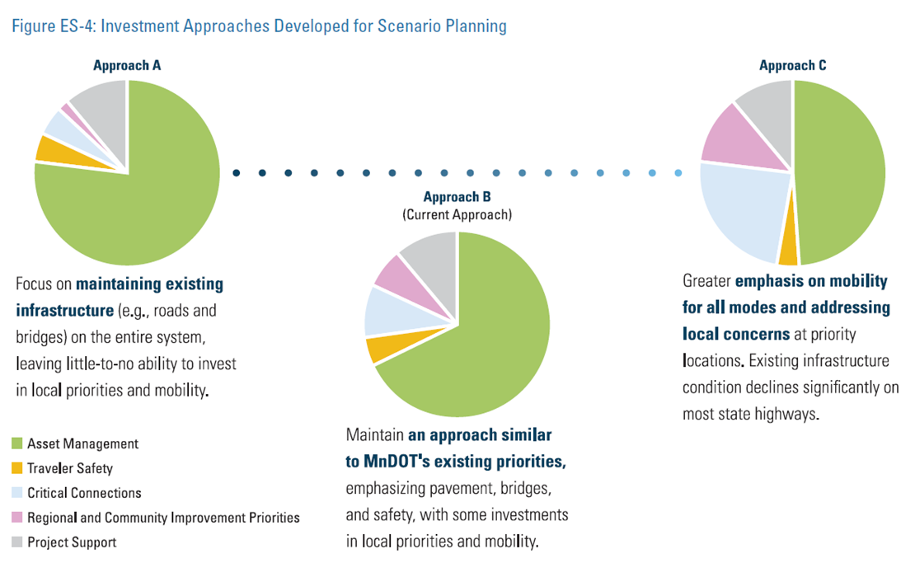
Minnesota GO: Investment Priorities & Direction
Emphasis on Maintaining existing infrastructure
Emphasis on mobility for all modes, address local concerns
Emphasis on infrastructure & safety, some local/mobility
Notes:
So how does MnSHIP set the investment priorities? Who makes the decision on what the priorities will be? The answer is we all do. Deciding on MnDOT’s investment priorities is a process that includes everyone.
State Legislature
Federal government
MnDOT policy and technical analyses
Stakeholder and public outreach
Governor’s feedback
I would like to highlight how public opinion is taken into account in establishing the investment priorities. An extensive effort is made to involve the public, including other government agencies, local governments, stakeholder and advocacy groups, and private citizens. MnDOT engages the public using several different methods such as meetings, workshops, an interactive website, and webinars.
The build your own budget calculator was on online tool that allowed users to mix and match the investment categories in amounts of their choosing to produce the outcomes they liked. It would not allow them to spend more than 100% so they had to make choices. And there was a public webinar for those who could not travel to an in-person meeting location.
As part of MnDOT’s State Highway Investment Plan, MnDOT engaged the public and transportation stakeholders in an innovative scenario planning and outreach process to inform investment priorities. Stakeholders were presented with three investment scenarios.
Approach A focused on maintaining existing infrastructure on the entire system, leaving little-to-no ability to invest in local priorities and mobility.
Approach C focused on a greater emphasis on mobility for all modes and addressing local concerns at priority locations. Existing infrastructure conditions decline significantly on most state highways.
Approach B focused on maintaining an approach similar to MnDOT’s existing priorities, emphasizing pavement, bridges, and safety, with some investments in local priorities and mobility.
The participants were asked to select an approach that they preferred, or if they wished, to design their own investment strategy. Some participants used pie shaped cutouts representing various sized investments and assembled them into their own investment pie. We found out not only what the public wanted more of, but also what they were willing to accept less of in exchange.

Slide 6
Minnesota GO: Investment Priorities & Direction
Notes:
And this was the final result for investments over the next 10 years.
The green pie slices on this graphic represent asset management categories, which include pavement, bridge, roadside infrastructure condition (totaling 67% of revenues for asset management). Each slice of the pie, although expressed in terms of dollars, has an associated expected outcome. Those can be found in more detail in MnSHIP.
Focusing on asset management will allow MnDOT to achieve multiple objectives through coordinated investments. For example:
Improving drainage infrastructure, which is part of Roadside Infrastructure Condition, helps pavements last longer
Funding Bridge Condition at a high level of performance supports traveler safety
Investing in Pavement Condition can enhance the bicycle network through shoulder repairs
The ever-increasing needs associated with maintaining and operating the current system require MnDOT to devote a much larger percentage of the capital program to asset management than in previous plans.
With that, MnSHIP is complete. But before projects can be selected, we need to describe criteria to evaluate potential projects that will achieve those performance objectives that we have worked to identify.
Project selection is what MnDOT refers to as programming. A program for preserving pavement will have different selection criteria than a program for reducing congestions. MnDOT runs several different programs that are associated with achieving the planned investment goals. Here are some examples of programs and criteria used by MnDOT to evaluate projects.

Slide 7
Example: Pavement Preservation Project
Recommendations of management systems:
Pavement smoothness
Pavement quality
Achievement of plan outcomes and FHWA targets.
Project continuity and coordination with other state or local projects.
Notes:
Almost 40% of MnDOT’s capital investments go to preserve pavements. The most important criteria used to select projects include these.
The first criterion is the recommendation of the pavement management system, which is a robust computer model that predicts future pavement conditions under different investment scenarios. The models provide information to optimize the benefits of capital investments.
Another criterion is whether or not the project helps the state to accomplish the pavement quality outcomes of the statewide investment plan such as the percent of pavements in poor condition and meet the condition requirements set forth in Federal law (MAP-21).
The next criteria are project continuity and scheduling factors. Asset management systems provide technical recommendations that a project is needed, but are not able to logically select project limits nor coordinate between pavement , bridge, and other asset systems. That requires human judgment to organize these segments into logical project lengths and proper timing.
Another is coordination with other state and local projects so as to not disrupt traffic unnecessarily.

Slide 8
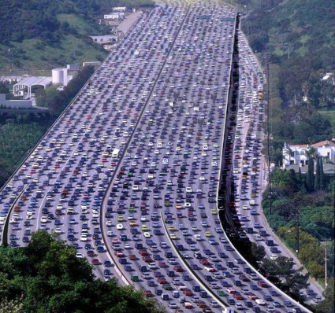
Example: Twin Cities Mobility Project
Identifying congested areas may involve using the following evaluation criteria
Predictable, congestion-free travel options
Return on Investment
Congestion levels
Traffic volumes
Potential congestion improvement using technology or operations
Crashes
Lane continuity
Notes:
Metro congestion relief projects generally result from one or more studies that examine the performance of trunk highway corridors. In the Twin Cities area, the Metropolitan Council has a broader planning role and MnDOT and the Council work collaboratively to create a regional plan that includes transportation. The studies and plan goals suggest that certain types of improvements would provide the most benefits. Some criteria that are used to select projects include the following:
Creates a predictable, congestion-free travel option (MnPASS)
Has a relatively high Return on Investment
Improves congestion with technology or operational improvements.
Addresses a congestion problem
Has a relatively higher traffic volume
Reduces crashes
Provides lane continuity
NOTES from Metro District
This is good background information. I think it's good to identify the 4 strategies to address mobility issues: -Strategic Capacity enhancements- interchanges, non-priced managed lanes, and limited general purpose lanes that address corridor congestion and/or provide lane continuity -Priced managed lanes- Priced managed lane projects (MnPASS lanes) that provide a predictable, congestion-free travel option for transit users, those who ride in carpools, or those who are willing to pay. -Spot mobility improvements- Lower cost, high-benefit projects that improve traffic flow and provide bottleneck relief at spot locations. -Active Traffic Management- Technology and operational improvements to help manage the effects of congestion. As far as data-driven criteria, each of these strategies has slightly different criteria and improvements have been identified through fairly extensive studies over a number of years such as the MnPASS studies and the Congestion Management Safety Plan studies. But each uses crash factors, vehicle volumes, congestion levels as well as potential costs as considerations in proposing improvements.

Slide 9
Example: Regional and Community Investment Priority Project
Local government and public support
Readiness (MnDOT and local partners)
Return on Investment
Economic development potential
Quality of life benefits
Notes:
MnDOT’s priorities identify about 10% of MnDOT investments for Regional and Community Investment Priorities or RCIPs.
RCIPs differ from the previous two examples in that these projects often are not identified by MnDOT as a maintenance or performance problem. Instead, these projects tend to be priorities for the region who may wish to create a stronger connection to other regions of the state or enhance the climate for economic development. Sometimes these projects may be partnerships between MnDOT and local agencies. Because there is a different kind of need driving these projects, this category uses a few different criteria.
Local government and public support. This might also include consistency with a local or regional plan.
Readiness (MnDOT and local partners). When a project requires state and local funding, it is necessary that all parties are ready to take the project on.
Return on Investment (cost/benefit analysis).
Economic development potential. Some projects may be tied directly to job creation. Others contribute in a more general way to an improved climate for commerce.
Quality of life benefits, such as health.
And others may also be used. Some special programs have specific goals such as economic development or flood mitigation and would have criteria to support it.
RCIPs can be small or large. The small ones are often called municipal agreement projects, such as in Metro District. They are often an intersection improvement or access changes or turn lanes. These often have a performance issue, but are just to small to show up on our measures.
The large ones are the TH 14's and TH 371's. With these it's not that these projects aren't beneficial, but they just don't rise to the top of our performance measure based system. They often have strong local support and are tied to economic benefits by local governments. Many of these have ended up in the Corridors of Commerce capacity building category.
Different programs have different criteria. A more complete explanation of the project selection criteria for the various MnDOT investment categories can be found on the MnDOT website in the Minnesota Statewide Highway Investment Plan.
So now, the planning is done and we have criteria for picking projects that will enable us to meet our statewide goals. At long last we are ready to select the projects.

Slide 10
What is programming?
Programming is the process of selecting projects
Selecting projects in the 4-year State Transportation Improvement Program (STIP)
Selecting projects in the10-year Highway Investment Plan (HIP)
Notes:
Project selection is what MnDOT refers to as programming.
MnSHIP is renewed every four years, but programming is an annual process.
Each year MnDOT produces a 10-year work plan STIP.
The STIP covers years 1-4. MnDOT considers the projects in these years to a be commitment. The STIP is financially constrained, meaning it is all within our expected revenues. Projects in the STIP have been “scoped”, which means we have confidence that we know what each project will include, how much it will cost, and when it will be constructed.
Years 5-10 are called the work plan years. Together with the STIP, these constitute the 10-Year Work Plan, formerly know as the Highway Investment Plan or HIP. Projects in the work plan years are also financially constrained, meaning that with they all fit within our estimated revenues over the 10-year period.
Individual projects are identified in years 5-10, but some spending is still listed only by category in what we call “set-asides”. For example, safety projects are not identified out 10 years because it is not possible to know where the safety problems are likely to occur 10 years from now. Projects in years 5-10 are less developed. They may not be scoped, meaning we are not sure yet what all the projects will include, what they will cost, or what the schedule is.
Ideally, major projects enter the work plan in year 10 and advance one year each year when the plan is updated until ultimately the project is constructed in year 1.

Slide 11
7 Steps to Programming - Project Selection
Step 1. Collect Project Selection Inputs
Step 2. Identify Projects
Step 3. Develop Draft Project List
Step 4. Project List Review
Step 5. Statewide Outcome Balancing
Step 6. Public Review and Input
Step 7. Approve the Program
Notes:
I have broken down the programming process into these 7 steps. The funnel shape of the diagram is meant to illustrate how we take information on a wide variety of roads and bridges and narrow that down through the selection process until we have a final list of projects – the program.

Slide 12
Step 1: Collect Project Selection Data
Pavement and bridge management systems identify needed maintenance
Crash records
Congestion data
Local Priorities
Notes:
STEP 1. Collecting data
MnDOT uses computer models called asset management systems to recommend where future improvements will be needed. MnDOT has both a pavement and a bridge asset management system.
The models optimize the available resources by recommending improvements which meet the performance targets for the system and minimize life-cycle costs as much as possible. There may also be other needs at the bridge or within the roadway segment that should be addressed. Other infrastructure such as drainage structures, lighting, signals, or guardrail may also need improvement. These other assets are not yet included an asset management model, but MnDOT does maintain records of the roadside infrastructure.
MnDOT also collects data about crash locations and about roadway characteristics that can improve safety performance. Information is captured in District Safety Plans to identify where improvements are needed.
MnDOT collects data about traffic volumes and levels of congestion.
MnDOT also receives information from its partners about local priorities. Often these are captured in regional or metropolitan area plans.
With all this data collected, the process moves on to Step 2.

Slide 13
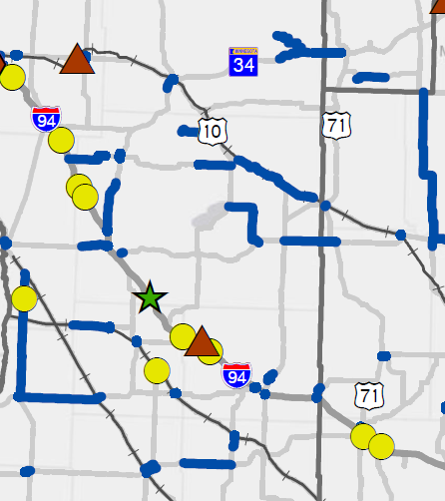
Step 2: District Evaluation
Districts review data for recommendations
Public and stakeholder input
Local priorities expressed by local agencies,
legislators, stakeholders, and the general public
Districts consider a variety
of other factors:
Community impact
Maintenance operations
Conflicts with other projects
Funding
Safety
Congestion
Accessibility
Notes:
Step 2. District Evaluation
District staff examines all of the data that has been collected and evaluates it to begin to narrow down which locations might be made into the best projects. Data might look something like this picture – needs of different kinds scattered about the system. How can we address the most needs the most efficiently is the question. District staff use their expertise and knowledge of the area, to change the segments/bridge needs into logical and buildable construction projects.
Although there is no formal opportunity for public input at this stage, MnDOT continually receives input from the public and partners over the course of the year. Those local priorities feed into MnDOT’s decision making on which needs are the most important to address.
As potential project limits become identified, the District staff must look at all of the other factors that might influence the choice of whether or not a particular project is chosen or when it is scheduled if it is chosen.
Other Investment factors could include many of these.
Are there needs for other improvements within the limits? Such as culvert replacements of pedestrian/bike accommodations.
Local Community Impact
Ensures proposed projects do not cause additional undue burden on communities.
The model recommends the only two major routes into a community be constructed at the same time.
The model recommends major construction through a community which cannot financially afford it at this time.
Maintenance Operations Concerns - Localized maintenance issues or operational problems within the segment may require additional investment.
Conflicts with other scheduled projects – a parallel road may be under construction at the same time necessitating an adjustment to the schedule.
Available funding – Other needs beyond the bridge or pavement work may make the project cost prohibitive to pursue or may require a delay until more funding is identified.
Because the models are only looking at total system performance, the recommended segments and bridges may or may not be good fits for actual construction projects. Examples of model outcomes which would not be good projects;
Pavement model recommends improving 5 of the 7 miles of pavement between two towns. MnDOT would not likely choose to improve only 5 of 7 miles.
Bridge model recommends replacing a bridge in five years, when the pavement model recommends doing the pavement in ten years. MnDOT would choose to avoid disrupting traffic multiple times and would likely adjust the schedule to address both needs in the same year.

Slide 14
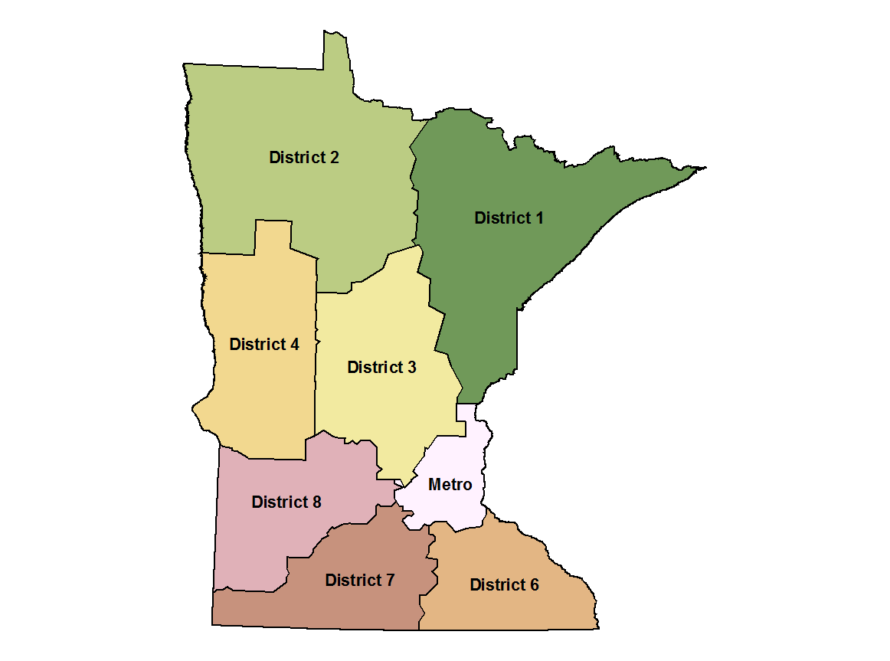
Step 3: Develop Draft Project List
Districts select projects
The list should meet the performance goals
The list should fit within budget constraints
The District Engineer ultimately decides which projects to include
Notes:
In Step 3, the Districts select the projects from the candidates that they have identified and produce the draft District program. Typically District staff will converse with their specialty office counterparts in the Central office to assure that selected projects will meet the desired outcomes and that it fits within the budget and available funding.
Step 3 finishes with the District Engineer submitting the draft program back to the Central Office to be combined with the programs of the other Districts.

Slide 15
Step 4: MnDOT Project List Review
Specialty offices evaluate District project lists
Assures equity across all Districts
Addresses unique regional issues
Assures that MnSHIP performance outcomes are met
The results of this balancing decide the draft statewide program
Notes:
STEP 4.
The central specialty offices (Bridge Office, Materials Office, Traffic Safety, etc.) evaluate the performance outcomes of the draft statewide program to assure that MnSHIP goals are being met.
MnDOT’s Programming Office and Finance Office evaluate the program to assure that it is within the budget and matches the available funding sources.
If one or both of these evaluations is not passed, the draft program is returned to the Districts with instructions for revisions.
When the draft program is within acceptable performance and financial requirements, the draft program proceeds to Step 5
After the District programs have been analyzed and the performance and budget have been evaluated, the statewide program is reviewed by all the Districts and specialty offices in an exercise called statewide balancing.
The review is a corporate exercise involving the District Engineers, Assistant District Engineers, District Planners, and Specialty Offices in a large group meeting.
The review assures that needs are addressed equitably across all the Districts. If the needs are not equitably met, resources may be moved from one District to another.
This is also the time to address any unique concerns or regional issues that may have emerged since the last update of MnSHIP.
The review assures that the MnSHIP performance outcomes are being met, or if they are not, that a change from the MnSHIP outcomes is necessary to address changing needs.
It is this process that decides what the draft statewide program will be.

Slide 16
Step 6: Public Project List Review
Notice is published that the draft statewide program list is available for comment
Each district uses their own process to collect input on the draft program list
Districts and specialty offices review the public comments and may make adjustments to the draft program list
Step 7: Program List Approval
The District Engineer makes final adjustments
Finance and Programming offices conduct a final performance and financial review
MnDOT’s senior leadership gives the final review
Commissioner gives final MnDOT approval
Notes:
STEP 6 Formal Public Review
Each phase of planning, programming, and project development has formal opportunities for public comment.
For programming, that happens in Step 6. MnDOT publishes a public notice announcing the availability of the draft statewide program for public comment. In addition to that formal request, each district uses their own public input process to collect input on the draft program from partner agencies and constituents.
Districts and specialty offices review the public comments and may make changes to the draft program in response.
After evaluating public input, the District Engineer considers any final adjustments to their program of projects and recommends the final draft to MnDOT Leadership for Step 7.
STEP 7
The final program is presented to a Committee of MnDOT’s senior leadership who give the program its final review for adherence to MnSHIP direction and agency policy. If the performance outcomes are not satisfactory, Leadership will request district/s to re-work their recommendations., but if it is satisfactory, the Committee recommends the complete list of projects to the Commissioner for final approval.
Here is an example of a typical project going through the steps.
The original project started out as pavement segments that was recommended by the pavement model for in 2015. The segment of pavement was US Highway 71 from the north junction with Minnesota Highway 23 to the junction of Minnesota Highway 9 north of Willmar, Mn.
Step #1: The project started out as several pavement segments recommended by the Pavement Management computer model as needing to be done in the near future for this area.
Step #2: District staff transitioned the pavement segments into a single logical construction project that went through both intersections and covered all the pavement between the intersections. From this action, Project #3417-18 is created.
Step #3: Historical safety concerns at the junction of US Highway 71 and Minnesota Highway 9, cause the traffic engineer to recommend a Highway Safety Improvement Project at this intersection. That recommendation leads to the development of Project #3417-185. To avoid causing construction work on the intersection for two different years, District 8 drafts a Program of Projects which has both projects being constructed in the same year, FY 2017.
Step #4: MnDOT Performance Reviews are run to determine both the state and district performance outcomes, with this project in the program. Projected performance is within agency goals.
Step #5: During statewide balancing, the District stresses the need to do these projects together and that the Highway Safety Improvement Project must go in 2017 because of recent bad accidents. During statewide balancing, the projects remain in 2017.
Step #6: The public input process generates comments of support from both stakeholders and members of the general public for doing the projects. Particularly in light of some recent higher profile crashes at the intersection.
Step #7: The District Engineer recommends that both Project #3417-18 and #3417-185 be in the final Program of Projects. MnDOT Leadership reviews the recommendations from all the districts, compares the recommended programs to MnSHIP investment goals, and ultimately recommends approval of the FY 2017 program by the Commissioner.

Slide 17
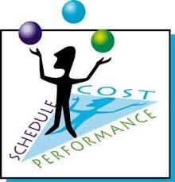
Program Management
Projects move in and out of the program
Flexibility needed - budget, project delays, etc.
NexTen projects are not hand picked but instead go through the same process
Notes:
And Congratulations – you have a program!
As we discussed before, in the ideal world, a project would enter the work plan in year 10 and advance one year each year until it was construction. Sometimes the reality is not ideal. For various reasons, projects may move in or out, forward or backward. Issues arise that may change the cost. Comments are received that may change the scope. Funding may not arrive exactly as we predicted. Projects in the STIP, years 1-4 have the most certainty. Projects in the later years from 8-10 have less certainty.
A note about NexTen, which is the “plan” for how to spend about $6 billion in the next 10 years. Those projects were picked following a very similar process – based upon data about needs, in accordance with our vision and investment priorities, taking into consideration public a stakeholder opinion as expressed in MnSHIP, and vetted by all of the Districts and MnDOT leadership. NexTen will have the ultimate public involvement process as it is debated by you and your colleagues in the legislature.
Thank you for your time.

Slide 18
Design-Build
Chris Roy, Director
MnDOT’s Office of Project Management & Technical Support

Slide 19
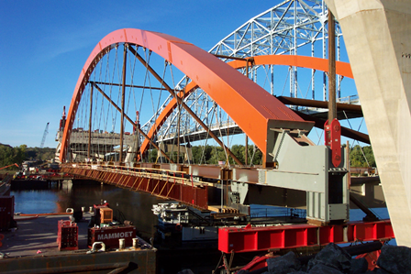
MnDOT’s Design-Build Program
First DB project in 1997
First modern DB project in
2002: ‘ROC52’
29 Awarded Projects
19 ‘Best Value’, $1-234 Million
10 ‘Low Bid’, $2-19 Million
$1.6 Billion Total
Typically 20-30% of MnDOT’s program by cost.
2-3% or program by number (limited to 10% by Statute)
Typically 3-5 projects per year over last five years.
TH 61 Hastings bridge

Slide 20
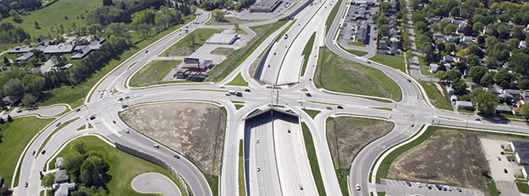
DB Strengths and Weaknesses
DB Benefits:
Accelerated Delivery
Risk Transfer (Quantities, etc)
Competing/Innovative Designs
Contractor ‘Value Engineering’
/ATCs
“Best Value” Awards
Flexibility
DB Drawbacks:
Non-Complex Project Cost Efficiency
Less Control over Design
Third party permits or agreements
Design Oversight Resources
‘ROC 52’ in Rochester

Slide 21
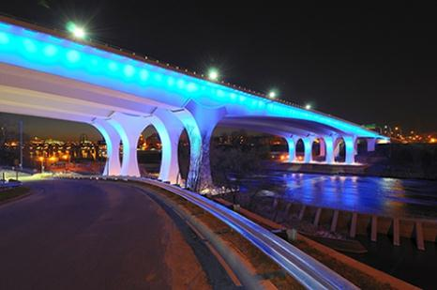
Design-Build Benefits
Acceleration
I35W Collapse: completion in
(less than) 1 year
‘ROC 52’: Construction duration
reduced by 1.5 years
Cost Efficiencies
Change Orders reduced from 6% in DBB to 2%
ATCs often reduce costs: rough average of 3% reduction
Value Engineering: TH 610 and St Croix roadways
‘Fixed cost’ structure
Design Improvements
Crookston slope stability
Bridge/structure minimization
Innovations: MSE Walls, ‘ABC’ techniques, warranties, performance specs
Notes:
Many new innovations: MSE Walls, ‘ABC’ techniques, warranties, performance specifications, etc

Slide 22
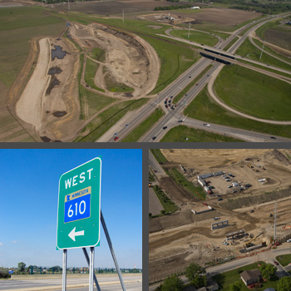
Delivery Method Selection
Primary Factors Considered
Cost
Schedule
Project Complexity &
Innovation
Current Status of Design
Staffing/Workforce
Availability & Experience
Risk Allocation

Slide 23
Scoring Methods
Low Bid
Pass/Fail Technical Proposal
Best for: non-complex projects, minimal risk transfer, lower dollar value (under $10 to 20 million)
Best Value
Formal Technical Proposal Scoring
Best for: major bridges, complex highways, unique designs, major risk transfer
Weight of price vs technical score is determined before RFP is issued
Notes:
Scoring Criteria Development
Written by core project team and the process manager
Based on project risks and goals
Draft posted for public comment
Transparency
Throughout the process information is posted on the website
After project award all information is made available

Slide 24
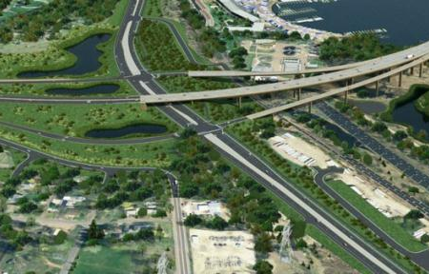
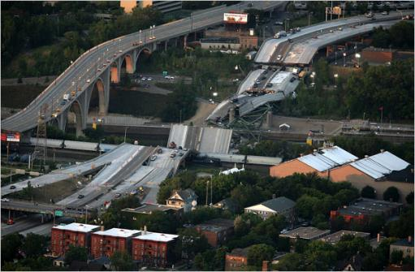
Design-Build Scoring
Prior to letting, technical proposals are submitted
Each Technical Review Committee (TRC) member reviews and comments on them independently
By statute, the TRC includes at least 5 members
One member is appointed by Associated General Contractors (AGC)
After proposal review the TRC convenes to compare comments and discussion
Following the discussion, each member scores individually
The teams’ final technical scores are averaged from the individual scores

Slide 25
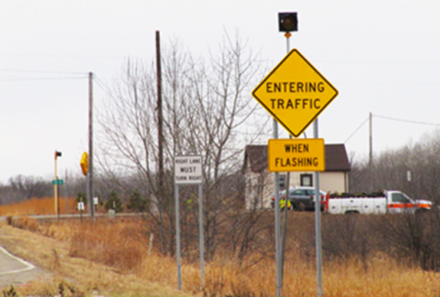
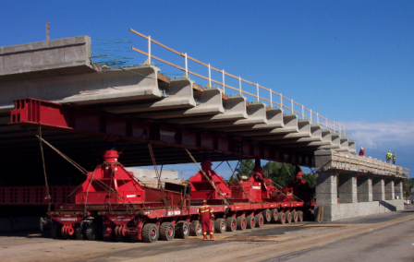
Design-Build Scoring
The winner is determined using the following formula:
Adjusted Score = Price Proposal / Technical Score
…the project is awarded to the team with the LOWEST Adjusted Score.
Notes:
*Note: All scoring forms, comments, and proposals are posted publically

Slide 26
Public-Private Partnerships Overview
Scott Peterson, Director
MnDOT Office of Government Affairs

Slide 27
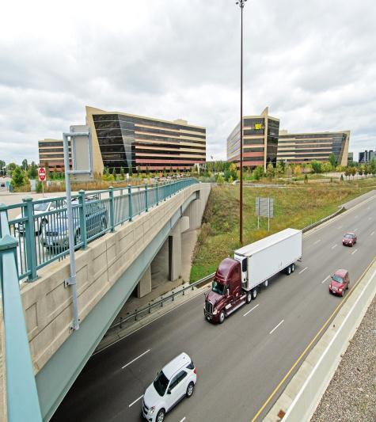
Public Private Partnerships (P3s)
P3 is a phrase that defines a wide variety of agreements between public agencies and private firms
Private entity assumes a role or roles more typically performed by public entity
Provide opportunities to increase net public benefit
MnDOT has been sporadically active for 20 years
I-494 & Penn Ave Interchange
Notes:
Minnesota Highway Partnerships come in many forms.
One of our most successful partnerships is the D/B program. The leverage we gain with our D/B partners is with more appropriate risk sharing, time savings in project delivery. We sometimes gain project cost savings when new designs, construction methods or materials are used.
Maintenance partnership agreements are an area where we see significant advantages. These could include facilities sharing, combined purchases in materials or equipment. Better utilization and economies of scale.
Solar on R-O-W, we are now evaluating our first proposals for this concept.
We have recently conducted a study on the Return-On-Investment with the consulting firm Parsons Brinckerhoff. That work considered the Return-On-Investment (net contribution to tax revenue) that the state receives for the TED program and for unsolicited proposals as well as the overall Benefit-Cost ratios (societal benefits). Our analysis shows that there are significant benefits in the states participation in these smaller partnerships, both Public-Public Partnerships as well as Public-Private Partnerships (P3s).
The following slides describe some findings from a recent analysis of our partnership program.

Slide 28
Typical types of P3s
Concessions and long term leases
Design/Build
Operate and maintain
D/B Operate and Maintain
D/B Finance
D/B Finance Operate
D/B Finance Operate and Maintain
D/B (own) Operate Maintain and Transfer
Financial Contributions
Notes:
Minnesota Highway Partnerships come in many forms.
One of our most successful partnerships is the D/B program. The leverage we gain with our D/B partners is with more appropriate risk sharing, time savings in project delivery. We sometimes gain project cost savings when new designs, construction methods or materials are used.
Maintenance partnership agreements are an area where we see significant advantages. These could include facilities sharing, combined purchases in materials or equipment. Better utilization and economies of scale.
Solar on R-O-W, we are now evaluating our first proposals for this concept.
We have recently conducted a study on the Return-On-Investment with the consulting firm Parsons Brinckerhoff. That work considered the Return-On-Investment (net contribution to tax revenue) that the state receives for the TED program and for unsolicited proposals as well as the overall Benefit-Cost ratios (societal benefits). Our analysis shows that there are significant benefits in the states participation in these smaller partnerships, both Public-Public Partnerships as well as Public-Private Partnerships (P3s).
The following slides describe some findings from a recent analysis of our partnership program.

Slide 29
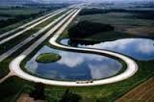
MnDOT Experience
Transmart
Connecting Minnesota
Design/Build
MnROAD
Solar on ROW
Transportation and Economic
Development (TED) program
Unsolicited Proposals
MnROAD
Notes:
Minnesota Highway Partnerships come in many forms.
One of our most successful partnerships is the D/B program. The leverage we gain with our D/B partners is with more appropriate risk sharing, time savings in project delivery. We sometimes gain project cost savings when new designs, construction methods or materials are used.
Maintenance partnership agreements are an area where we see significant advantages. These could include facilities sharing, combined purchases in materials or equipment. Better utilization and economies of scale.
Solar on R-O-W, we are now evaluating our first proposals for this concept.
We have recently conducted a study on the Return-On-Investment with the consulting firm Parsons Brinckerhoff. That work considered the Return-On-Investment (net contribution to tax revenue) that the state receives for the TED program and for unsolicited proposals as well as the overall Benefit-Cost ratios (societal benefits). Our analysis shows that there are significant benefits in the states participation in these smaller partnerships, both Public-Public Partnerships as well as Public-Private Partnerships (P3s).
The following slides describe some findings from a recent analysis of our partnership program.

Slide 30
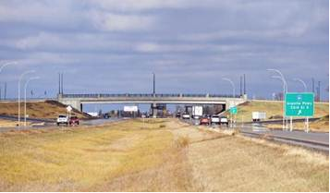
Why a P3?
Lower cost and/or more public benefit
Accelerated completion
Raise funds for other public purpose
Reduce public debt
Project cost savings
Project construction time savings
Life cycle efficiencies
Higher quality
Reduction in overall risk
Hwy 15/33rd Street South
Notes:
Minnesota Highway Partnerships come in many forms.
One of our most successful partnerships is the D/B program. The leverage we gain with our D/B partners is with more appropriate risk sharing, time savings in project delivery. We sometimes gain project cost savings when new designs, construction methods or materials are used.
Maintenance partnership agreements are an area where we see significant advantages. These could include facilities sharing, combined purchases in materials or equipment. Better utilization and economies of scale.
Solar on R-O-W, we are now evaluating our first proposals for this concept.
We have recently conducted a study on the Return-On-Investment with the consulting firm Parsons Brinckerhoff. That work considered the Return-On-Investment (net contribution to tax revenue) that the state receives for the TED program and for unsolicited proposals as well as the overall Benefit-Cost ratios (societal benefits). Our analysis shows that there are significant benefits in the states participation in these smaller partnerships, both Public-Public Partnerships as well as Public-Private Partnerships (P3s).
The following slides describe some findings from a recent analysis of our partnership program.

Slide 31
P3s need a revenue stream
Traditional state or federal revenue
New taxes or taxing districts
Tolls
Shadow tolls
Availability payments
Value capture
Notes:
There is always a great deal of risk in P3s. If managed well, however, the risks are divided among partners in a way that is most suited to managing those risks.
Indiana Turnpike was leased for 75 years to a P3 consortium. That consortium has since refinanced the project has filed for Chapter 11 bankruptcy.
Chicago Skyway: 99 year agreement
SR-91; Private sector builit toll lanes in the middle of the freeway. Included a non-compete clause which was very controversial. Since sold to Orange County for a significant profit.
I-495-I-95 Express Toll lanes in the Middle of the Interstate. Only open 2 years still in ramp-up period.
I-95 Miami Tunnel, Partner built project and financed with availability payment tool. Allows the partner to not have to take revenue risk, but they still get paid.
TransMart in Minnesota: moved to full development agreement before the city of Eden Prairie vetoed the project. There is no recourse in the law for this veto.
Connecting Minnesota: Fiber optics was installed along the I94 corridor boarder to boarder. State received dark fiber. Value was estimated to be a $50 million over the life of the project.

Slide 32
P3 Financing
Usually a blend of public and private sources
Private equity markets
Private debt instruments
Public revenue
Public debt
Innovative public financing
Transportation Infrastructure Finance and Innovation Act (TIFIA)
State Infrastructure Bank
Tapered match
Private activity bonds
Notes:
There is always a great deal of risk in P3s. If managed well, however, the risks are divided among partners in a way that is most suited to managing those risks.
Indiana Turnpike was leased for 75 years to a P3 consortium. That consortium has since refinanced the project has filed for Chapter 11 bankruptcy.
Chicago Skyway: 99 year agreement
SR-91; Private sector builit toll lanes in the middle of the freeway. Included a non-compete clause which was very controversial. Since sold to Orange County for a significant profit.
I-495-I-95 Express Toll lanes in the Middle of the Interstate. Only open 2 years still in ramp-up period.
I-95 Miami Tunnel, Partner built project and financed with availability payment tool. Allows the partner to not have to take revenue risk, but they still get paid.
TransMart in Minnesota: moved to full development agreement before the city of Eden Prairie vetoed the project. There is no recourse in the law for this veto.
Connecting Minnesota: Fiber optics was installed along the I94 corridor boarder to boarder. State received dark fiber. Value was estimated to be a $50 million over the life of the project.

Slide 33
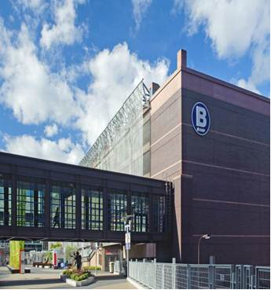
P3s agreements must be well constructed
Clear, measurable performance requirements
Appropriate assignment of risk
Well defined roles of each party
Effective safeguards of other public interests
Assignment of liability
B Ramp, Target Field
Notes:
There is always a great deal of risk in P3s. If managed well, however, the risks are divided among partners in a way that is most suited to managing those risks.
Indiana Turnpike was leased for 75 years to a P3 consortium. That consortium has since refinanced the project has filed for Chapter 11 bankruptcy.
Chicago Skyway: 99 year agreement
SR-91; Private sector builit toll lanes in the middle of the freeway. Included a non-compete clause which was very controversial. Since sold to Orange County for a significant profit.
I-495-I-95 Express Toll lanes in the Middle of the Interstate. Only open 2 years still in ramp-up period.
I-95 Miami Tunnel, Partner built project and financed with availability payment tool. Allows the partner to not have to take revenue risk, but they still get paid.
TransMart in Minnesota: moved to full development agreement before the city of Eden Prairie vetoed the project. There is no recourse in the law for this veto.
Connecting Minnesota: Fiber optics was installed along the I94 corridor boarder to boarder. State received dark fiber. Value was estimated to be a $50 million over the life of the project.

Slide 34
Risk transfer
Transferred to private party
Revenue
Construction cost
Project schedule
Operations and Maintenance
Traffic forecasts
Maintained by public sector
Environmental process
Permits
ROW
Legal framework
Notes:
There is always a great deal of risk in P3s. If managed well, however, the risks are divided among partners in a way that is most suited to managing those risks.
Indiana Turnpike was leased for 75 years to a P3 consortium. That consortium has since refinanced the project has filed for Chapter 11 bankruptcy.
Chicago Skyway: 99 year agreement
SR-91; Private sector builit toll lanes in the middle of the freeway. Included a non-compete clause which was very controversial. Since sold to Orange County for a significant profit.
I-495-I-95 Express Toll lanes in the Middle of the Interstate. Only open 2 years still in ramp-up period.
I-95 Miami Tunnel, Partner built project and financed with availability payment tool. Allows the partner to not have to take revenue risk, but they still get paid.
TransMart in Minnesota: moved to full development agreement before the city of Eden Prairie vetoed the project. There is no recourse in the law for this veto.
Connecting Minnesota: Fiber optics was installed along the I94 corridor boarder to boarder. State received dark fiber. Value was estimated to be a $50 million over the life of the project.

Slide 35
Challenges to an effective P3
Public skepticism
Public sector capacity in key skill sets
Transparency
Accountability
Accurate calculation of cost, benefits, and risks
Authorized public procurement methods
Availability of revenue streams
Legal obstacles
Data privacy
Notes:
There is always a great deal of risk in P3s. If managed well, however, the risks are divided among partners in a way that is most suited to managing those risks.
Indiana Turnpike was leased for 75 years to a P3 consortium. That consortium has since refinanced the project has filed for Chapter 11 bankruptcy.
Chicago Skyway: 99 year agreement
SR-91; Private sector builit toll lanes in the middle of the freeway. Included a non-compete clause which was very controversial. Since sold to Orange County for a significant profit.
I-495-I-95 Express Toll lanes in the Middle of the Interstate. Only open 2 years still in ramp-up period.
I-95 Miami Tunnel, Partner built project and financed with availability payment tool. Allows the partner to not have to take revenue risk, but they still get paid.
TransMart in Minnesota: moved to full development agreement before the city of Eden Prairie vetoed the project. There is no recourse in the law for this veto.
Connecting Minnesota: Fiber optics was installed along the I94 corridor boarder to boarder. State received dark fiber. Value was estimated to be a $50 million over the life of the project.

Slide 36
Public-Private Partnerships (P3s)
National Examples
Indiana Toll Road ($3.8 billion)
Chicago Skyway ($1.2 billion)
SR-91, Orange County ($100 million)
I-495 / I-95 Express Lanes, Virginia ($2 billion)
I-95, Miami Tunnel, Florida ($500 million)
Notes:
There is always a great deal of risk in P3s. If managed well, however, the risks are divided among partners in a way that is most suited to managing those risks.
Indiana Turnpike was leased for 75 years to a P3 consortium. That consortium has since refinanced the project has filed for Chapter 11 bankruptcy.
Chicago Skyway: 99 year agreement
SR-91; Private sector builit toll lanes in the middle of the freeway. Included a non-compete clause which was very controversial. Since sold to Orange County for a significant profit.
I-495-I-95 Express Toll lanes in the Middle of the Interstate. Only open 2 years still in ramp-up period.
I-95 Miami Tunnel, Partner built project and financed with availability payment tool. Allows the partner to not have to take revenue risk, but they still get paid.
TransMart in Minnesota: moved to full development agreement before the city of Eden Prairie vetoed the project. There is no recourse in the law for this veto.
Connecting Minnesota: Fiber optics was installed along the I94 corridor boarder to boarder. State received dark fiber. Value was estimated to be a $50 million over the life of the project.

Slide 37
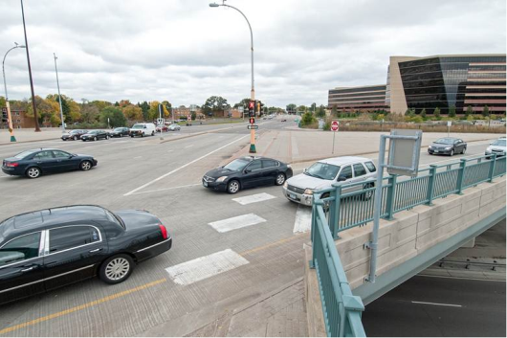
Minnesota Context
Traditional bond financing is inexpensive
Tolling restrictions
Local veto for new toll roads
No project or combination of projects of sufficient scale
Skepticism about preserving the
Public interest in public infrastructure investments
I-494 & Penn Ave Interchange
Notes:
Minnesota Highway Partnerships come in many forms.
One of our most successful partnerships is the D/B program. The leverage we gain with our D/B partners is with more appropriate risk sharing, time savings in project delivery. We sometimes gain project cost savings when new designs, construction methods or materials are used.
Maintenance partnership agreements are an area where we see significant advantages. These could include facilities sharing, combined purchases in materials or equipment. Better utilization and economies of scale.
Solar on R-O-W, we are now evaluating our first proposals for this concept.
We have recently conducted a study on the Return-On-Investment with the consulting firm Parsons Brinckerhoff. That work considered the Return-On-Investment (net contribution to tax revenue) that the state receives for the TED program and for unsolicited proposals as well as the overall Benefit-Cost ratios (societal benefits). Our analysis shows that there are significant benefits in the states participation in these smaller partnerships, both Public-Public Partnerships as well as Public-Private Partnerships (P3s).
The following slides describe some findings from a recent analysis of our partnership program.

Slide 38
Example Partnerships in Minnesota
Name of Partnership | Type | MnDOT Stake | Program
TH 7 and Louisiana Avenue | Public-Public: St. Louis Park-MnDOT | 25.6% | TED
Penn Avenue and I-494 | Public-Private-Public: City of Richfield-Best Buy- MnDOT | 22.2% | Unsolicited Proposal
US HWY 169/Bren Road | Public-Private-Public: City of Minnetonka-United Health Group-MnDOT | 54.6% | Unsolicited Proposal
US HWY 10/CSAH 34 | Public-Private-Public: Perham-Perham Memorial Hospital, local businesses-MnDOT | 62.7% | TED
TH 15 and 33rd Street South | Public-Public: St. Cloud-MnDOT | 69.0% | TED
ABC RAMPS Improvements | Public-Public: City of Minneapolis/Target Field-MnDOT | 100.0% | Unsolicited Proposal
Notes:
We have been doing partnerships for many years, but up until now we haven’t evaluated the Return-On-Investment for the state’s contribution. This table represents a sampling of projects done around the state and shows what portion of the projects cost was contributed by the state.
These projects were picked not to show case the best projects, but rather to give a cross-section of the types of projects and areas where we have been involved. By necessity, the projects were selected where we had good and reliable data to conduct an evaluation.
Unsolicited proposals are when for example a city comes to MnDOT with an idea to form a mutually beneficial partnership

Slide 39
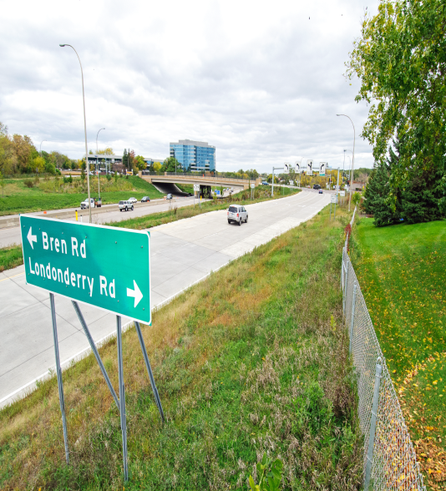
Requirements for Successful P3s
Commitment from Executive Leadership
Support of policy makers
The Right Opportunity /
The Right Project
The Right Partner(s)
Public Involvement
Transparency and accountability
A Well-Crafted Plan, Contract, and
Defined Process
Notes:
Commitment from Executive Leadership: this simply means P3s need a champion
Enabling Legislation for Partnering: state laws require clarity regarding the formation and management of public and private sector partnerships and contributions. They need to be flexible. Partnerships are risky ventures, conditions often change during the project development process. Must be able to take advantage of innovative and creative solutions.
The Right Opportunity / The Right Project: Generally speaking, big P3s have to be of the right scale to get partners willing to invest significant equity.
The Right Partner: "best value" in a partner is critical in a long-term relationship. A candidate's experience in the specific area of partnership being considered is an important factor.
Public Sector Involvement
A Well-Crafted Plan: A carefully developed plan will substantially increase the probability of success of the partnership. This plan most often will take the form of an extensive, detailed contract, clearly describing the responsibilities of both the public and private partners.
Effective Communication with Stakeholders
Well-Defined Management Processes

Slide 40
Questions?
www.mndot.gov
Scott Peterson, Director of Government Affairs
651-366-4817
scott.r.peterson@state.mn.us

