Slide 1
Metropolitan Council Metropolitan Area Transit Budget Request
Notes:
Change the Minnesota logo to your agency logo

Slide 2
Transformational Investment in Transit: 10 Year Plan
1/8-cent sales tax in the seven-county metropolitan area to maintain and expand the regional bus and transitway system. $770 million over 10 years
Increase in the Motor Vehicle Sales Tax rate from 6.5% to 6.875%. $205 million over 10 years
General obligation bonding for bus rapid transit capital expansion. $230 million over 10 years
Separates Metro Mobility funding from the Metropolitan Council’s general transit appropriation. Provides more than $240 million for increased service demand over 10 years
Notes:
Continued financial support from the county transit sales tax collections in the region (replaces $700 million in previous state obligations)

Slide 3
Transformational Investment in Transit: 10 Year Plan
Eliminates Structural Deficit in Bus – permanently out of General Fund
Assumes current 50% State Share of Dedicated Transitway Operations remain with the State (Blue Line, Green Line, Northstar and Red Line)
Assumes future 50% Dedicated Transitway Operations remain a State Obligation (Orange Line, Blue Line Extension, Gold Line, Rush Line and Riverview)
Along with assistance from our County Partners, all Dedicated Transitways and Bus Rapid Transit lines in our 10 Year Increased Revenue Plan have their local funding in place
Notes:
*Only if asked
Current Dedicated Transitways will need $6M in SFY 22/23
Future Dedicated Transitways will need $2M for Orange Line operations in SFY 22/23

Slide 4
Budget Outcomes

Slide 5
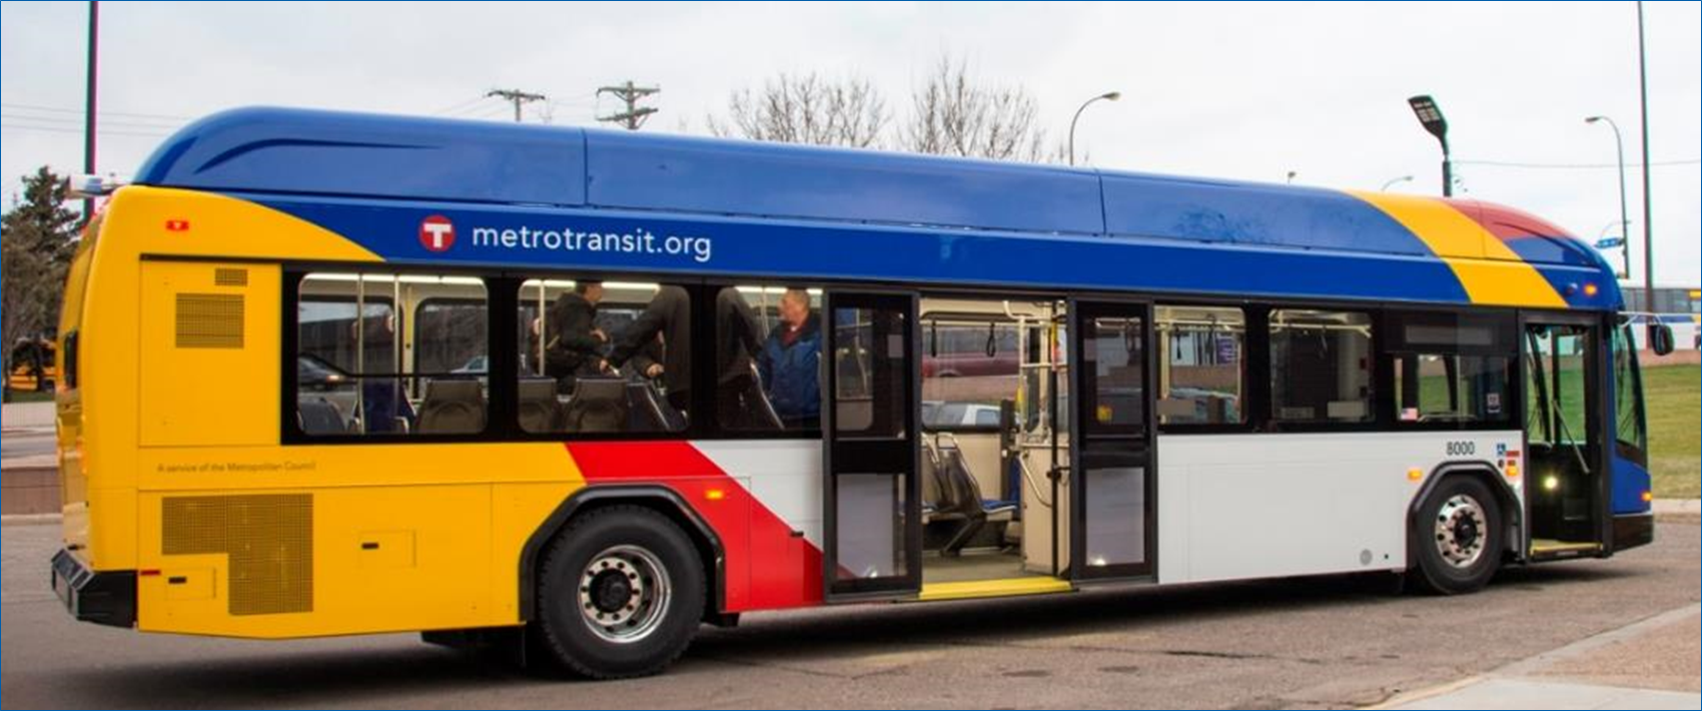
Transformational Investment in Transit: 10 Year Plan
10 new lines in 10 years
40% increase in service on the region’s busiest routes
Bus rapid transit amenities attract riders
Traffic signal priority and off-board payment = faster trips
Shelters include real-time information, heat, and light
Proven success: A Line ridership is 30% higher over base service in 2015

Slide 6
10-year transitway investment
YouTube link

Slide 7
10-year transitway investment

Slide 8
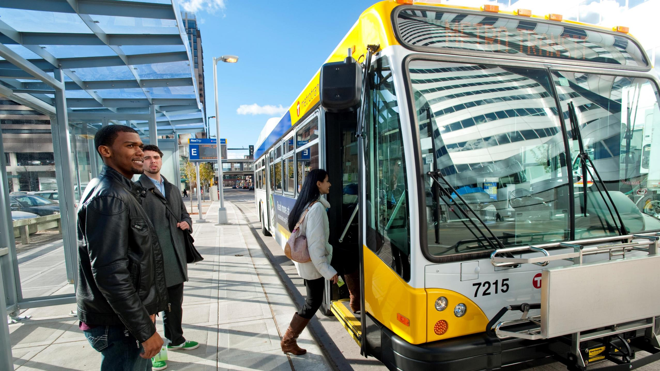
Improves regular route bus routes
Funds high priority service identified in the long-term service development plan
Increases frequency and extends service hours of current high performing routes
Results in about 17,000 more daily rides

Slide 9
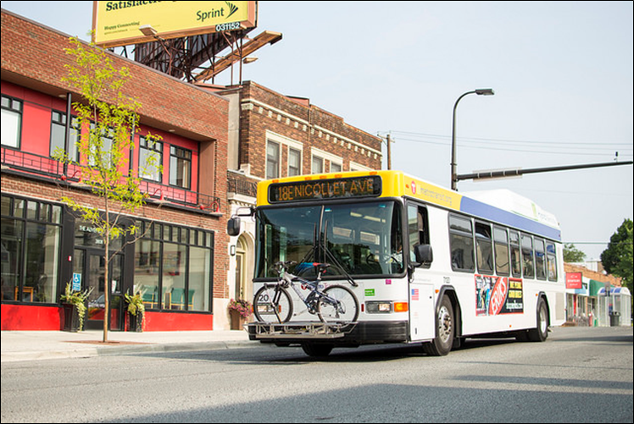
A better customer experience
Increase speed and reliability of local routes
Improve real-time schedule info at bus stops, on buses, and mobile app
Improve bus stop signs, shelters, heat, light, maintenance, add ADA sidewalk pads
More snow removal at stops
Improve fare collection to allow mobile phone payment for customers
Fare enforcement / Administrative presence
Notes:
Our Arterial Bus Rapid Transit (BRT) provides fast, reliable and comfortable space, and A Line has had strong ridership since its launch.
This budget would allow us to apply these amenities to core local service beyond the BRT. Goal is to respond to customer interests at a time when our riders have several travel options. This proposal would also provide funds to improve all our customer amenities throughout the system.

Slide 10
Advancing sustainability
Accelerates electric bus fleet transition
220 all-electric buses
Complements Metropolitan Council goal of powering operations with 100% renewable electricity by 2040

Slide 11
Modern transportation system for growing region
By 2040:
700,000 more people
500,000 more jobs
1 bus = 40 cars
At rush hour, buses carry 1.5 lanes of traffic
3-car LRT = 600 cars

Slide 12
Transit connects people to places that matter
Half of riders are Millennials (18-34)
2/3 of trips are to work or school
Half of bus riders don’t have a driver’s license
2/3 of local bus riders don’t have access to a vehicle

Slide 13
Increases access and mobility over 10 years
Connecting 500,000 people to a 30-minute transit commute
More bus routes, with more frequent and more reliable service
Up to a 40% ridership increase
11 of Minnesota’s 17 Fortune 500 companies are located on lines for potential development

Slide 14
Transit connects people with jobs
Fortune 500 companies near transit
Notes:
We will be dropping in an updated map showing the F500 companies along a zoomed in version of this map

Slide 15
Investing in transit strengthens economic competitiveness
“Transit investments strengthen our economy – both by generating good jobs at manufacturing businesses across Minnesota and by providing better access to jobs by transit in the Twin Cities and Greater Minnesota. The importance of Minnesota’s transit supply chain to communities across the state should be an important part of the conversation at the State Capitol this year.”
– Jonathan Weinhagen, Minneapolis Regional Chamber
Notes:
Another one:
“Minnesota’s transit supply chain is interconnected – showing the importance of sustained transit investments for the state’s economy,” said Beth Osborne, Director of Transportation for America. “These Minnesota businesses rely on a steady pipeline of projects to keep their workforce strong. Without continued state and federal support for transit, they would see negative impacts that would affect their ability to thrive.”

Slide 16
Budget Proposal FY 2020 – FY 2021

Slide 17
FY 2020-2021 Metropolitan Area Transit Budget
FY 2020-2021 Budget Request:
General Fund request for Metro Mobility (above base):
FY 2020 $10.569M
FY 2021 $25.621M (added to Metro Mobility base for FY 2022)
1/8 Cent Sales Tax Revenue
FY 2020: $28.739M
FY 2021: $70.064M
Notes:
Current Metro Mobility Base is $57.2M The Governor’s proposal sets the new base at $82.821M for FY 2022
Current Rail Base is $32.6M

Slide 18
FY 2020-2021 Metropolitan Area Transit Budget
MVST Sales Tax Rate Adjustment
FY 2020: $18.0M
FY 2021 $19.0M
General Obligation Bonding for BRT Transitways
FY 2020: $20.0M request for D Line Arterial BRT
FY 2021: TBD

Slide 19
FY 2020-2021 Metropolitan Area Transit Budget
Metro Mobility / DHS Data Sharing
GANs technical fix

