Slide 1
Minnesota Board of Pharmacy
Dr. Cody Wiberg, Executive Director
House Health and Human Finance Division
February 5, 2019

Slide 2
Minnesota Board of Pharmacy
General
Independent, non-cabinet level state agency
Has been in continuous existence since August, 1885
Per Minn. Stats. §214.01 – one of 15 “health-related licensing boards”
MDH Office of Unlicensed Complementary and Alternative Health Care Practice also included in definition of HRLB
The 15 boards, plus Boards of Barber Examiners Cosmetologist Examiners work cooperatively
.

Slide 3
Minnesota Board of Pharmacy
General
Nine Board Members appointed by the Governor
Six pharmacist members, three public members
Four-year, staggered terms
Board meets in general business session approximately every six weeks
Board delegates some of their authority to the Executive Director
Executive Director
Appointed by the Board – but:
Governor can ask any HLB to review performance of an ED – and take appropriate action up to and including dismissal
Must be re-elected as Board’s Secretary annually
Assisted by 20 other staff
Office Manager and six clerical/administrative
Attorney/legal analyst
Prescription Monitoring Program Manager and three PMP staff
Seven licensed pharmacists – certified inspectors and investigators

Slide 4
Minnesota Board of Pharmacy
Mission
“Promote, preserve, and protect the public health, safety, and welfare by fostering the safe distribution of pharmaceuticals and the provision of quality pharmaceutical care to the citizens of Minnesota.”

Slide 5
Minnesota Board of Pharmacy
Powers and duties
License pharmacists and pharmacies
Regulate practice of pharmacy
Regulate operation of pharmacies
License drug manufacturers and drug wholesalers
Regulate the manufacture and distribution of drugs within and into the state
License or register medical gas distributors, wholesalers and retailers
Inspect the in-state facilities we license
Insure that out-of-state facilities are licensed by their state and have passed inspections

Slide 6
Minnesota Board of Pharmacy
Powers and duties
Investigate complaints – approximately 200 – 250 per year
When warranted issue disciplinary orders – reprimands, civil (monetary) penalties, limit or condition licensure, suspend licenses, revoke licenses
Engage in rule-making
Includes authority to makes changes to the state’s controlled substances schedules
So, very involved in controlled substance abuse issues
Administer the Prescription Monitoring Program
Provide technical assistance to the Governor’s Office and legislators
Work with many local, state and federal agencies on drug-related issues

Slide 7
Minnesota Board of Pharmacy
The Board does not:
Regulate drug prices
Regulate the insurance functions of pharmacy benefit managers
We do license and regulate any mail orders pharmacies they own
Regulate the state’s medical cannabis program or the THC Therapeutic Research Act
Regulate the cultivation of hemp or the sale of hemp products, except for:
Products containing cannabinoids (like CBD) extracted from hemp and sold for medical purposes
Enforce the criminal sections of the state’s Controlled Substances Act

Slide 8
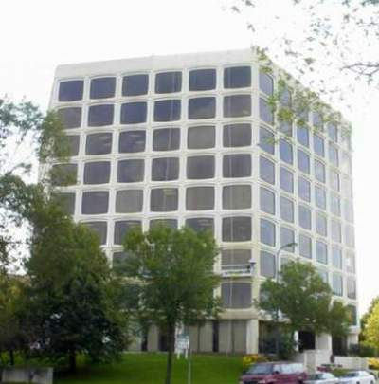
Contact Information
Cody Wiberg, Pharm.D., M.S., R.Ph.
Executive Director
Minnesota Board of Pharmacy
2829 University Avenue SE, #530
Minneapolis, MN 55414
(651)201-2825 (651)201-2837 (fax)
cody.wiberg@state.mn.us

