Slide 1
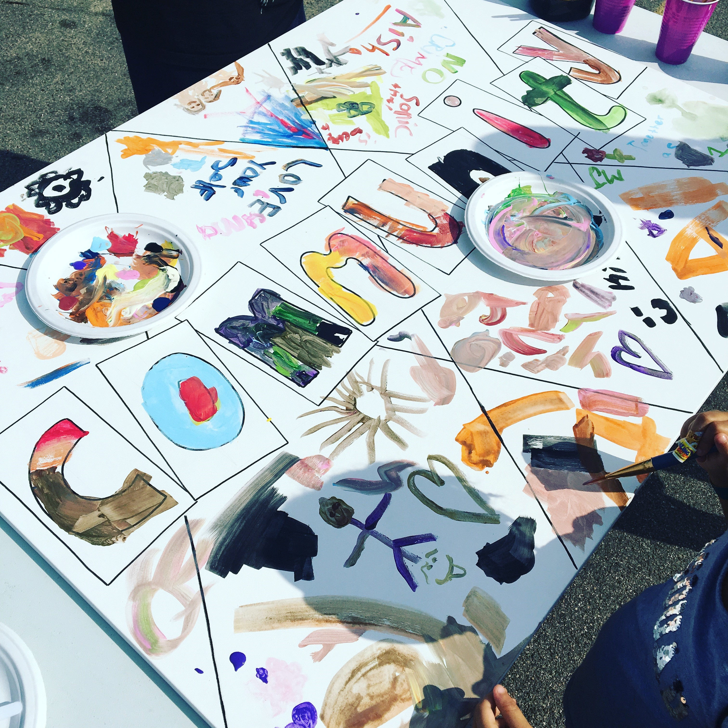
Minnesota KIDS COUNT 2018: Building Community in a Time of Changing Needs
January 24, 2019

Slide 2
Children’s Defense Fund
Nonpartisan, nonprofit organization
CDF does not seek nor accept government funds
Minnesota is one of eight state and regional offices
The Children’s Defense Fund Leave No Child Behind® mission is to ensure every child a Healthy Start, a Head Start, a Fair Start, a Safe Start and a Moral Start in life and successful passage to adulthood with the help of caring families and communities.

Slide 3
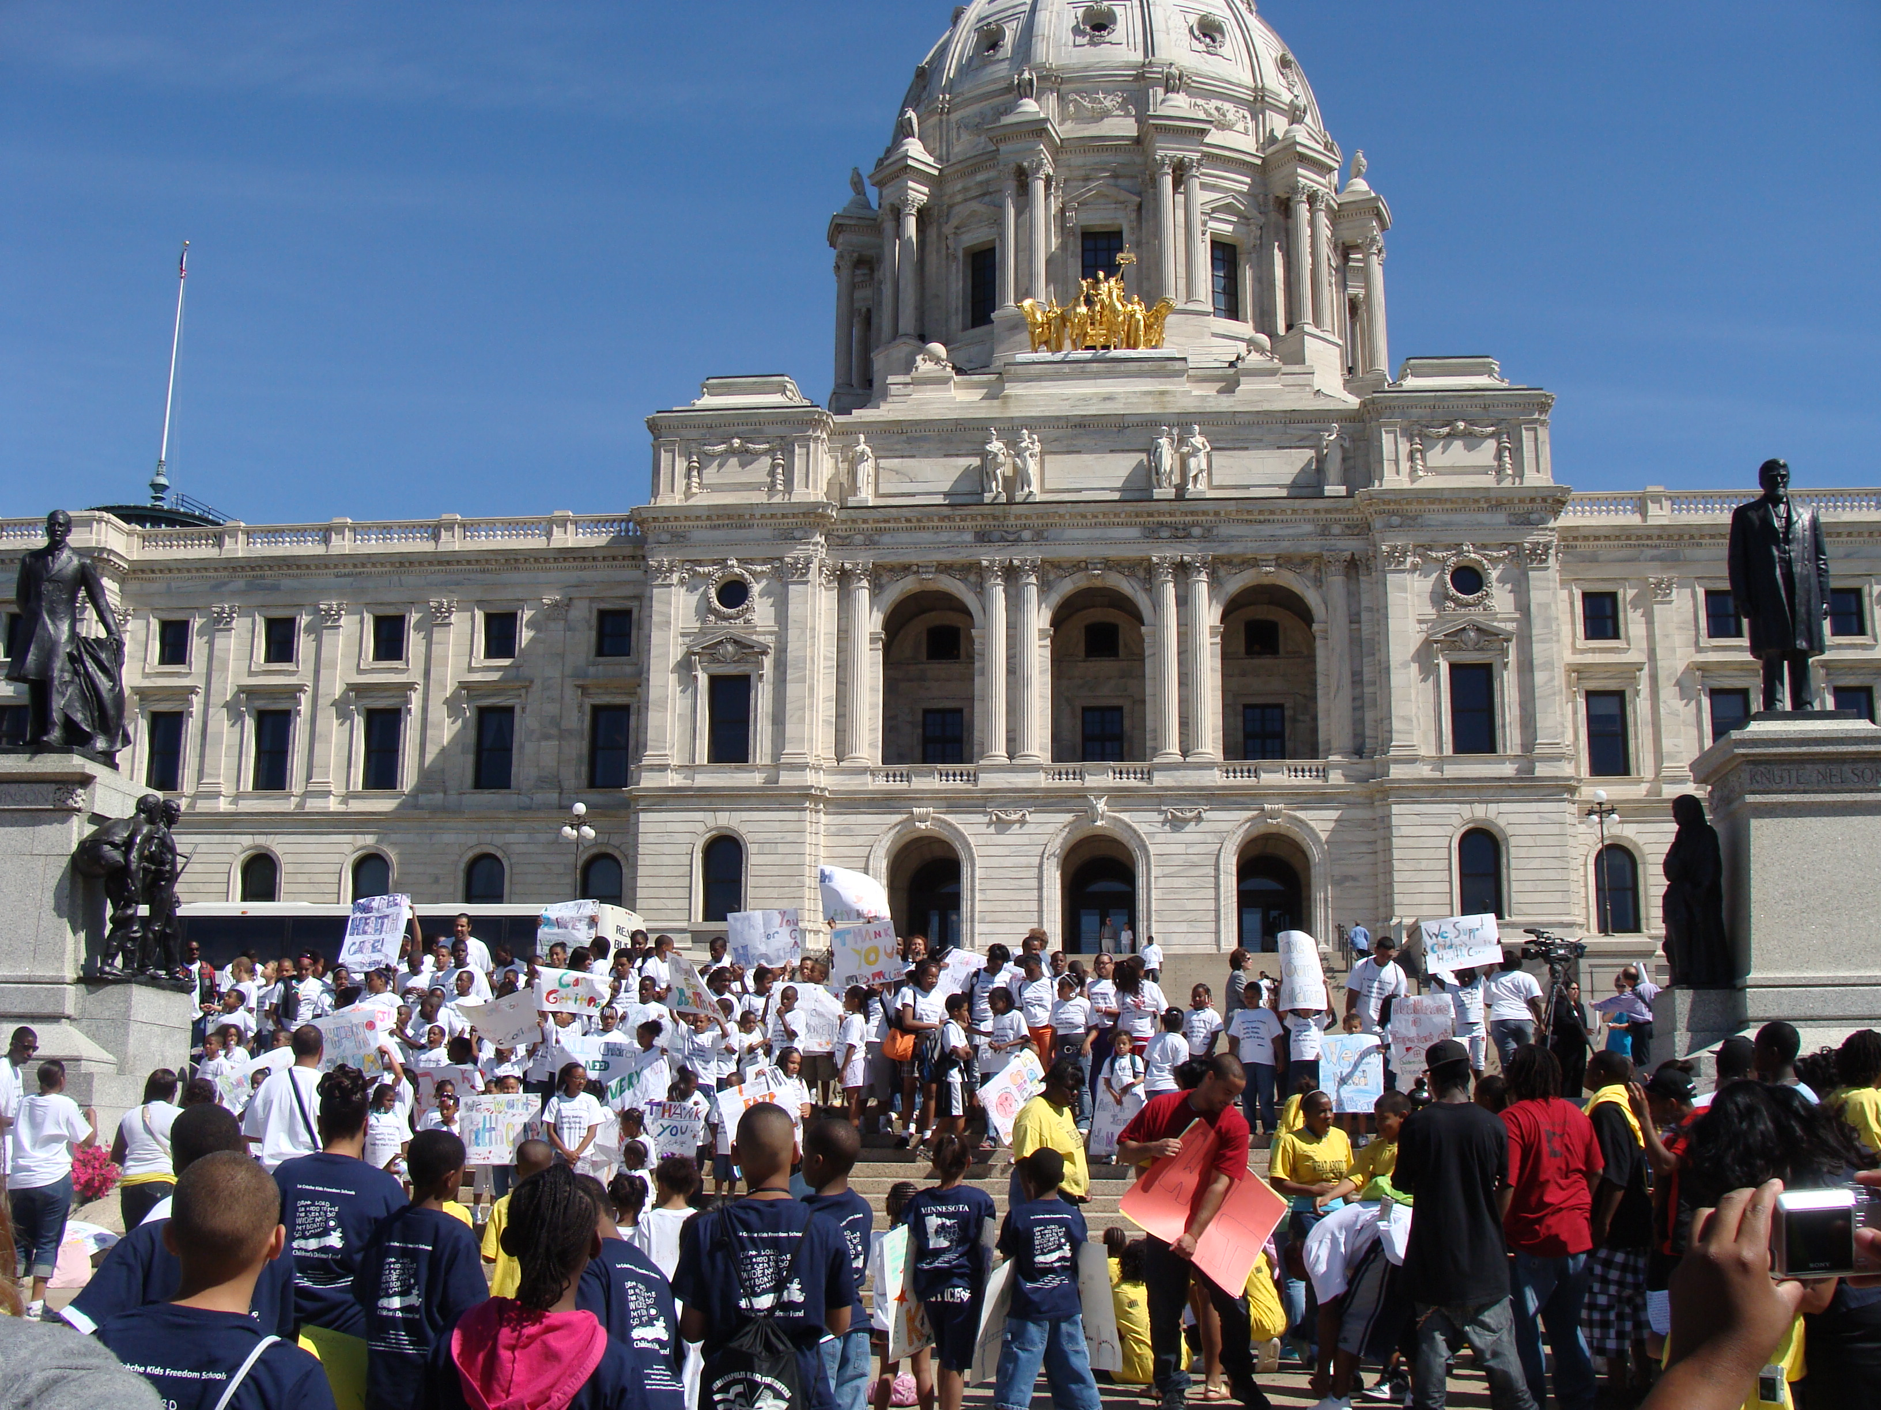

Children’s Defense Fund - Minnesota
Legislative Advocacy
Early Childhood
Health Care
Child Care
Child Well-Being
Economic Security
Research & Education
Issue research
KIDS COUNT ®
Outreach & Organizing
Bridge to Benefits
Voices & Choices Coalition
Youth Leadership
Freedom Schools ®
Beat the Odds ®

Slide 4
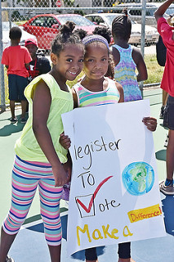
KIDS COUNT Ranks Minnesota Fourth
Annie E. Casey Foundation KIDS COUNT ranked Minnesota 4th overall in 2018
5th in Family and Community
11th in Education
5th in Economic Well-being
6th in Health
However, when data is disaggregated by race and ethnicity Minnesota has some of the worst disparities in outcomes and access to opportunities for children of color and American Indian children in the country.
Notes:
While we maintained our ranking of 4th overall, we dropped in each of the four categories, notably from 1st to 6th in health, and 8th to 11th in education.

Slide 5
KIDS COUNT Data Center
Find state, county, city and congressional district data
Create custom reports
Compare and rank data for different geographies
Design graphics, maps and trend lines

Slide 6
Census 2020
Undercounted individuals could cost the state millions of dollars in Federal allocations for many programs that benefit children and families
Children under age 5 are among the undercounted groups
KIDS COUNT relies on accurate Census data to measure child well-being

Slide 7
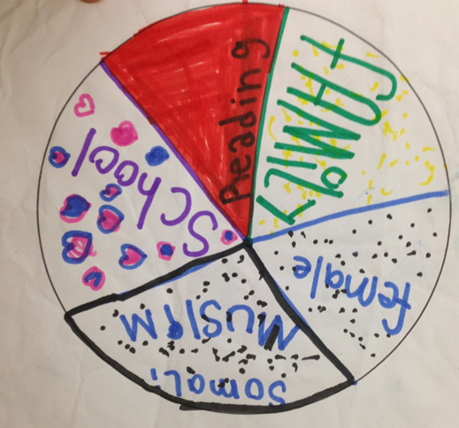
Examining Data by Race and Ethnicity
U.S. Census Bureau and state agencies often use five racial categories in data collection:
American Indian
Asian
Black
Hispanic or Latino
White
Two or More Races
Data with additional ethnic categories or nationalities is not often accessible
More stratified data would help identify unique trends for subsets of these racial groups

Slide 8
Examining Data by Race and Ethnicity
Minnesota has historically been and continues to be a state with a White majority
Structural racism has permeated policies and programs for decades, affecting outcomes for children of color and American Indian children
Expanding the number of racial and ethnic groups in datasets would help us better understand subsets of populations

Slide 9
Minnesota Child Population Overview
Children (under 18) comprise 23% of total MN population or 1.3 million Minnesotans
Racial and ethnic diversity continues to grow in Minnesota - 30% of children are children of color or American Indian.
Young children under 5 make up 27% of all Minnesota children
About 70K children per single age group under age 5
Notes:
Growing diversity means that we need to be aware of the needs of every child in Minnesota, regardless of race or ethnicity, and ensure that our programs fit those needs.
While the total child population in Minnesota is remaining relatively stagnant, the makeup of the population is shifting. Population growth for children and adults is driven by growth in the number of people of color.
(I don't always say this explicitly but American Indian population is also declining like the White child population)

Slide 10
Minnesota KIDS COUNT 2018 Data Book
Four Components of Child Well-being
Safe and Supportive Homes and Communities
Economic Well-being
Health Coverage and Care
High–Quality Early Childhood and K-12 Education
Notes:
In each section we show a few data points that demonstrate trends and areas of strength and improvement. Then we highlight policy solutions that we have identified in each category but these aren't the only solutions to the issues addressed in the data. Just some starting points.

Slide 11
Safe and Supportive Homes and Communities
Safety is of critical importance to children’s overall well-being, both in their families and in their neighborhoods and schools, to ensure that every child has positive health and educational outcomes.

Slide 12
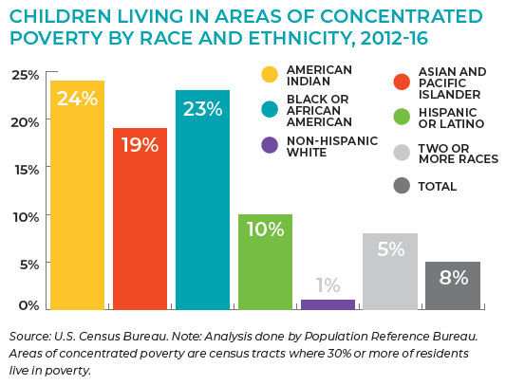
Safe and Supportive Homes and Communities
Neighborhoods with low rates of poverty provide increased access to resources and opportunities, resulting in easier development of community and improved child outcomes.
Notes:
This slide is a great example of data that demonstrates disparities as a result of structural inequities - examples such as redlining, transportation development and segregation of communities shine through in this data.
Over time the overall number of children in these neighborhoods has been increasing, even when poverty has declined. It means we are segregating lower income people and people of color into under-resourced areas.
Also can talk about difference between equity and equality.

Slide 13
Safe and Supportive Homes and Communities
Widespread disparities persist in Minnesota for Black children, American Indian children and children of Two or More Races in the child welfare system and out-of-home care.
The Legislative Task Force on Child Protection continues to monitor the Minnesota child welfare system.
Notes:
Trend data here with child maltreatment as well - what's driving this over time?

Slide 14

Economic Well-being
Health, education, and well-being outcomes for children improve when their family is economically stable. Even an extra $1,000 per year for families to spend on basic needs can make a major impact on children’s well-being.

Slide 15
Economic Well-being
Disparities persist for American Indian and Black children and overall more than one in ten children in Minnesota are living in poverty*.
Young children are more likely to experience poverty- 14% or 56,000 children under 5 in poverty in MN
31% of all MN children live in low-income families (2x the poverty level)
*Poverty is defined as under $24,339
for a family of 4 with 2 children
Notes:
Federal poverty guidelines are set at $25,100 for a family of four with two adults and two children in 2018.
Talk about trend over time. Saw decreases over the past two years but still haven't dipped to the low rates before the recession.

Slide 16
Economic Well-being
Increases to the minimum wage will benefit families, but still not catch up to a living wage that enables working families to achieve economic stability.
Work support programs such as SNAP and Medicaid fill the gap between lower wages and basic needs and provide economic boost to communities.
Notes:
Minneapolis and St. Paul are both moving toward $15 minimum wage over the next few years.
Poverty is not a work issue, it’s a wage issue and families need to earn well above the poverty guidelines to make ends meet without work support programs.

Slide 17
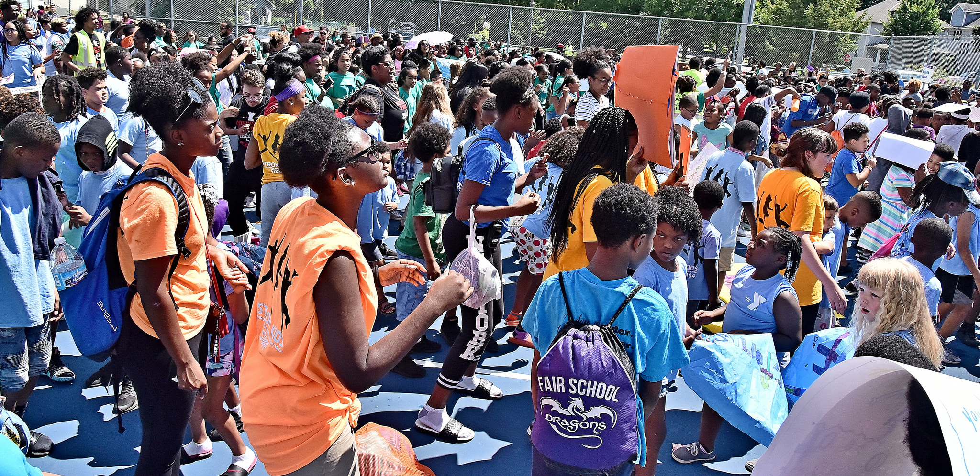
Health Coverage and Care
When children have access to affordable preventive health care, the whole community benefits from improved health, lower rates of uncompensated care, and more productive citizens.

Slide 18
Health Coverage and Care
The Affordable Care Act (ACA) of 2013 changed eligibility requirements for Medical Assistance (MA), enabling many who formerly were enrolled in MinnesotaCare to access MA.
MA provides health coverage and care to 38% of all children and 43% of all babies born in MN.
Since the ACA, the number of uninsured children has declined by 60%.
484,650
1,116

Slide 19
Health Coverage and Care
Though uninsured rates have fallen among all children by race/ethnicity, Latino and American Indian children continue to be less likely to be covered by health insurance in Minnesota.

Slide 20
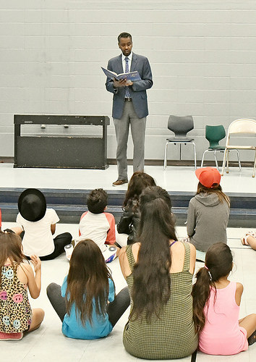
High-Quality Early Childhood and K-12 Education
Schools can serve as a community hub for children and parents to learn, build relationships, and receive support.
Notes:
Children and families develop friendships and support networks informally through school connections. But they also find helpful services connected to school.

Slide 21
High-Quality Early Childhood and K-12 Education
Every region in the state is experiencing a shortage of child care, particularly infant care.

Slide 22
High-Quality Early Childhood and K-12 Education
Access to high-quality early childhood education continues to be hindered by the high cost and limited funds available to provide financial assistance.
We have 43 early childhood programs in our state, according to the OLA report.
The ECLDS online tool allows us to look at access to programs across agencies prior to Kindergarten entry.

Slide 23
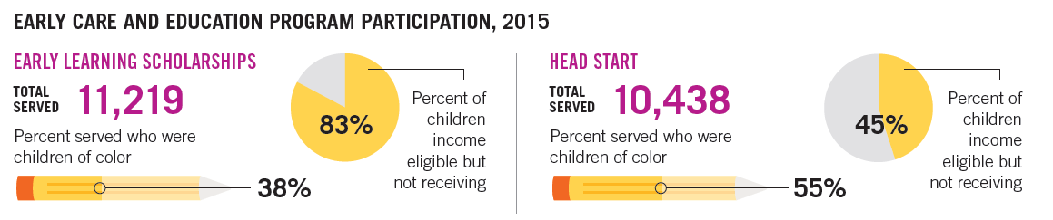

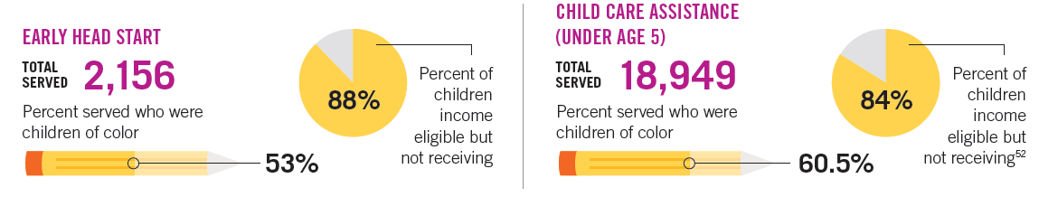
Program Access Data
16,531
10,803
54%
79%
66%
55%
3,098
17,540
91%
55%
72%

Slide 24

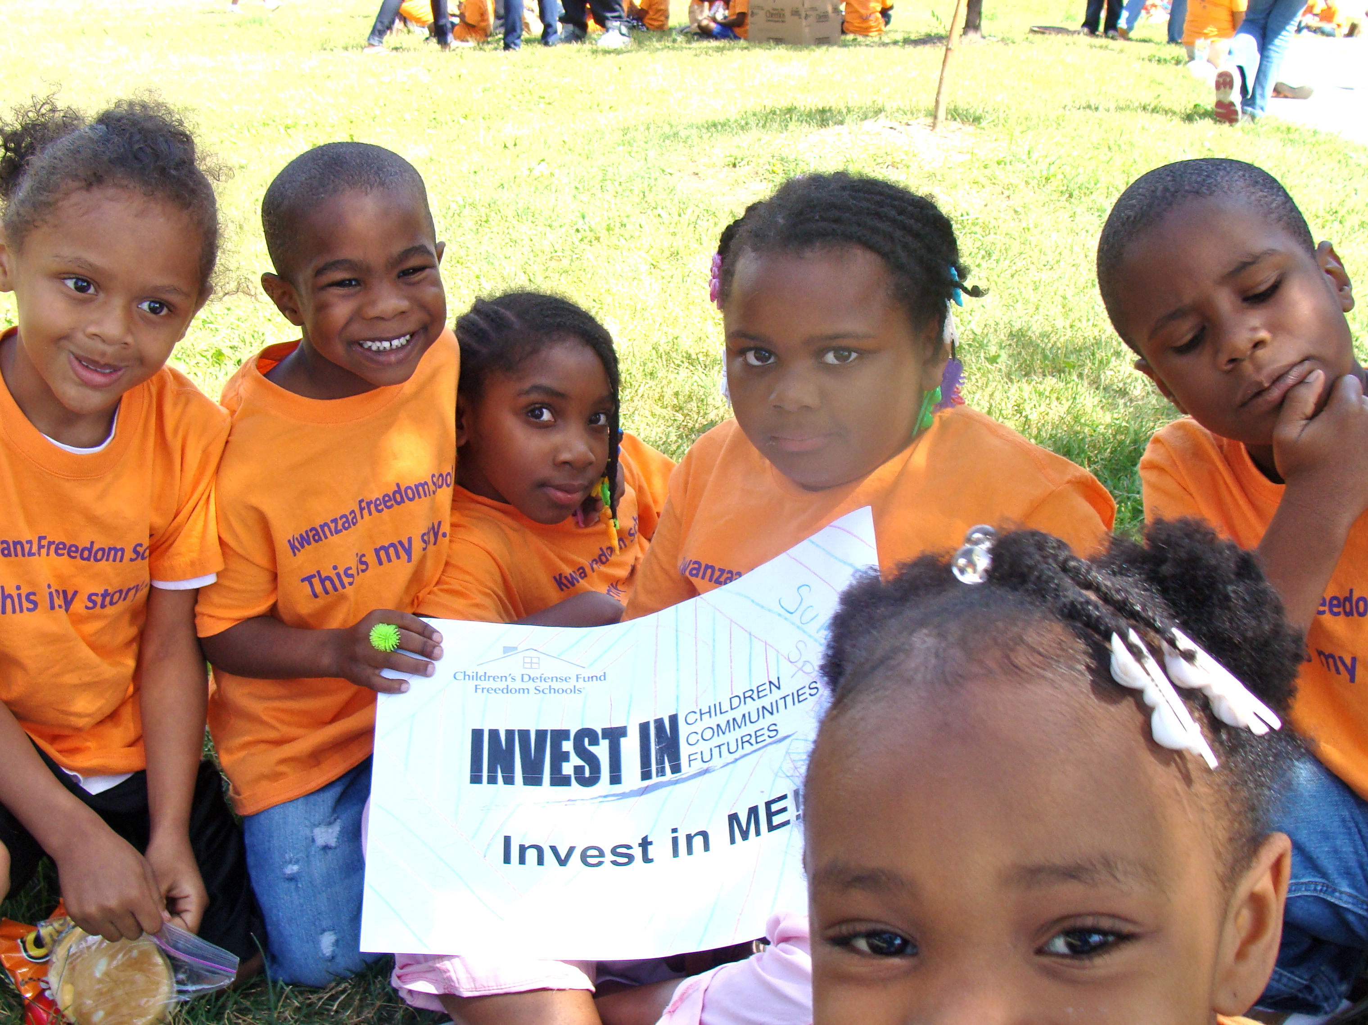
Questions?
Feel free to contact us with questions or data requests:
Jennifer Bertram Stephanie Hogenson
KIDS COUNT Coordinator Outreach Director
jbertram@childrensdefense.org shogenson@childrensdefense.org
651-855-1172 651-855-1175

