Slide 2
Context: The Landscape Affecting Homelessness
COVID, economic fallout, racial disparities, housing market..all factors
Growing Crisis:
Between Jan. 2016 and Jan. 2021, unsheltered homelessness increased by ~130% from 136 to 314 people.
1/27/21 point-in-time (PIT) count found 1,447 people experiencing homelessness in shelters or unsheltered, the highest # in the past 5 years.
Demand Exceeds Supply:
Gap of +15K housing units for those at or below 30% Area Median Income in Ramsey County in 2020
The 1,030 people entering over 12 months into transitional housing (96), rapid rehousing (313) or permanent supportive housing (621) is insufficient compared to Coordinated Entry (CE) waiting list with approximately 2,400 persons as of October 1, 2021.
Significant Disparities:
People who identify as African Americans make up 13% of Ramsey county’s population, 27% of county residents experiencing poverty, and 47% of the county’s homeless population in shelters or street outreach in 2021.
People who identify as American Indians were 14.5 times more likely to experience homelessness than White people in 2020. African Americans were eight times more likely and Latinx twice as likely compared to whites.
Sources: HHR Homeless Needs Assessment (2020); Ramsey County PIT Counts (2013-2018 and 2020); HHR Data Dashboard 2021

Slide 3
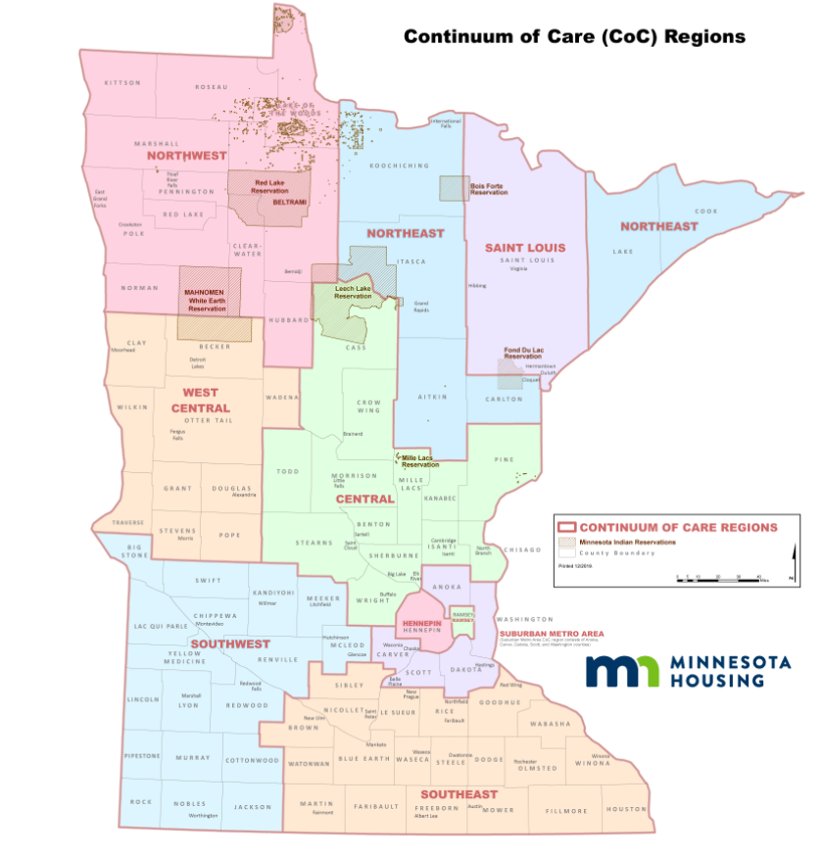
Minnesota has 10 CoCs

Slide 4
Heading Home Ramsey Continuum of Care (CoC)
Vision:
We work together to create a community where homelessness is rare, brief, and non-recurring, where we eliminate racial disparities, and everyone is housed.
Mission:
Prevent and end homelessness by delivering effective, people-centered, integrated responses that are racially equitable and driven by community voice, advocacy, and learning.

Slide 5
Ramsey County’s COVID Emergency Operations Aimed to:
Support shelter partners to depopulate shelters
Initially focused on those at greatest risk (elderly and medically fragile)
Support cities to minimize encampments and reduce number living on streets
Provide increased day spaces to help support people to come inside

Slide 6
Summary of County COVID Operations:
Total # single/adult beds added through RC-operated shelters: 509 at peak, currently 293
Isolation and Quarantine for exposed or ill within homeless population: 32 beds
Family shelter supports added: 100 beds
Day operations supports added: Freedom house
Monthly Operating Costs: ~$3 Million

Slide 7
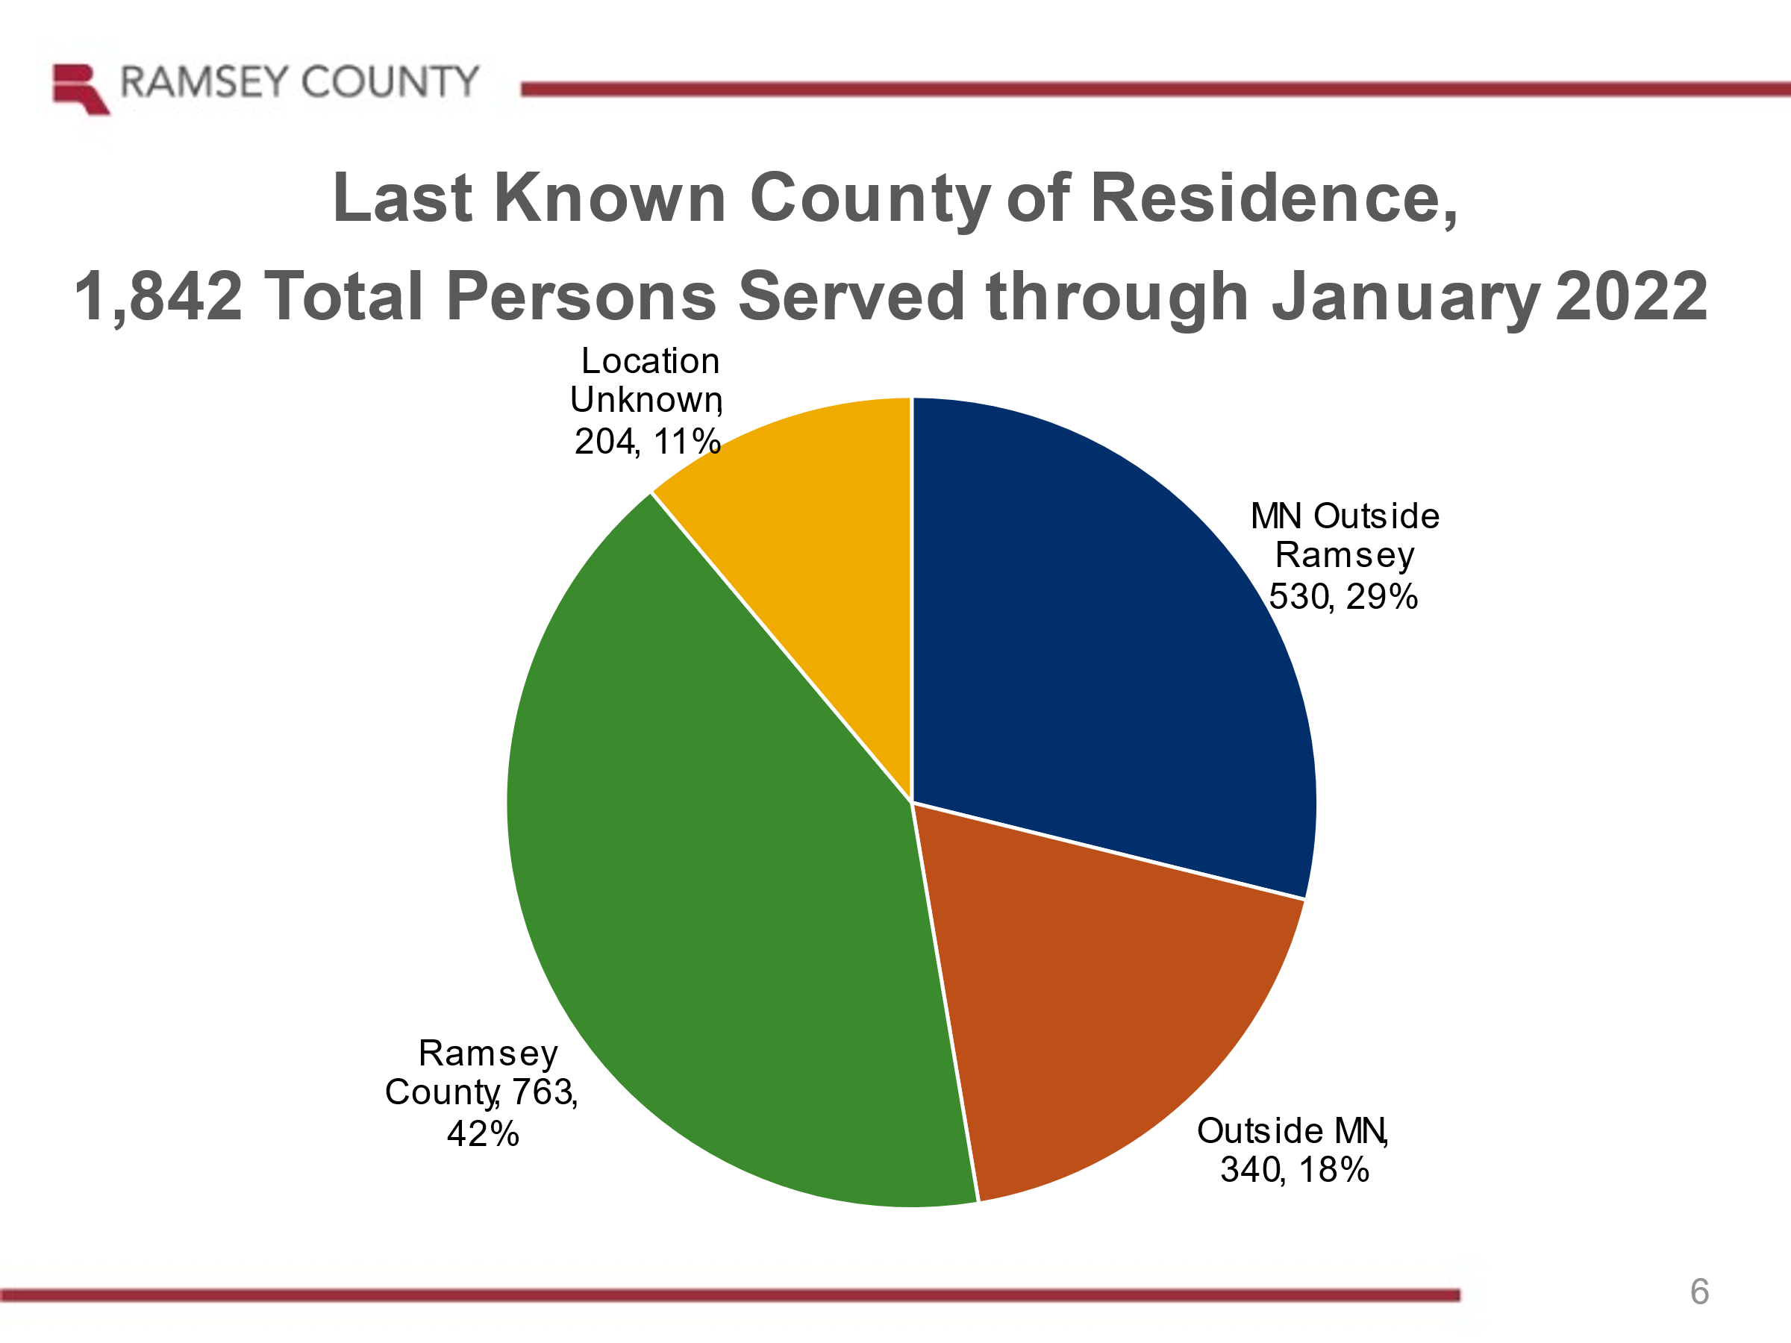

Slide 8
Charge to the CoC:
Help identify and develop community solutions to the needs of the Ramsey County homeless population given the loss of the Ramsey County Emergency Operated COVID Shelters and need to relocate 400+ individuals
CoC developed workgroups to assess:
The needs related to single adult emergency shelter after the depletion of the COVID emergency funds supporting this work
The need for families after the depletion of the COVID emergency funds supporting this work
4 Recommendations were developed by the workgroups, advanced to the Steering Committee, and adopted by the Governing Board

Slide 9
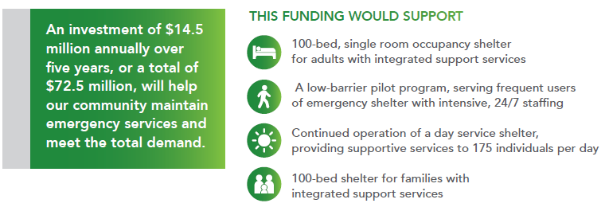
Advancing the ‘Big 4’ asks from the shelter workgroups

Slide 10
Cost Breakdowns
Request for 100 bed family shelter:
Services: $1.2M/yr
Lease: ~$600,000/yr
Admin costs 10% - = $200,000/yr
Annual Total: $2 million
Familiar Faces
Shelter staffing: $125K/yr
Services: $295K/yr
Security: 100K/yr
Housing navigation specialist support: 115k/yr
Food, cleaning, rent: TBD
Admin: 10%
Annual total: $2.5 million
Request for 100 bed single adult shelter with wrap around services:
Staff operation: $3.2M/yr
Mental and Chemical Health: $1.3M/yr
Housing navigation specialist support: $276,000/yr Food/logistics: $636,000/yr
Property Management (lease, security, janitorial, etc): $2.9M/yr
Admin costs 10% - = ~830,000k
Annual total: $9 million
Day shelter: $1 million annually

Slide 11
Governing Board members
Commissioner Jim McDonough, Ramsey County, Chair
Deputy Mayor Jaime Tincher, city of Saint Paul, Vice Chair
Mayor Marylee Abrams, city of Maplewood
Ling Becker, Workforce Solutions
Johanna Berg, Ramsey County
Tonya Brownlow, Emma Norton Services
Kizzy Downie, Model Cities
Angela Gauthier, Ain Dah Yung
Superintendent Joe Gothard, St. Paul Public Schools
Jon Gutzmann, St. Paul Public Housing
Dr. Eric Jolly, St. Paul & Minnesota Foundation
David Katzenmeyer, People, Inc.
Trisha Cummins-Kauffman, Solid Ground
Tiffany Scott Knox, St. Paul Promise Neighborhood
Ruby Lee, CLUES
Rebecca Noecker, Councilmember, City of St. Paul
Marika Reese, Ubuntu Care Services
Brooke Schultz, Radias Health
Deborah Smith, Project for Pride in Living
Terri Smith, Metropolitan Council
Lucy Zanders, Theresa Living Center
Otis Zanders, Ujamma Place

Slide 12
Steering Committee Members
Keith Allen, M Heath Fairview
Nikki Beasley, YWCA
Ricardo Cervantes, City of St. Paul
KaTina Cummings, Catholic Charities
Alexis Dauenhauer, American Indian Family Center
Sue Hackett, Aeon
Holly Henning, Ain dah Yung Center
Helene Freint, Health Care for Homeless
Nick Gisi, Union Gospel Mission
Nicolle Goodman, City of St. Paul
Andrea Hinderaker, Model Cities
Jacqueline Jones, Amherst H. Wilder Foundation
Keith Lattimore, Ramsey County, Chair
Faith Lofton, Ujamma Place
Richard McLemore II, McLemore Holdings & Consulting
Chris Michels, Catholic Charities
Dominic Mitchell, St. Paul Public Housing Agency
Jesse Mollner, St. Paul Police Department
Alan Ostergaard, Radias Health, Vice Chair
Maria Wetherall, Ramsey County

Slide 13
Community Outreach and Stabilization Unit (COAST)
Saint Paul Police Department
Community Advocacy Response Team (CARES)
Saint Paul Fire
Department
Homeless Assistance Response Team (HART)
Dept. of Safety and Inspections
Office of Neighborhood Safety
(ONS)
City Attorney Office
Collaborate with community partners and coordinate and city teams to have a trained, skilled, integrated, diverse response capability for 911 low-acuity or non-medical calls.
Address short-term needs through immediate stabilization
Identify and coordinate long-term solutions for residents in need
Increase safety and improve outcomes by assisting people living with or experiencing mental illness, chemical dependency, and/or homelessness
Support and encourage wellness while reducing the stigma related to mental illness, chemical dependency and homelessness

Slide 14
Questions?
CoC Staff Team:
Loni Aadalen, Ellen Watters, Mary Kay Bailey, Mark Herzfeld, Joseph Desenclos, Leigh Ann Ahmad, Maggie Dreon

