Slide 1
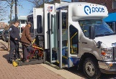
Program for All-Inclusive Care for the Elderly (PACE)
Saves Money
Addresses Social Determinants
Metro and
Outstate
PACE
Proven National Program
Underserved
Populations
Community-based
Care
Covid Reducing

