Slide 1


Protecting Patients with Chronic Pain:
Ensuring Health & Safety in Opioid
Prescribing and Deprescribing
Beth Darnall, PhD
Director, Stanford Pain Relief Innovations Lab
Associate Professor
Stanford University School of Medicine
Anesthesiology, Perioperative and Pain Medicine
Psychiatry and Behavioral Sciences (by courtesy)
Wu Tsai Neurosciences Institute (affiliated faculty)
@BethDarnall

Slide 2




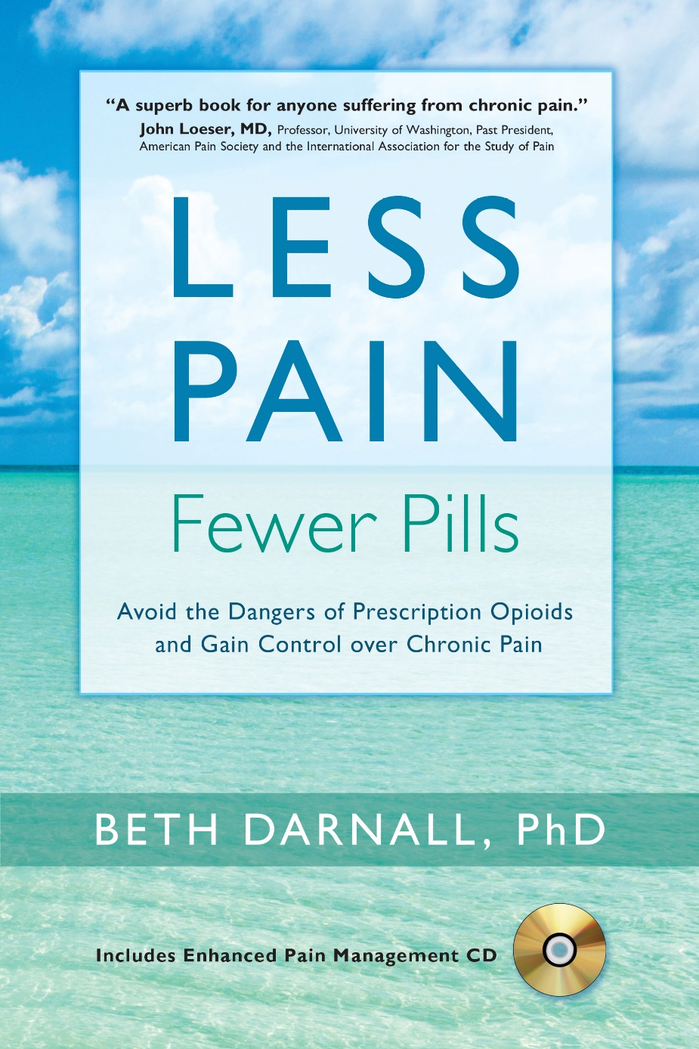
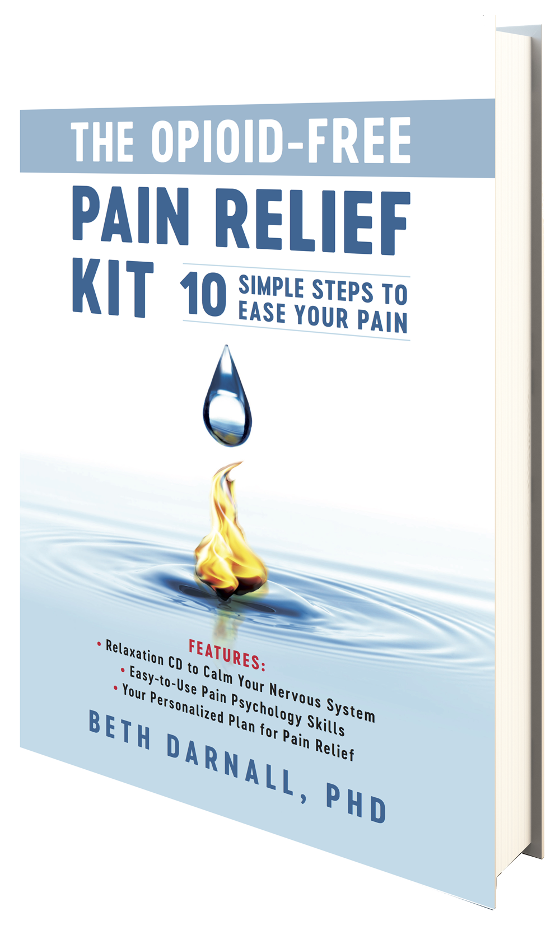
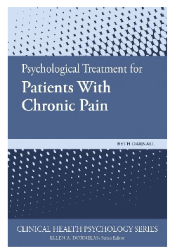


Contracts and Grants
Disclosures
Chief Science Advisor: AppliedVR
NIH / NIDA Brief digital treatment for chronic pain
PCORI Patient-Centered Opioid and Pain Reduction
NIH / NCCIH Behavioral Treatment for Chronic Pain
Board of Directors
American Academy of Pain Medicine
Institute for Brain Potential
Scientific Member
CDC Opioid Workgroup (2020-2021)
NIH Interagency Pain Research
Coordinating Committee (IPRCC)

Slide 3

2011 IOM Report: Relieving Pain in America
100 million adults
$635 billion annually
Erodes quality of life,
confers suffering

Slide 4
Long‐Term Use of Daily Prescription Opioids
3.4 % of US adults
11 million individuals
Notes:
By 2015
Being told that opioids will be reduced can induce Nocebo which undermines opioid analgesia precisely when opioid are being reduced.
Physiologic and neurobiological adaptations can occur from long-term opioid use
Some patients may be benefitting and require opioids. How do we discern? Data were lacking.

Slide 5

Patients taking long-term prescription
opioids require careful considerations
Reducing opioid doses creates new risks
Right methodology can be applied to
minimize iatrogenic risks from de-prescribing
Apply patient-centered principles
Credit: Celia Krampien
Notes:
Treat the person, not the pill

Slide 6
Growing Outcry Against Iatrogenic Opioid Reduction Risks and Harms
Nov 2018
Dec 2018
April 2019
April 2019
April 2019
International Stakeholder Letter publishes
Human Rights Watch
HP3 Letter
FDA
CDC
Darnall BD, Juurlink D, Kerns R, et al.
Reuters Wire service
>20 news outlets worldwide
Declares the issue a “human rights violation”
Laura Mills
Kertesz, Satel, et al.
300+ signatories
3 former U.S. Drug Czars
AMA signs support
Clarifies labeling and cautions against abrupt discontinuation
Dowell et al. Clarification of opioid prescribing guidelines publish in NEJM.
Notes:
POOR OUTCOMES FOR FORCED OPIOID TAPERING
We cannot be harming patients in the name of helping them.
How do we fix this?
Need better data on iatrogenic harms

Slide 7
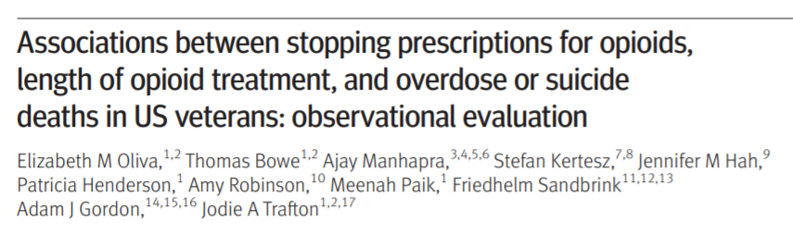
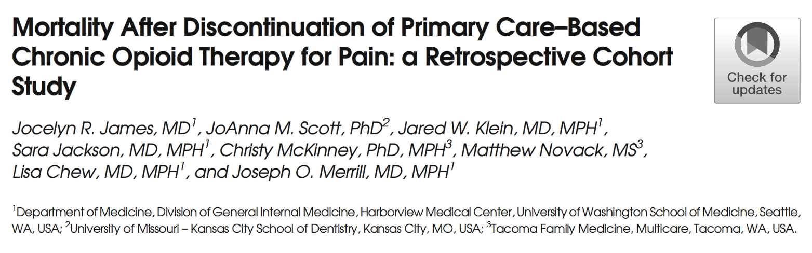
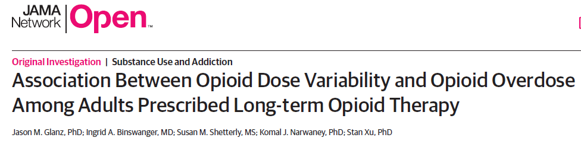

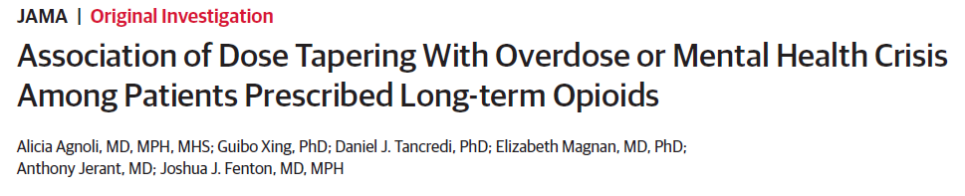
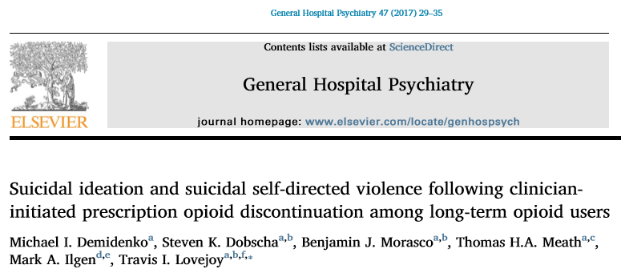
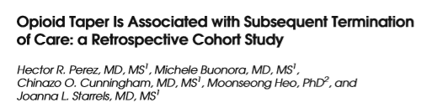
Notes:
Iatrogenic risks: abandonment, overdose, suicidal ideation, suicide.
Oliva and Trafton: 1.5M VA patients (2013-2014). Patient monitoring should be intensified for at least 3 months after starting opioids and changing doses.

Slide 8
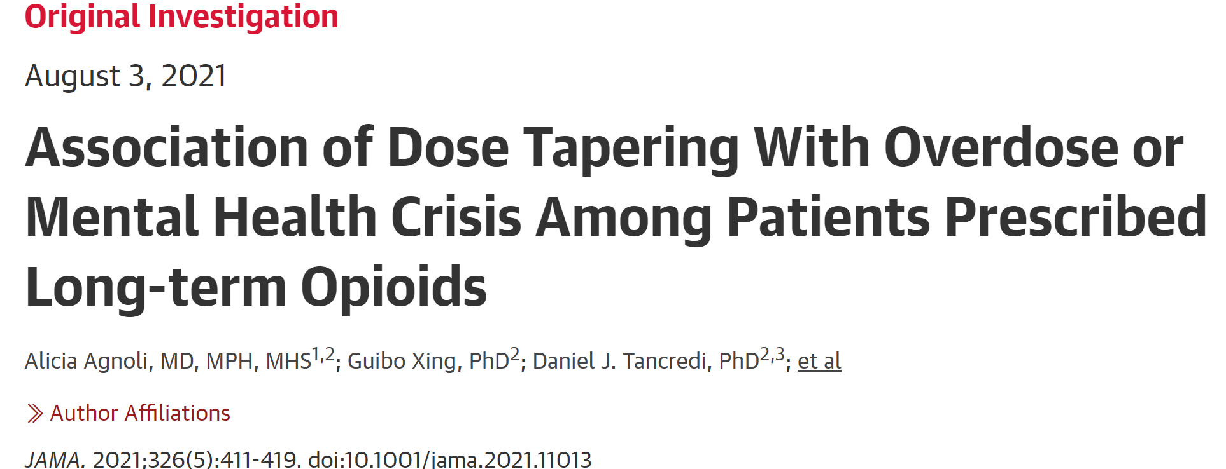
Notes:
CONCLUSIONS AND RELEVANCE Among patients prescribed stable, long-term, higher-dose
opioid therapy, tapering events were significantly associated with increased risk of overdose
and mental health crisis. Although these findings raise questions about potential harms of
tapering, interpretation is limited by the observational study design.

Slide 9
What we are getting wrong
Lack of patient-centered pain care
Systems that do not collect patient reported data
One-size-fits-all approaches
Lack of flexible policies that support clinicians and patients
Lack of meaningful access to comprehensive pain care
Failure to implement tapers properly and maintain flexibility based on patient response to taper
Notes:
This is what happens when we treat a pill, not the person
And now, an overfocus on yet another pill, buprenorphine, for pain treatment!

Slide 10
Tapering the wrong way
Withdrawal Symptoms
Discomfort
Distress
Failed tapers
False belief that outpatient tapering
is impossible
Remaining on high doses
Overdose
Suicidal ideation
Suicide
Aggressive
Taper
Forced
Taper

Slide 11
Treat the person, not the pill
Notes:
This is the first thing we are getting wrong.
Policies at the state-level and in healthcare organizations.
The original 2016 opioid prescribing guidelines were meant to guide PCPs on new opioids starts, NOT DEPRESCRIBING

Slide 12
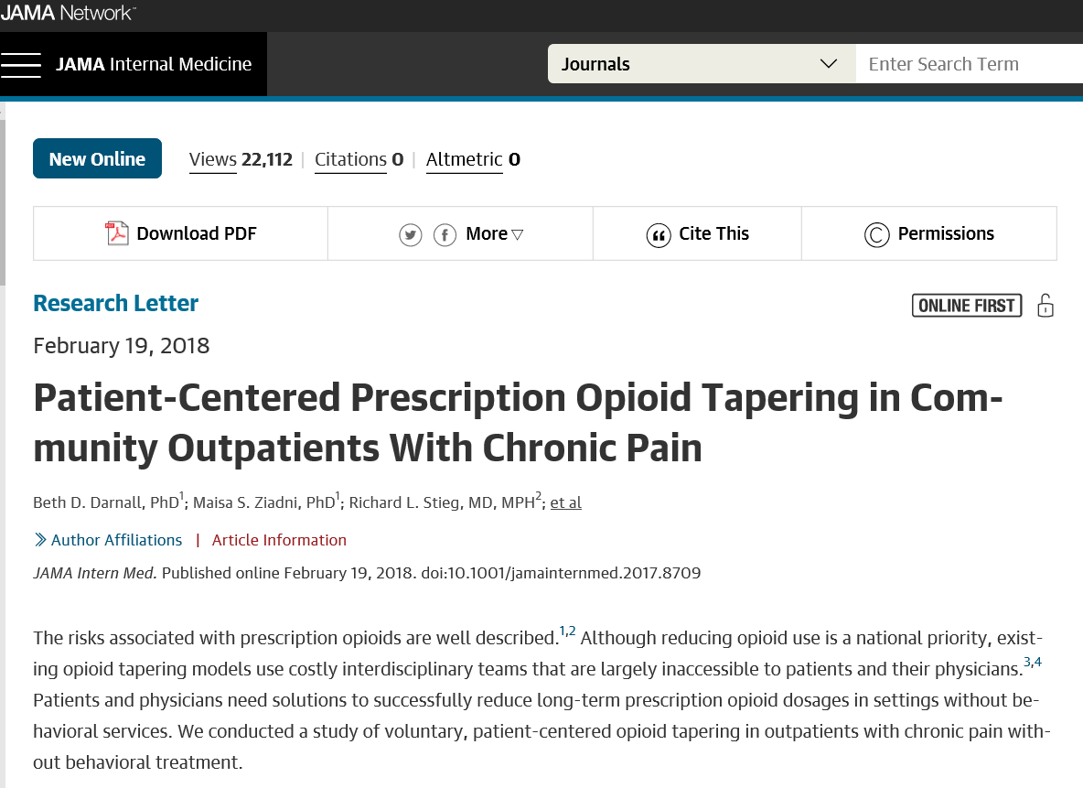

Slide 13
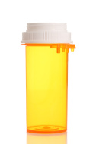

Opioid Cessation vs. Opioid Reduction
VS.

Slide 14
We Optimized Patient Choice and Control in Their Taper
Participation was VOLUNTARY
Patients could control the pace of their taper
Patients could pause their taper
Patients were free to drop out of the study at any time
The taper was NOT to a pre-defined opioid dose unless patient chose it
Patients partnered with their doctor to achieve their lowest comfortable dose over 4 months
The taper was NOT unidirectional

Slide 15
Study Variables
Demographics (Gender, Age)
Pain Treatment History (Pain Dx, Duration of Opioid Use)
Opioid Dose (MEDD)
Average Pain Intensity (0-10)
Pain Catastrophizing Scale
PROMIS Measures
Marijuana use (Y/N)
16 Weeks

Slide 16
Sample Characteristics (N=51)
55% female
52 years of age (range = 25 – 72)
6 years on opioids (range = 1 – 38)
Moderate pain intensity
Marijuana: 37% (18)
Opioid MEDD = 288 (60, 1005)
Darnall BD, Ziadni MS, Mackey IG, Kao MC, Flood P (FEB 2018; JAMA Int Med)
Notes:
Median values (IQRs omitted for brevity)

Slide 17
 | Baseline | 16 weeks
Variable | Median (IQR) |  | P-val
Opioid Dose (MEDD) | 288 (153, 587) | 150 (54, 248) | 0.002
Pain Intensity (NRS) | 5.0 (3.0, 7.0) | 4.5 (3.0, 7.0) | 0.29
PCS (catastrophizing) | 22 (10, 30) | 15 (7, 23) | 0.04
Fatigue | 61 (54, 65) | 59 (51, 65) | 0.64
Anxiety | 60 (53, 64) | 54 (46, 62) | 0.06
Depression | 56 (49, 64) | 55 (48, 61) | 0.31
Sleep Disturbance | 59 (54, 70) | 56 (50, 64) | 0.13
Pain Interference | 63 (58, 67) | 63 (57, 67) | 0.44
Pain Behavior | 60 (57, 63) | 59 (56, 64) | 0.47
Physical Function | 39 (34, 41) | 39 (34, 43) | 0.78
Kruskal-Wallis rank sum test
Notes:
Minimal missing data;
With minimal resources, the opioid taper was successful

Slide 18
Notes:
Even people on high dose opioids were able to reduce substantially in 16 weeks

Slide 19
Notes:
Pain did not worsen with opioid taper (though 10-15% of sample did have increase)

Slide 20
Notes:
Pain did not worsen with opioid taper (though 10-15% of sample did have increase)
We don’t treat averages. And we don’t treat opioid doses. We treat people.

Slide 21
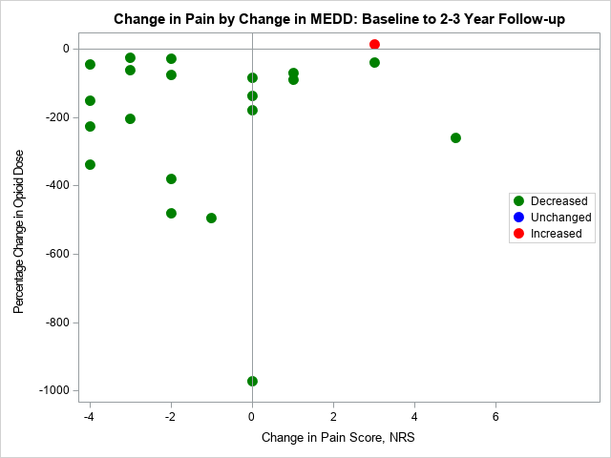
Ziadni MS, Chen A, Krishnamurthy P, Flood P, Stieg RL, Darnall BD. Patient-Centered Prescription Opioid Tapering in Community Outpatients with Chronic Pain: 2- to 3-year follow-up in a subset of patients. PAIN Reports®: September/October 2020 - Volume 5 - Issue 5 - p e851

Slide 22
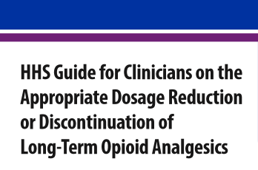
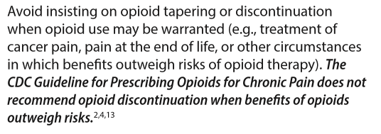
October 2019
Notes:
October 2019.
This is terrific.
One step further would be to require PRO data as a critical metric.
Remains a persistent omission

Slide 23

Comparative Effectiveness of Pain Cognitive Behavioral Therapy and Chronic Pain Self-Management Within the Context of Voluntary Opioid Reduction
Darnall BD (PI)
https://empower.stanford.edu/
Funded by the Patient-Centered Outcomes Research Institute®
Notes:
“PSYCHOLOGICALLY – INFORMED patient centered opioid reduction
*** voluntary ***

Slide 24

Pragmatic
We are directly influencing clinical care
Notes:
2016 created study design

Slide 25
Surveyed 250 patients taking opioids on preferences:
Patients wanted the choice to taper or not (voluntary)
More willing to be randomized to behavioral treatment or not
Patients chose co-primary outcomes: Pain & Opioid Dose at 1 year
Notes:
Asked about interest in opioid reduction & under what circumstances

Slide 26
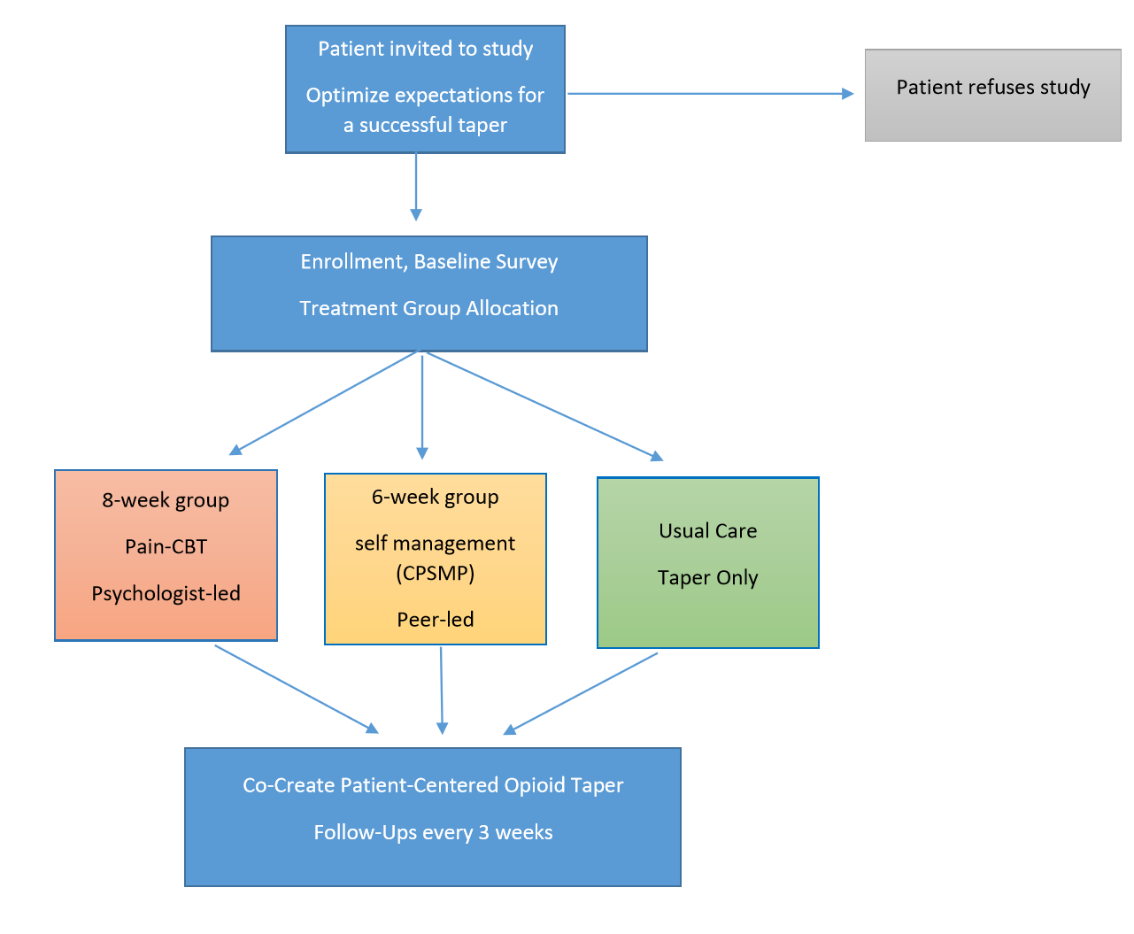
Comparative Effectiveness of Pain Cognitive Behavioral Therapy and Chronic Pain Self-Management Within the Context of Voluntary Opioid Reduction
Patients partner with their doctor to achieve their lowest comfortable dose over 12 mos
We exclude for moderate OUD*
Darnall BD et al. Pain Med. 2019 (study protocol paper)
*You DS et al. Brief Screening Tool for Opioid Use Disorder: EMPOWER Study Consensus Protocol. Front. Med. 2021

Slide 27

1365 patients taking long-term opioids for chronic pain
Stanford Pain Management Center (CA)
Stanford Primary Care (CA)
Kaiser Permanente (Oakland, CA)
Intermountain Health (Utah)
Veterans Affairs (Phoenix, AZ)
MedNOW Clinics (Denver, CO)
Lehigh Valley Health Care (Allentown, PA)
Notes:
Pragmatic trial, embedded into clinics, we carefully vet for suitability for tapering and monitor very closely for symptoms and problems.
low (10-49 MEDD)
moderate (50-89 MEDD)
high (90-199 MEDD)
super high (>200 MEDD)

Slide 28


Slide 29

We must create a caring and safe system that makes patients want to join and remain in EMPOWER
Notes:
13 members of the research team have lived experience with chronic pain and several with opioid use

Slide 30
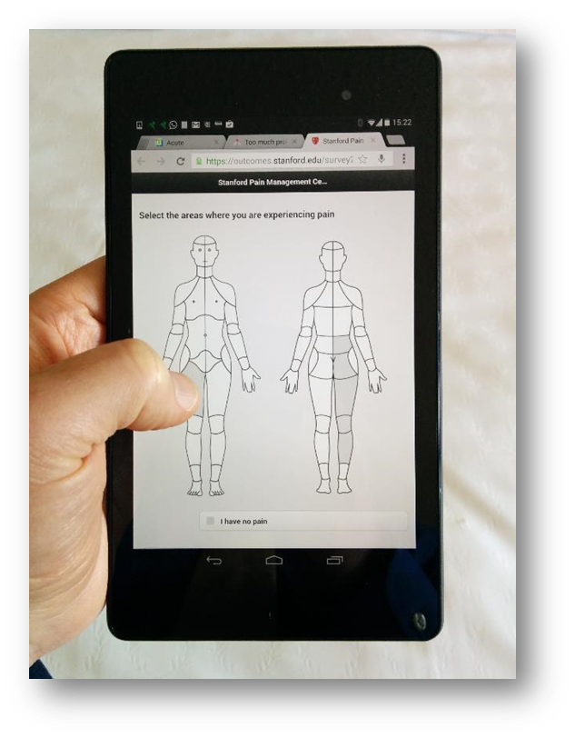
Assessments & Monitoring
Baseline, 6- and 12-month: comprehensive battery
Psychosocial factors (PROMIS)
Opioids
Substance use
Degree of choice
Readiness to taper
Taper beliefs
Satisfaction with clinician relationship
**Comments**
WEEKLY surveys for withdrawal symptoms, mood, comments
MONTHLY surveys for mood, suicidality, opioid dose, satisfaction, comments
Notes:
CHOICE and READINESS TO TAPER
Patients are seen in clinic every 3-4 weeks for follow-up
If they are assigned to groups they receive 6-8 weeks of weekly behavioral treatment

Slide 31
Close Monitoring of Patient Response to Opioid Reduction
WEEKLY surveys for withdrawal symptoms, mood, comments
MONTHLY surveys for mood, suicidality, opioid dose, satisfaction, comments
Alerts are sent to prescribers in real time
Patients receive tailored messages
We track patients over 12 months
Notes:
Alerts are sent in real time
PATIENTS GET BETTER CARE IN EMPOWER THAN OTHERWISE

Slide 32
In 2019 HHS called for patient centered voluntary tapering practices as a priority
HHS also called for patient support during tapering
Multiple groups have called for close and extended patient monitoring (home-based e-reports) to assure patient safety
We offer MN all of our established systems at no cost:
EMPOWER study methods
Patient e-reporting system
Single-session, 2-hour, online pain management skills class to support those who wish to reduce prescription opioids.

Slide 33
Opioid tapering is NOT right for all patients
Apply patient-centered principles
Policies MUST reflect patient variability and protect prescribing for patients who need opioid medication
Opioid reduction INCREASES health risks unless right methods are used
Monitor closely during tapering, patient response should inform the next steps
Notes:
Care centers on the patients needs and wants

Slide 34

Colleagues and Collaborators
Kate Lorig, PhD
Wendy Schadle
Anu Roy, MA
Lu Tian, PhD
Joel Porter, MD
Penney Cowan
Garrick Olsen, PhD
Laura Garcia, PhD
Ashley Gomez
Sara Davin, PsyD
Maisa Ziadni, PhD
Pamela Flood, MD
Heather King, PhD
Sophia You, PhD
Corinne Jung, PhD
Kristen Slater, PsyD
Todd Maddox, PhD
Josh Sackman, MBA
Brandon Birckhead, MD
Sean Mackey, MD, PhD
Partha Krishnamurthy, PhD
Jesmin Ram, BS
Lanja Sinjary, BS
Regina Visca, MA
Ming-Chih Kao, PhD, MD
Ian Mackey, BA
Ming-Chih Kao, PhD, MD
Rob Louis, MD

Slide 35

