Slide 1
2022 Year in Review
Minnesota House of Representatives Agriculture Finance and Policy Committee
AURI’s Role and Impact
Minnesota’s Agriculture Industry &
Innovation Ecosystem

Slide 2


Statewide Locations and Staffing
35 full and part time staff
Auri.org/staff
Crookston
Administrative Office
11 directors – producer
councils, grower orgs,
agribusiness, legislature,
at-large
Metro
UMN St. Paul
Marshall
Meat and Food lab
Biobased and Renewable Energy
Analytical
Product Evaluation/Sensory
Waseca
Coproducts lab and annex site

Slide 3
Client Project Locations
10 Year Totals
July 2012 through June 2022
AURI also conducts several statewide public good initiatives each year

Slide 4
FY22 Activity At a Glance

Slide 5
AURI Programs
Commercialization Services
Public Research Initiatives
AURI Connects
Entrepreneur in Residence

Slide 6




Active Support Area
Vibrant Food Ecosystem
Diverse Clients
Small Meat Processors
Finance
Needs Assessment
Resource Map
Initiatives
Wheat FODMAP Project
MN Wild Rice Protein
Commercial Kitchens
Bold Growth
Business Development
AURI Connects
Food
Technical assistance
Shelf Life
Nutrition Labels
Product Evaluation
Sourcing
Product Development
Process Development

Slide 7

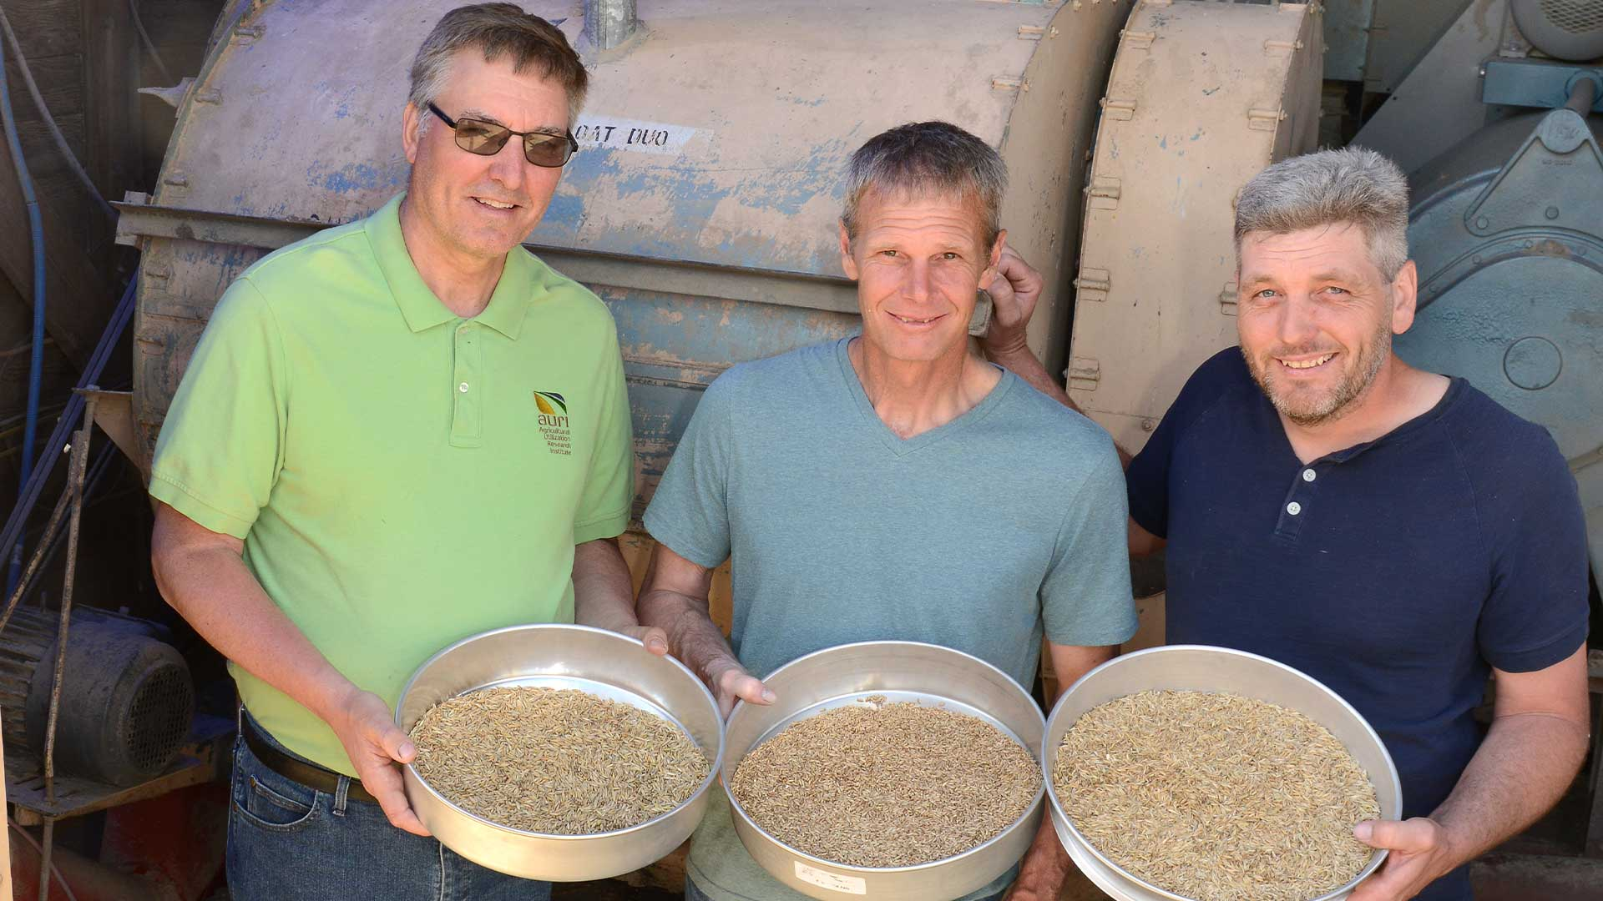
Coproducts
Circular Approaches
Food, Feed, Fuel, Fertilizer
Technical Assistance
Dewatering
Drying
Densification/Pelleting
Product Development
Process Development
Nutrient Analysis
Hemp decorticator
Oilseed pressing
Business Development
AURI Connects
Anaerobic Digestion

Slide 8

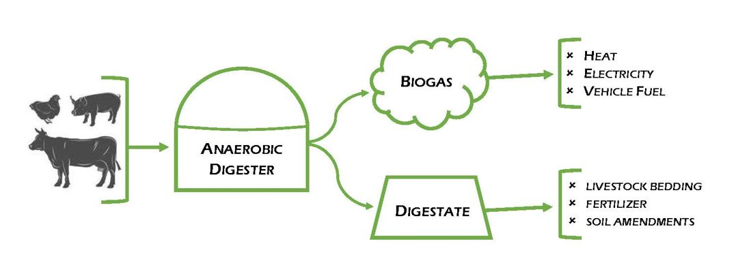

Renewable Energy
Biomass Derived Renewable Fuels
Ethanol, Biodiesel, Renewable Diesel, Renewable Natural Gas
Initiatives
Hydrogen / Green Ammonia
Renewable Natural Gas / Anaerobic Digestion
Technical Assistance
Business Development
AURI Connects
Carbon Intensity Scores

Slide 9
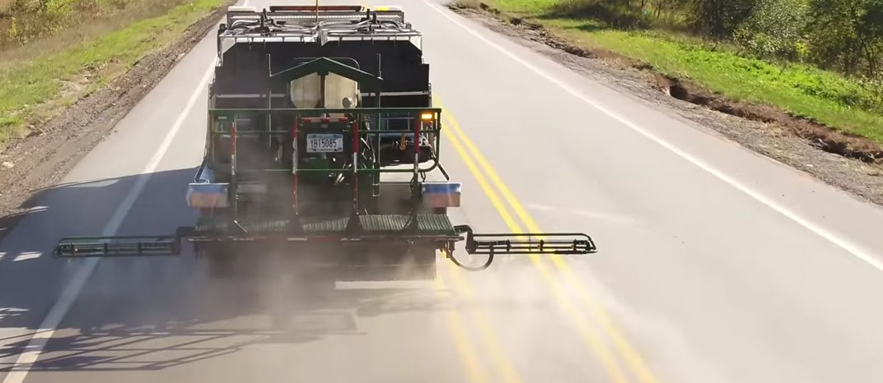
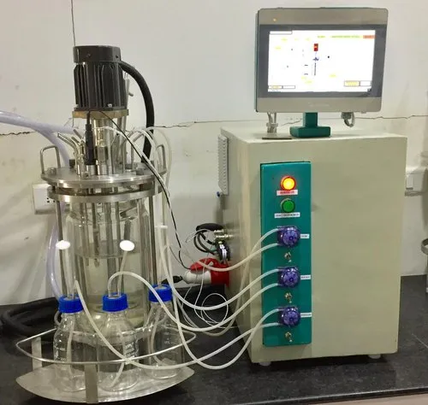
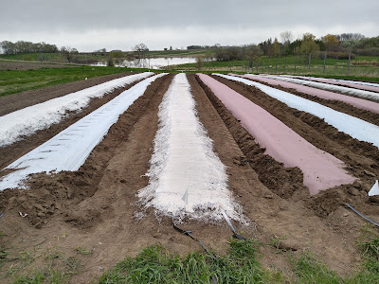
Biobased
Replacing Petroleum Products
Technical Assistance
Feasibility Analysis
Market Awareness
Technical Insight
Product Development
Fermentation
Initiatives
Erosion Control Road Mats
Road Preservation/Dust
Business Development
AURI Connects

Slide 10



Thought Leaders
Fields of Innovation
Webinar Wednesday
Renewable Energy Roundtable
New Uses Forum

Slide 11
Research Initiatives and Public Events
Examples
MN Renewable Energy Roundtable
Product Shelf Life
Nutrient Recycling for Crop Production
Technical Assistance Provider – Meat
Opportunities and Challenges in MN’s Aquaculture Industry
Green Ammonia’s Future
Comanufacturing Assessment
E-commerce and Digital Marketing
Commercial Kitchen Feasibility
Controlled Environment Agriculture
Life Cycle Analysis
Forever Green collaboration
Hempcrete Demonstration
Tofu/Okara report*
Cultivated Wild Rice report*
Wheat FODMAP/ATI report *
Cash cover crop market opportunities*
Exploring Food and Fiber Market Opportunities for MN’s Hemp Supply Chain
Paving the Way for Ag-Based Asphalt Preservation Solutions

Slide 12
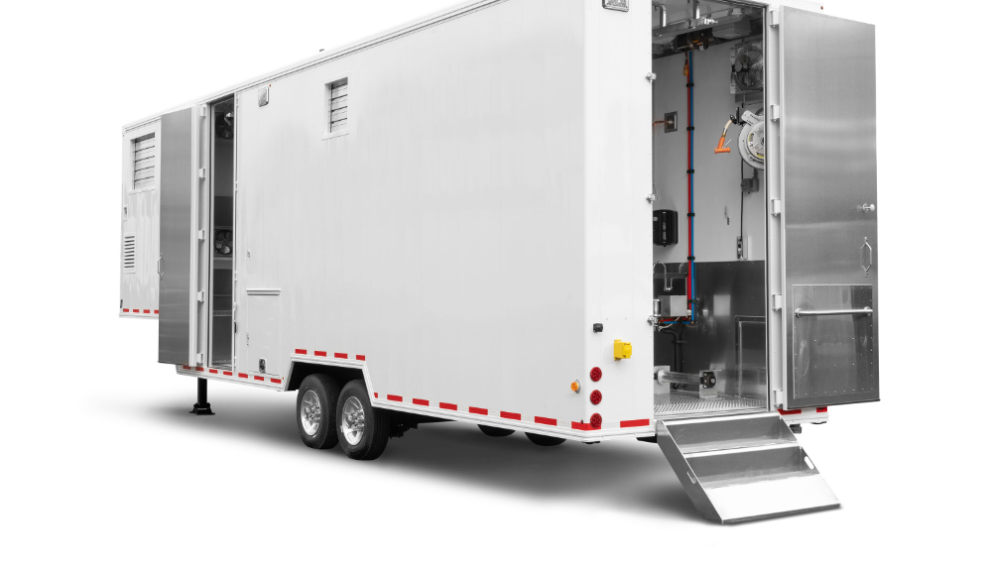
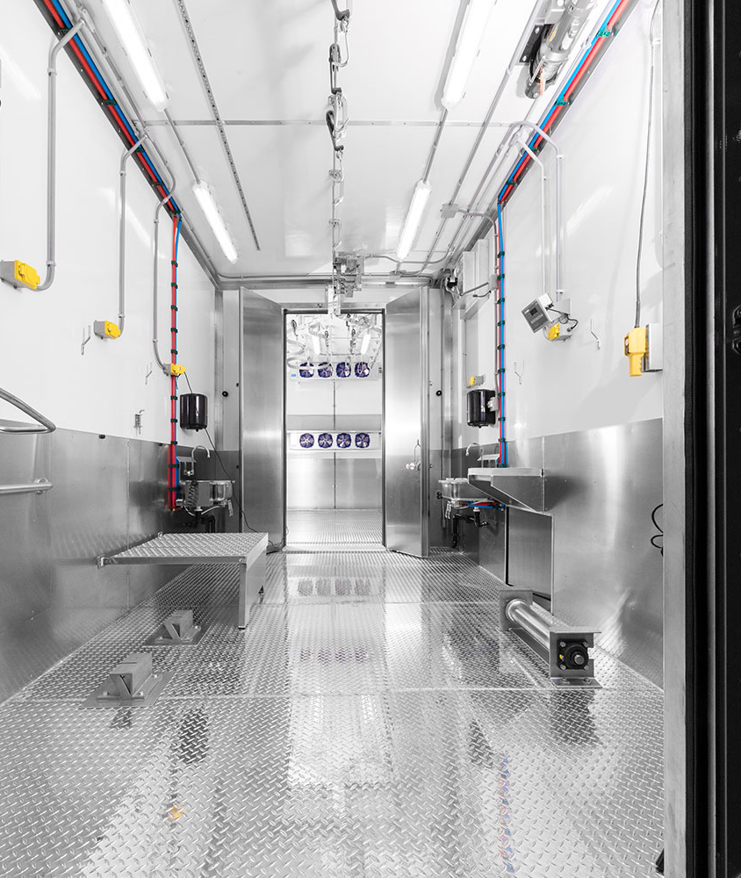
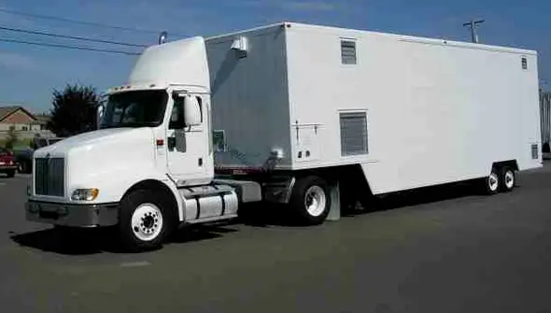
Meat / Livestock Initiative
Mobile meat slaughter grant
Designated meat science funding
Clay Newton, Meat Scientist
Laura Bachmeier, Business Development for Meat
USDA/AMS cooperative agreements
Regional & national efforts
Tech/Biz assistance

Slide 13
New Resources
Equipment and People
Fermenters and Sterilizer
2 Meat Scientists
1 Program Manager for Meat work
Anerobic Digestion Pilot Size Equipment

Slide 14
Looking Forward – Gaps and Opportunities
Equipment gaps – cross functional support for analytics & process
Renewable natural gas and anaerobic digestion potential
Small foods & cottage food industry business support
Sustainable proteins – traditional and novel/alt proteins
Comanufacturing / commercial kitchen needs
Hydrogen / green ammonia – fuels, fertilizer, etc.
Bioindustrial processing & fermentation

Slide 15
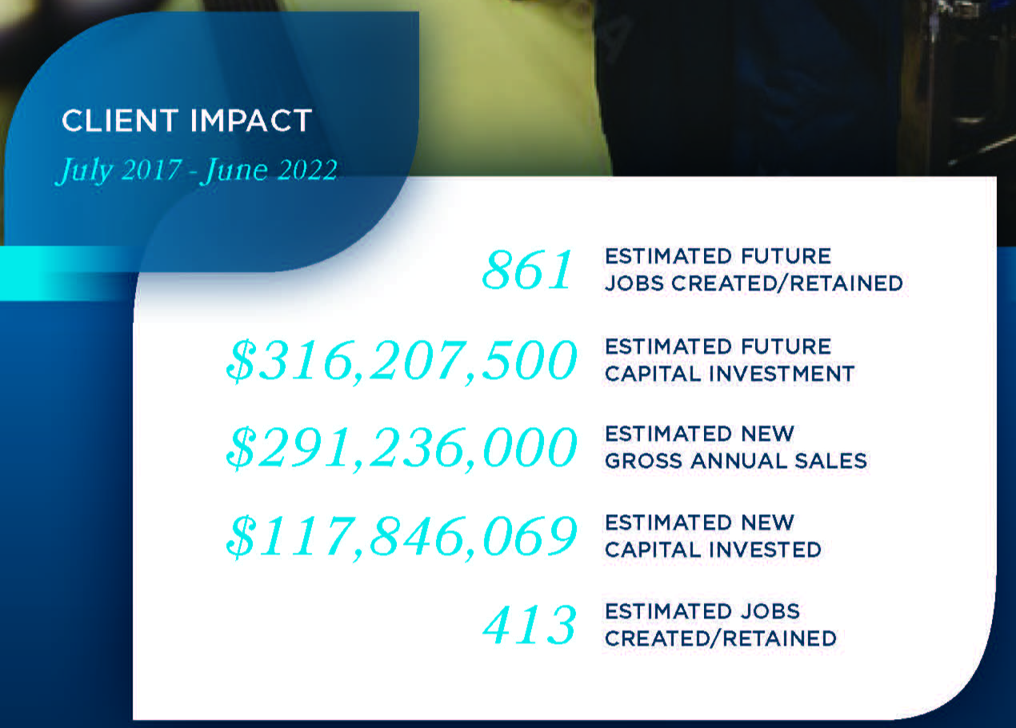
5 Year Totals
July 2017
through
June 2022

Slide 16
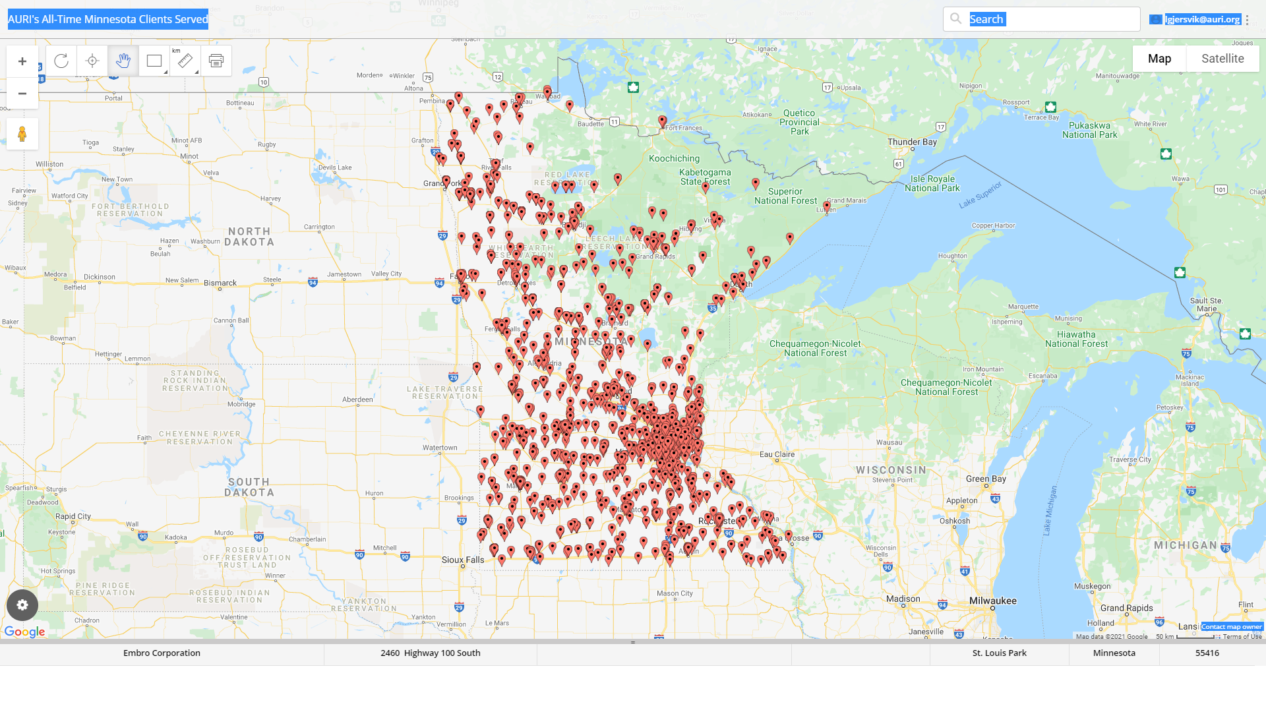
Great state for ag and food innovation…
Historical AURI
Client Projects
*1989 to current
MN Legislature Partnership

