Slide 2
Building HOPE Project
Youth homelessness is REAL.
HOPE 4 Youth has continually expanded to meet the needs of young people experiencing homelessness in Anoka County, but we’ve outgrown our footprint. We’re ready to do more in a facility built with an eye to the future.
The Building HOPE Project will allow us to share our successful programs with even more 16- to 24-year-olds who find themselves experiencing homelessness.

Slide 3
OUR MISSION
To provide pathways to end youth homelessness
OUR VISION
All youth will feel safe, valued, and supported while reaching their full potential. This begins with meeting their basic needs and leads to giving them the tools to thrive.
OUR STRATEGIC PRIORITIES
Deepen our impact through high quality, high-impact programs and services
Create a diverse, equitable, and inclusive organization
Strengthen business practices to support high performance
OPERATIONAL FACILITIES
Drop-In Center
HOPE Place

Slide 4
2021 Drop-In Center Impact
314 youth served, 45% Increase in visit over 2020
61% Anoka Cty * 19% Hennepin Cty * 13% Ramsey Cty * 7% Other Cty
Youth Demographics
20% Under 18
20% Young parents
58% BIPOC
56% Female
42% Male
2% Nonbinary
19% LGBTQ
Services and Support
200 youth helped through 1,100 hours of case management
1,450 Meals served
1,422 Grab-and-go food/hygiene
840 Visits to clothing closet
250 hours of internet access
162 On-site partner services
350 Referrals to outside agencies

Slide 5
Our Approach
The young people we see at HOPE 4 Youth carry many burdens. We recognize that every young person is on their own journey — no two stories are the same. We are one touchpoint on their journey. As such, we have a four-fold approach when walking alongside youth. 1
Trauma-Informed Care (TIC)
Strengths-Based
Client-Centered
Harm Reduction
1 - Informed by “Measuring Up: Youth-level Outcomes and Measures for Systems Response to Youth Homeless- ness” from the University of Chicago, and the 2014 publication “9 Evidence-Based Principles to Help Youth Overcome Homelessness.

Slide 6
HOPE 4 Youth FUTURE
Our ability to support even more young people with our proven strategies is constrained only by an existing rental facility with no capacity for expansion.
A new center would also expand access to our life-changing services that
focus on creating:
 Ongoing basic-needs support
 Stable housing
 Employment
Education
Healthy connections
Social and emotional
well-being

Slide 7
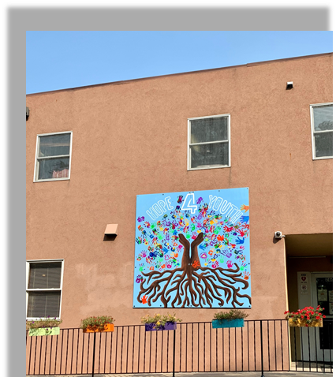
Building HOPE Vision
Located in Anoka County
10,000-15,000 Square Foot facility
Primary site of Drop-in Center
Primary site of Administrative office
Expansion in partner collaboration and youth engagement
Site – on public transportation
Expansion for growth in future years
$8M purchase and renovation

Slide 8
Story of SUCCESS

Slide 9
Building HOPE Project
Questions?

