Slide 1
WELCOME TO LUMEN
THE PLATFORM FOR AMAZING THINGS

Slide 2
We are all Lumen
Under the Lumen name, our teams support multiple brands
Lumen: All products & services for Enterprise Market
Enterprise
Mass Markets
Quantum Fiber: Fiber-based services to Mass Markets (home and small business)
Fiber-fed homes
and small
businesses​
CenturyLink: Copper-based services to Mass Markets (home and small business)
Copper-fed homes and small businesses
fiber
copper

Slide 3
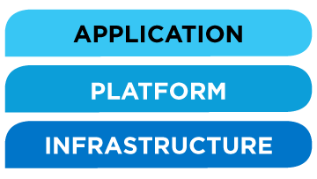
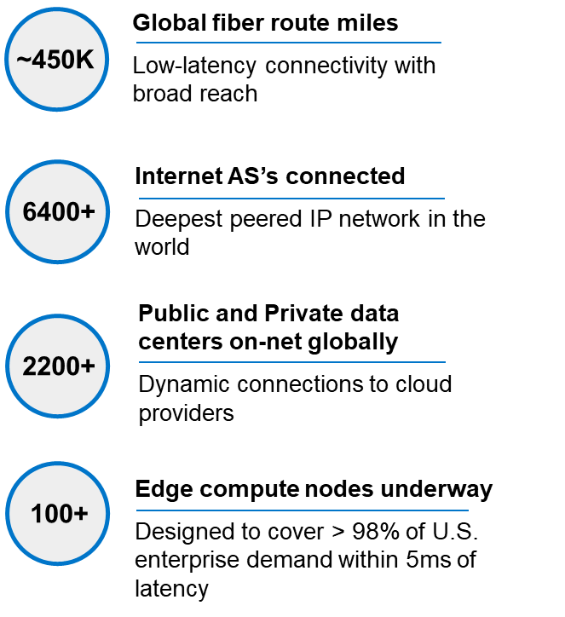
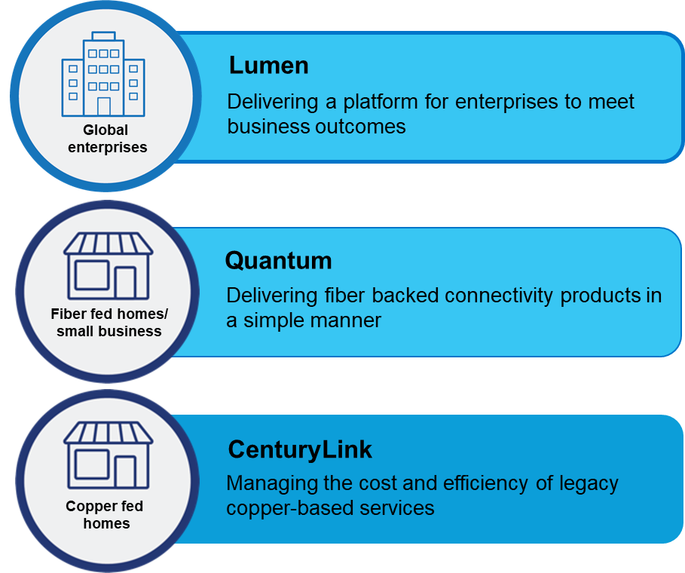
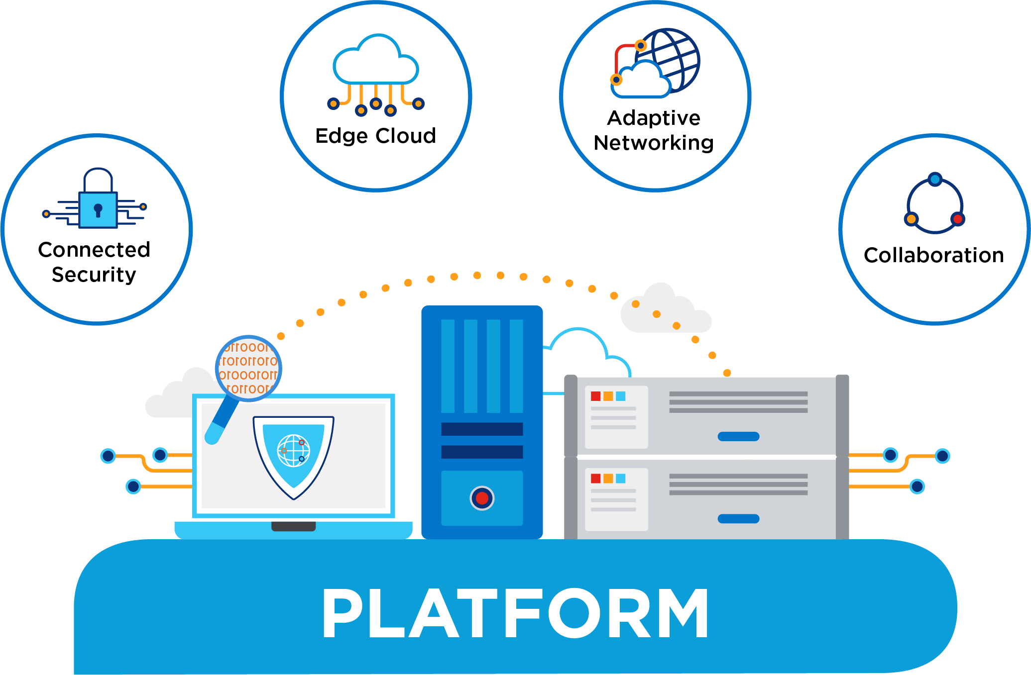
Lumen: The Platform for Amazing Things
Furthering human progress through technology
The fastest, most secure platform for next-gen apps & data
Architecture designed for the needs of the 4th Industrial Revolution
A house of brands built around market demand and customer success
3

Slide 4
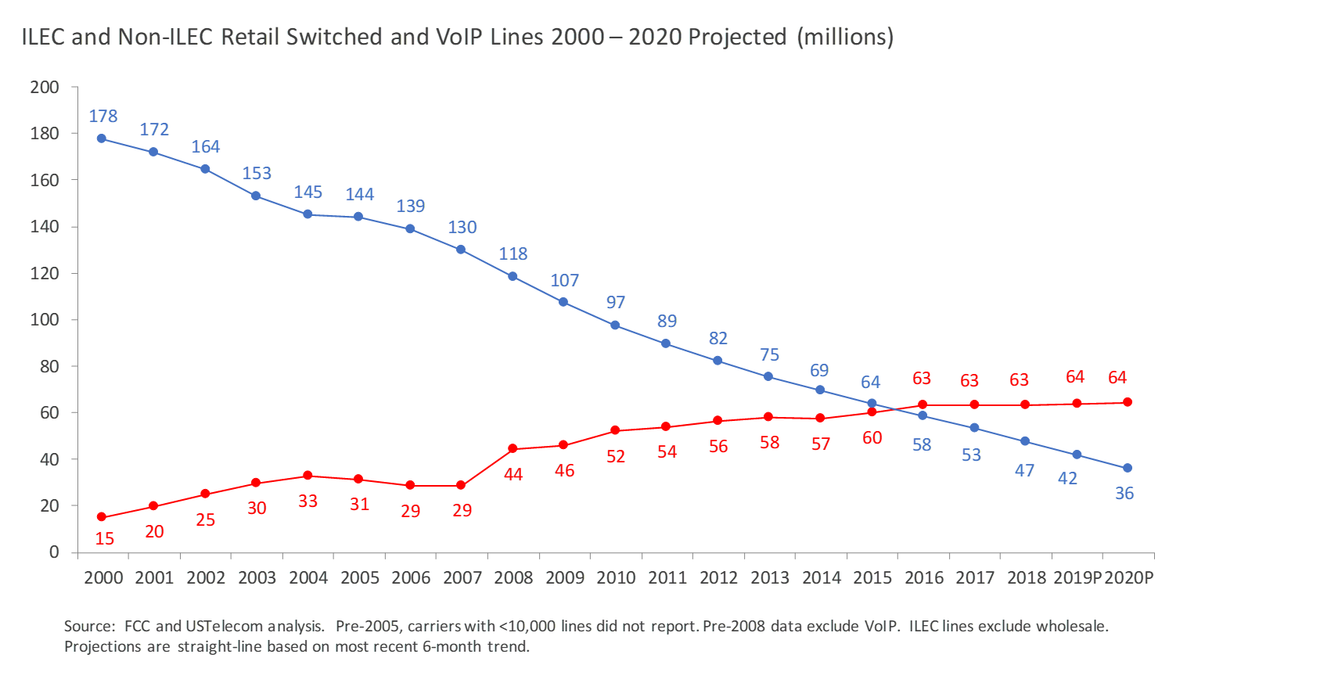
Marketplace Challenges
Nationally, Competitive Local Exchange Carriers(CLEC) surpassed Incumbent Local Exchange Carriers (ILEC) in wired voice service 5 years ago​
Here in Minnesota, Lumen has lost 77% of it’s plain old telephone (POTS) lines in MN – loss continues at rate of 10-15%/year
Latest CDC from 2018 data shows only 4.4% of Minnesotans are wireline only – pandemic accelerated that decline
Last round of MN BB Grants didn’t go to anyone offering speeds less than 100/40 – you cannot deliver this on copper
ILEC voice decline​
Competitive Wired Voice Growth

Slide 5
Public Policy Priorities Broadband Investment
Consumer Driven Policies
Equity in Available Technologies
Lumen’s Footprint in Minnesota:
Nearly 2,000 employees – over half of them members of the CWA
Invested $200M in broadband in the last three years
While we continue to stay competitive in broadband, we lost 15.8% of voice customers in 2020
Ongoing investment in broadband will be primarily in fiber through
Technology transition from legacy copper
Partnerships with federal, state, and local governments
We are asking for modifications to 237.025 Competitive Market Regulation to recognize the following:
Modernization of Minnesota’s 106-year-old telecom statute will not only help Lumen maximize our investment in Minnesota’s – it will also help maximize the state’s broadband ecosystem
A copper-switched wireline isn’t the only way to reach 911, and competition for voice services in Minnesota are ubiquitous
Current State and Federal subsidies being appropriated for broadband – incumbent voice providers no longer have ability to capture rate of return
We cannot collectively close the digital divide in Minnesota if 20th century statutes aren’t changed to recognize 21st century voice technology
FCC petition process for discontinuance is the backstop – requires prior federal approval to exit the market and continues to hold public harmless

