Slide 1
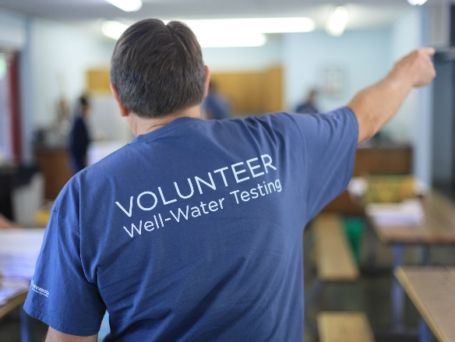
Safe Drinking Water: Voluntary Testing of private-well water in Minnesota
Jeff Stoner & Bruce OLSEN Retired, MGWA
Jeff Peterson & Joel Larson, UMN-WRC
Jeff Broberg & Paul Wotzka, MNWoO
MDH
Notes:
Pilot for Expanding education of well owners through water-screening clinics across Minnesota.
Much work done by non-profits and local water organization (MNWOO, MGWA, County Health, SWCD etc)
Volunteers are out there (retired, and working)
Learned so far—Scaling up to cover Minnesota will require a full-time coordination/planning effort> UofMinn Extension? MDH

Slide 2
Problem: unsafe drinking water in some private wells
About 1.2 million Minnesotans drink water from private wells
Few private-well owners test their water quality
Focus on Arsenic, Bacteria, and Nitrate (geological and human sources of contamination)
Notes:
Knowledge of safe drinking water from private wells is limited: Newly drilled water well get a bacteria test.
Estimate that ONLY 10% have tested their well water for bacteria and NO3
Most well owners assume safe drinking water and therefore rarely monitored over time and for potential geological and human-cause contaminants.

Slide 3
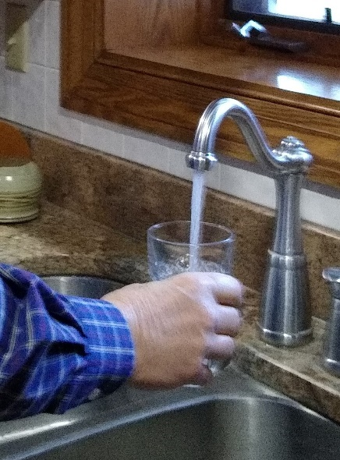
well-water testing to Make drinking Water Safer for private-well owners
Educate private-well owners to become better
stewards of their drinking water
Expected Outcome: “Clean water at kitchen sink.”
Integrate social science, hydrogeology, and community engagement
Build collaborative partnerships, UofMinn: (Extension, Health, Landscapes), MDH, MDNR, MPCA, MDA, watershed districts, SWCD, Freshwater—master water stewards, Olmsted & Anoka county programs for GW awareness, and other community organizations
Develop flexible knowledge & solutions for well owners
Notes:
MNWOO partnerships with local groups = Clinics to date: SE Karst and Central sand plains (Olmsted & Stearns counties. Also, Tribal lands in northern Minn.
Learned much. One concern is the ability to reach back to well owner about their motivation to be better well-water stewards—an important aspect of the expansion pilot

Slide 4
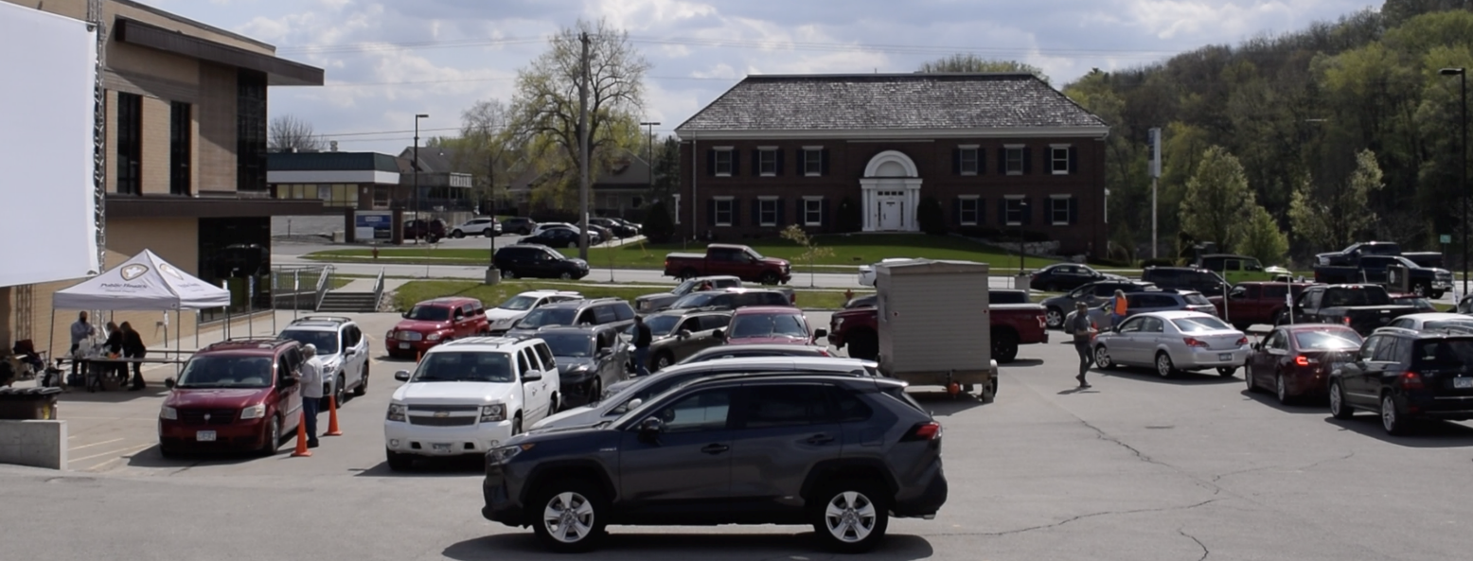
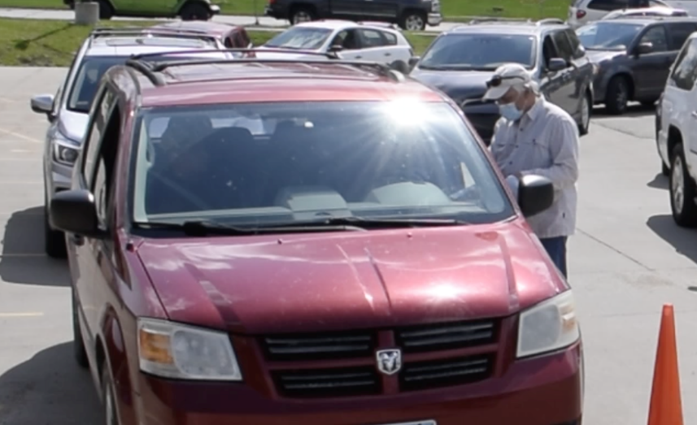
Science and Community Engagement During the CoVID-19 Pandemic
Free water testing clinics
Local Collaborators: (Coordinate space, announcements, testing equipment, paper forms to name a few)
Recruit volunteers: (groundwater professionals, lab technicians, traffic control, runners, follow-up contacts, info on water-treatment options)
Assess performance of clinics > adjust guides for future testing clinics
Rochester example
Notes:
This clinic: 8 local coordinators (Olmsted/Rochester/SWCD) , 5 volunteers = 13. About 230 clients over five+ hours
MNWOO and local groups have tested water from ~1,000 well owners in 2021,--AMAZING response by owners—it’s time to move forward with expansion efforts toward full statewide Implementation.
2021 reached out to owners in 14 Counties: through six clinics:
Stewartville and Rochester clinics: Olmsted, Mower, Dodge, Fillmore, Goodhue, Winona, and Wabasha
For NW(3) and St. Joe: Becker, Morrison, Stearns, Hubbard, Benton, Sherburne, and Otter Tail

Slide 5
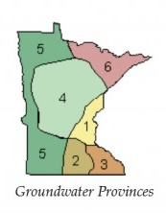
Ask: Resources for 2-Year pilot (Coordinator + grants to nonprofit & well owners)
Pilot for ~24 testing clinics statewide covering:
Groundwater provinces
Geological and Human-caused contaminants
Variety of well owner socioeconomic conditions/knowledge
Estimated cost $795,000
--safe drinking water at the kitchen sink--
MDNR
Notes:
PROPOSE LONGER THAN 1FY. FY23-24 FOR A COMPREHENSIVE PILOT that would produce an implementation plan that covers the complexities of this education effort.
~ 1/2 budget directed toward well-owner support for follow-up lab test, and for some treatment assistance; ¼ coordinator role WRC
Coordinator, supplies, equipment, volunteer travel for average of 12 clinics/yr (40 – 300 owners per clinic)
Outcome: finely-tune methods for motivated well owners throughout the state to manage the safety of their drinking water
Cost > U of Minn WRC (extension), grant to MNWOO, grants to well owners for lab for lab tests and some treatment offsets
Ready to start FY22 (Federal water infrastructure funding)?

