Slide 1

Housing Finance and Policy Committee
January 10, 2023
Anne Mavity
Executive Director
Minnesota Housing Partnership

Slide 2
MHP MISSION: to expand housing and community development opportunity for those most impacted by economic and racial disparities by leading collaborative work to promote systems change and grow equitable development capacity.

Slide 3
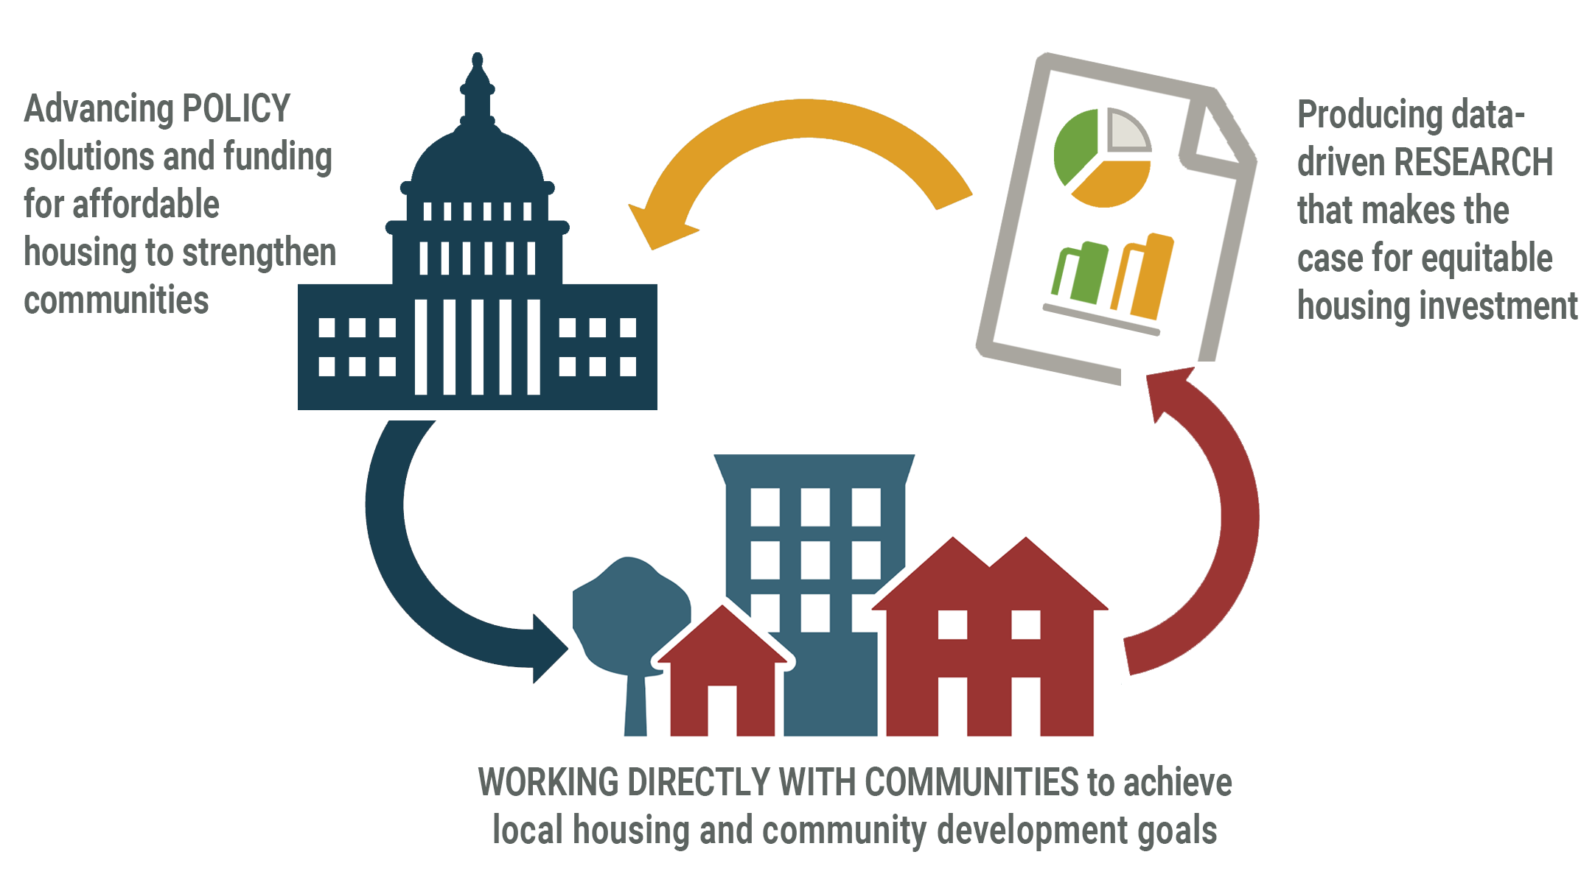
MHP Areas of Focus
Research / Policy / Community Development

Slide 4

Notes:
Deborah and family in her house. Image by Bruce Silcox Photography, Courtesy of Twin Cities Habitat for Humanity

Slide 5
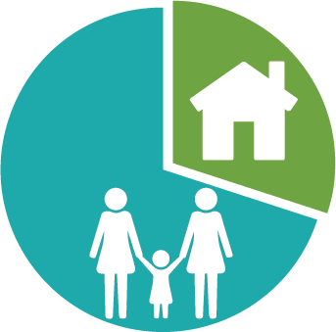
What is “affordable”?
Any household that spends more than 30% of their income on their home will likely have to sacrifice on daily needs, like food and medicine.
Established originally at 20% by the National Housing Act of 1937 for public housing; increased to 30% in 1981
OVERALL WAGES
RENT 30%

Slide 6


Common Housing Terms
Median Income (AMI):
The household income for the median—or middle—household in a region.
Extremely Low-Income Households (ELI): Households at or below Federal Poverty Level or at or below 30 percent of area median income. (low income = 60%AMI)

Slide 7

Common Housing Terms
Cost burden: Households that pay 30% or more of their income on their home, likely sacrificing other needs such as food, medical care, etc.
Severe cost burden: Households that pay 50% or more of their income on their home.

Slide 8
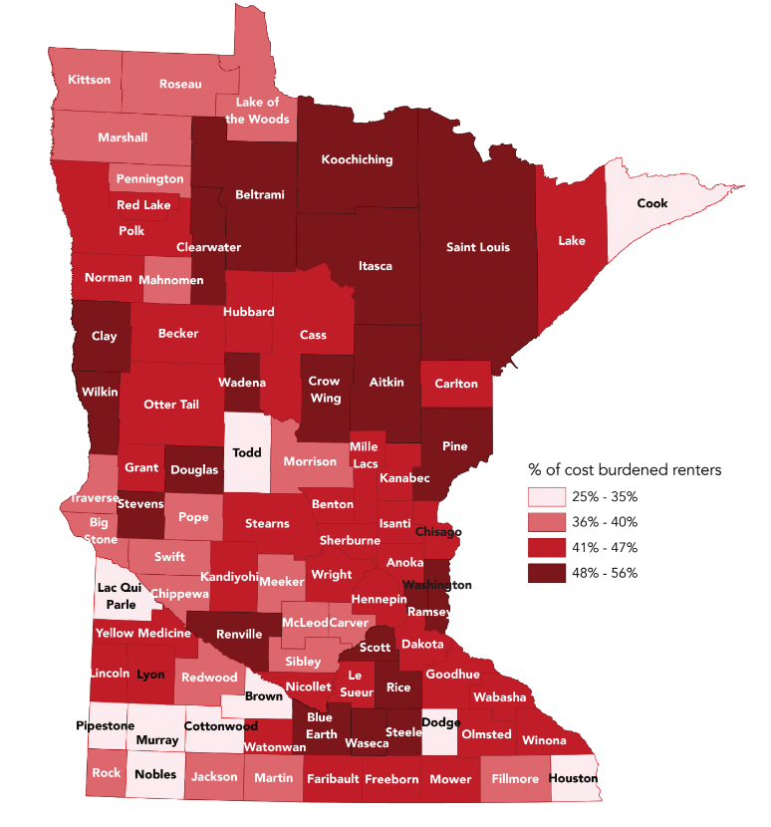
Housing Cost Burden impacts every corner of Minnesota

Slide 9
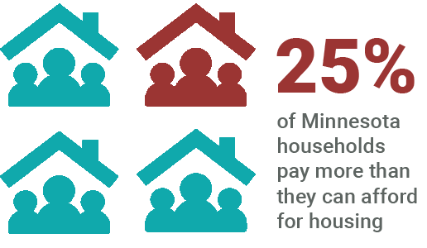
Cost Burden in Minnesota
More than 554,000 households (25%) pay more than they can afford for housing

Slide 10
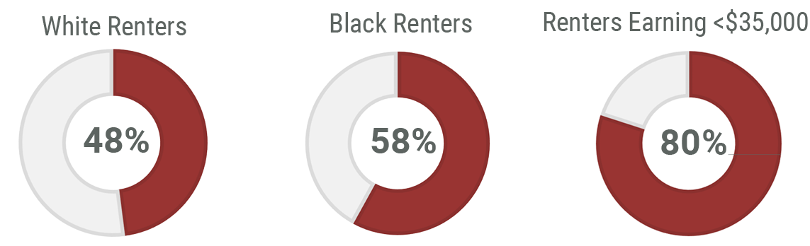
We are Paying More than We Can Afford
Minnesota Renters Experiencing Cost Burden

Slide 11
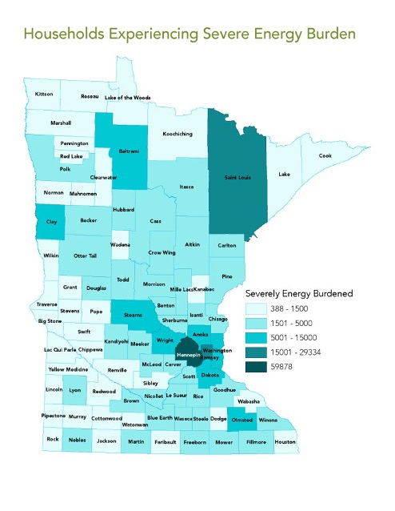
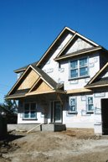
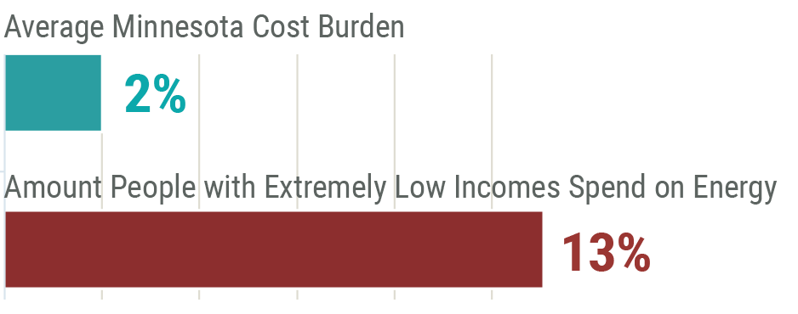
Rising Energy Prices Restrict Spending
Severe Energy Cost Burden

Slide 12

Housing Insecurity Leads to Houselessness
On a single night in Minnesota,
January 2022,
7,917 people
had no place
to call home.
That means about 20,000 people are unhoused in MN every year.
Nearly half of those were children.

Slide 13
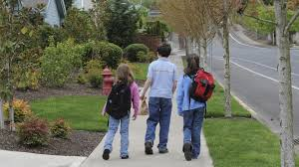
Shelters save lives....
Housing ends homelessness

Slide 14
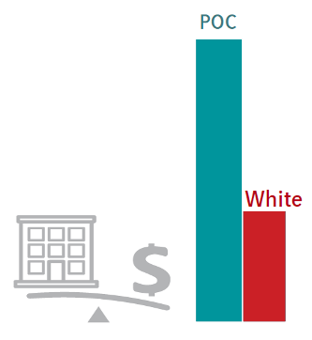
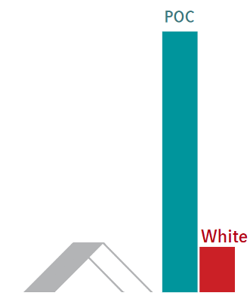
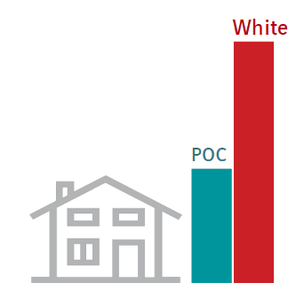
Racial disparities in housing, among the worst in the nation, caused by discrimination and past and present structural racism
Homeownership
Severe cost burden
Homelessness
People of color households are half as likely to own a home as white households
People of color households are 2.5X as likely to be severely cost burdened as white households
People of color households are 6.2X as likely to be homeless as white households

Slide 15
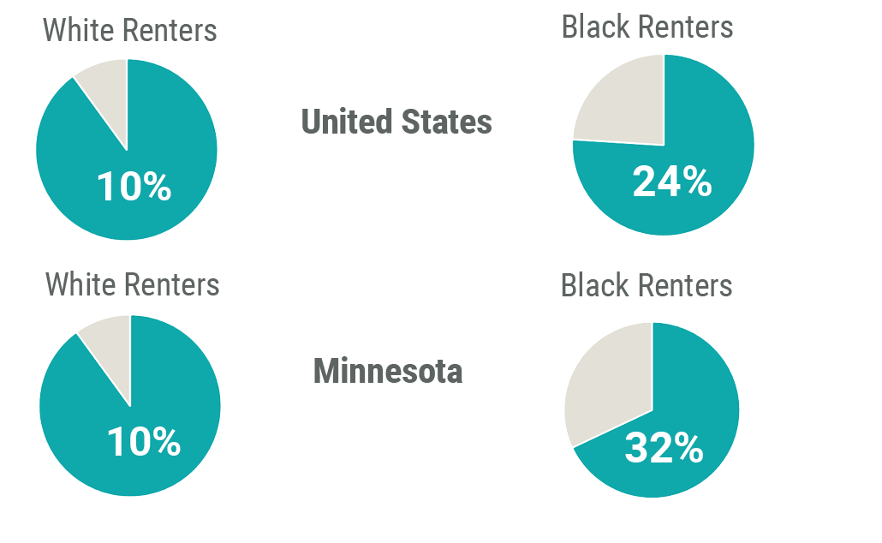
Housing Insecurity is Inequitably Felt
Households Behind on Rent

Slide 16
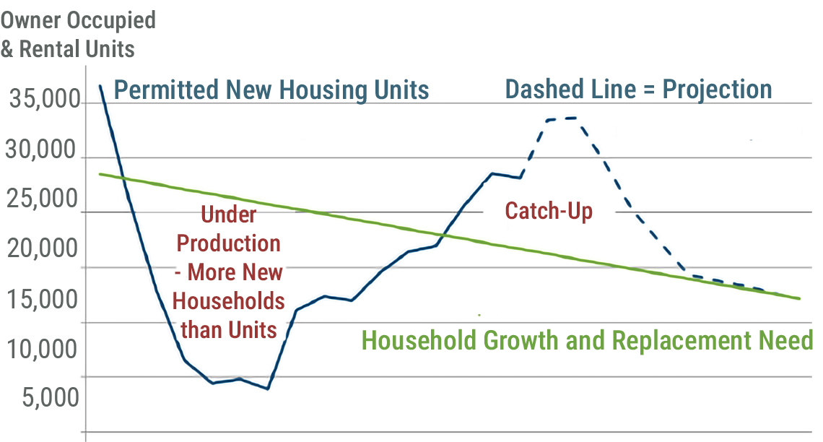
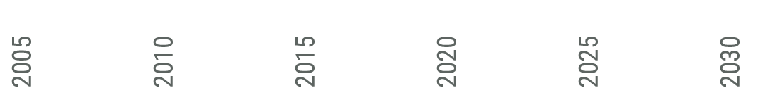
There are Not Enough Homes
The State has Fallen Behind on Creating New Homes

Slide 17
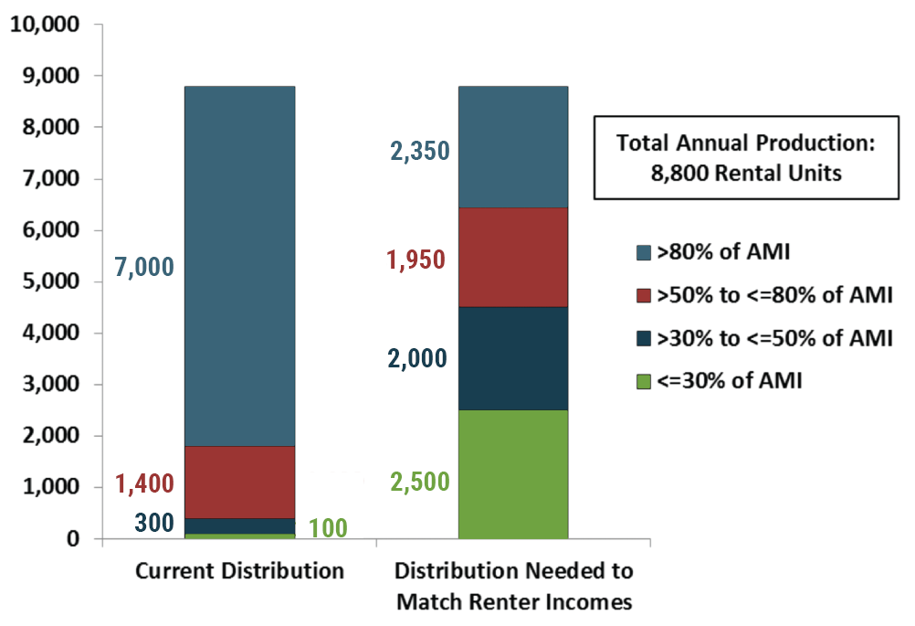
Home Production Mismatch in Minnesota
There is a severe mismatch between market supply and market demand.
Production of new units is skewed toward higher incomes.
Source: MN Housing 2018

Slide 18
Minnesota Needs More Homeownership
17,000 need access to homebuyer education and down payment assistance
5,000 first time homeowners need assistance to enter into homeownership

Slide 19
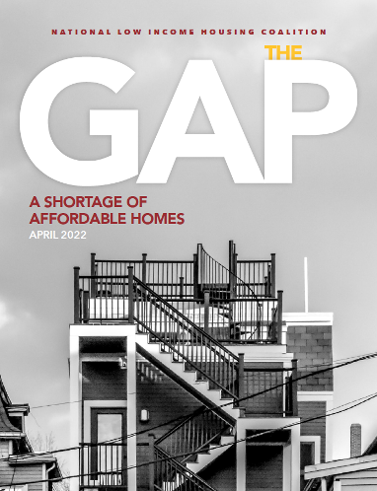
Minnesota's Rental Housing Shortage
Minnesota is home to
169,291 extremely low-income renter households but only has 69,630 rental units available and affordable to these households.
This makes a 99,661 deficit of affordable and available homes

Slide 20
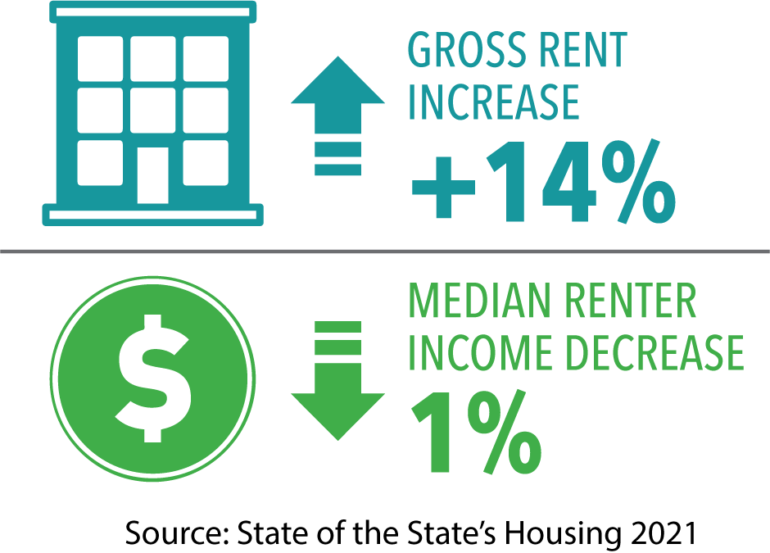
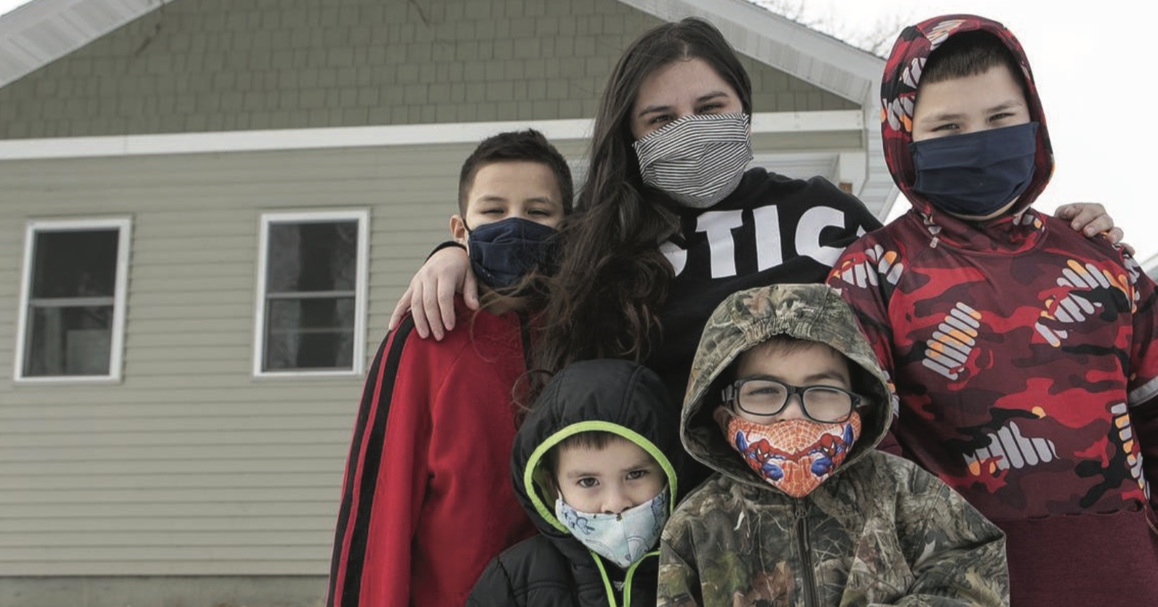
Housing Costs are Increasing
10 year trend
Notes:
Costs for homes continue to increase disproportionately to income. Between 2000 and 2019, the median renter income in Minnesota decreased by 1 percent, yet the median gross rent for the state increased by 14 percent.

Slide 21
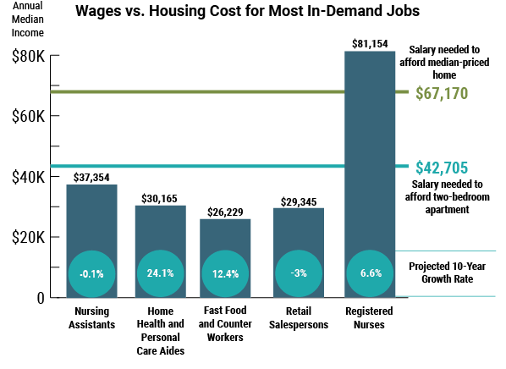

Slide 22
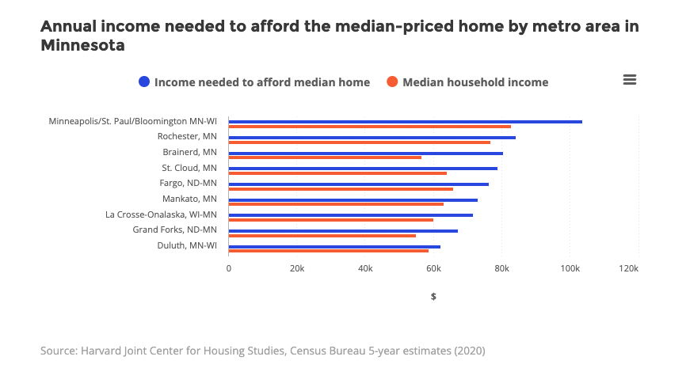
Annual income needed to afford median-priced home

Slide 23
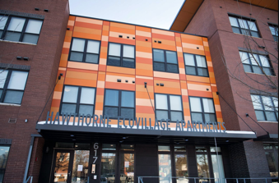
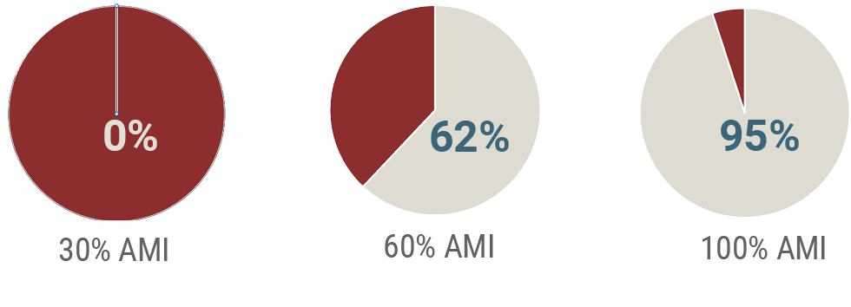
We Need More Affordable Homes
Especially for Families with Lower Incomes
% Rental Vacancies Affordable by Income
Source: *City of Minneapolis, June 2022

Slide 24

There is a Rental Assistance Shortage
3 out of 4 households that are eligible for rental assistance DON’T receive it
With government programs critically underfunded, there isn’t enough assistance to meet the need.
Meanwhile ALL eligible homeowners receive a subsidy through the mortgage interest deduction

Slide 25
Evictions are on the Rise
Monthly Eviction Filings, January 2021 - November 2022
When households are behind on rent, they may face eviction or otherwise be forced to leave their residence, with lasting consequences to finding safe and affordable homes. Most evictions happen because a renter cannot or does not pay rent.
Source: Eviction Lab

Slide 26
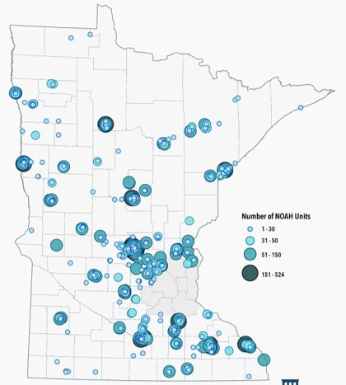
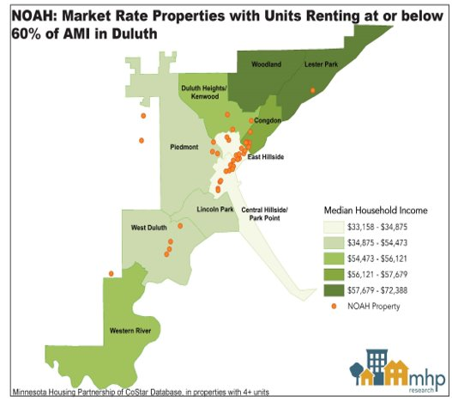
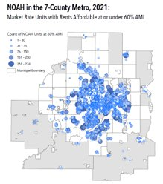
NOAH impacts communities across MN
(Naturally Occurring Affordable Housing – private sector)
Duluth
Twin Cities Metro

Slide 27
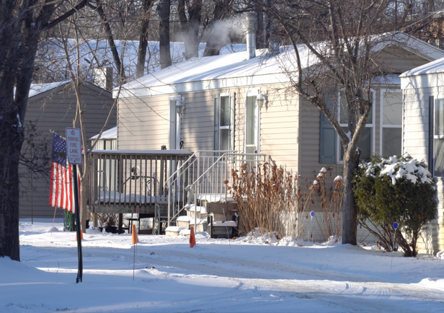
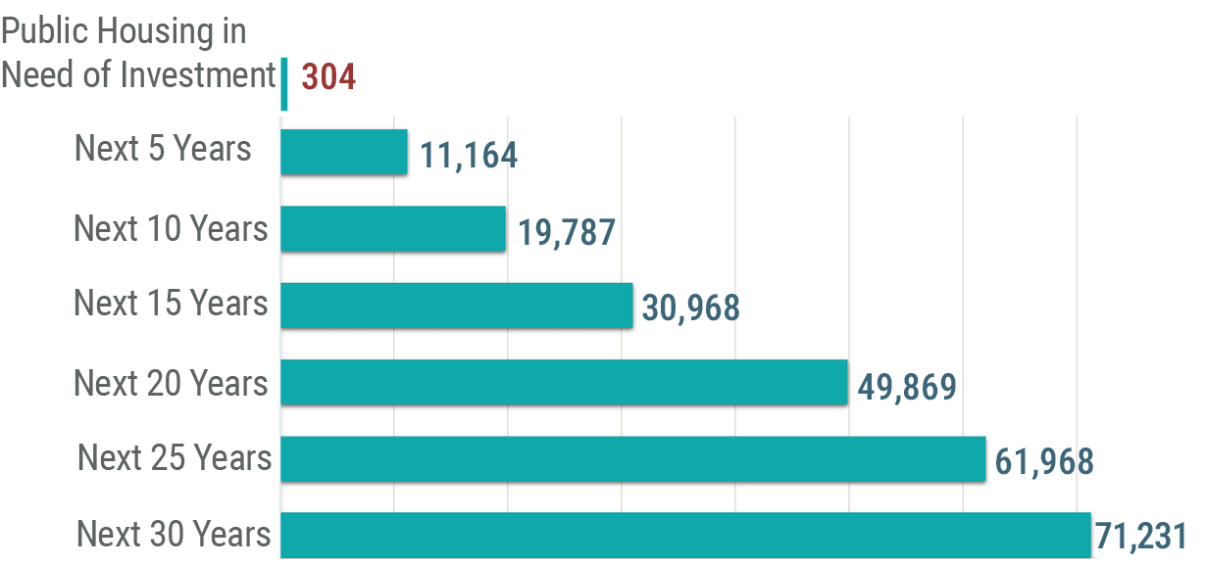
We Need to Preserve the Housing We Have
Publicly Financed Rental Homes at Risk of Loss
The above graph includes homes with income restriction due to financing through HUD, USDA and Low-Income Housing Tax Credit (LIHTC).

Slide 28
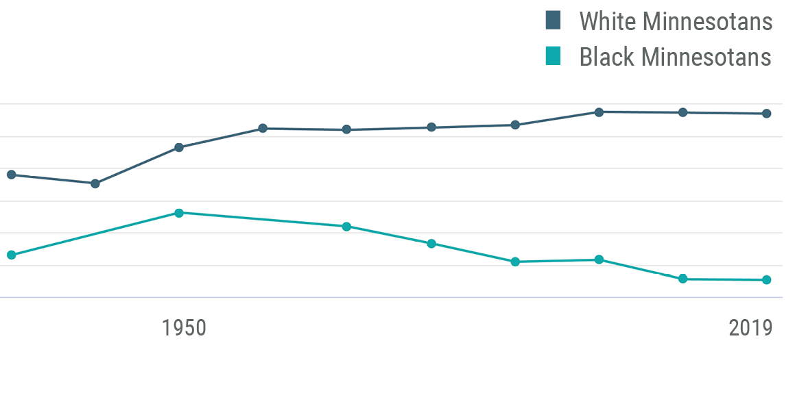
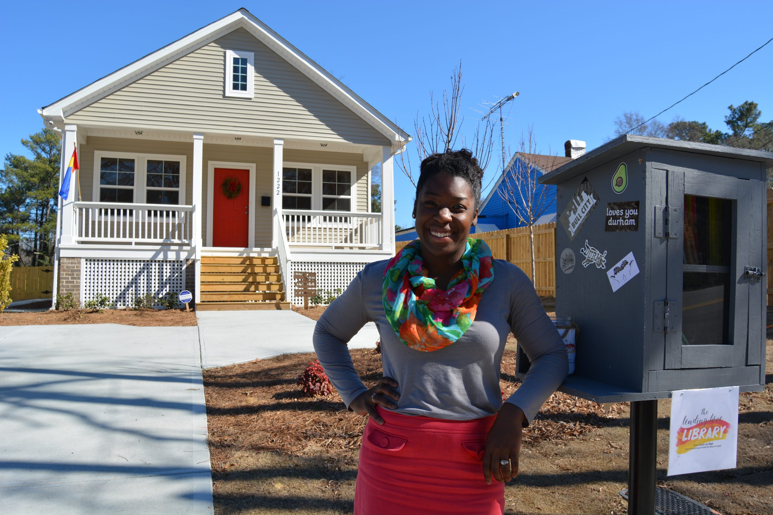
Home Ownership Disparities Persist
Home Ownership Levels Have Fallen for Black Residents

Slide 29
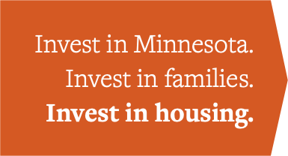
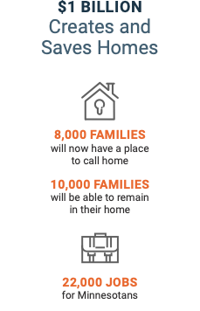
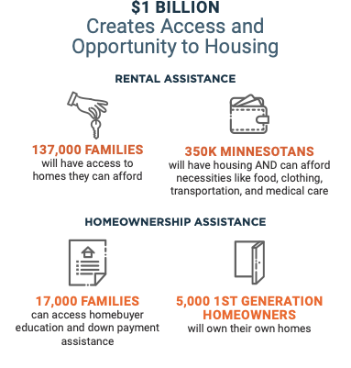
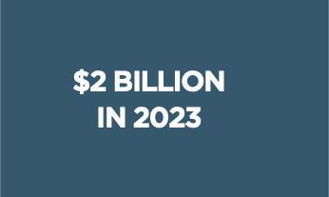
Solutions are Within Reach - $2 Billion in 2023
Housing on the ballot
in 2024!

Slide 30

$2 Billion in 2023
Investing in housing will…
Reduce disparities and expand choice
Provide stability, housing choice for low-income renters, and homeownership and wealth-building opportunities for generations to come.
Notes:
Picture from Strib, Aug 22, 2020
Jovonta Patton and his wife, Symone, are pictured with daughters Ella, 5, Zoey, 3, and baby Cali in front of the new home they purchased a few months ago in Minneapolis.

Slide 31
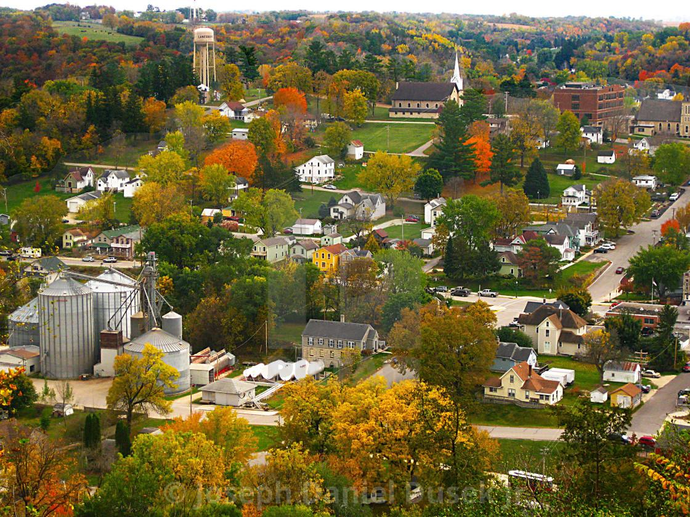
A bold move for housing is essential now ….. and
A Constitutional Amendment is necessary to meet our future housing investment needs.

Slide 32
Housing on the Ballot in 2024
To ensure that the State is making the investments needed to truly address our current housing crisis.
​
A constitutional amendment for housing on the ballot in 2024 will create:​
  A Homeownership Opportunity Fund​
  A Rental Opportunity Fund (including rental assistance)​
  A Household and Community Stability Fund

Slide 33
Connect with MHP
mhponline.org
@followMHP
info@mhponline.org

