Slide 1

Legalizing Affordable Housing Act
HF2235
Rep Steve Elkins | House District 50B
Rep.Steve.Elkins@House.mn.gov

Slide 2

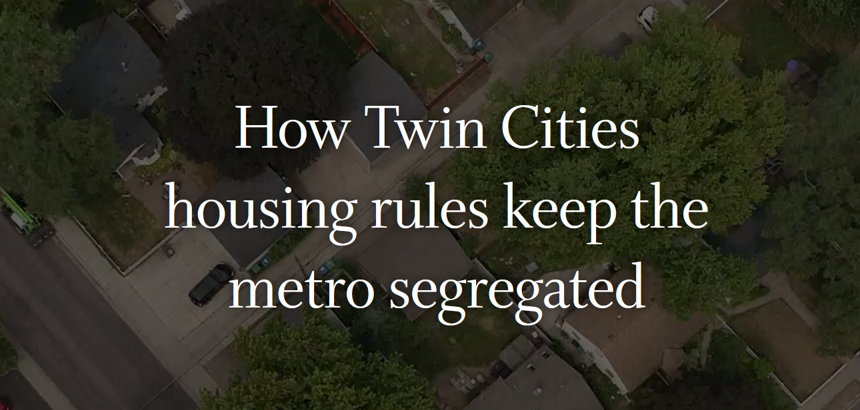
How Twin Cities housing rules keep the metro segregated
Notes:
In August of 2021, the Star Tribune published a front-page expose on how Twin Cities zoning ordinances perpetuate racially segregated living patterns in the Twin Cities. The investigative team that researched the story discovered case after case where development restrictions that had commonly been included in racially restrictive covenants had simply migrated from the covenants to municipal zoning codes – in some cases, word for word – when the Supreme Court ruled those covenants unenforceable. Many of these restrictions live on, today, in current zoning codes.
And this isn’t just a racial equity issue, it’s a generational equity issue, as well. Today, these same restrictions prevent the creation of a new generation of “starter homes” for young millennial families of all races and ethnicities. I was not yet 30 years old when my wife and I purchased our first starter home, the “Condo in Redondo”. My two college educated daughters, who are approaching their 40th birthdays, have still not purchased their first homes because the “Starter Homes” built for previous generations are beyond their means.
House File 2235, the Legalizing Affordable Housing Act, is designed to sweep away barriers that prevent housing developers, both for-profit and non-profit, from building housing that responds to the demand for housing of all kinds at more affordable price points. After all, it doesn't matter how much money the legislature appropriates to build new affordable housing if cities won't allow it to be built.

Slide 3
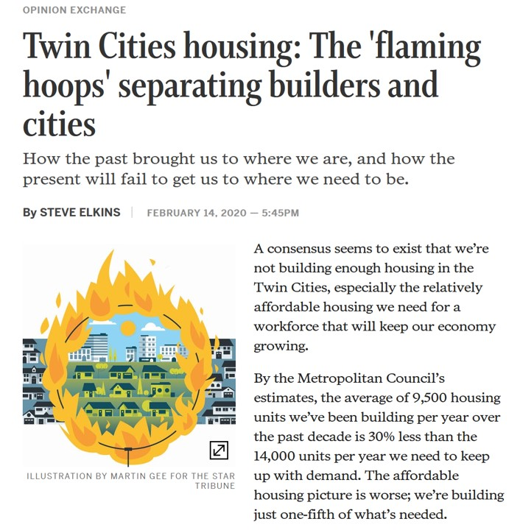
Flaming Hoops
Basic Premise:
  Because Cities are not allowed to assess cost-based development impact fees to recover their infrastructure costs, directly, they use a variety of fees and zoning restrictions to slow development and recover their costs, indirectly.
  Cities will not increase property taxes on existing taxpayers to fund new housing development that existing residents don’t even want.
Notes:
Back in 2020, the Star Tribune published my own piece entitled “Twin Cities housing: The 'flaming hoops' separating builders and cities” in which I observed that, in the absence of a mechanism for cities to use development impact fees to directly defray the cost of building the new infrastructure needed to support new housing projects, cities were resorting to backdoor mechanisms such as the “planned unit development” process to exact these fees from developers and to limit housing development to expensive executive homes which would have a quicker property tax pay off.
Under the PUD process the zoning code is essentially thrown out the window and the developer and city staff play “let's make a deal”. The planned unit development concept was invented to accommodate building sites with unique characteristics, and novel development forms that were not contemplated when the zoning code was devised. Requiring the use of the PUD process to approve everyday housing projects adds unnecessary time, cost and risk to every housing project. We must get back to a process wherein housing developers have the right to build housing which complies with zoning codes designed to “protect the public health, safety, and general welfare”.
Therefore, the very first article in this bill would provide cities with a direct way for development to “pay its own way” – but no more. In exchange, cities would be required, by the provisions in later articles of the bill, to relinquish the back door mechanisms that they currently use to exact indirect development fees from Housing developers. That’s the basic deal that I'm proposing in this bill between the cities and the housing developers.
In this draft of the bill, the development impact fee would be similar to an assessment against the property owners whose land would be rendered more developable, and therefore more valuable, if the infrastructure, such as a new or expanded road, was built. This article will probably be revised to make it more like Chapter 444, which provides an established, tried-and-true funding mechanism for water and sewer infrastructure and could be expanded to cover transportation infrastructure, as well.

Slide 4
Article 1: Development Impact Fees
Enables local governments to assess benefiting property owners for the cost of building infrastructure that prepares their land for development.
Notes:
Article 1

Slide 5
Article 2: Environmental Review
This article prevents NIMBY groups from using Minnesota’s Environmental laws (MERA) to challenge city comprehensive plans that promote affordable housing.
Notes:
After Minneapolis adopted its 2040 comprehensive plan, which included provisions which allow duplexes and triplexes in single family neighborhoods, the city was sued by NIMBY’s posing as environmentalists to block the plan. Article 2 of the bill would outlaw these lawsuits by preventing comprehensive plans from being challenged under the Minnesota Environmental Rights Act.

Slide 6
Addressing the “Local Control” Issue
Minnesota is a “Dillon’s Rule” State
  Cities have the authorities granted to them by the State
The zoning and planning authorities granted to Cities are described in two chapters of State law:
  462 (Statewide Zoning and Planning)
  473 (Metropolitan Land Planning Act)
These chapters of State law were last reformed in 1995
Notes:
The remaining articles of the bill restrict the ability of cities to engage in exclusionary zoning practices which increase the cost of housing and restrict its supply.
You'll hear a lot today about “local control”, so a basic understanding of the Minnesota zoning statutes is in order. Cities in Minnesota are creatures of the State and derive their zoning authority from Chapter 462. Section 473, known as the Metropolitan Land Planning Act, provides an overlay that describes the relationship between local governments in the Twin Cities region and the Metropolitan Council, and the related requirements related to comprehensive planning and zoning.
These statutes where last overhauled in 1995 and some of the reforms that were enacted in that period, such as the precedence of comprehensive plans over zoning, have been eroded by subsequent court decisions which exposed ambiguities in the wording and compromises the original legislative intent. The remaining articles of the bill represent a long overdue update of those 1995 statutes, not an assault on the autonomy of local governments.
Whenever I hear the term “local control” expressed as a mantra with respect to this issue, I hear an echo of the term “states rights” as it was used to rationalize Jim Crow institutions such as the restrictive covenants that have been supplanted by the exclusionary zoning practices that we’re here to address, today.

Slide 7
Article 3: Planning & Zoning Reforms
These changes reinstate the intent of the 1995 Reforms
  Comp Plan/Zoning Conformance is defined for the first time
  Discrepancies must be resolved by conforming the zoning to the comp plan if it has not already been done by the time a development proposal has been received
  Development moratoriums may not be applied retroactively after a development proposal is received
  Only land that has been both guided and zoned for affordable housing counts towards a metro city’s Livable Communities grant program qualification goal.
Notes:
The lack of a definition in the 1995 statutes for what it means for a city’s zoning to be in conformance with its comprehensive plan has effectively rendered this requirement meaningless -- it can mean whatever a city wants it to mean and so it’s effectively ignored. Courts have observed that discrepancies can be eliminated by either changing the zoning or changing the comp plan, so cities regularly conform their comp plans to their zoning even though it is clear that this is not what the 1995 legislature intended. The bill provides a common-sense definition of conformance which would lead to a better alignment of zoning ordinances to comprehensive plans.
Existing law requires cities to conform their zoning to their comp plan within 9 months of an update to their comp plan. If this has not been done, the bill requires the city to do so upon receipt of a development proposal that is consistent with the comp plan.
The bill prevents cities from freezing a housing development proposal by declaring a retroactive moratorium only after the development application has been received.
Finally, in order to qualify for the Twin Cities Livable Communities grant program, cities in the metro area must commit to including enough land within their comprehensive plan to accommodate that city’s share of the region’s affordable housing needs over the next decade. The bill requires that this land also be zoned for affordable housing to count towards satisfying this requirement.

Slide 8
Article 4: Limiting Regulations on Development
Cities may not ban modular apartment buildings
Duplexes or ADUs may be built in single-family districts
Planned Unit Development process my not be imposed
Purely aesthetic mandates are prohibited
Multi-car garages may not be required
Minimum home (or garage) sizes may not be required

Slide 9
Article 5: Municipal Dedication Fees
Park Dedication Fees/Dedications capped at 10%
Excessive dedications of land for roads is prohibited
The uses of dedication fees must be tracked/reported

Slide 10
Article 6: Planning Densities
In newly developing areas of the Twin Cities
  Planned average densities must be at least 4 units/acre
  At least a quarter of the land planned for single family housing must allow up to 8 units per acre (small lots or duplexes)
    Developers can develop at lower densities, but they cannot be required to do so.
  Planned rural land must allow densities of no more than 1 unit per 10 acres (to enable efficient subdivision when the land is ripe for development)
Notes:
At present, the Metropolitan Council requires newly developing cities to plan for residential development in a range of from 3 to 5 units per acre. regional system capacity for roads and sewer infrastructure is plan based on an assumption that average densities will come in at the middle of that range. However, residential platting data reported by the cities to the metropolitan council reveal that actual densities have been coming in at about 3 and a half units per acre, and there are 16 newly developing communities that have been developing at densities of less than 3 units per acre.
This represents both a waste of regional infrastructure capacity which must be paid for by regional taxpayers at large, and a clear expression of the exclusionary zoning practices that this bill is designed to address

Slide 11
Article 7: Sewer Availability Charges (SAC)
SAC charges must be charged on the basis on no less than 4 units per acre.
  A home built on a ½ acre lot would be assessed 2 SAC charges
Notes:
Cities collect sewer availability charges (SAC charges) and remit them to the metropolitan council to help finance the reserve capacity of the regional sewer system. These charges are calculated to reflect an assumption of residential development at 4 units per acre. This article requires cities to collect SAC charges from developers based on an assumption of no less than 4 SAC charges per acre. So, if a developer creates a housing development on half acre lots, each home would be assessed 2 SAC charges.

Slide 12
Article 8: Building Permit Deadlines
If a building permit application is not acted upon within 60 days, the city must refund the building permit fee after the application has been processed.
  The 60 days does not begin until the application is complete, and the city has all the information required to process the request.
Notes:
In a previous iteration of this article, the building permit would have been automatically approved if not acted upon within 60 days. This could have resulted in unsafe buildings being approved.

Slide 13
Article 9: Building Permit Fees
The Dept of Labor & Industry will provide and maintain a standard methodology for estimating home values against which building fees are assessed.
  Building fees are assessed based upon the estimated value of the completed home.
  This provision is included (along with Article 11) in HF2283
Notes:
This provision would provide consistency in the way building valuations are estimated across cities. Cities retain the ability to set their own fee schedules.
This provision is acceptable to all parties.

Slide 14
Article 11: Building Permit Fees
Raises the reporting threshold for cities to report building fees to DLI from $5K to $7K
  This provision is included (along with Article 9) in HF2283
Notes:
This provision will reduce the number of small cities that must submit reports to DLI

Slide 15
Article 10: Energy Cost Disclosures
Home sellers must disclose information about the home’s energy efficiency to potential homebuyers
  New Homes: Home Energy Rating System Index
  Resales: Utility bill history
Notes:
Builders complain that homebuyers do not value home energy efficiency by enough to justify the added cost of energy efficiency provisions in the building code. It turns out that this is because they are not provided any home energy efficiency information in home listings. This article requires that this information be provided in the home listing and requires that the utilities provide this information to the realtors at the request of the selling homeowner.

Slide 16
Article 12: Repealer
Repeals session law that exempts the cities of Oak Grove and Now Then from provisions in Chapter 473 (and this bill).
Notes:
This provision was surreptitiously included in the Transportation bill at the end of the 2017 special session.

Slide 17
Recap: What the draft bill does NOT require
Things that the draft bill does not do:
  It does not abolish the Planned Unit Development Process
    It does require mutual agreement between the city and the developer to enter into the PUD process for a housing development that is code-compliant.
  It does not require cities to only permit affordable housing to be built
    It does limit cities from prohibiting the construction of affordable homes
    The market should decide what gets built
  It does not establish a new requirement that zoning is subordinate to the comp plan
    This has been required since 1995
    It does provide clarity around this existing requirement
  The Duplex and ADU provision does not override existing zoning performance standards
    Existing setback, height and impervious surface coverage standards must be met

Slide 18
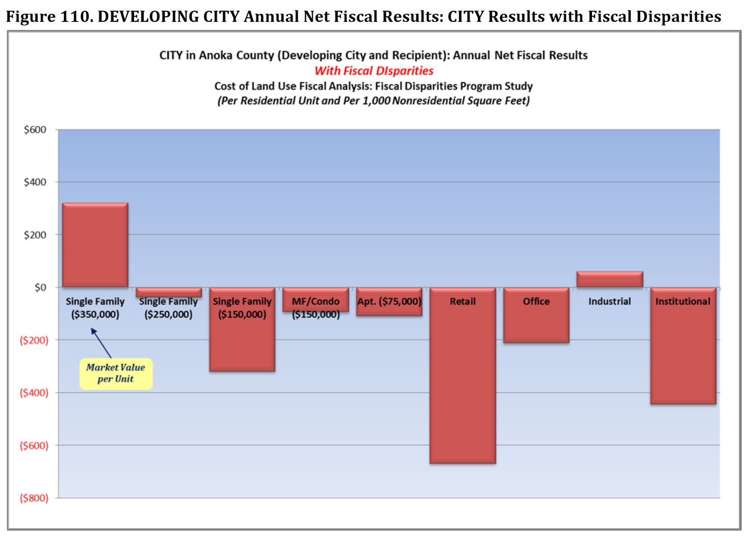
Fiscal Incentives Drive Municipalities to Favor Expensive Housing
For a growing suburban city, only expensive homes provide a positive net fiscal impact.
Home value above $500K is taxed at 1.25 times the rate of home value up to $500K, providing an extra bonus for especially expensive homes.
Building Permit Fees are based upon home value.
Many elected local officials are unaware of these incentives, but all city managers know this.
Source: Study of the Metropolitan Area Fiscal Disparities Program
Tischler Bise for the MN Dept of Revenue, 2012, Page 143

Slide 19
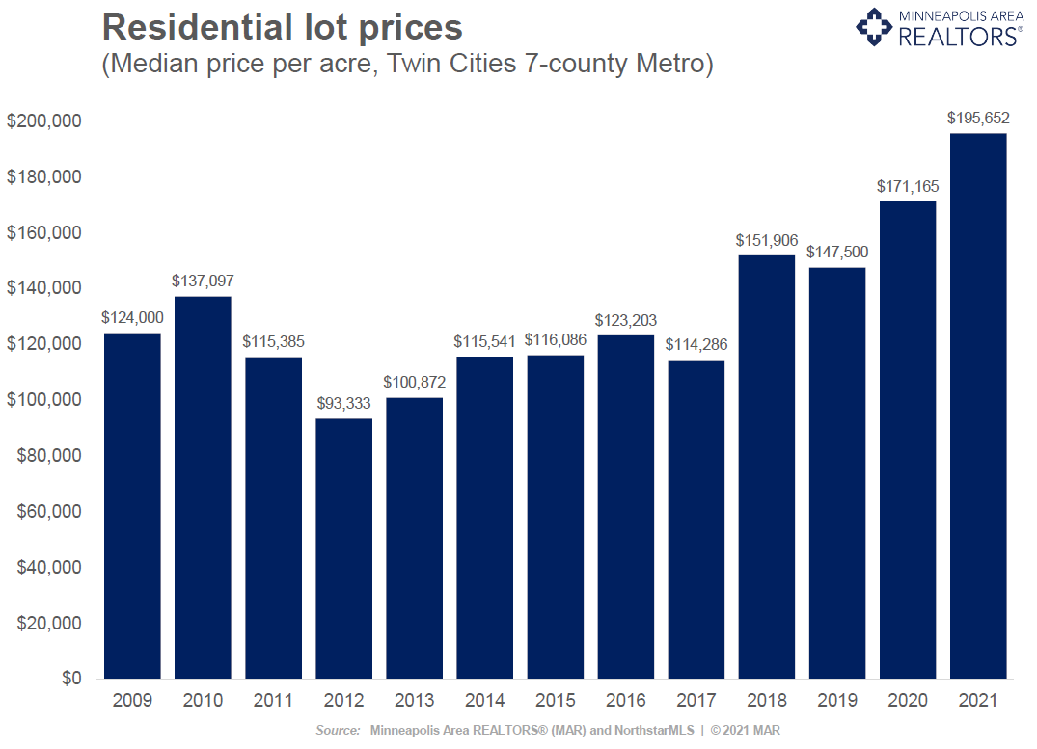
Cost of Residential Lots is Skyrocketing!
Restrictions on the supply of buildable lots are the key driver of housing cost inflation.
  Housing financiers will not finance projects where the cost of “dirt” is more than 25-30% of the final cost of the home.
  Multiply the cost of the lot by 4 to determine the minimum price of a home that can be built on the lot.
  The cost of building materials and labor will be resolved by the market, over time. The cost of land is institutional and is driven by zoning policy.

Slide 20
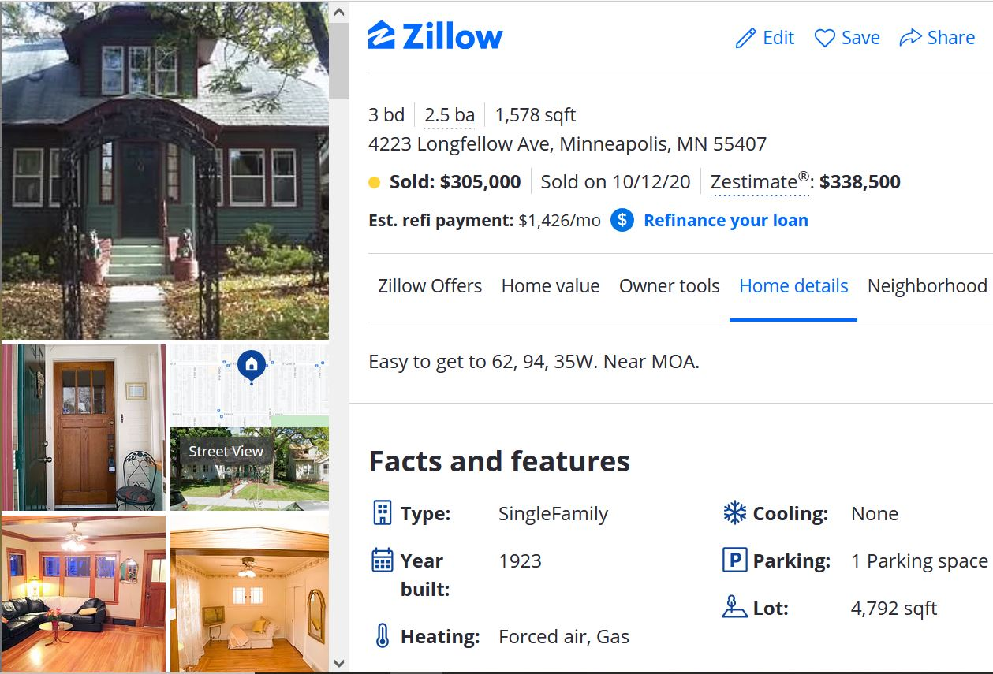
What does an “Affordable” Home Look Like, Today?
My Legislative Assistant’s New Home:
  1,578 sq ft home
  4,792 sq ft lot (1/9th Acre)
  1 Parking Space (tuck under garage on back alley)
  Vinyl Siding
  Fixer-upper
  Purchased for $305K
Why shouldn’t it be legal to build a new home like this, today, in a developing community?

Slide 21

Thank You
Rep Steve Elkins | House District 50B
Rep.Steve.Elkins@House.MN
651-296-7803

