Slide 1
Hearing state capitol 2022
Mission Statement
The mission of this 501c3 organization is to provide relief and recreation to military veterans and their families as part of the continuous reintegration process. The Disabled Veterans Rest Camp Board of Directors, the administrating organization, and Veterans Campground on Big Marine Lake staff actively seek out military members and Veterans dealing with reintegration issues, such as post-traumatic stress disorder, as well as their families to offer them rest and recovery through various outdoor recreational activities. Veterans Campground on Big Marine Lake provides many outdoor experiences, to include camping, swimming, boating, softball, volleyball, horseshoes, and fishing for the families of military veterans. Additionally, because children are missing a parent due to a military deployment, and sometimes it is their only parent that is deployed, they do not have the same opportunities for outdoor and land stewardship activities. Veterans Campground on Big Marine Lake strives to reach out to those children to provide enjoyable outdoor activities. Also, groups such as Gone Fishing of South Washington County are recipients of various outdoor programs that the camp hosts, along with numerous veteran service organizations, patients of the VA Hospital, and residents of the Veterans Home in Hastings, Minnesota. This is all possible due to the accessibility of the camp for handicapped and disabled guests. This camp reaches out to all ages, races, and abilities, as service to our nation and disabilities affect without discrimination.

Slide 2
Hearing state capitol 2022
History
The Disabled Veterans Rest Camp (DVRC) is a non-profit camp located in Washington County just north of Stillwater on beautiful Big Marine Lake. The campground started in 1926 from a local farm that was donated to help disabled veterans recover from what was then referred to as shell shocked from battle in World War I. The original main farmhouse was converted to a dormitory-type house for these shell-shocked veterans. During WW II, shell-shocked was called battle fatigue; today it is known as post traumatic stress disorder. Through the years the camp's main focus has not changed, only the name of the disabled veterans' affliction.

Slide 3
Hearing state capitol 2022
Opportunities, challenges, issues and needs facing our organization
With so many Minnesotans affected by military duty in the past 18 years, more people are turning to the camp to be the provider of such outdoor activities in which they themselves cannot provide due to parental absence, emotional/ physical inability, or financial reasons. Veterans Campground is another venue where veterans can go when they want to connect with fellow veterans and families. Camp activities and programs include fishing, boating, gathering and picnicking at the Yellow Ribbon Pavilion, camping via RV, tent, and cabins, swimming, softball field, volleyball court, horseshoes, canteen with mini-library, youth game room, and snack bar, visiting the Veterans Memorial Garden, or hiking the Korean Trail.
This greater demand of our veteran community in Minnesota has required a large expansion of the camp, and financial support is greatly needed. While the camp focuses on veterans, it has also been fulfilling the recreational needs of many more, to include the families and friends of veterans who greatly assist with reintegration activities. They are all touched by military duty, and all are the beneficiaries of the camp.

Slide 4
Hearing state capitol 2022
2021 Campground Demographics
Total visitors in – 41313
We welcomed the following Veterans
WWII Veterans – 1
Korean Veterans – 12
Vietnam Veterans – 108
Gulf War Veterans – 72
Iraqi/Afghanistan Veterans – 100
Other Veterans - 23
First time Veteran visitors - 316

Slide 5
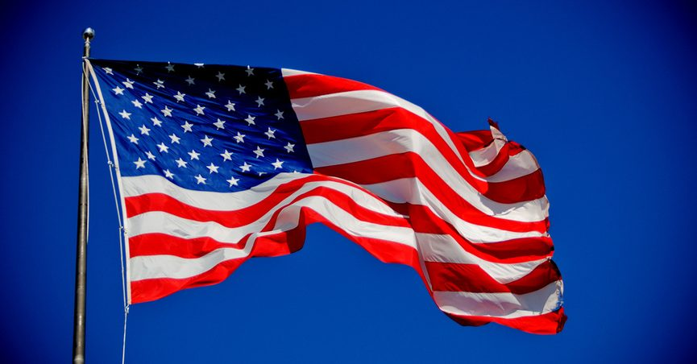
Hearing state capitol 2022
Questions

