Slide 1
Veterinary Institutional License
February 22, 2024
Dr. Michael Henson

Slide 2
Veterinary medical education
UMN is only College of Veterinary Medicine in MN
Graduate ~120 DVMs each year
Also train interns and residents - future specialists & faculty
Demand for veterinarians is growing
Existing schools are expanding class size – UMN included
Universities are planning new veterinary colleges

Slide 3
Problem: Clinical faculty workforce crisis
Demand for veterinary specialists is growing
New / expanding colleges of veterinary medicine
Increased competition from private practices
Nationwide shortage of faculty
# of open veterinary faculty positions has doubled in last 10 years
Affects clinical veterinary faculty most severely - ~12% vacancy rate
Increased student-to-faculty ratios
Cannot train as many specialists, further decreasing the pool of potential future faculty

Slide 4
Problem: Clinical faculty workforce crisis
Minnesota’s situation:
Can only hire graduates from AVMA-accredited schools or board-certified specialists
Other states allow universities to recruit the best and brightest from around the world
Proposed solution:
Create a UMN-specific license to allow highly qualified faculty, residents & interns from non-AVMA-accredited schools to practice and teach
All other existing licensure rules apply
UMN goes further by requiring mentorship and regular reviews
License is revoked if they leave the UMN

Slide 5
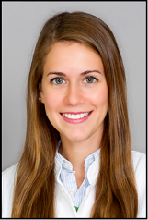
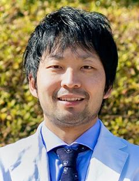
Unable to hire great educators
Dr. Louise Hauser
Ludwig Maximilian University, Munich Germany
License to practice veterinary medicine in Germany 2012
Washington State University
Specialty internship in medical imaging 2016
Residency in medical imaging 2017-2020
Dr. Manabu Kurihara
DVM from Azabu University, Japan 2012
Massey University, New Zealand
Radiology internship 2017
Tufts University, Boston
Radiology residency 2020

Slide 6
Risks of inaction
# of UMN open faculty positions increases every year
Smaller pools of veterinary residents and interns (future academic veterinarians), particularly large animal
Reduced diversity in the MN veterinary workforce
Inadequate diagnostic pathology to support our Ag industry
The quality of veterinary education is threatened

Slide 7
Please support the proposed change to allow institutional licenses for UMN veterinarians
Dr. Michael Henson
henso001@umn.edu

