Slide 1
Minnesota Credit Union Overview
January 2023

Slide 2
What is a credit union?
Credit unions are not-for-profit financial cooperatives. Like at a bank, consumers can access many financial services at their community credit union, like checking and savings, credit cards, and home and auto loans. Unlike a bank, however, consumers don’t generate profit for their credit union—instead, earnings are returned to consumers through:
Higher yields on savings;
Fewer and lower fees;
Reduced loan interest rates;
Dividends back to members’ accounts; and
Lower barriers to lending
Notes:
Every credit union is restricted to serving a specific field of membership. All members must be connected by a common bond. There are three types of bonds that exist:
1) Occupational
2) Associational
3) Community
The first Minnesota credit union was chartered in 1925.
The Federal Credit Union Act was enacted in 1934.
The legislation allowed credit unions to incorporate under either state or federal law. This system of dual chartering continues today.

Slide 3
Who can belong to a credit union?
Live
Many credit unions service anyone that lives in a defined geographic area such as a specific county or region.
Work
Companies sponsor credit unions as a benefit for employees; and some credit unions are organized for special trade groups - like aviation or healthcare workers.
Belong
Membership in a group such as a place of worship, school, labor union or homeowners’ association may qualify you to join a credit union. And, most credit unions encourage members families to join.

Slide 4
History of Credit Unions
1925
The first Minnesota credit union was chartered in 1925.
1934
The Federal Credit Union Act was enacted in 1934.
The legislation allowed credit unions to incorporate under either state or federal law. This system of dual chartering continues today.

Slide 5
Federal vs. State Chartered
Federal
Governed by the Federal Credit Union Act
Regulated by the National Credit Union Administration
State
Governed by MN Statute Chapter 52
Regulated by the NCUA and the Minnesota Department of Commerce
State Chartered credit unions pay yearly assessments as well as hourly exam fees to the Department of Commerce
Notes:
Risk-Focused Examinations
Based on CAMEL code (Capital Adequacy, Asset Quality, Management, Earnings and Liquidity)
Quarterly Call Reports
Supervisory Committees
All Minnesota credit unions are federally insured.
NCUSIF is backed by the full faith and credit of the United States Government.
Members’ shares are insured up to a minimum of $250,000.
Not one penny of insured savings has ever been lost by a member of a federally-insured credit union.
No federal tax dollars have ever been placed in the share insurance fund.

Slide 6
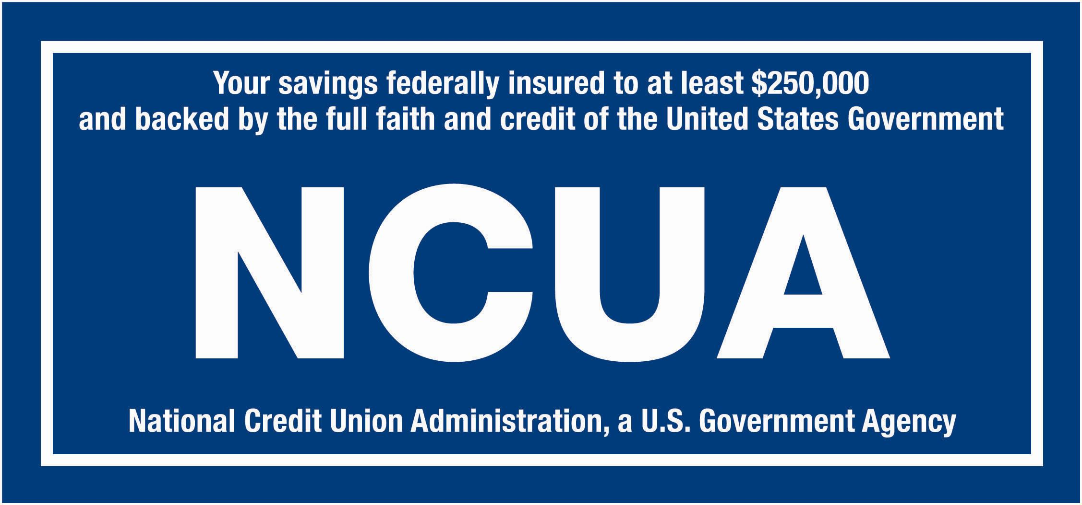
National Credit Union Administration
The NCUA is an independent federal agency with the primary mission to ensure the safety and soundness of credit unions.
Administrator of the National Credit Union Share Insurance Fund (NCUSIF).
All Minnesota credit unions are federally insured and backed by the full faith and credit of the United States Government.
Members’ shares are insured up to a minimum of $250,000.

Slide 7
Examinations
Risk-Focused Examinations
Quarterly Call Reports
Supervisory Committees

Slide 8
Minnesota Credit Unions
88 credit unions |  | 399 branches |  | 2.1 M members |  | 5,707 employees |  | 37B assets

Slide 9
MN Credit Unions by Asset Size

Slide 10
Financial Benefits
Minnesota Credit Unions provided $135 million in direct financial benefits to the state’s 2.1 million members
Lower Loan rates = $71 million
Higher savings rates = $47 million
Fewer/lower fees = $16 million
These benefits are equivalent to $67 per member or $140 per household
Calculated for the 12 months ending September 2022.

Slide 11
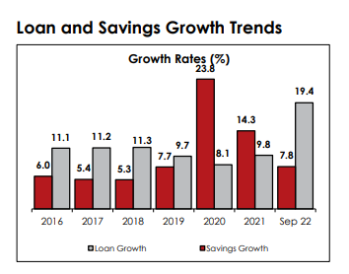
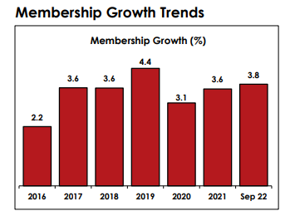
Economic Performance

Slide 12
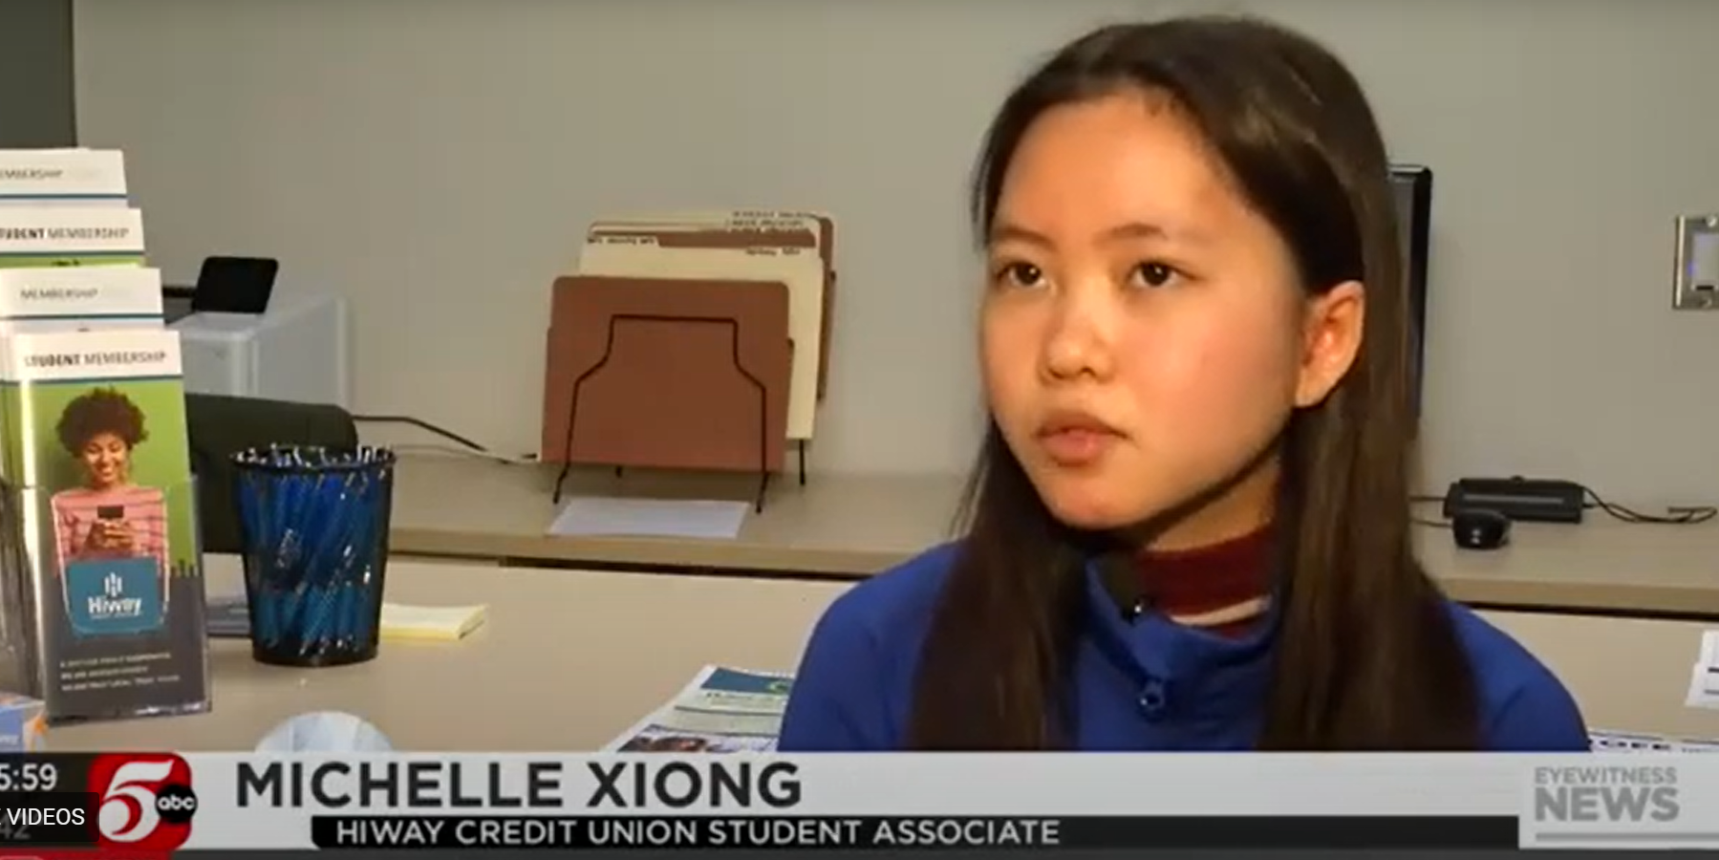
Financial Education
6 school credit union branches in high schools provide money management and career skills for students.
Through hands-on experience, students learn about financial services and credit responsibility.
Students also provide education to their peers about importance of saving, how to budget and building credit.
100 Minnesota credit union employees have a Certified Financial Credit Union counselor designation.
Notes:
Median Account Balance
$355
Number of State-wide Prizes
622
Total Dollars Awarded in State-wide Prizes
$86,000
Number of participating Credit Unions
14

Slide 13
Ensuring Financial Well-being for All
Nearly 90% of CU members say their credit union has improved their financial well-being.
Credit union members who live in rural areas are more likely than nonmembers to say their CU makes it easy to get loans
Credit unions members are 2x more likely than non-members to say they have received personalized financial education.
NCUA data shows that 86% of credit unions provide access to financial education to their members.
Source: CUNA 2022 National Voter Poll
Notes:
Median Account Balance
$355
Number of State-wide Prizes
622
Total Dollars Awarded in State-wide Prizes
$86,000
Number of participating Credit Unions
14

Slide 14
Number of Accounts | 8,749
Total Dollars Saved | $13,128,285.73
Median Account Balance | $376
Average Account Balance | $1,501
Number of Credit Unions | 22

Slide 16
Minnesota Credit Union Network
www.mncun.org
Ryan Smith
Director of Government Affairs
rsmith@mncun.org

