Slide 1


Slide 2


Housing is an Economic Development Issue
Heartland Lakes Development Commission
Hubbard County Housing & Redevelopment Authority

Slide 3
Housing Profile of Hubbard County
Renter Households
Rents have gone up 23%
Incomes have gone down 3%
30% of the units were built prior to 1970.
39.7% are cost burdened
Owner Households
Home values have gone up 43%
Incomes have gone up 8%
23% of the units were built prior to 1970.
29.1% are cost burdened
As the cost of housing continues to increase the number of cost burdened households will continue to rise.

Slide 4
Housing Challenges in Greater Minnesota
Limited Gap Resources
  Expensive Application Costs
  Long Timelines
  Increased Requirements
Limited Land w/Services
Rising Construction Costs
Rising interest rates
Limited Expertise

Slide 5
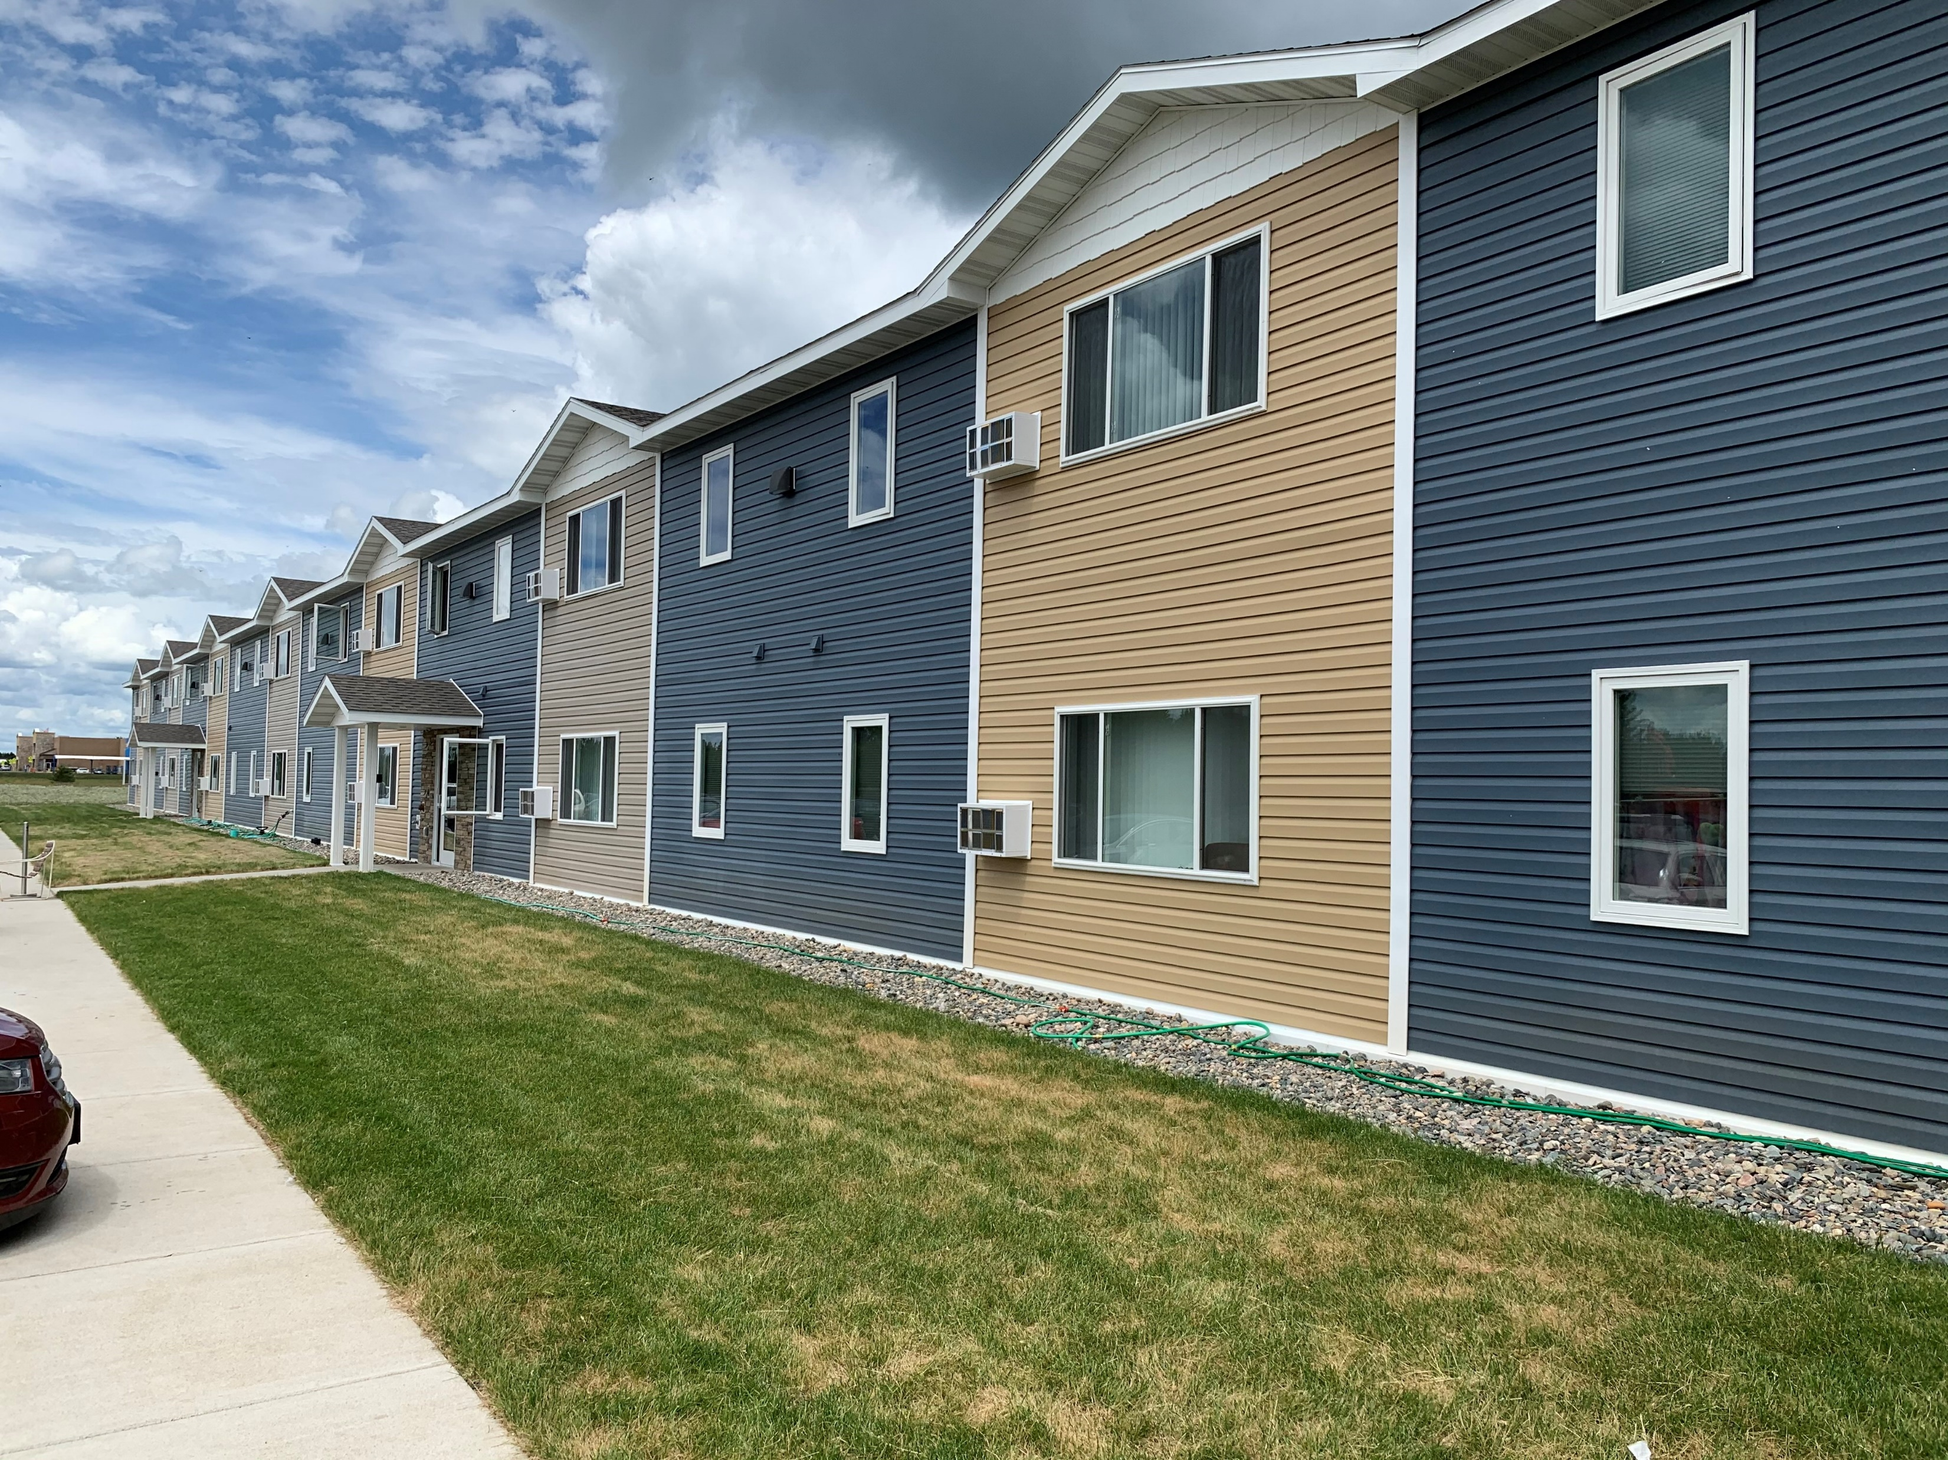
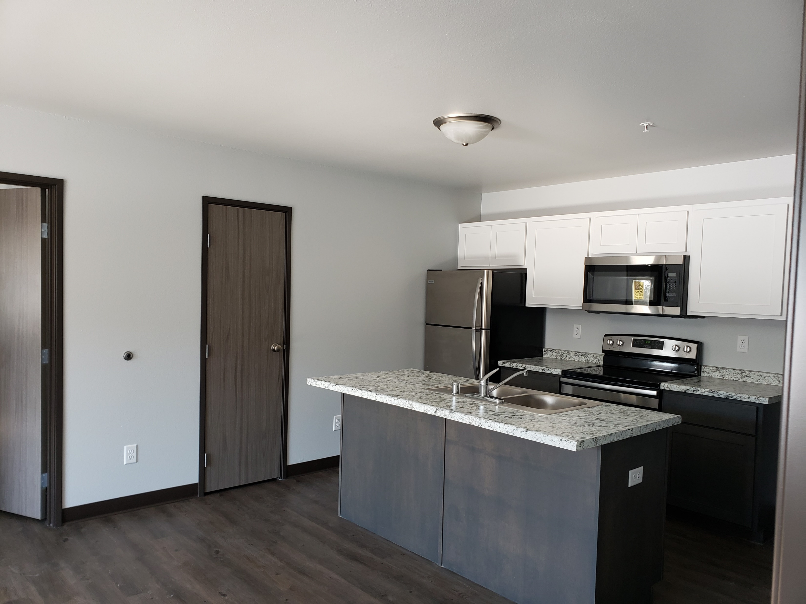
Workforce Housing Project
2 Apartment Buildings – 58 units
Rents
  Studio - $700
  1 BR - $800
  2 BR - $1,000
  3 BR - $1,200
  Tenants responsible for electricity
Minnesota Housing Workforce Housing Development Program
Maximum of 25% of TDC
Match funding of $1 for every $2
Required prevailing wages
Developer can not provide any match

Slide 6
Project Details
Costs without Prevailing Wage Rates
Costs using Prevailing Wage Rate
Category | Amount
Land | 160,900
Soft Costs | 140,170
Hard Costs | 5,715,647
Financing Costs | 86,096
Total | 6,102,813
Category | Amount
Land | 160,900
Soft Costs | 140,170
Hard Costs | 6,563,286
Financing Costs | 86,096
Total | 6,810,282
Difference is $707,469 using prevailing wage rates.
As a public/nonprofit developer there is no developer fee included in these costs.

Slide 7
Using Workforce Funding
Sources | Amount
Bank Financing | 4,158,737
Workforce Housing Development Program | 1,702,571
Required Match | 851,285
Additional Gap Needed | 97,689
Challenges of using this program in Greater Minnesota
Bank Financing (DCR vs LVR)
Capped contribution of program (25%)
Public Match Requirement
Timeline between application and approval

Slide 8
Questions?
Heartland Lakes Development Commission
Mary Thompson, Executive Director
(218) 732-2256
mthompson@heartlandlakesdc.org

