Slide 1

County Road and Bridge Funding House Transportation Finance and Policy Committee February 14, 2023

Slide 2

AMC
A voluntary association of Minnesota’s 87 counties Since 1909
The voice of county government in Minnesota
An education, training, & research resource for counties and county officials
MCEA
Engineers A
An association of the county highway engineers in the state of Minnesota. MCEA’s membership includes county highway engineers from each of the 87 counties.
MCEA is an affiliate of AMC
Notes:
AMC
447 county commissioners
81 boards have five county commissioners.
6 boards have seven county commissioners.
We also have more than 20 affiliates, generally made up of specific county functions, like the MN County Engineers Association
MCEA is an association of the County Engineers in the state of Minnesota organized under the Articles of Incorporation to promote the county engineering profession and uphold the Code of Ethics
Minnesota highway engineers are appointed by the local county board according to MN Statute 163.07
Must be a registered professional engineer
Associate members also must be PE

Slide 3
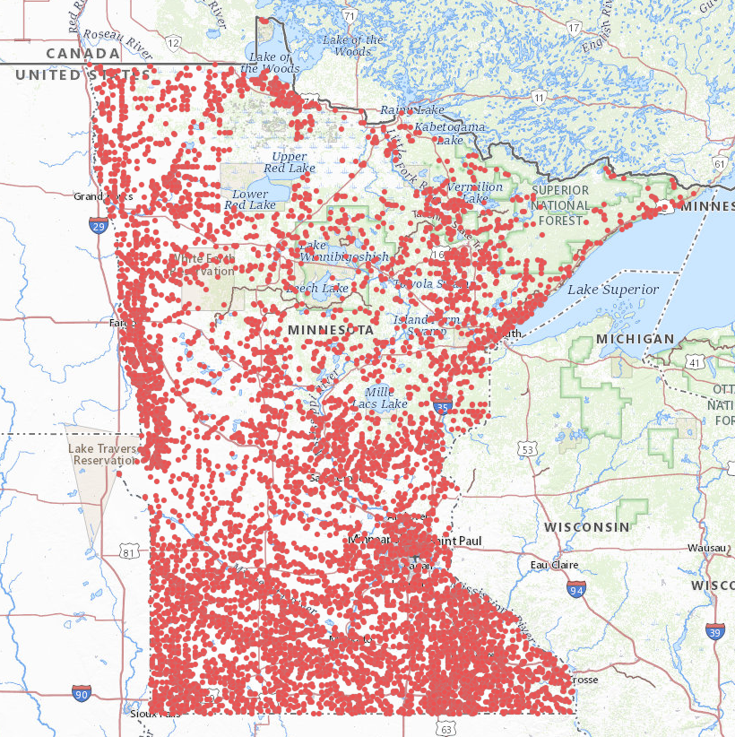

County Road and Bridges
44,526 Miles County Highways (31% of State Total)
30,671 County State Aid Highway (CSAH)
13,855 County Road (CR)
8,178 Bridges (41% of State Total)
County Highway Bridges
Notes:
Roads: 142,865 miles Statewide Bridges: 19,829 Total
County 44,526 (31%) County 8,178 – 586 on 5-year replacement list
MnDOT 11,703 Trunk Highway 3,988
City 23,146 City 1,413
Township 55,548 Township 6,250
Other 7,939 88 HISTORIC BRIDGES on local system
County highways are farm to market routes. They are the designated truck routes in our local communities – allow for freight, farming and construction. They are our major commuter routes – connecting communities to the state highway systems. Our county highways are increasingly multimodal – serving as key bus routes, and important bike and pedestrian corridors. And in many areas, they serve as the main streets – providing commercial access and helping to define our communities.
County State Aid Highway System (CSAH) : 30,659 miles of roadway – 69% of total county mileage.
CSAH funds can be used towards assisting in road construction, improvements, and maintenance of highways on the state aid system. State aid funding is established by the Minnesota Constitution and administered by MnDOT’s State Aid for Local Transportation Division through the HUTDF.
County Roads (CR): 13,855 miles – 31% of county system. HUTDF funds can not be used for CRs. Property Tax, Wheelage tax and other county revenue funds these.

Slide 4
Traditional County Funding Sources
HUTDF -> 29% of 95%
Fuel Tax, License Tab Fees, MVST, Sales Tax Auto Parts and Rentals, Misc.
Wheelage Tax -> Up to $20/vehicle
Local Option Sales Tax –> Up to ½ %
Federal Funds -> Competitive through MPOs/ATPs -> IIJA
State Bonding for Local Bridges (LBRP)
State Bonding for Local Roads (LRIP)
State Bonding for Local Road Wetland Replacement (LRWRP)
County Levy
County GO Bonds
Notes:
HUTDF fund sources are mostly constitutionally dedicated except for GF transfer for Sales Tax on Auto Repair Parts and Rental Sales Tax and LMVST. These are Statutorily dedicated.
Remainder of funding sources are local government initiated, grants, or one-time funds.

Slide 5



Fuel Tax
$909 Million
Townships
Town Bridge Account
$20.3 Million
16%
2023 MINNESOTA HIGHWAY TAX DISTRIBUTION FUND
Feb. 2023
License Fees
$840 Million
Townships
Town Road Account
$38.7 Million
30.5%
5%
Less Collection Fees, Transfers, etc..
53.5%
TOTAL HIGHWAY USERS FUND
$2.57 Billion
Turnbacks
Flex Highway Account
$65.6 Million
Motor Vehicle Sales Tax
$616 Million
Counties
$686.1 Million
MnDOT
Trunk Highway Fund
$1.493 Billion
$703.6 2022
Interest/Other
$14 Million
95%
Less Collection Fees, Transfers, etc.
62%
DNR
$5.2 Million
Counties
CSAH Fund
$698.3 Million
29%
Research, Admin, Disaster
$17.2 Million
Sales Tax Auto Parts
& Rental Sales Tax
$194 Million*
After adjustments
9%
Cities
MSAS Fund
$217 Million
Cities
$215.2 Million
*Transfer From GF
$145.64 M (fixed) Sales Tax on Auto Repair Parts, Tires, Accessories
Research, Admin, Disaster
$5.4 Million
Notes:
Fuel Tax: 28.5c/G Mn- 100% to Road and Bridges (sidewalks, on road bicycling). 3.5c used for MnDOT Debt Service. 0% to Transit. Federal tax 18.4c/G – R&B & transit
License (TAB) Fees: Current law sets a base fee of $10 to register your vehicle, but then adds an additional cost of 1.25 percent of the value of the vehicle. 1.285% for 2020 and newer. The value of the vehicle is depreciated by 10 percent each year until year 11. For year 11 and on, the minimum amount paid is $35. 100% to Road and Bridges
MVST: 6.5% Sales Tax. Minimum 40% to Transit. Rest to HUTDF. Currently 40-60
Interest/Other: Fees on Vehicles, Interest on HUTDF, LMVST (11% or $6.7M). Only HUTDF portion shown. Remainder of LMVST($60.7M Total in 2023) +/- adjustments split 38% GM Transit, 38% 5-Metro Suburban Counties, 13% Local bridges.
Sales Tax on Auto Repair Parts and Rental Cars –Starting in 2020 100% of rental sales tax and $145.64 from sales tax on auto repair parts (approx. 55%) was transferred to HUDTF.
CSAH Funds distributed by:
62% Apportionment Sum: 38% Excess Sum:
10% Equalization 40% Motor Vehicle Registration
10% Motor Vehicle Registration 60% Money Needs
30% lane miles
50% CSAH money needs – complex computer program based on traffic, actual costs, 60 year lifecycle.

Slide 6
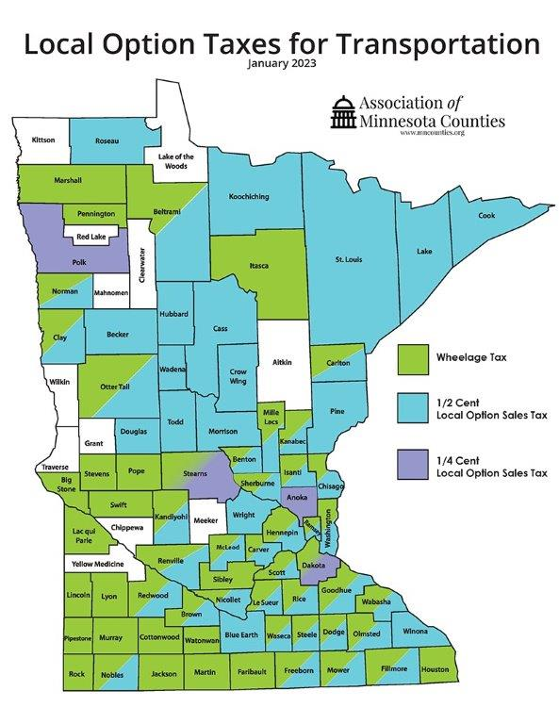
Wheelage Tax
Rate: up to $20 per vehicle charge on vehicles housed in the county
Collection: With annual tab fees
Use: Highway purposes; used for CRs or CSAHs, facilities.
How enacted: By County Board approval
55 counties have adopted
Green counties on map
$54 Million in 2020
Notes:
$54 M total, 36 M in Metro (2/3), 18M GM (1/3)
$10, $15, or $20 per vehicle
Vehicles that do not require a registration don’t pay.
Also exempt vehicles include:
• Motorcycles
• Motorized bicycles
• Trailers
• Mopeds

Slide 7
Local Option Sales Tax
Rate: Up to ½ of 1 percent on retail sales within the county
Use: A specific transportation project, transit capital expenditures as well as operating costs
How Enacted: by County Board approval
55 counties have adopted
Blue/purple counties on the map
$420 Million in 2021
$259 Million 8 Metro Counties, $161 Million 43 GM Counties
Notes:
Total Revenue Statewide in 2021 = $420 M. Hennepin $138M, Ramsey $46M, or $184M, 44% from 2 counties.
$259M from 8 Metro counties, $161M from 43 GM Counties.
In the Metro the revenue is used for a combination of transit and roads. Hennepin and Ramsey Counties use most of their funds for Transitways.
Suburban Counties use a substantial amount of their revenue for Trunk Highway Projects
GM Counties don’t generate much revenue unless they have a regional center.
Rural counties rely on the HUTDF way more than the sales and wheelage tax.

Slide 8
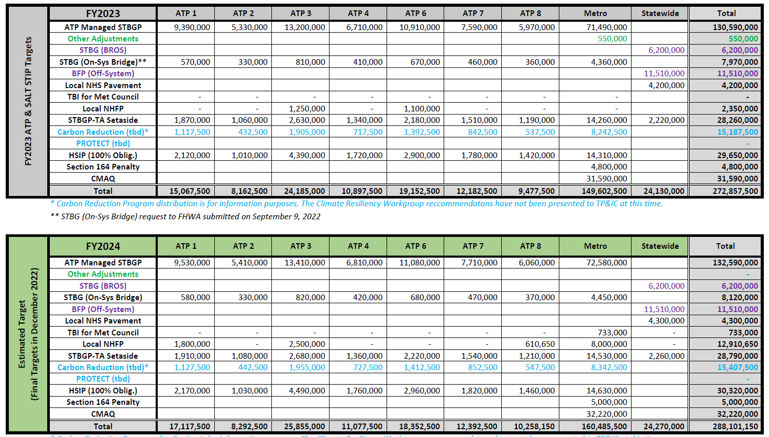
Federal Funds IIJA
Roads, Bridges, Transit, Bike-Ped, Safety
~33% Increase from FAST-ACT
Competitive Through ATPs/Met Council/MnDOT
Metro -> $155 Million/Year
GM -> $101 Million/Year
Statewide -> $24 Million/Year
$30 Million+/-in Local Match for County Road and Bridge Projects
Notes:
Estimate of funds is based on MnDOT Targets. Actual awarded funds can vary form these.
IIJA is a 5-year bill. 2022- 2026. Total $4.6Billion. 70-30 MnDOT-Locals. $1.4B local or $280M per year. Majority of local share of funds are distributed through ATP/MPOs.
It should be noted that approximately half of the roadway funds in the Metro area are used for TH Projects led by local agencies (~$70 million in 2-year cycle).
It is estimated that County Road and Bridges will get about $150 M per year in federal funds Statewide. Took out CMAQ(Transit), TA(trails), MnDOT (TH Projects) and Cities (assume cities get 20%).
Takeaway: Significantly more money than in the past, however GM Counties still have a limited pot of money to compete for. Counties also struggle coming up with local match, usually 20% match (10% for HSIP, 0%? for off system bridges)
Local match needs for IIJA local roads and bridge projects = $33 Million
HSIP, SRTS administered by MnDOT. SRTS considered a state program.
Some Other Programs are available
Locals can also apply for DOT Discretionary Grants. RAISE, BUILD, INFRA etc. These are highly competitive programs and require significant resources and planning. Applications cost $30-40k. Projects require significant planning and predesign to be competitive. Awards almost always require a local match of more than 20%.

Slide 9
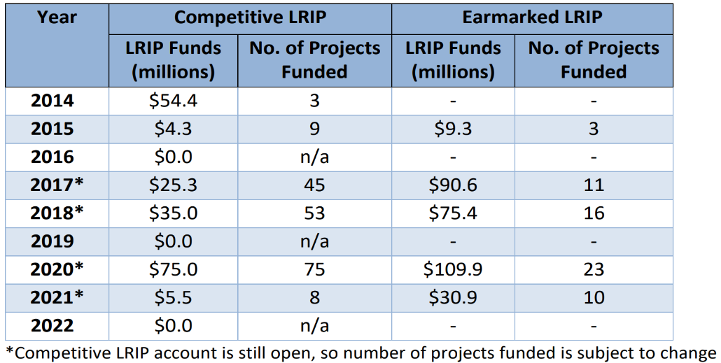
Local Road Improvement Program (LRIP)
Grant program administered by Office of State Aid.
LRIP provides funding assistance to counties, cities, and townships for constructing or reconstructing local roads.
Projects are selected through a competitive solicitation process.
LRIP Advisory Committee provides recommendations as to which projects will be funded.
Awards are balanced by MnDOT District.
2020 Solicitation: 425 applicants requesting $344 Million.
Unfunded: $263.5 Million
Notes:
First funding for LRIP was in 2003.
Extremely high demand for funding.
Last solicitation 2020. 425 Submittals. Total request $344M. 83 Funded, $80.5 Million with total project cost $261 million.
38% went to Counties, 29% MSA Cities, 20% Small Cities, 13% Townships. Balanced by District throughout the state.
Additional 33 projects funded through direct appropriation (earmarks). $140.8 million
2020 and 2021 LRIP solicitation program and project update-19743053-v1.PDF
The committee is made up of one county commissioner, one county engineer, one city engineer, two city council members or city administrators (one each from cities with population less than and greater than 5,000), and one town board member (appointed by the Minnesota Association of Townships)

Slide 10
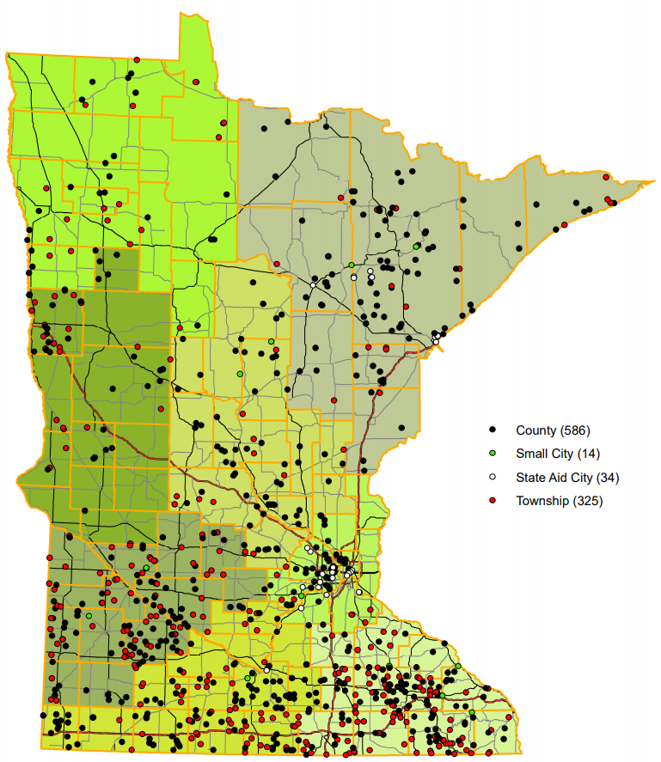
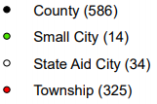
Local Bridge Replacement Program (LBRP)
15,842 bridge structures on the local system.
8,178 (41%) are on county system.
The LBRP provides local agencies transportation funding for the reconstruction, rehabilitation and/or removal of bridges.
Master Bridge Priority List: a compilation of all eligible local bridge projects identified by local bridge owners as priority for replacement or rehabilitation.
959 ($781M) on list, 586 ($462M) County
$289 M LBRP Needed
2023-2027 Master Bridge Replacement Priorities
959 Bridges
$781 Million
Notes:
In 2022 there were 19,829 Bridges in Minnesota
3988 Trunk Highways
15842 Local Roads:
8178 County
1413 City
6250 Township
Locals submit their 5-year priorities on an annual basis. Bridges must be eligible for replacement or rehabilitation based on condition ratings. (In 2020 1124 were eligible)
The LBRP is funded with State Bridge Bonds and Leased Motor Vehicle Sales Tax. 13% of LMVST goes to local bridges. (LMVST: $9M in 2022. Expected to drop to $6M in 2023.) In 2020 the $30 Million in GO bonds went to bridges and in 2021 $14M in State General Funds went to local bridges.
The program is administered by MNDOT Office of State Aid. Projects are funded on a first come first serve basis. The program is extremely efficient.
Locals submit their 5-year priorities on an annual basis.
Most County Bridges are funded 50-50 LBRP/County
Maximum award is $7M, above which must be a special legislative appropriation.

Slide 11
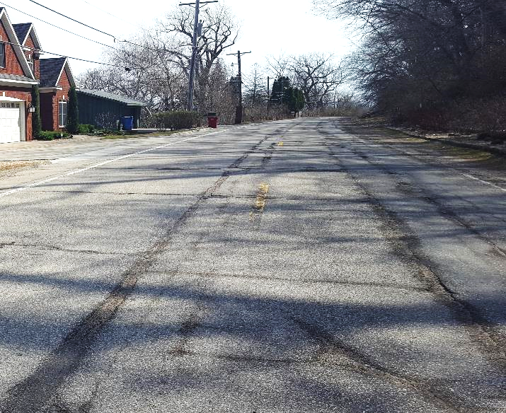
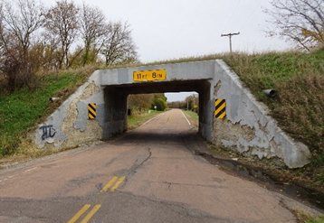
Transportation Funding Needs
County Road and Bridge Needs Estimated at $1.2 Billion Per Year
TFAC Report (2012)-Annual Funding Gap (Scenario 3):
$450 Million CSAH
$450 Million County Roads
CSAH Needs Study
2022 Construction Needs
$20 Billion for 25 years (CSAH Only)
Cost to replace system on 60-yr lifecycle.
$800 Million per Year (+$360 M for County Rds)
Available from HUTDF $422 Million, CSAH Only (60%)
GAP $378 Million (CSAH) + ($250M for County Rds*)
Assume $150 Million/Yr IIJA - > Total Gap $478 Million/Yr.
Recent inflation has grown this number
* Assumes County Roads get resurfaced only every 20yrs at $180k per mile. Paid with levy, wheelage tax, LOST
Notes:
TFAC
• Scenario 1 Status Quo — This scenario assumes no new funding or inflationary adjustments to the current funding stream.
• Scenario 2 - Maintaining Current Performance — This scenario assumes sufficient funding to maintain and operate the system in a condition equal to today, including existing service levels and condition ratings.
• Scenario 3 - Economically Competitive / World Class — This scenario assumes a greatly improved road surface and bridge condition, additional safety improvements, congestion reduction and some regional highway expansions, as well as significant transit and modal enhancements.
County Road Funding Gap is estimated but is reasonable as revenue for County Roads is very limited. County Levy, Wheelage Tax. Not eligible for HUTDF
CSAH Needs Study:
The Screening Board looks at 25-year construction needs. The needs system is a “look back” that considers actual average unit prices for the past 5 years (2016-2020 here). The NEEDs system calculates a 60-year Lifecyle Cost of the county system, annualized and then applied for 25 years. Reporting 25 years' worth is a statutory requirement.

Slide 12
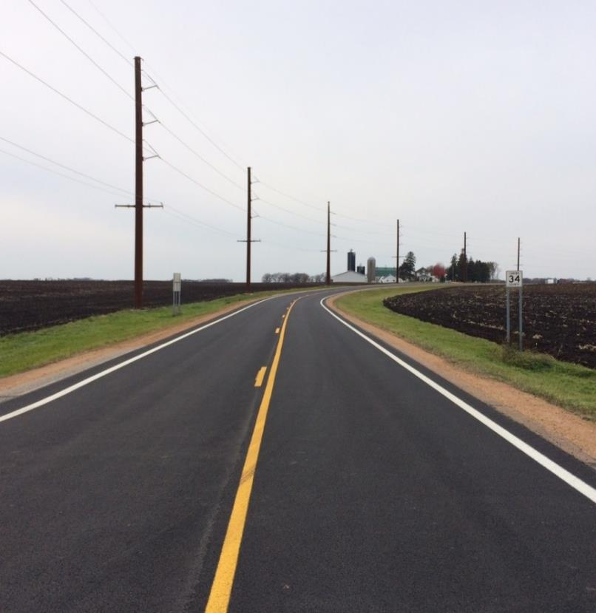
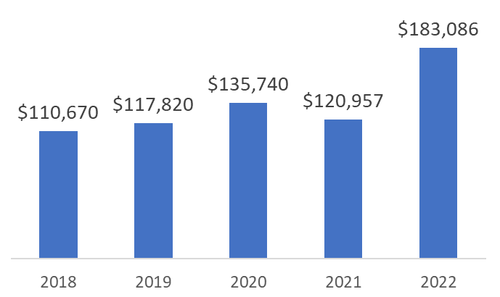
Inflation Impact to Counties
Bituminous Road Resurfacing (2-lane rural)
36% increase in one year
From $120K per mile average to $183K
$2 Million Budget (Carver County)
16.7 Miles per year (2018-2021) -> 17-year cycle
11 Miles per year 2022 on - > 25-year cycle
Resurfacing Cost Per Mile 2-Lane Rural Road in Carver Co.
Notes:
Carver County budgets $2million in County Levy for roadway resurfacing.

Slide 13
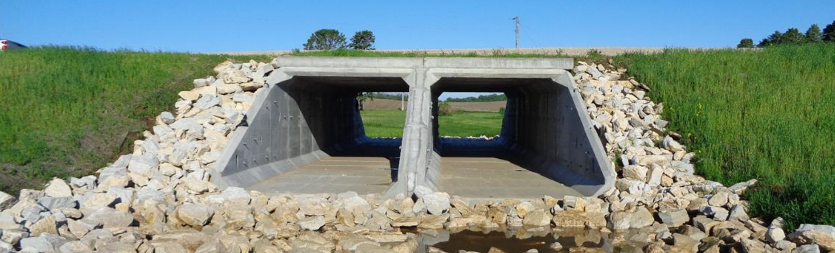
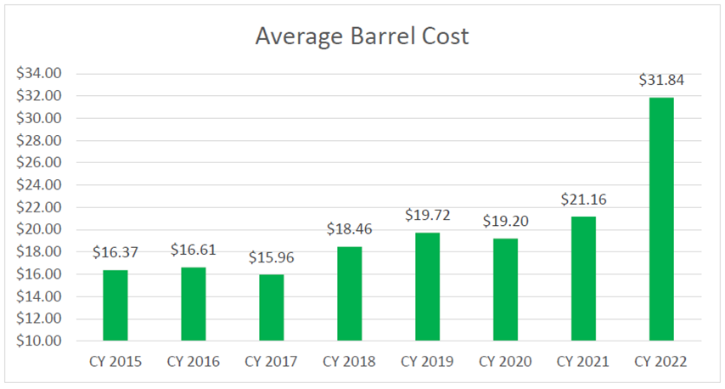
Inflation Impacts to Counties
Concrete Box Culverts
50% increase in one year
Many old bridges are replaced with Concrete Box Culverts
100 +/- installed each year
Supply Issues – extended wait time. 9 months.
Avg Barrel Volume Cost: From MnDOT State Aid Bridge Office
Notes:
The precast concrete culvert costs escalated up 80 - 100 % in some counties.
We have only two Minnesota precasters fabricating box culverts. Rinker in Elk River and Oldcastle in Hancock/Cannon Falls.
Skilled labor and welded wire fabric shortages have exasperated the situation.

Slide 14
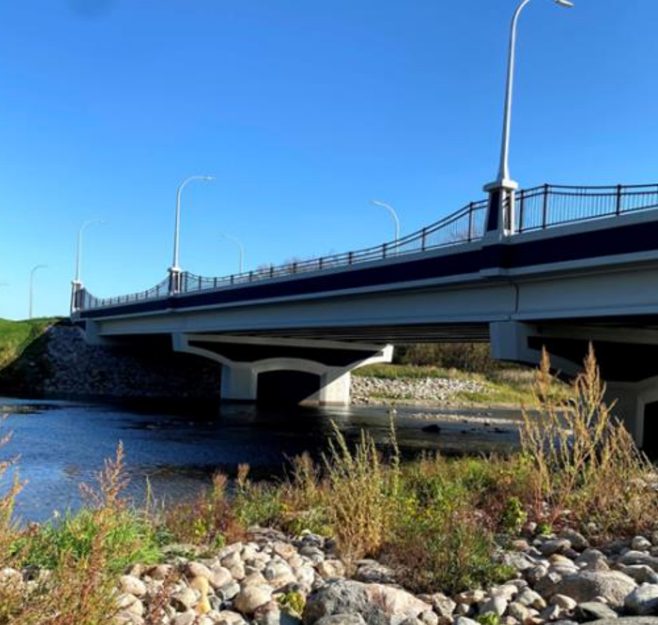
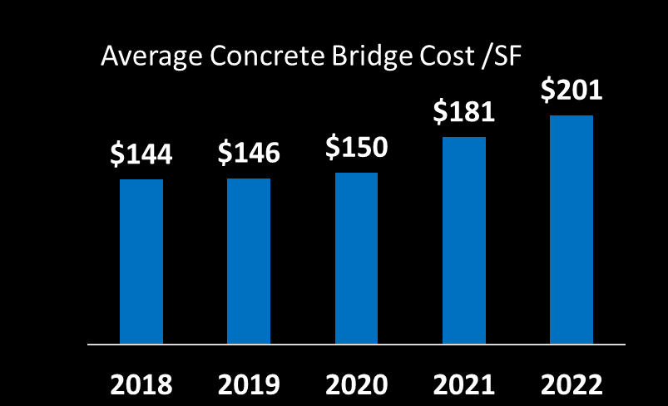
Inflation Impacts to Counties
Bridges
25% Cost Increase in 2 years.
Locals build approximately 50 Bridges per year
95% of County Bridges are Concrete
Prestressed Concrete Beams (PCB)
Cast-In-Place Concrete Slab (C-Slab)
Bridge 57526, CSAH8 over the Red Lake River, Thief River Falls, Pennington County.
Notes:
Stable prices 2015-2020.
Bridge 57526, CSAH8 over the Red Lake River, Thief River Falls, Pennington County.
Note, C-Slab means cast-in-place concrete slab bridge, and PCB means prestressed concrete beam bridge. Minnesota Locals predominately build C-Slabs and PCB type bridges. They build roughly 50 bridges annually and 95% of them are generally either C-slabs or PCB bridges. PCB structure cost was up 6 percent and C-SLAB structure cost was up 16 percent in 2022.
Regarding PCBs, Rinker in Elk River pretty much supplies Minnesota’s PCB needs right now. With essentially only one fabricator in Minnesota producing PCBs we’re likely headed into more supply and demand issues.

Slide 15
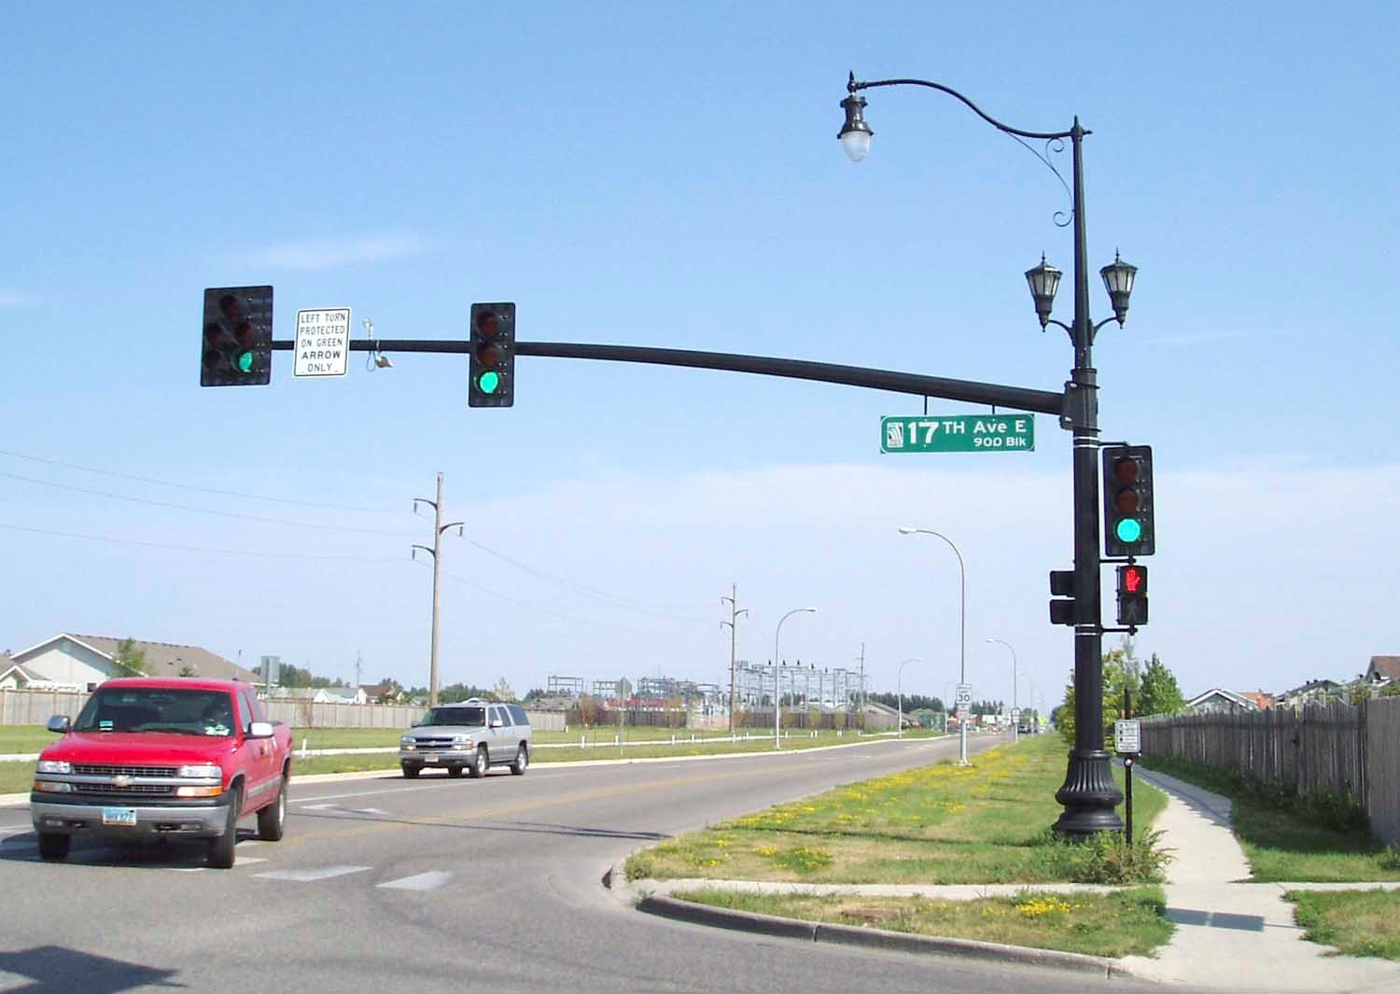
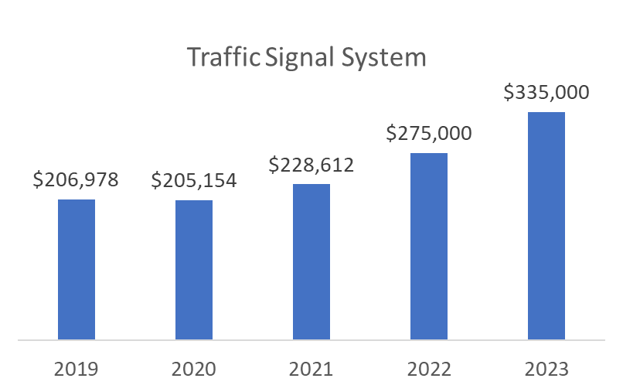
Inflation Impact to Counties
Traffic Signal System
31% Increase in 2 years.
Traffic Signal System Costs in Anoka County

Slide 16
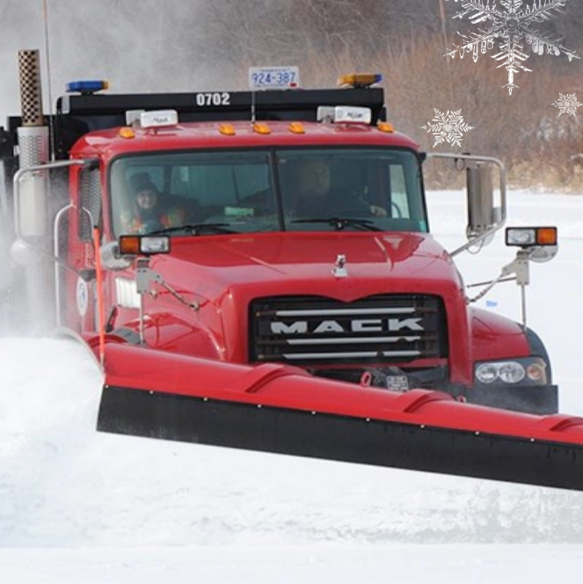
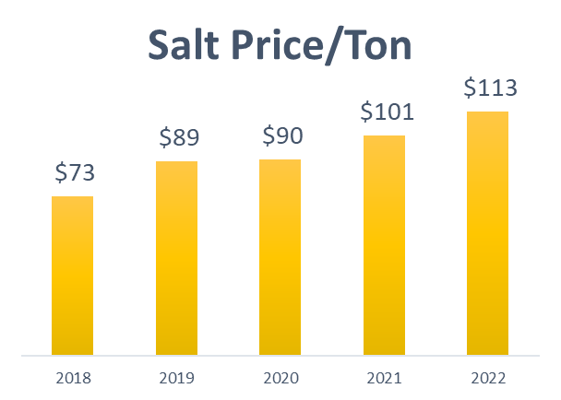
Inflation Impact to Counties
Equipment Up 25% from 2020
Tandem Snowplow $260k to $340k
Mid Size Wheel Loader $223k to $280k
Mid Size Excavator $232k to $275k
Skid Steer $54k to $74k
Salt up 20% from 2020
$90/Ton to $113/Ton
Up 35% from 2018
Notes:
Western Star 4700SF Tandem Plow Truck Cab & Chassis. $123,056.87 to $144,761.00
Towmaster Up-Fit Dump Box and Plows. $137,581.00 to $193,723.00
Tandem Plow Truck with Up-Fit Complete Total. $260,637.87 to $338,484.00
Bobcat T76 T4 Skid Steer. $54,389.78 to $73,925.00 T76 Compact Track Loader - Bobcat Company
John Deere 644P Wheel loader. $233,723.83 to $277,845.00 644 P-Tier | Mid-Size Wheel Loader | John Deere US
John Deere 250G Excavator. $232,755.77 to $275,309.75 250G LC | Mid-Size Excavator | John Deere US
Toro Groundsmaster 4000-D Turf Mower. $58,368.17 to $80,581.02

Slide 17
Transportation Funding Requests
Increase Motor Fuel Tax, Registration Fees, MVST, Electric Vehicle Fees
Dedicate 100% of Sales Tax on Auto Repair Parts to Transportation
General Fund Appropriation to CSAH Fund for Revenue Loss and IIJA Local Match
Bonding for Local Bridges (LBRP), Local Roads (LRIP)
Bonding and Base Funding for Local Road Wetland Replacement Program (LRWRP)
Notes:
Make preservation on historic bridges eligible for LBRP. We support HF1349 - Rep. Tabke (MnDOT housekeeping bill)

Slide 18
Fuel Tax, License Fees, MVST, EV Fees
Increase Fuel Tax by 5c/G - > $160 Million ($32M/c)
CSAH Increase $44 Million
Increase Tab Fees - > $175 Million in FY 24 (Gov. Proposal)
CSAH Increase $48 Million
Increase MVST from 6.5% to 6.875% - > $30 Million in FY 24
CSAH Increase $8 Million
Increase EV Fees ($75 to $150) or charge per KWH- > $3.3 Million?
CSAH Increase $1 Million
New Retail Delivery Fee $0.40 to $0.50 per delivery -> $67-77 Million HUTDF
CSAH Increase $18 Million
Notes:
Show Governors proposal for License Tab fees for information only. Other proposals were considered last legislative session.
License (TAB) Fees: Current law sets a base fee of $10 to register your vehicle, but then adds an additional cost of 1.25 percent of the value of the vehicle. 1.285% for 2020 and newer. The value of the vehicle is depreciated by 10 percent each year until year 11. For year 11 and on, the minimum amount paid is $35. 100% to Road and Bridges
EV fee increase or per KWH charge is needed as most EVs are much heavier than gasoline engines and produce more wear and tear on the road and bridge system.
EV estimate is based on 45,000 EVs registered in MN. Number is increasing. Using a KWH charge would be beneficial as it would generate revenue from EVs outside Mn.

Slide 19
Sales Tax on Auto Repair Parts
Current law : $145.6 Million to HUTDF -> Approx. 45.5%
$40 Million to CSAH
Request: All remaining revenue to Transportation - > +$174 Million (FY 23)
100% to HUTDF -> Increase of $49.6 M to CSAH
Alternative: New formula for all revenue -> $320 Million (FY 23)
45.5% to HUTDF (Same as current)
7% Small Cities -> $22.4M
7% Townships -> 22.4 M
25% Transit -> $80 M
10.25% CSAH -> $32.8 M
5.25% MSAS - > $16.8 M
-> Trunk Highway Fund - no new money (current amount remains the same: $86M)
Notes:
Alternative proposal includes transit and small cities.
If this formula is used to bring in small cities and townships, the Counties and MSA cities are requesting a direct allocation percentage as shown, instead of going through the HUTDF formula. We would get less than a 100% allocation through the HUTDF but it is close ($32.8M vs $49.6M).
To do this MnDOT would not get any of the additional allocation beyond what current law gives them.

Slide 20
General Fund Appropriation to CSAH
2022 CSAH Fund $703.6M
2023 CSAH Fund $686.1M
$17.5M less
Factor in inflation → $25.7M
$1 in 2018 has $0.68 buying power in 2022
CSAH Request $25.7 Million FY 23
IIJA Local Match $30 Million/Yr. FY23-26
From MnDOT Construction Inflation Report Oct 2022
Notes:
If you look at the buying power of the total fund, the impact of inflation is dramatic:
With 8% Inflation:
$759.9M needed in 2023 to match buying power of 2022
2023 CSAH Fund $686.1M
$73.8M Less
If you look ahead the picture is not bright either. MnDOT is projecting a HUTDF increase of 1.2% in 2024, 1.4% in 2025, 1.9 % in 2026. If inflation doe not stabilize we will be further and further behind.

Slide 21
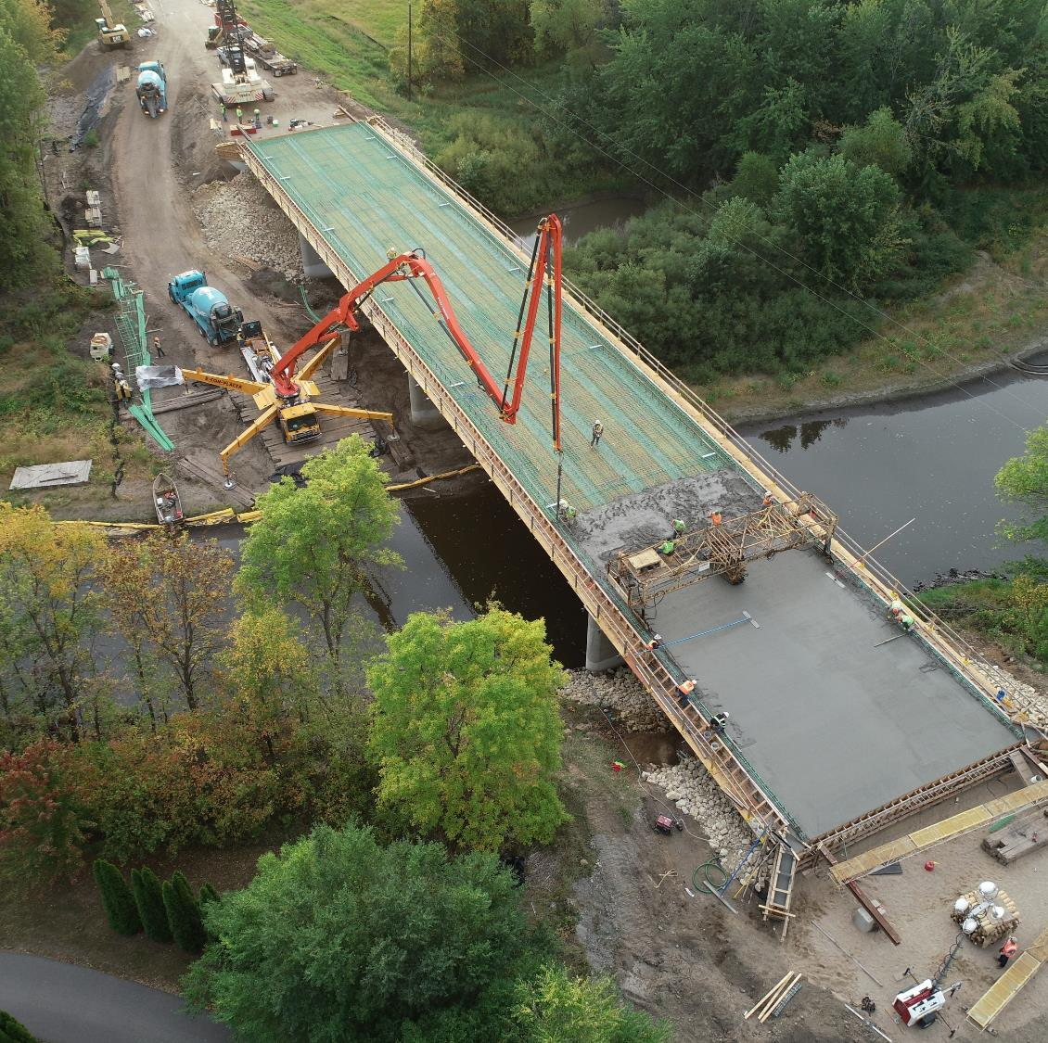
Bonding
Local Bridge Replacement Program -> $200 Million
Local Road Improvement Program -> $200 Million
Local Road Wetland Replacement Program - > $17 Million

Slide 22
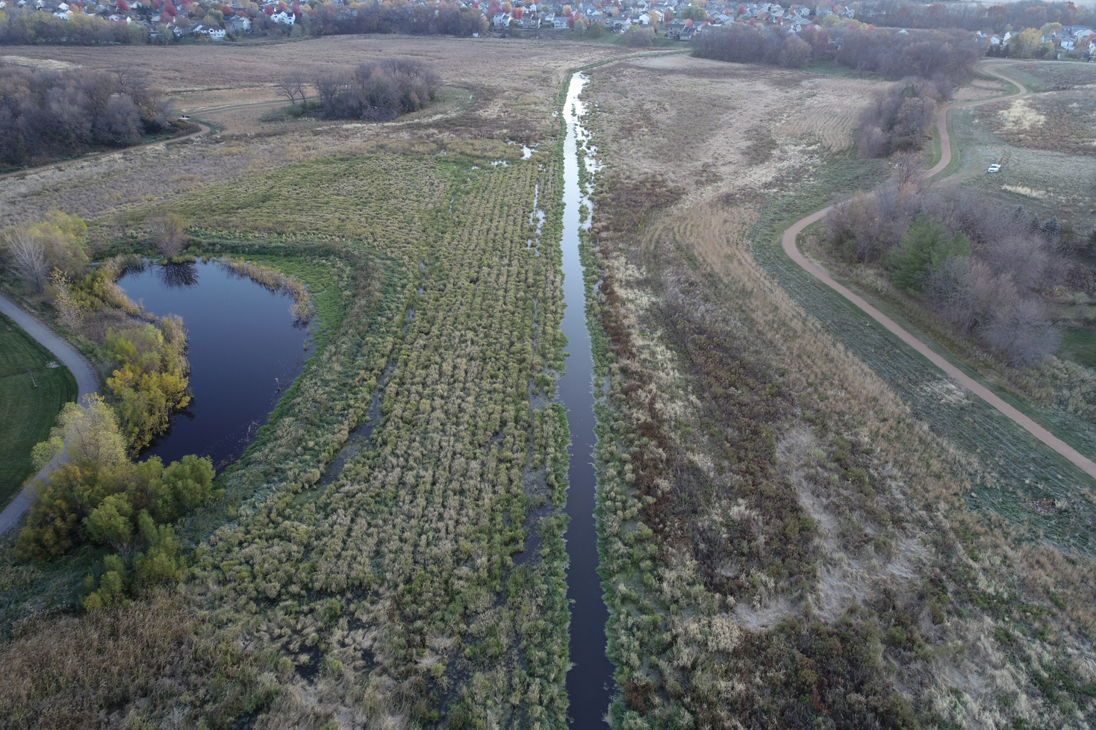
Base Funding for LRWRP
Annual General Fund Budget of $7 Million

Slide 23
County Road and Bridge Funding Request Summary
20% minimum increase from sustainable user-based fees to CSAH fund - > $140 million per year
One time GF appropriation to CSAH for revenue reduction, inflation - > $25.7 million
GF appropriation for IIJA local match - > $30 million per year 2023-2026
Local Bridge Replacement Program - > $200 million bonds
Local Road Improvement Program - > $200 million bonds
Local Road Wetland Replacement Program - > $17 million bonds + $7 million annual base funding.
Notes:
Estimated Annual Gap for CSAH = $387M 20% increase in CSAH funds reduces this by $140 million or 36%
Estimated Annual Gap for CR = $250M. County Levy, Wheelage Tax, LOST only options.

Slide 24
Thank-you

