Slide 1
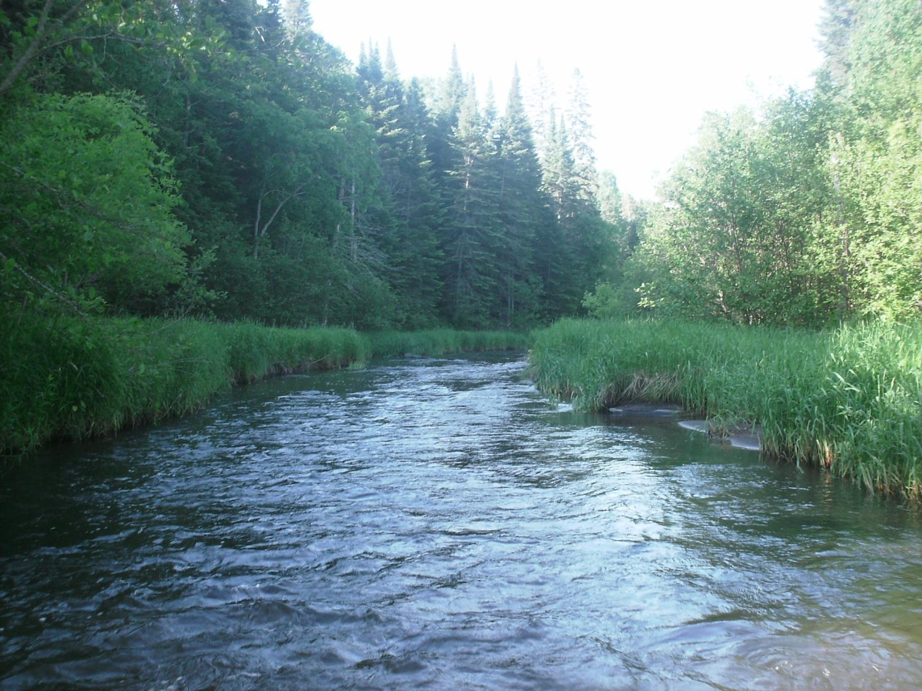
Legislative Subcommittee on Water Policy February 2022
Jim Stark
1

Slide 2
Subcommittee Structure
Bi-Cameral
Bi-Partisan
12 Members

Slide 3
Subcommittee--12 Members
Body | First Name | Last Name
Sen | Chris | Eaton |  |  | Co-chair
Rep | Todd | Lippert
Sen | Rich | Draheim
Sen | Kent | Eken
Rep | Peter | Fischer
Rep | Patty | Acomb
Sen | Michael | Goggin
Rep | Josh | Heintzemann
Rep | John | Poston |  |  | Co-chair
Rep | Paul | Torkelson
Sen | Bill | Weber
Sen | Chuck | Wiger

Slide 4
Statutory Powers and Duties
Reviews water reports and data
Informs members about water issues and policy
Makes recommendations to the legislature
Prepares water-related bills
Shares data and information with LCCMR, CWC, legislative standing committees

Slide 5
Legislative Process 2022
Fifty legislative recommendations were evaluated
Surveys to Subcommittee Members and stakeholders
Stakeholder meetings held--comments and suggestions
Prioritized to 13 topics
Subcommittee consensus reached on 13 topics
Bills are drafted and being introduced

Slide 6
Bills in Process
B1: Sustainable Water: (MGS)
B15: Watershed District Funding: Emily Javens (MAWD)
B3:Improving Water and Agriculture: Precision Ag: Dr David Mulla (UM)
B5: Voluntary private well testing
B7: Water safety plans for cities– a pilot: Jeff Broberg (MNWOO)
B8: Soil-health action plan including research, implementation, and outreach
B6: Identifying vulnerable aquifers– coordinated monitoring
B9: Water Commission and the Wastewater Advisory Council
B10: Complete land preservation goals for the Upper Mississippi
B11: Ensure drinking water free from lead
B4: Riparian buffer tax credit
B12: Encourage groundwater recharge where needed
B 13: Keeping water on the land, water retention: Jim

Slide 7
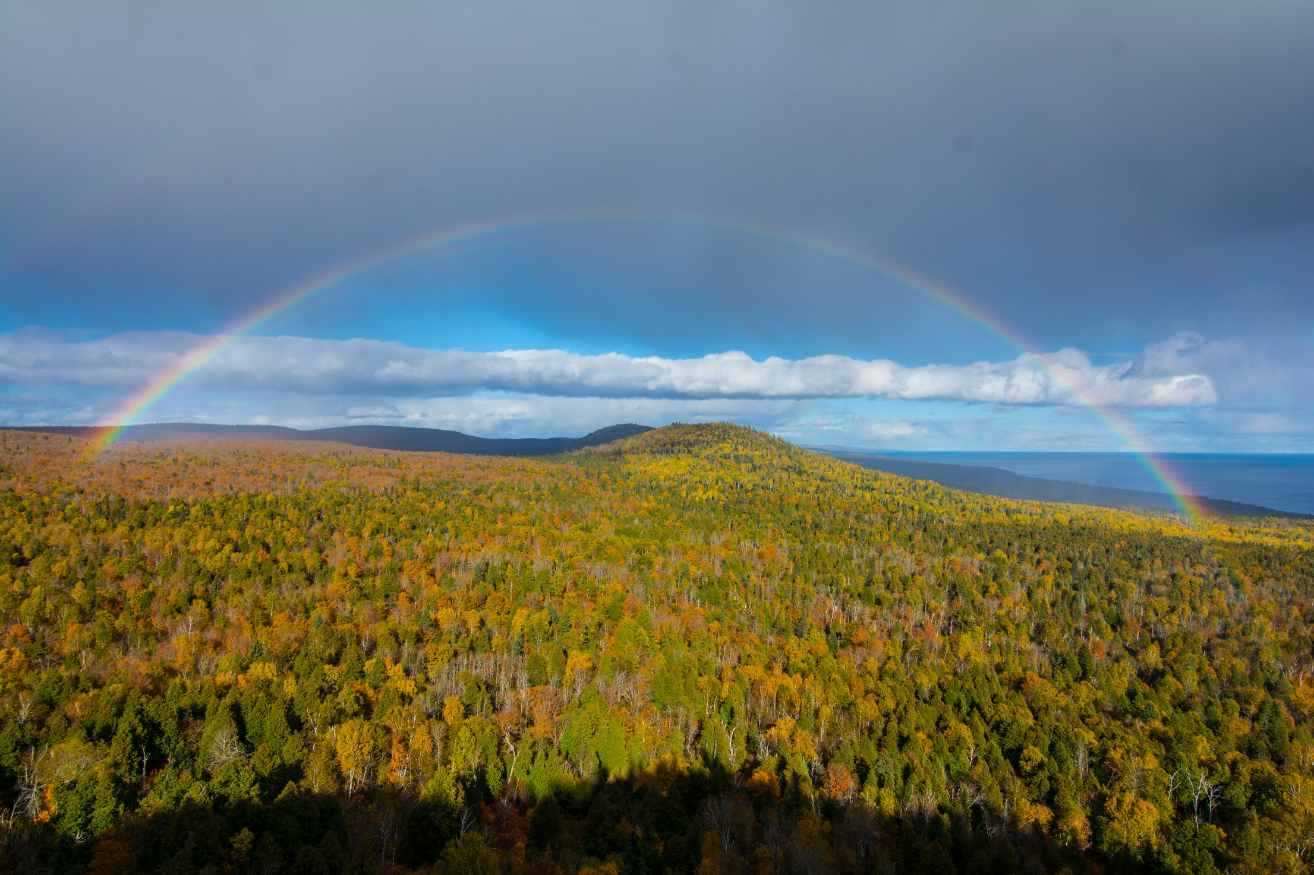
Thanks!
Notes:
to the northern forests

