Slide 1
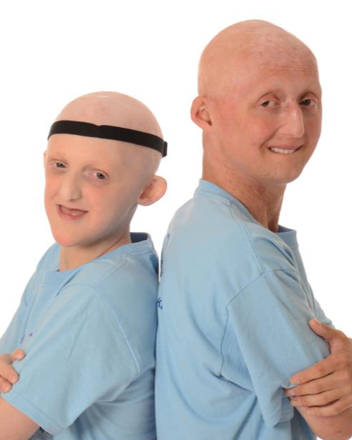
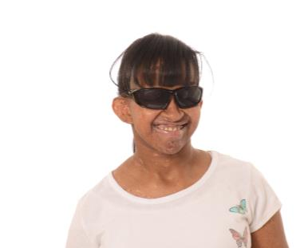
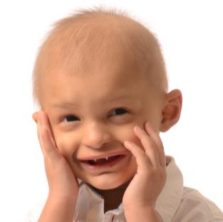
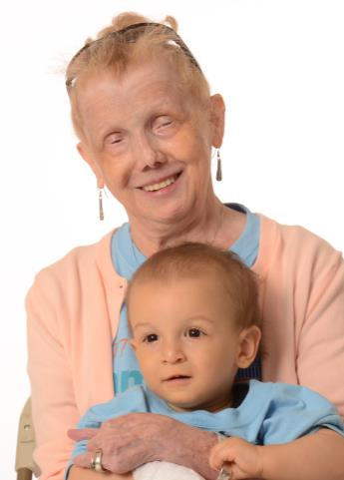
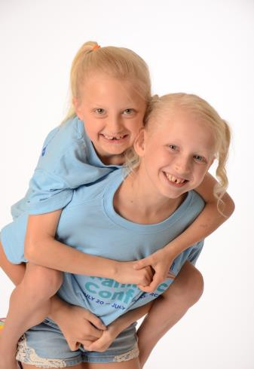
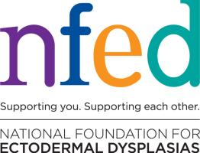
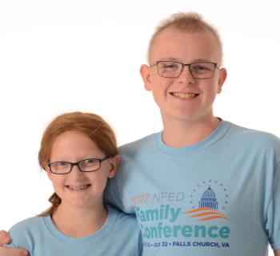
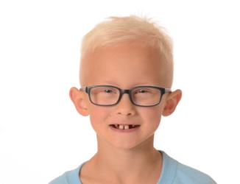
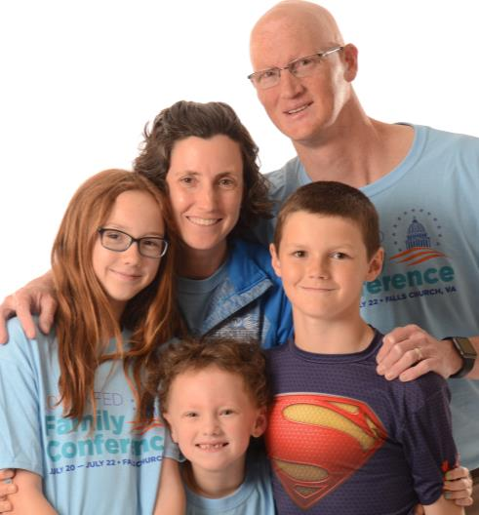
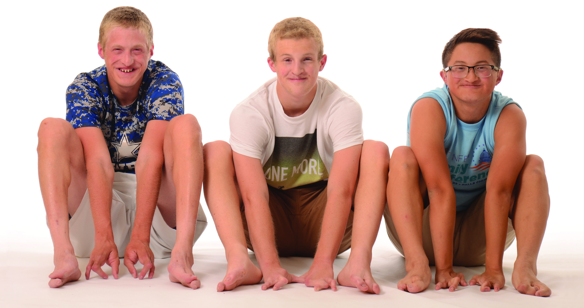
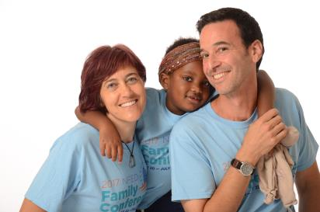

Slide 2
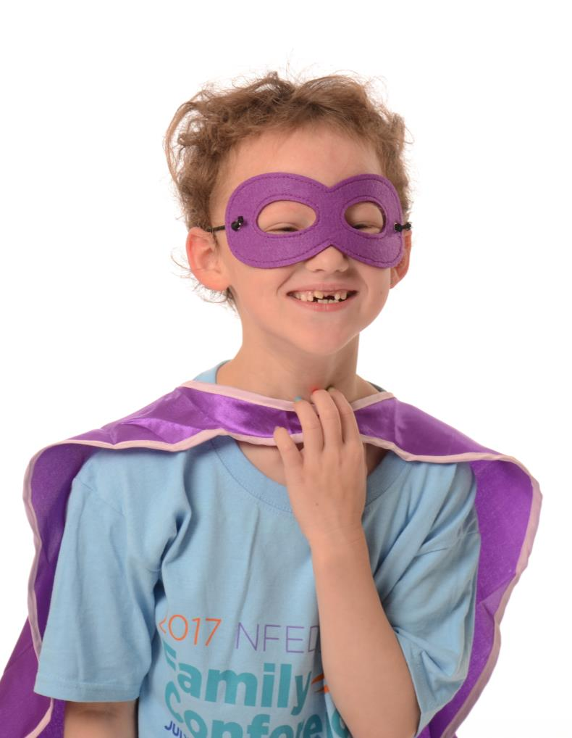
Our inspiration-Sammi

Slide 3
What are Ectodermal Dysplasias?
Syndrome of changes in the ectoderm during infant development due to genetic modifications
  Abnormal or missing teeth
  Abnormal to no sweating
  Severe eczema/itching
  Abnormal hair
  Abnormal nails
  Abnormal to missing breast tissue
3:10,000 birth → ~20 per year in MN (65,000 delivers in MN per year)
Most common subtype is Hypohidrotic Ectodermal Dysplasia (don’t sweat)
Other types include Goltz, EEC, AEC. ~180 subtypes
Prone to respiratory infections
Potentially severe skin erosions
Possible hand and foot congenital defects
Possible blindness over time
Possible facial deformities
Possible cleft lip/cleft palate

Slide 4
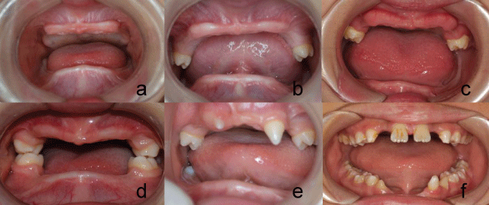
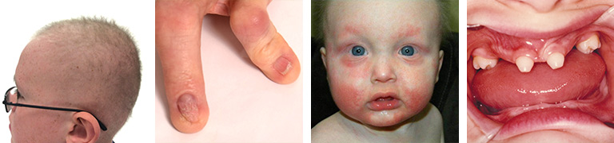
Ectodermal Dysplasias

Slide 5
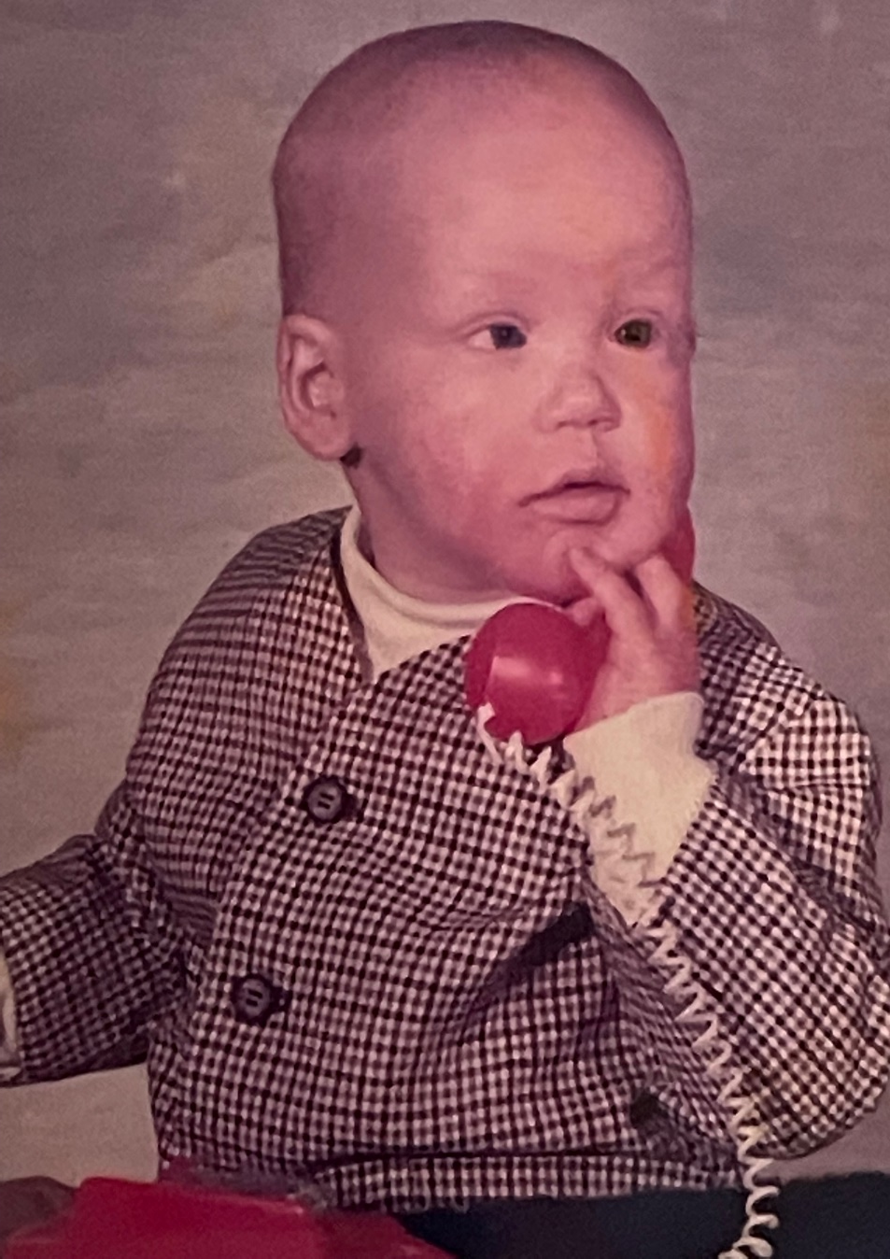
Call in a consult! “What do I got doc?”
Diagnosed at 5 yo
First set of dentures at 5 yo
Worked with multiple health systems across Minnesota
Multiple specialist… Family medicine, ENT, Dental, Dermatology, Genetics, Ophthalmology.
Insurance denials for dentures
Strong fashion sense

Slide 6
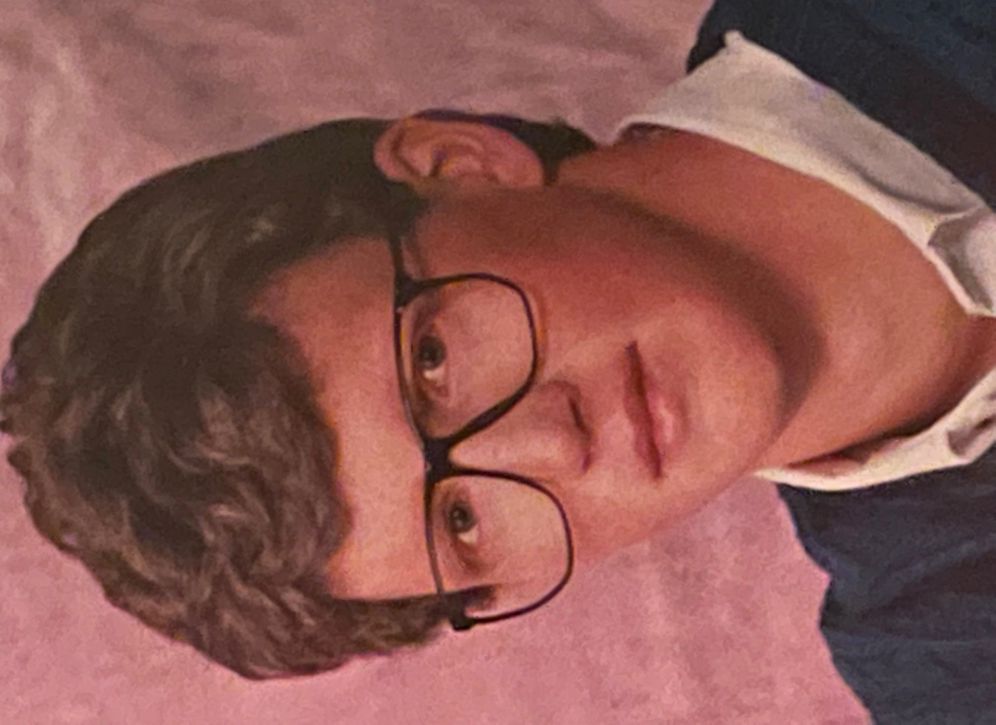
Gotta love senior pictures!
Strived to be normal
Wore a wig from 7th grade to my wedding day
Little to no coverage for hair prosthetics

Slide 7
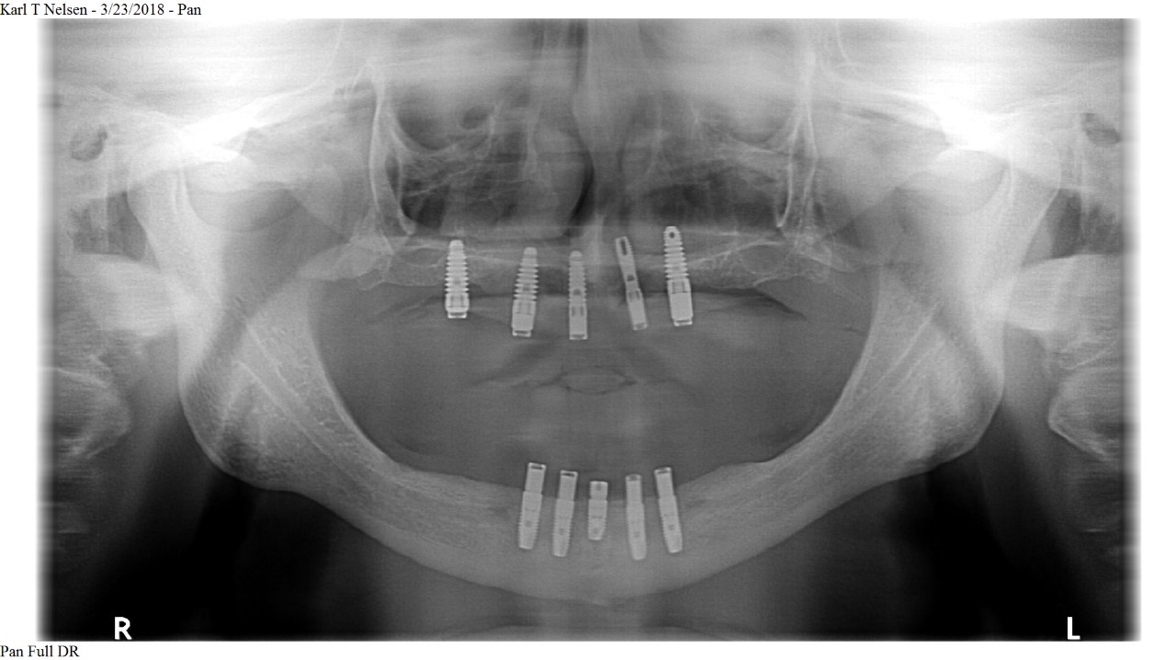
Bionic – Oral reconstruction in 20s
$30-50k for placement of implants (~$3000 per implant + sedation fees)
$40k for prosthetic work (dentures, titanium bars, etc.)

Slide 8
HF 2915 Overview-Ectodermal Dysplasias
Ensures coverage for reconstructive services for a rare population
  Includes dentures, implants, bone grafting, orthodontics, and maintenance.
  Includes wigs for alopecia secondary to ectodermal dysplasias
  Includes breast/nipple reconstruction for congenitally absent breasts.
These services are not cosmetic
Precedence in place
  Cleft lip and palate oral health protections exist in MN in statute (62A.042)
  Wigs for people suffering from alopecia areata are covered in statute (62A.28)
  Breast reconstruction secondary to mastectomy (62A.25)
  PANS/PANDAS mandate passed in 2019 (62A.3097) with little to no economic impact.

Slide 9
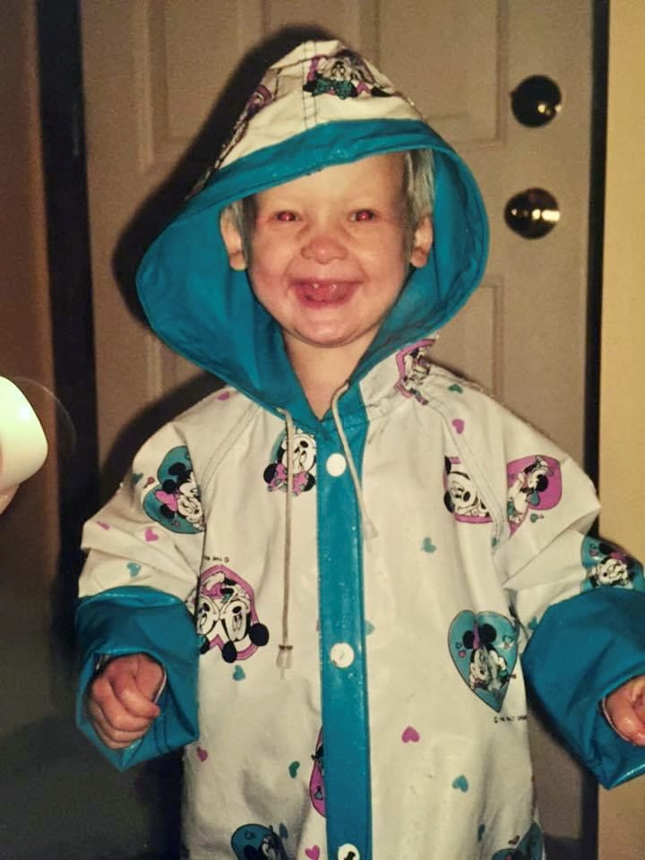
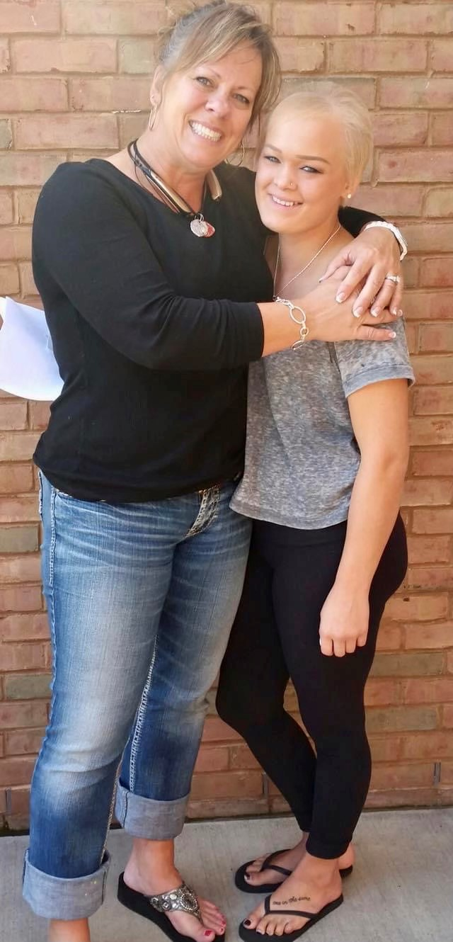
Let’s move forward together!
Molly and Hannah!!

