Slide 1
Student Loan Borrower Bill of Rights
Financial Institutions Division
Mark Hastie, Director, Non-Depository Director

Slide 2

Implementation Update – February 2022
Financial Institutions Division

Slide 3
Reminder - Key Parts of New Law (new chapter 58B)
Key definitions – the law defines student loans, servicer, and servicing, borrower, and person in control
Licensing Requirement – application process for student loan servicers, with limited process for servicers who contract with the U.S. Department of Education
Exemptions – exempts entities such as financial institutions, fiduciaries, the University of Minnesota, other state agencies, and family lending.
Duties and Prohibitions – the key part of the “Bill of Rights” imposing these in the areas of: response to borrowers, payments, transfers, income-driven repayment and loan forgiveness, and record-keeping
Examination authority for both safety and soundness/regulatory compliance
Enforcement authority
Updated data practices classification

Slide 4
Department of Commerce Areas
Licensing
Examinations
Regulatory Outreach
Enforcement
Communications

Slide 5
Licensing
July 2021 – drafted new application forms and checklists and finalized settings in the Nationwide Multistate Licensing System (NMLS) for new license types
We created separate applications for federal student loan servicers v. non-federal servicers
Started accepting new applications after 8/1/2021
32 companies licensed or with active applications totaling 68 licenses
All companies licensed prior to 12/31/2021 successfully completed the annual renewal process on NMLS for 2022

Slide 6
Examinations
Hired a Financial Institutions Examiner who started in December 2021
Examination Procedures Manual
  Fall 2021 - gathered sample documents from the CFPB and other states who have current examination programs with comparable regulatory requirements
  January 2022 – draft of examination program initial sections completed, and on pace to complete first draft of manual by end of February
Examinations
  January 2022 – created a temporary process to participate in a current multi-state examination in coordination with the CFPB on one of the largest servicers of federal student loans
  Second Quarter 2022 – start single state examinations and join upcoming multi-state examinations

Slide 7
Regulatory Outreach
Participating in regular federal/state regulator/AG calls with the Federal Student Aid office that oversees the US Department of Education loan programs where there is now heightened communication about any issues
Joined multi-state “ad-hoc” working group on student loan servicing, which includes communication with the federal government
Plan to join new multistate Charter and Protocol for Student Loan Servicer Supervisory Task Force under the authority of the National Association of Consumer Credit Administrators (NACCA)

Slide 8
Enforcement
To date, there have been three consumers who have contacted us, but they did not have complaints about the prohibited practices in the act.
The consumers have primarily asked for assistance in navigating their Public Student Loan Forgiveness programs to get their loans forgiven
We have received some consumer calls about the Attorney General action that was brought against Navient Solutions

Slide 9
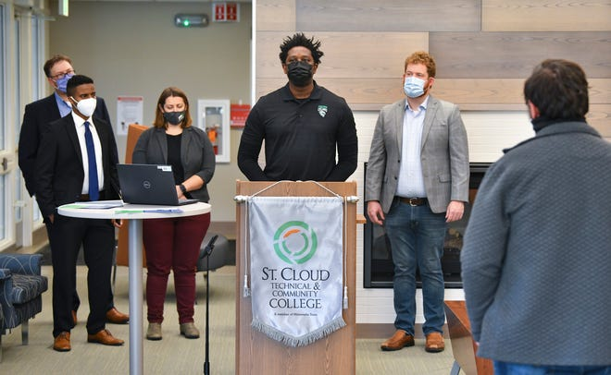
Communications
Commerce web page, fact sheet, videos, digital ads
mn.gov/commerce/consumers/your-money/student-loans/
News media event - October 29, 2021
St Cloud Community & Technical College
Covered by St. Cloud Times, WJON Radio
Featured Minnesota Student Association
(8 student reps), SCCTC president and alum student borrower, Commerce and Office of Higher Education Commissioners, Rep. Stephenson
Social media - Ongoing posts @MNCommerce
Paid media RFP - Selected marketer Russell Herder – woman-owned B-corp

Slide 10
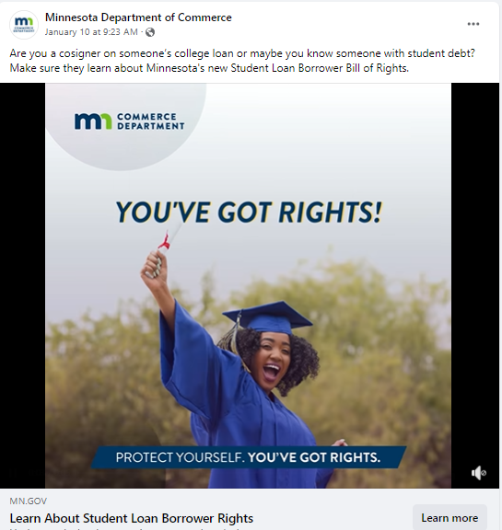
Communications
Digital campaign
December 2021 – January 2022
Digital ads:
Seen more than 1.8 million times
More than 17,000 views generated clicks on the ads to learn more
Traffic to Commerce web page (Dec-Jan):
13,857 unique visitors

Slide 11
Communications
Repayments for federal student loans - begin May 1
Help Commerce to reach more student loan borrowers in Minnesota:
Share @MNCommerce social media posts
Your e-newsletters – add info about Student Loan Borrower Bill of Rights

Slide 12
QUESTIONS?
Commerce Government Affairs
Jon Kelly
Director, Government Affairs
651-356-4061
Jon.Kelly@state.mn.us

