Slide 1
HOSPICE Report to House Preventive Health and Policy Division 3/23/22
Jessica Hausauer, PhD
Executive Director
Minnesota Network of Hospice & Palliative Care

Slide 2
Palliative Care
Palliative (pronounced PAL-ee-uh-tiv) Care
Medical care for people living with serious illness

Slide 3
Palliative Care
Focuses on improving quality of life
Reduces pain, symptoms, and stress related to serious illness
Supports patients and caregivers

Slide 4
Palliative Care
Any age
Any stage of serious illness
Can receive treatments intended to cure
Provided by a team that collaborates with your primary care doctor or other specialists
Receive in home, hospital, outpatient clinic, long-term care, assisted living, cancer centers

Slide 5
Who Pays
Medicare Part B and Medicaid offer some coverage
Some private insurance plans

Slide 6
Hospice
Hospice (pronounced HAW-spiss) care is:
Palliative care specific to the final six months of life
Forgo curative treatment
Medicare Hospice benefit
Reduce physical, spiritual, social, and emotional pain
Grief support

Slide 7
Hospice
Receive wherever you call home. Private home, assisted living center, long-term care facility, hospital, group home, foster home, apartment

Slide 8
Who Pays
Paid for by Medicare, Medical Assistance, MinnesotaCare, most private insurance companies, private pay, Veteran’s benefits

Slide 9
Core Differences
 | Palliative Care | Hospice
Appropriate For | Serious Illness | Terminal Illness
Time Limited | No | Yes (generally 6 months)
Receive Curative Treatment | Yes | No
Medicare Benefit | No | Yes

Slide 10
Overall Benefits
Pain and symptoms managed
Quality of life
Length of life
Family satisfaction
Family bereavement outcomes
Physician satisfaction
Fewer ER visits and hospital stays
Fewer unwanted medical interventions
Lower hospital mortality
Sources: The Case for Palliative Care, CAPC; What are Palliative Care & Hospice?, NIA

Slide 11
Hospice Utilization
(Medicare Hospice Deaths/Total Medicare Deaths
 | 2016 | 2020
Minnesota | 48.7% (Rank 15th) | 53.6% (Rank 8th)
National | 46.2% | 46.7%
Sources: 2016 & 2020 Medicare annual data, compiled by Hospice Analytics

Slide 12
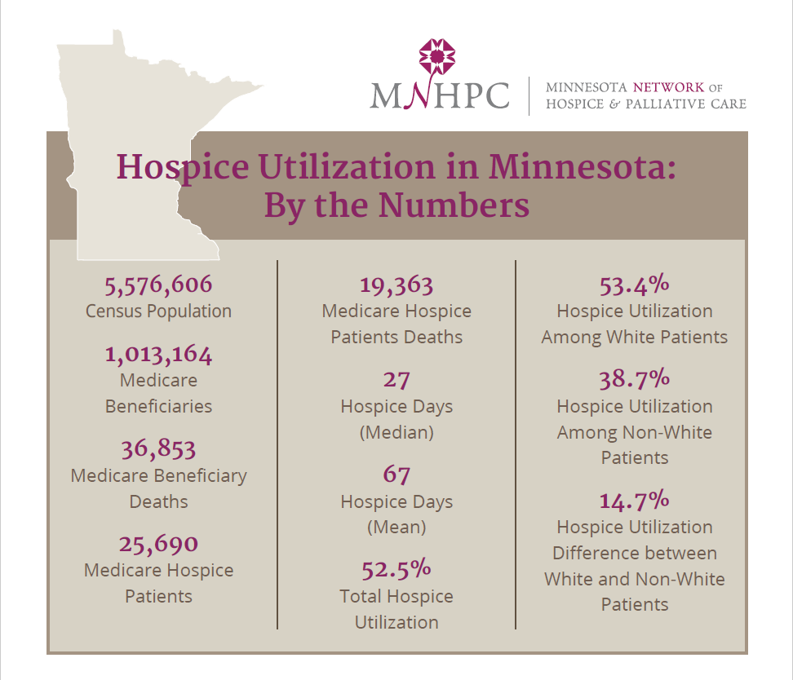
Source: 2017 Medicare annual data, compiled by Hospice Analytics

Slide 13
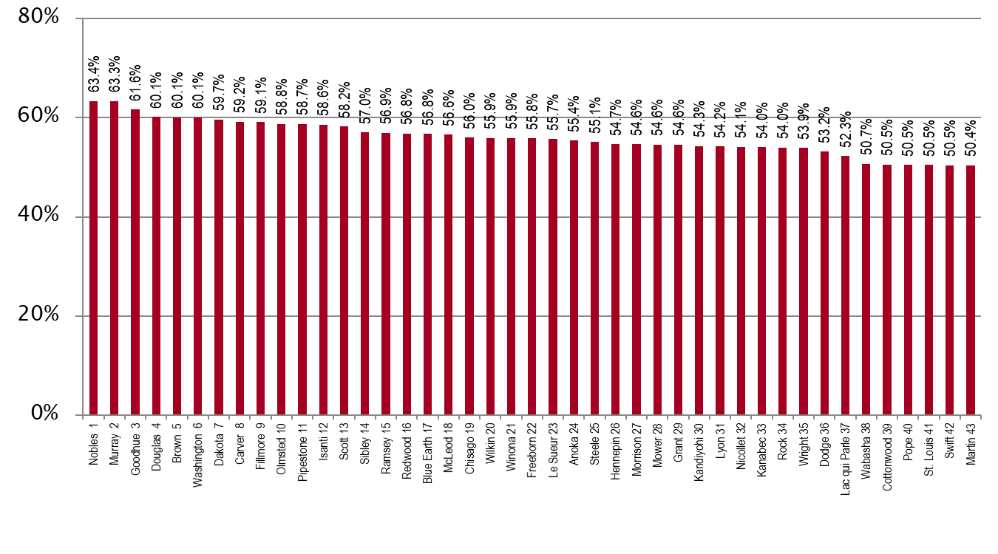
2017 Hospice Utilization x County – MN (slide 1 of 2)
(Medicare Hospice Deaths / Total Medicare Deaths)
Source: 2017 Medicare annual data, compiled by Hospice Analytics

Slide 14
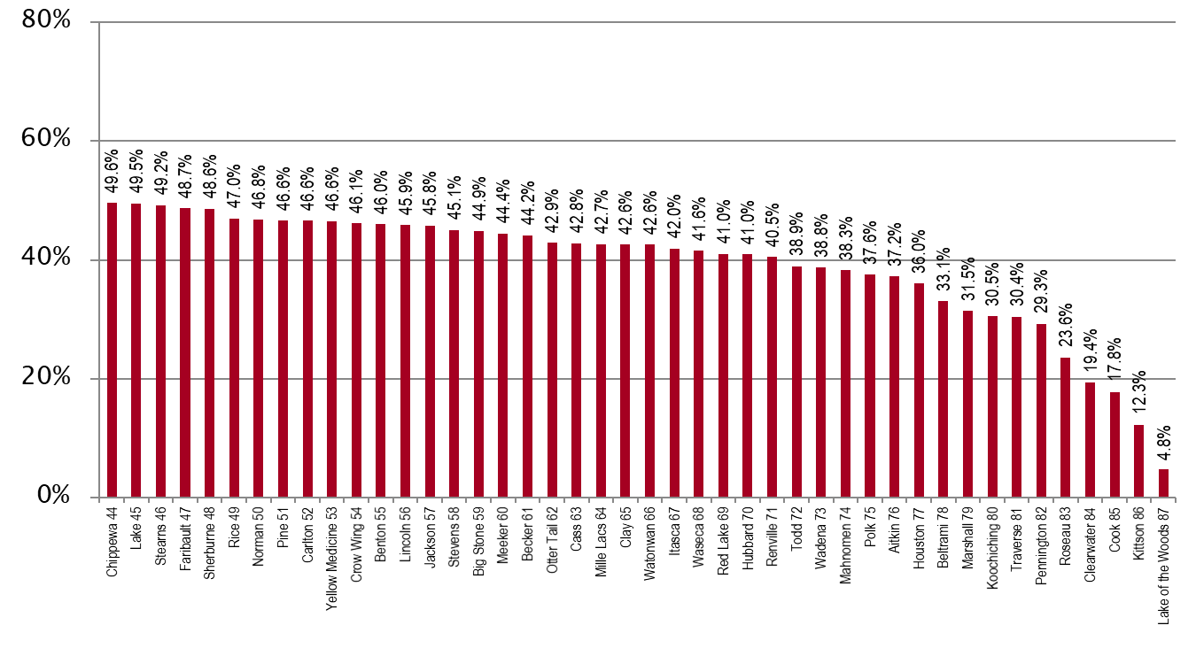
2017 Hospice Utilization x County – MN (slide 2 of 2)
(Medicare Hospice Deaths / Total Medicare Deaths)
Source: 2017 Medicare annual data, compiled by Hospice Analytics

Slide 15
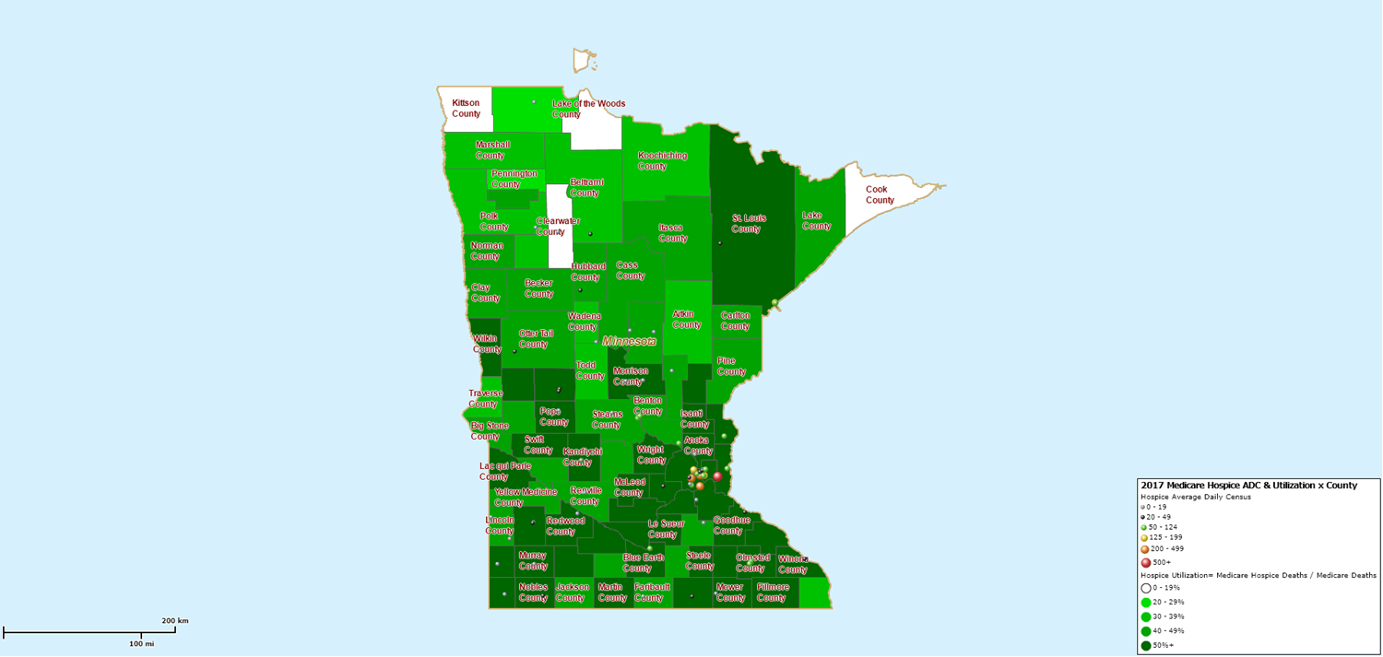
2017 Hospice Utilization – Minnesota
(Medicare Hospice Deaths / Total Medicare Deaths)
Source: 2017 Medicare annual data, compiled by Hospice Analytics

Slide 16
Top Primary Diagnoses
Cancer: 25%
Dementia: 20%
Stroke: 9%
Congestive Heart Failure: 8%
COPD: 6%
Source: 2018 Medicare Fee-For-Service Post Acute Provider Public Use File

Slide 17
Increasing Hospice Use
Increasing access to high quality end of life care requires a multi-pronged approach that targets:
the current and future palliative care and hospice workforce
non-hospice and palliative care health care professionals
patients, families and consumers

Slide 18
Increasing Hospice Use
Support the recommendations of the Minnesota Palliative Care Advisory Council
Address current and long term workforce crisis
Support education and training for primary and specialty palliative care and hospice
Fund a public awareness campaign for palliative care and hospice that is culturally and linguistically appropriate
Fund grief and bereavement services and utilize hospices as community resources
Ensure that hospice providers can provide palliative care under their hospice license

Slide 19
Resources
Minnesota Network of Hospice & Palliative Care
Minnesota Palliative Care Advisory Council

