Slide 1
Equity & Climate in State Planning Miguel Moravec, RMI
How incorporating GHG targets into CDOT projects advanced equity in Colorado

Slide 2
Introduction: Who we are

Slide 3
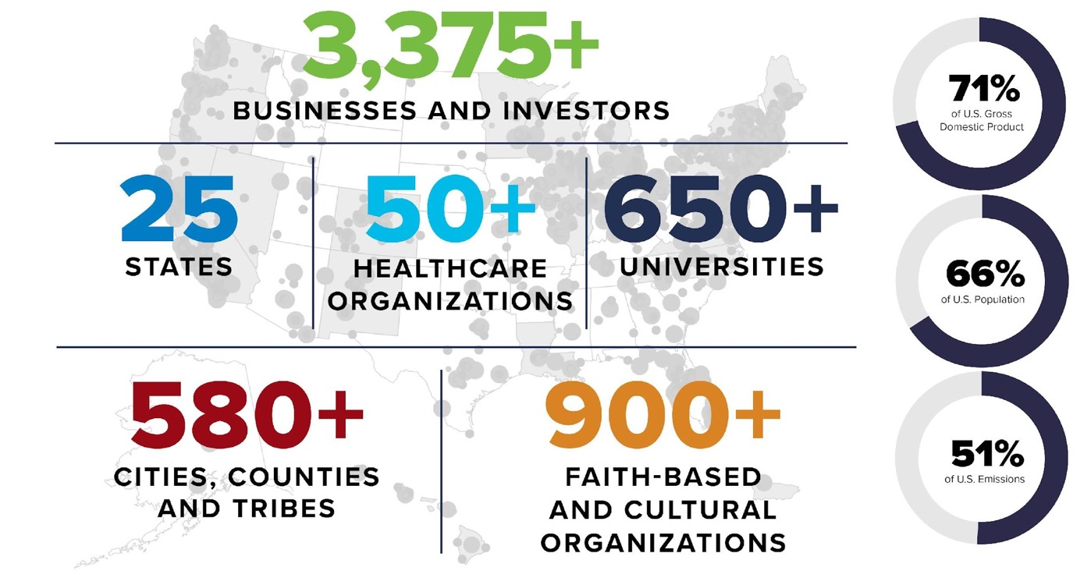
Introduction: America Is All In Coalition
Notes:
Largest coalition of non-federal actors ever assembled to tackle cliamte change
-Three quarters of GDP in terms of business representation

Slide 4
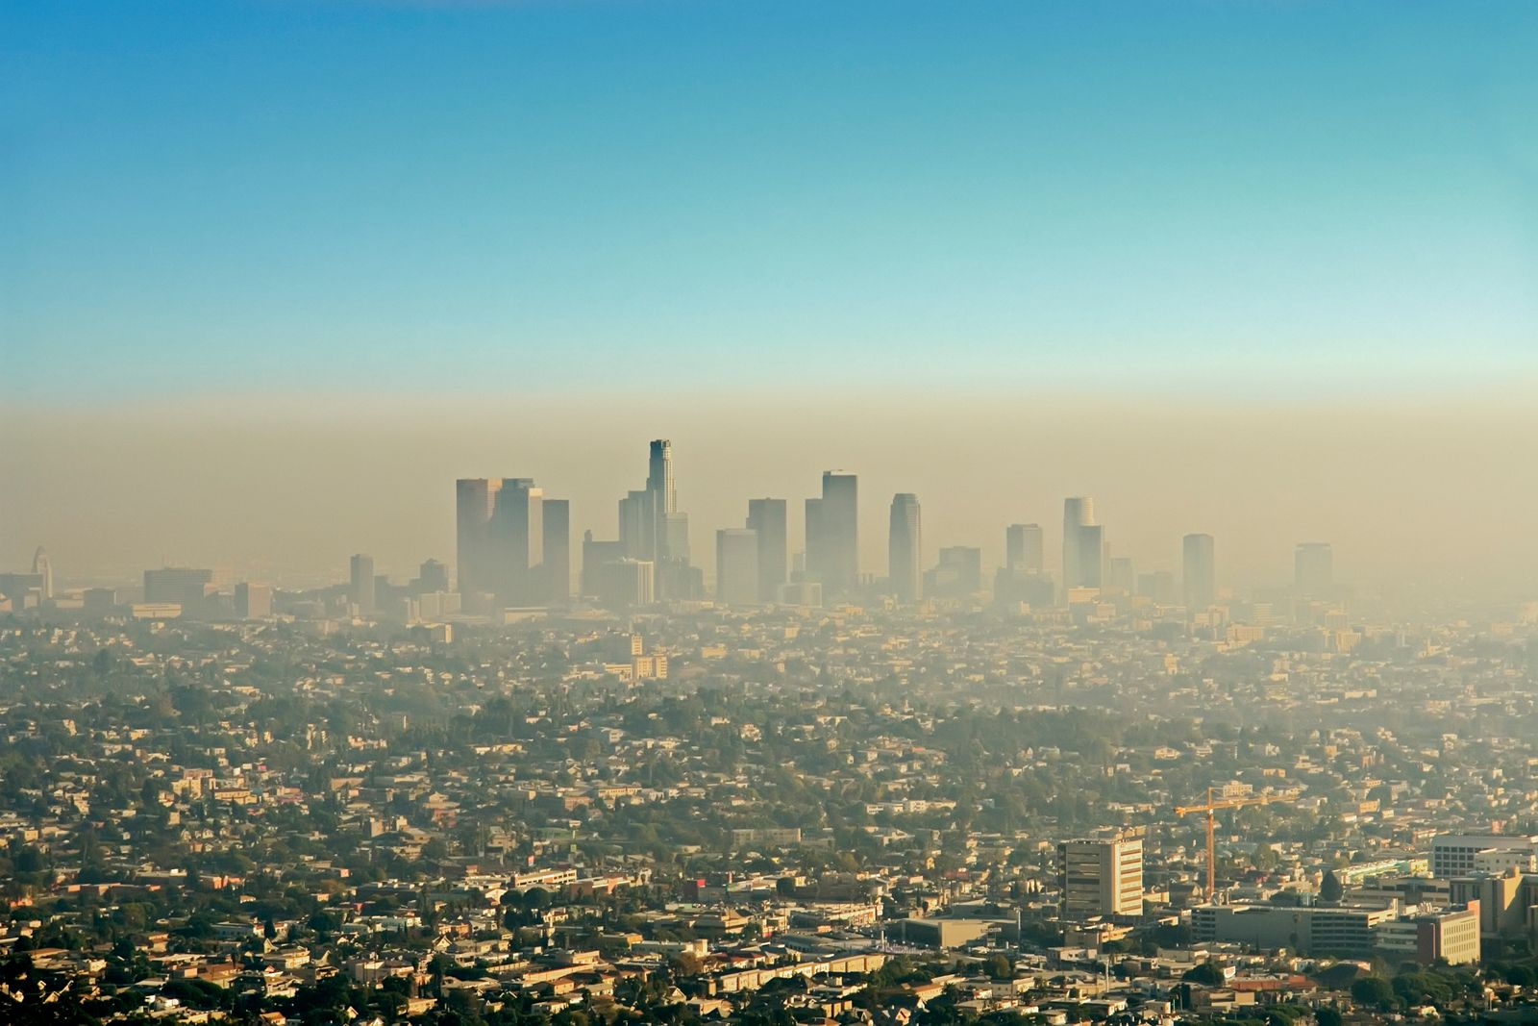
Climate Change: Great Inequity
Global & Local
Adverse Health
Disaster Risks
Resource Access
Affordability
Source: Encyclopædia Britannica, U.S. EPA
Notes:
Minnesota Climate action framework – inequities
Unequal exposure to pollution – black, indigenous, people of color, and residents with low incomes more likely to live near industrial sites and highways
Barriers to energy efficient buildings and improvements
Higher costs – energy bills during very hot summers

Slide 5
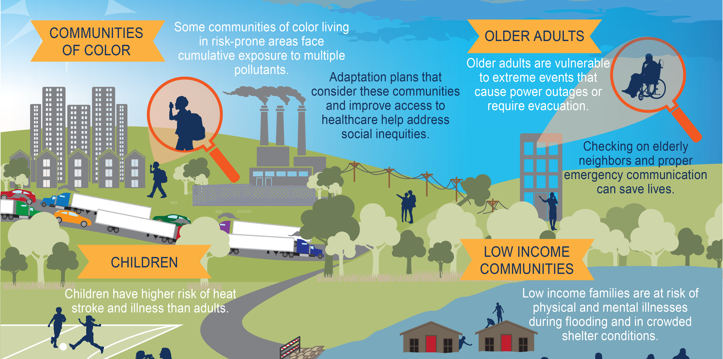
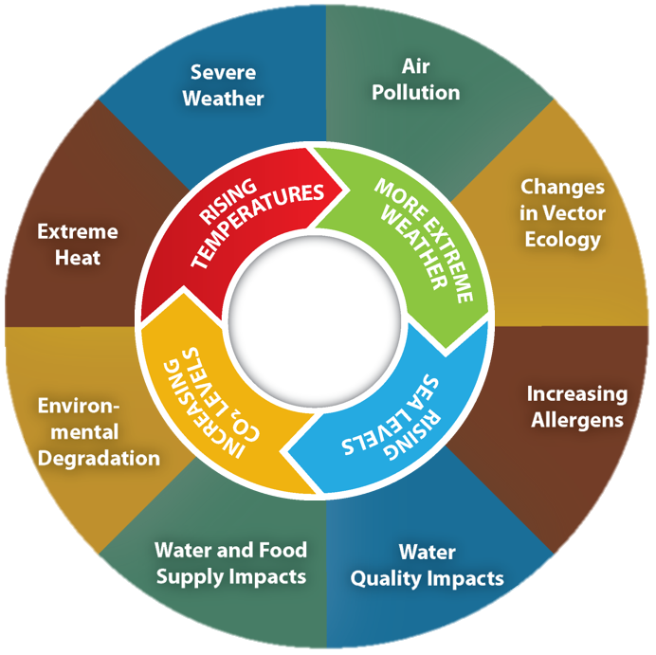
Climate Change: Vulnerable Populations
Source: Fourth National Climate Assessment
Notes:
Minnesota Climate action framework – inequities
Unequal exposure to pollution – black, indigenous, people of color, and residents with low incomes more likely to live near industrial sites and highways
Barriers to energy efficient buildings and improvements
Higher costs – energy bills during very hot summers

Slide 6
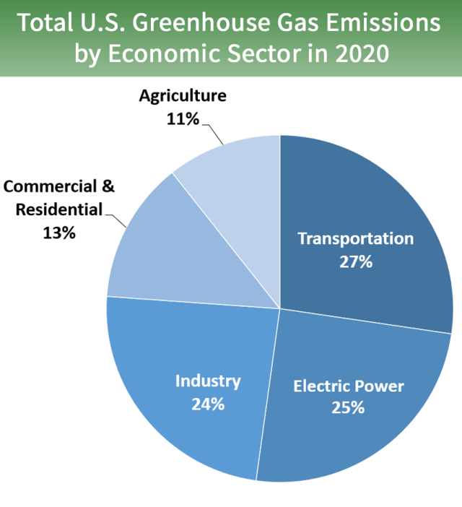
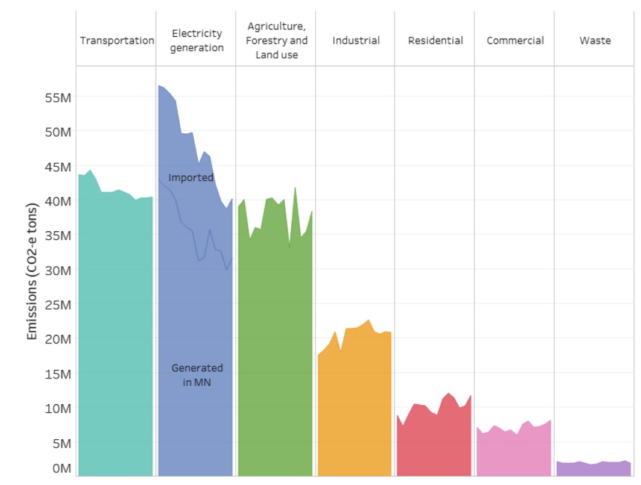
Transportation: Largest emitter in MN
Total Minnesota GHG Emissions by Economic Sector 2005-2018
28%
Source: U.S. EPA, MN Pollution Control Agency. Note: Imported electricity excluded from MN emissions
Notes:
For Minnesota, like the U.S., largest contributor to this problem is the transportation sector.

Slide 7
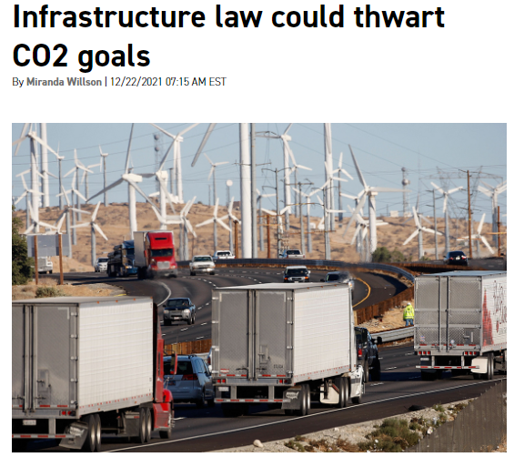
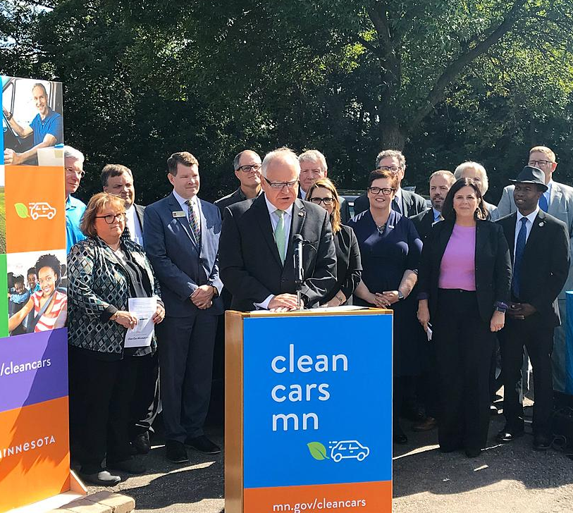
IIJA, Clean Cars not necessarily enough
Source: E&E News, Sierra Club, DeSmog
Notes:
The infrastructure law provides an opportunity to address these emissions, but if used to continue a status quo approach, this funding could actually increase emissions

Slide 8
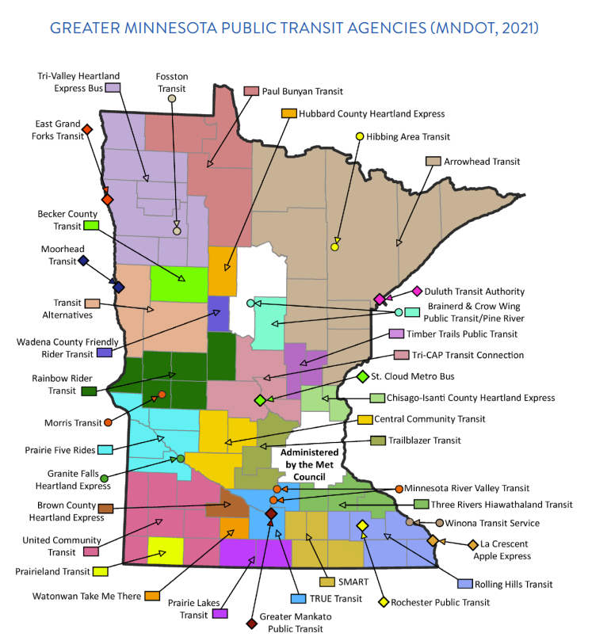
Transit & Multimodal:
Needed but underfunded
Twin Cities
Current: 92 mil. trips
2030: 9% pop growth
Greater MN
Current: 12 mil. trips
2030: 20 mil. trips (2x)
Funding Gap:
$350 million
Source: ASCE, MnDOT
Notes:
Investing in climate-smart transportation report

Slide 9
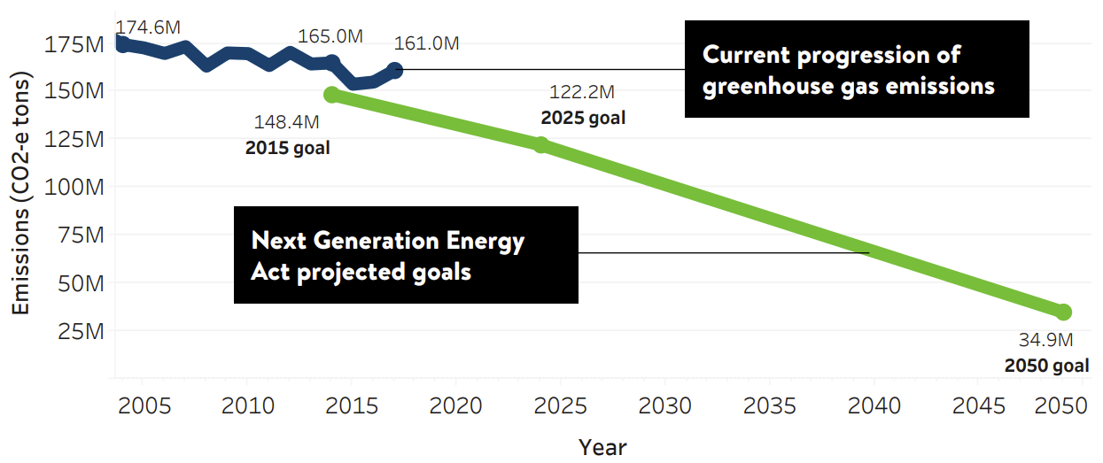
Climate Change: MN not on track
Source: Minnesota Pollution Control Agency
Notes:
As you know Minnesota is not on track to meet its climate goals

Slide 10
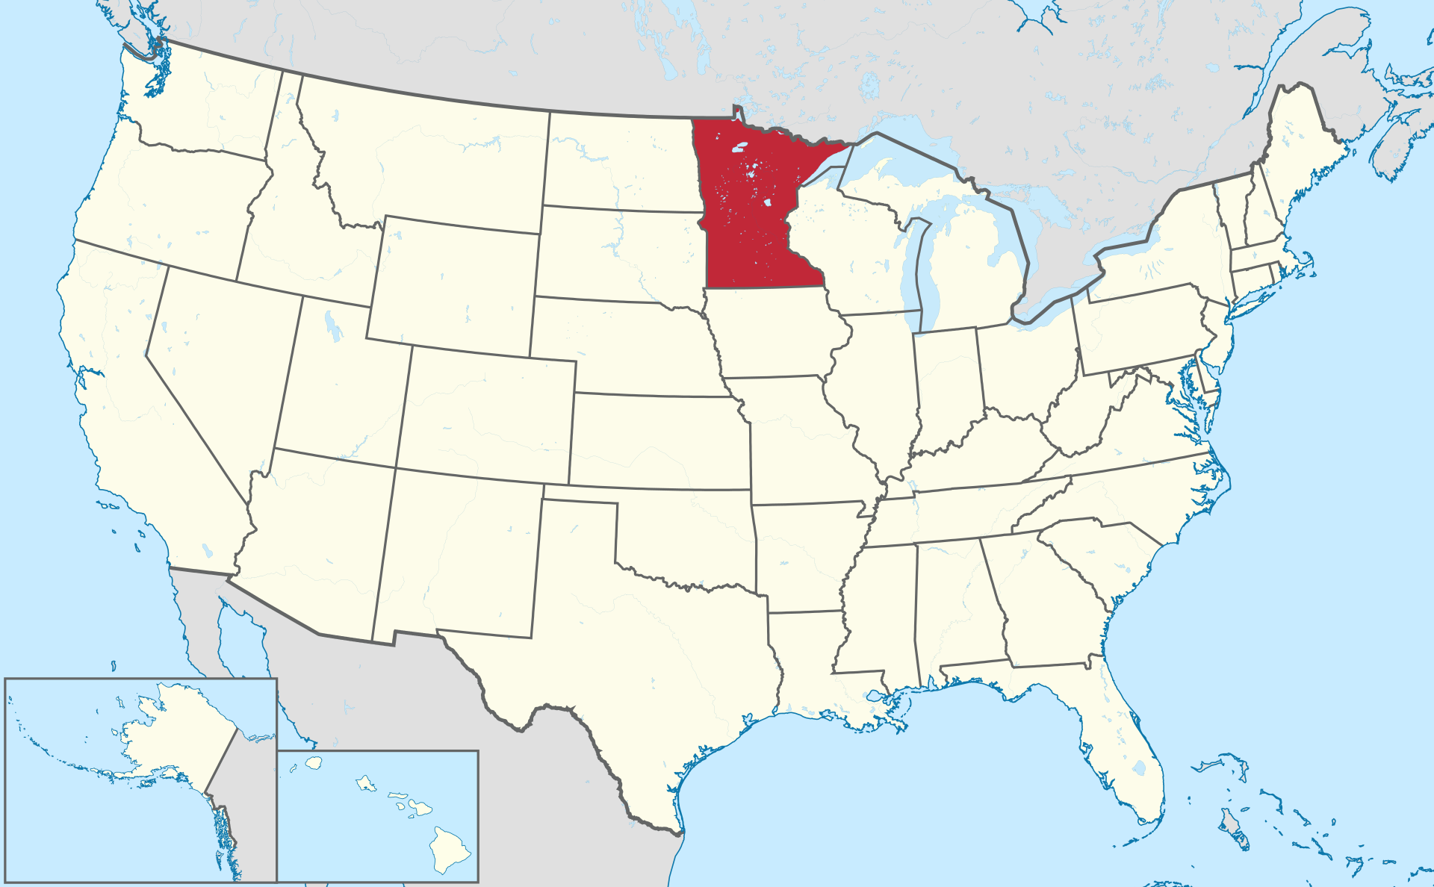
Colorado: GHG Planning Standard
Notes:
So let’s look at other states - Colorado
Colorado recently passed a leading transportation emissions rule that prioritizes multi-modal access
Were able to switch investments away from expansions
Took that money and shifted to clean transportation and multimodal solutions

Slide 11
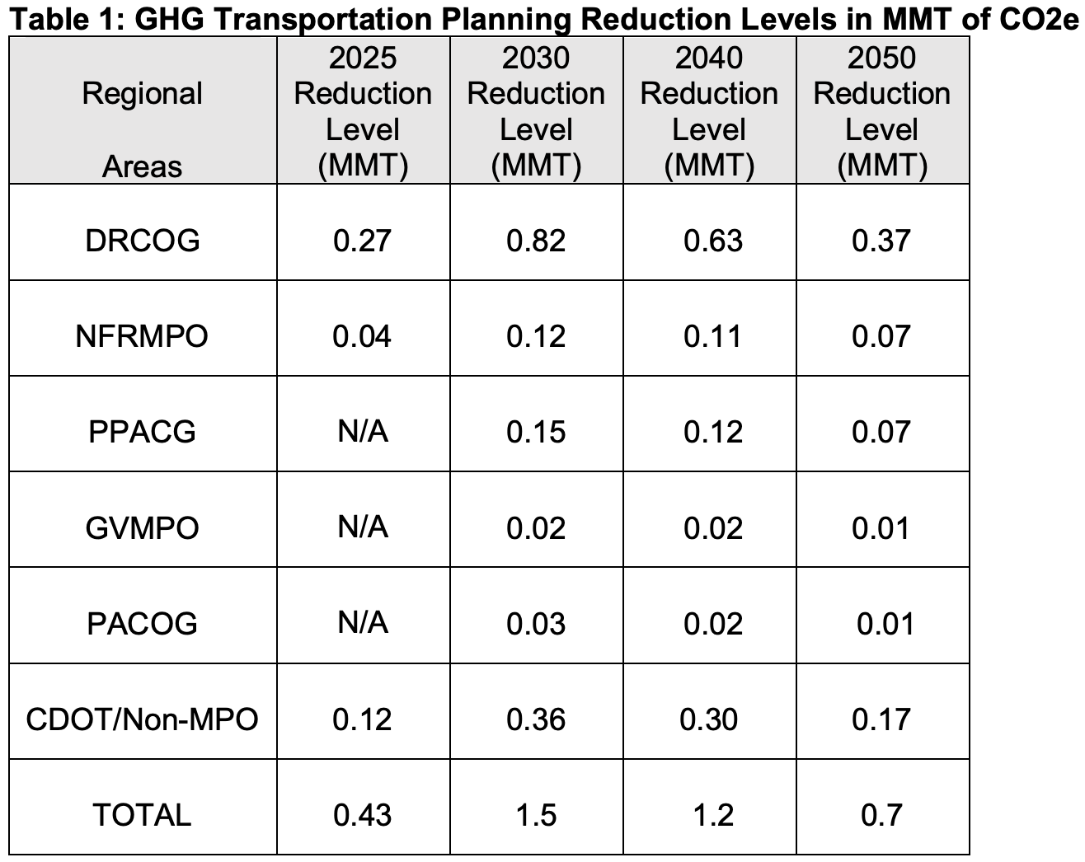
CO GHG Standard: How does it work?
Assign targets based on state climate/equity goals
Source: CDOT
Notes:
Goes all the way to 2019, the house bill 1261 set declining greenhouse emissions target for state
2 years later the governor released a roadmap to achieve these targets
Included language that planning processes would have to be updated to account for transportation
Before the governor fully implemented roadmap, the senate beat him to the punch
Director CDOT to require planning - directive with teeth that CDOT had to do this
CDOT rule making
Did public comment period,
During comment period, SWEEP created this analysis that colorado could save 40 billion by 2050
Rule implemented 2019-2022
Gold standard outside of California

Slide 12
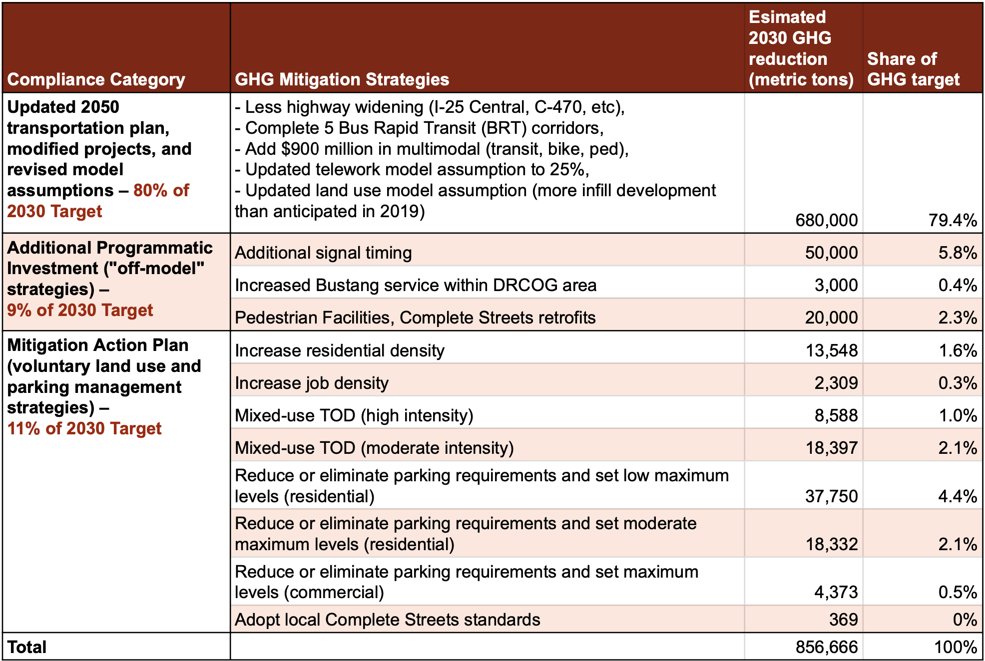
CO GHG Standard: How does it work?
Assign targets based on state climate/equity goals
Close gap mitigation actions and investment/ mode shift
Source: CDOT

Slide 13
CO GHG Standard: Projected Benefits
$40B
savings
Climate
Health
Equity

Slide 14
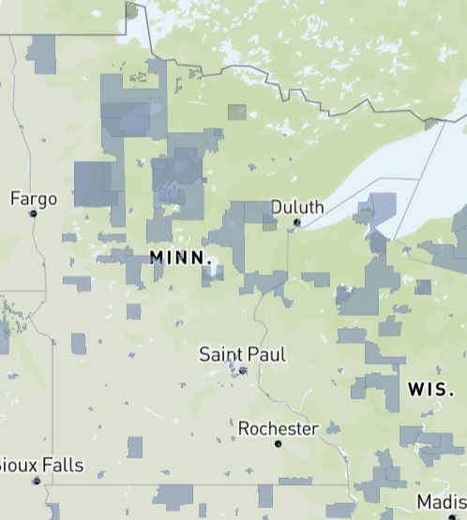
MN could benefit:
Equity a Federal Investment Priority
$200 B competitive IIJA funding prioritized for:
Environment
Safety
Equity
Justice40 Investment Communities

Slide 15
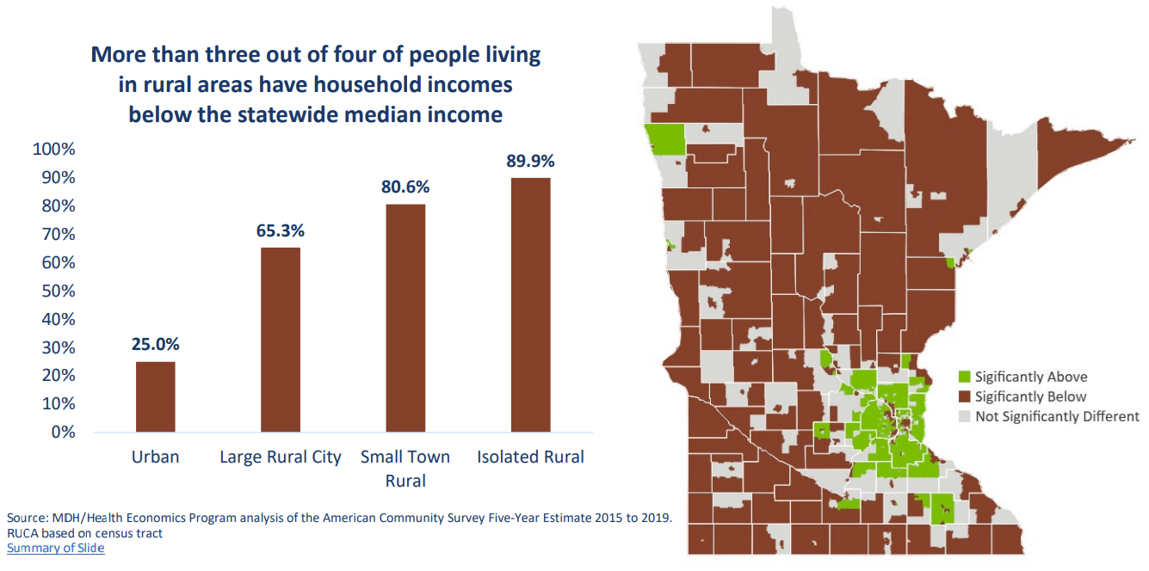
MN could benefit:
Need for affordable transportation
Source: Minnesota Dept. of Health
Notes:
Investing in climate-smart transportation report

Slide 16
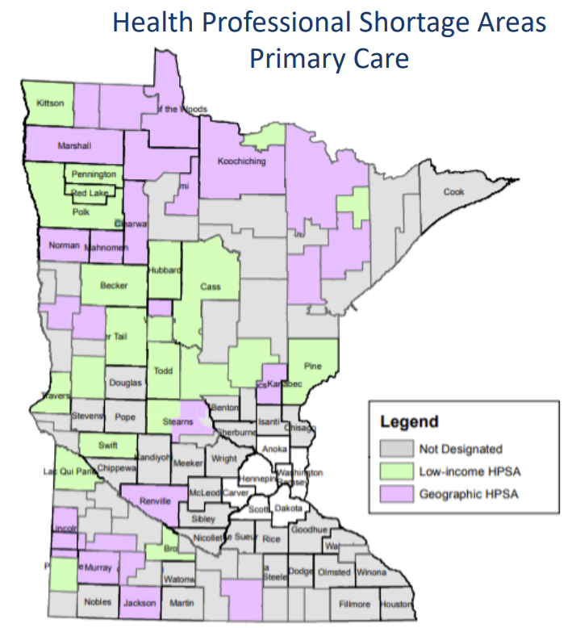
MN could benefit:
Healthcare access needs attention
28% rural physicians to retire in next 5 years
2033: 32% of rural counties will be 65+
85+ population to double in next 30 years
Source: Minnesota Dept. of Health
Notes:
Investing in climate-smart transportation report

Slide 17
Take-away
By adopting a GHG planning standard, MN can:
Lead Midwest
Advance Equity
Achieve Climate Goals

Slide 18
Questions? mmoravec@rmi.org

