Slide 1
What is cannabis?
What is the current cannabis policy?
What are the effects of the current cannabis policy?
How is cannabis policy changing in other states?
What technical elements need to be addressed?
What goals should Minnesota have for legalizing adult-use cannabis?

Slide 2
What is Cannabis?
Cannabis
85 cannabinoids have been isolated from cannabis, two most prevalent are cannabidiol (CBD) and tetrahydrocannabinol (THC)
Cannabis throughout history
2500 years old
Early 1600s farmers were required to grow hemp
Prescribed in 1830’s for Cholera symptoms
By 1931, 29 states outlawed cannabis after Great Depression

Slide 3
What is the Current Cannabis Policy?
Federal Policy
Legal until 1937
Under 1970 Controlled Substances Act, designated along with other substances as Schedule I controlled substance, prohibiting the manufacture, distribution, dispensation, and possession of cannabis
Substances are evaluated on potential for abuse; known scientific evidence of pharmacological effects; risk to public health; and psychic or physiological dependence liability.

Slide 4
What is the Current Cannabis Policy? (continued)
Minnesota Policy
Small amounts have been decriminalized since 1976
Sliding scale of consequences for possession and sale reaching up to 35 years’ incarceration and a $1,250,000 fine
Minnesota’s medical cannabis law is one of the strictest in the nation, and has approximately 17,000 participants

Slide 5
What are the effects of current cannabis policy?
Inaccessible to veterans suffering PTSD
Resources spent on enforcement
Youth Access
Racial Justice
Use

Slide 6
What are the effects of current cannabis policy? (continued)
Access for Veterans
Veterans Affairs (VA) cannot prescribe cannabis
Cost prohibitive even if a person can access it
The VA issued 1.7 million opioid prescriptions to nearly 450,000 veterans in 2014
Between 2010 and 2015, the number of veterans addicted to opioids increased by 55 percent to nearly 70,000

Slide 7
What are the effects of current cannabis policy? (continued)
Law Enforcement Resources
Enforcement of cannabis laws nationally cost $3.6 billion in 2010, $43 million of which was in Minnesota
Law enforcement made 8,752 arrests for cannabis in 2018
Legalizing cannabis can reduce law enforcement time and resources spent on cannabis offenses

Slide 8
What are the effects of current cannabis policy? (continued)
Youth Access
Cannabis use decreased among teenagers in Washington and Colorado in the years following legalization
66 percent of tenth graders across the country reported that cannabis is “very easy” or “fairly easy” to access, similar to what they reported for cigarettes (69 percent) and alcohol (75 percent)

Slide 9
What are the effects of current cannabis policy? (continued)
Racial Justice
Small disparity in the rate of usage between Caucasians and African-Americans
Large Disparity in rate of how laws are enforced
African-Americans more likely to be arrested for cannabis possession than caucasians
We have seen disparities in law enforcement increase in the past
(2013 ACLU Study)

Slide 10
What are the effects of current cannabis policy? (continued)
 | Alcohol | Marijuana
Lifetime – used once or more | 86% | 80% (of 55 year-olds); 55% overall
Within past year - use | 70% | 14%
Within past month - use | 56% | 9%
In Minnesota, 12% of adults, or 660,000 Minnesotans have use marijuana in the past year

Slide 11
What technical elements need to be addressed?
Expungement eligibility
Appropriate levels for driving
Clean Indoor Air Act
Personal cultivation limits
Barriers to banking and insurance
Product forms, i.e. oils, edibles, beverages, etc.
Potency guidelines
Age limitations
Involved Agencies
Advertising
Public information campaigns
Taxation
….the list goes on

Slide 12
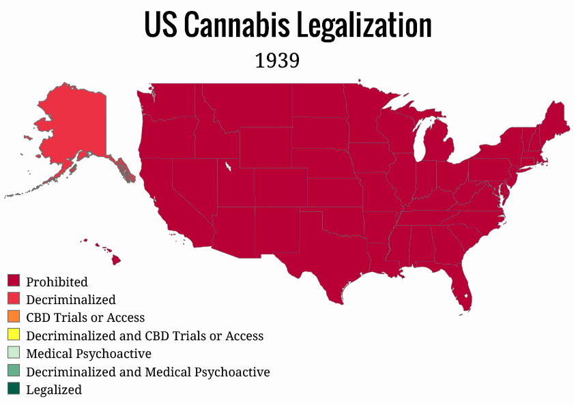
What should Minnesota do about cannabis?

Slide 13
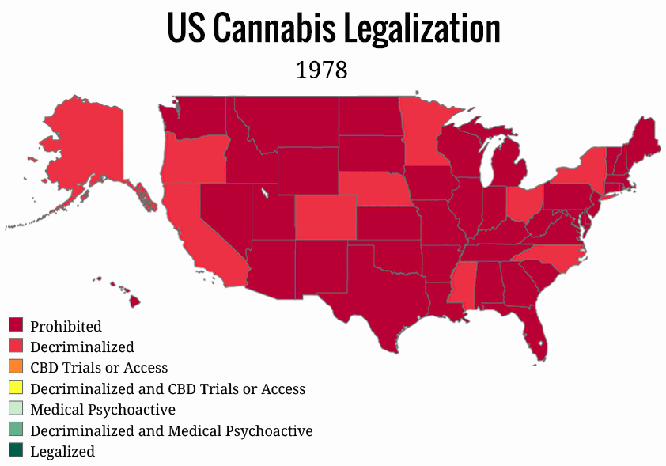
What should Minnesota do about cannabis?

Slide 14
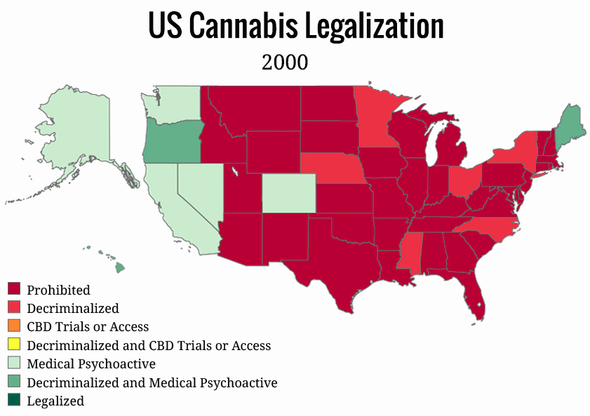
What should Minnesota do about cannabis?

Slide 15
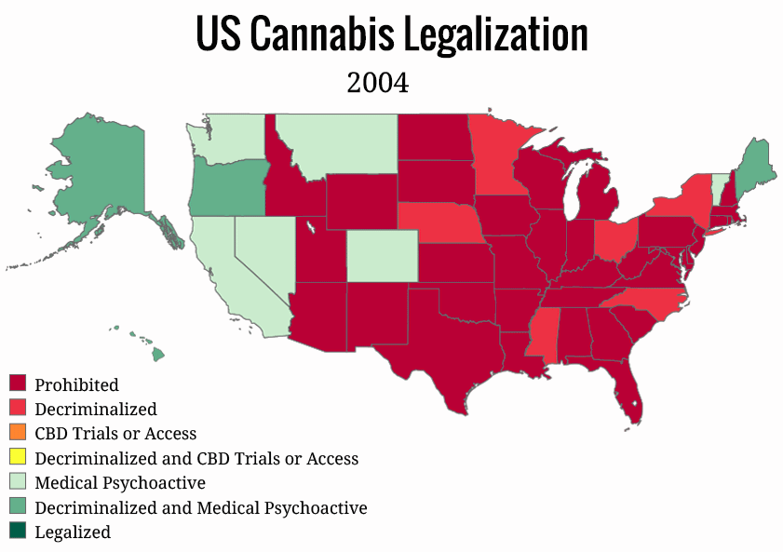
What should Minnesota do about cannabis?

Slide 16
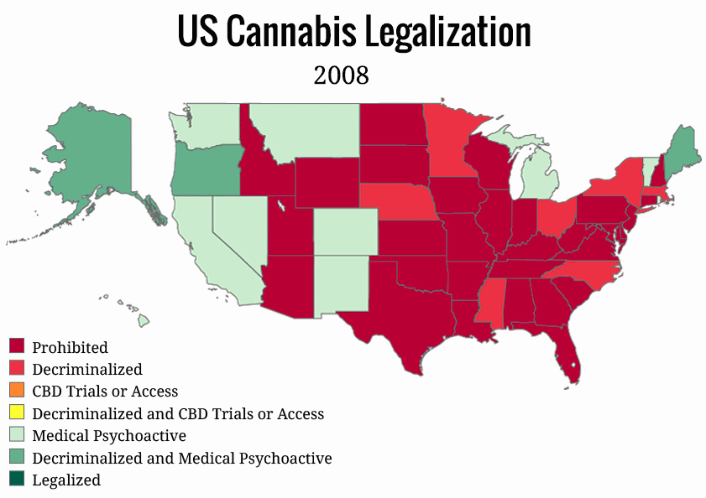
What should Minnesota do about cannabis?

Slide 17
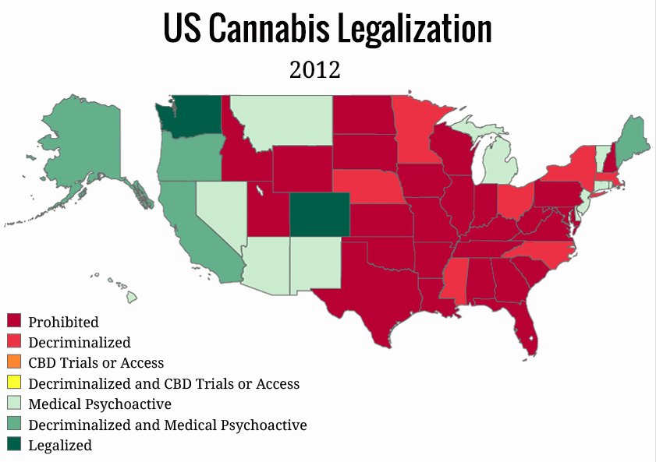
What should Minnesota do about cannabis?

Slide 18
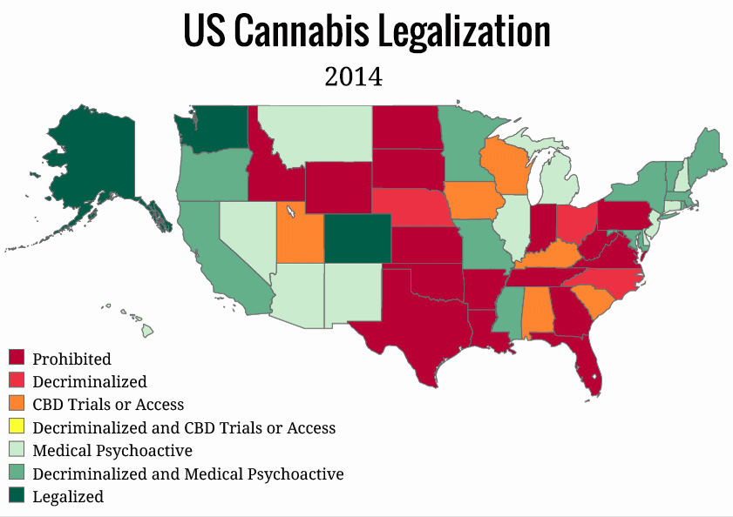
What should Minnesota do about cannabis?

Slide 19
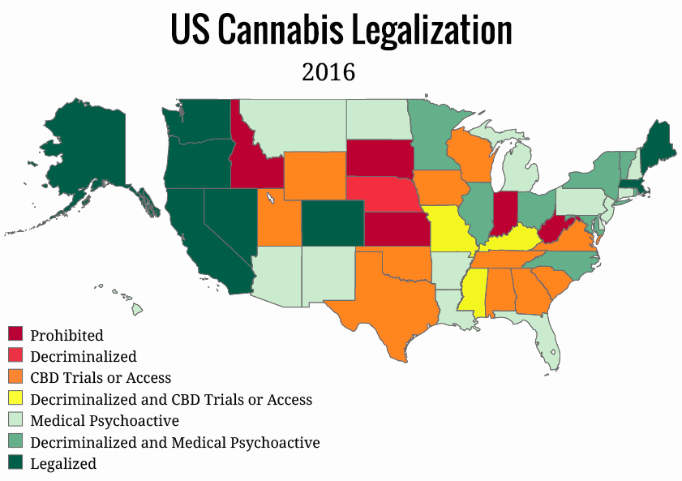
What should Minnesota do about cannabis?

Slide 20
What should Minnesota do about Cannabis?
What should Minnesota do about cannabis?

Slide 21
Colorado’s Cannabis Experience
Doug Friednash (dfriednash@bhfs.com)
Brownstein Hyatt Farber Schreck, LLP
Denver, Colorado

Slide 22
Marijuana in the US
67% of Americans say the use of marijuana should be legal. That is double what it was in 2000. 84% support medical marijuana use.
Medical cannabis is legal in 33 states; cannabis for recreational purposes is legal in 11 states, plus the District of Columbia; 20 states have decriminalized it (but not legalized it).
These could be the next states to legalize marijuana: Ohio, Arizona, Montana, Maryland, Delaware, New Jersey, Connecticut, Minnesota
Since 2019, cannabis has become the fastest growing industry in the U.S. If cannabis becomes legal in all 50 states, the industry will become larger than the organic food market.

Slide 23
Marijuana Impact Nationally
There are now over 28,000 cannabis businesses in the United States; 250,000 people employed in the industry with nearly a half-million by 2022. Creating more jobs than in any other industry in the U.S.
In 2018 it is estimated that there were $10.8 billion in sales of legal cannabis across the United States with projected sales of $24.07 billion by 2025. As legalization expands in the United States and abroad, these rising trends will continue.
Analysis shows that if marijuana were fully legal in all 50 states, it would create at least a combined $131.8 billion in in federal tax revenue between 2017 and 2025.
The study also calculates that there would be 782,000 additional jobs nationwide if cannabis were legalized today, a number that would increase to 1.1 million by 2025. That includes workers at all ends of the marijuana supply chain, from farmers to transporters to sellers.

Slide 24
Colorado’s Cannabis Industry Economic Impact
Generated $2.39 billion in state output.
Approximately 23,600 Coloradans are directly employed in the industry. When ancillary jobs are added, that figure rises to nearly 10,000 more jobs statewide. Nor are these menial jobs but good jobs providing good wages with openings at all levels of experience. For some reference, there are currently 52,000 coal mining jobs and 69,000 brewery workers across the United States.
Colorado has had over $6.5 billion in marijuana sales since legalization, with 2018 sales totaling $1.63 billion, which doesn't account for the full economic impact. Further, the open licensing system has allowed a mix of small and large businesses to flourish and ensure a competitive marketplace.

Slide 25
Statewide Coordination Efforts
In Colorado, 12 agencies are engaged in the execution of the state’s adult-use and medical marijuana programs.
Governor, Revenue, Public Safety, Transportation, Public Health, Education, Human Services, Agriculture, Natural Resources, Information Technology, Local Affairs, Regulatory Agencies.
Within the Governor’s Office, one individual oversees all marijuana policy issues and coordinates interagency efforts.

Slide 26
Marijuana Arrests
The total number of marijuana arrests decreased by 52% between 2012 and 2017, from 12,709 to 6,153. Marijuana possession arrests, which make up the majority of all marijuana arrests, were cut in half (-54%). Marijuana sales arrests decreased by 17%. Arrests for marijuana production increased appreciably (+51%).
The number of marijuana arrests decreased by 56% for Whites, 39% for Hispanics, and 51% for Blacks. The marijuana arrest rate for Blacks (233 per 100,000) was nearly double that of Whites (118 per 100,000) in 2017.
Separate data provided by the Denver Police Department’s Data Analysis Unit indicates an 81% decrease in total marijuana arrests, from 1,605 in 2012 to 302 in 2017.
The most common marijuana industry-related crime in Denver was burglary, accounting for 59% of marijuana crime related to the industry in 2017. There has been concern that, due to the cash-only nature of the marijuana industry, robbery would be prevalent but this has not been the case. Further, marijuana banking has become much more common in Colorado reducing the amount of cash available at dispensaries. Dispensaries have also routinely hired security guards as a deterrent.
Likewise, the number of non-industry-related marijuana crimes was small and remained stable. Burglary accounted for 40% of non-industry-related crime in 2017, followed by robbery at 29%.
The state’s overall violent crime rate is 17 percent below the national average.” (A Dive Into Colorado Crime Data In 5 Charts, CPR News, July 31, 2017.) And, according to the Colorado Division of Criminal Justice, Department of Public Safety, the overall crime rate in Colorado was lower in 2017 than in 2005. (Data drawn from the Colorado Bureau of Investigation (CBI), the Colorado State Judicial Branch, the Colorado Department of Corrections (CDOC), the Colorado State Demographers's Office (DOLA), the Bureau of Justice Statistics (BJS), and the Federal Bureau of Investigations (FBI) Uniform Crime Reports.)

Slide 27
Colorado Traffic Safety
Colorado established a limit of 5 ng/mL of Delta 9-THC in whole blood that creates a permissible inference that a “defendant was under the influence of one or more drugs.” After an arrest, if the officer has probable cause to believe the suspect is impaired by drugs and/or alcohol, the officer may transfer the suspect to a location where blood can be drawn for further toxicology screening. The Delta- 9 THC level in blood decreases rapidly in the first hour after use, then gradually thereafter, making prompt testing critical.
In 2012 there were 129 peace officers statewide trained as Drug Recognition Experts (DREs) and by June of 2018 there were 214. Additionally, hundreds of additional peace officers have also received training in Advanced Roadside Impaired Driving Enforcement (ARIDE).
Notably, a study comparing motor vehicle-related fatalities in Washington and Colorado to eight similar states found that three years after marijuana legalization, changes in motor vehicle fatality rates were not statistically different from those in similar states without regulated marijuana.
The National Highway Traffic Safety Administration and the AAA Foundation for Traffic Safety have both made the distinction that unlike alcohol, presence of THC in an individual’s bloodstream does not equate to impairment. Due to the lipid-solubility of THC, a frequent marijuana user may have measureable THC in their blood, even if they have not used in several days and are not necessarily impaired. “There is no reliable DUI test for marijuana, and drug tests can't distinguish between marijuana ingested immediately before driving and marijuana ingested a month or more before driving.” (Marijuana Doomsday Didn't Come: Those who thought Colorado's legalization would be a catastrophe were wrong then and are wrong now, U.S. News & World Report, December 17, 2017)

Slide 28
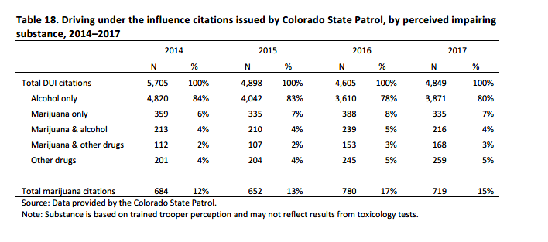

Slide 29
Driving under the influence citations issued by Denver Police Department, by impairment reason, 2013–2017
The Denver Police Department began collecting data on DUID in 2013. The number of cases of driving under the influence of marijuana or marijuana-in-combination was small but increased from 33 in 2013 to 63 in 2017. In 2013, these accounted for 1.1% of all DUI citations in Denver and in 2017 these accounted for 3.3% of all DUI citations.
 | 2013 | 2014 | 2015 | 2016 | 2017
DUI Total | 2,896 | 2,619 | 2,532 | 2,262 | 1,895
DUI Drugs | 84 | 129 | 148 | 122 | 119
Marijuana | 33 | 66 | 73 | 63 | 63
Other drugs | 51 | 63 | 75 | 59 | 56
Note: Marijuana includes marijuana alone or in combination with alcohol or other drugs. Other includes other drugs alone or in combination with alcohol. Source: Denver Office of Excise and License (2018).

Slide 30
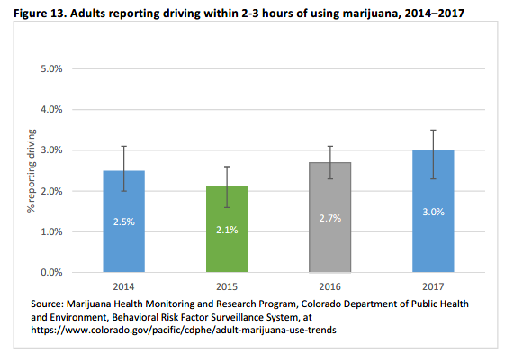

Slide 31
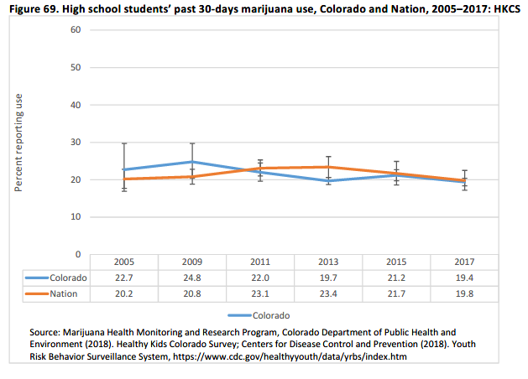

Slide 32
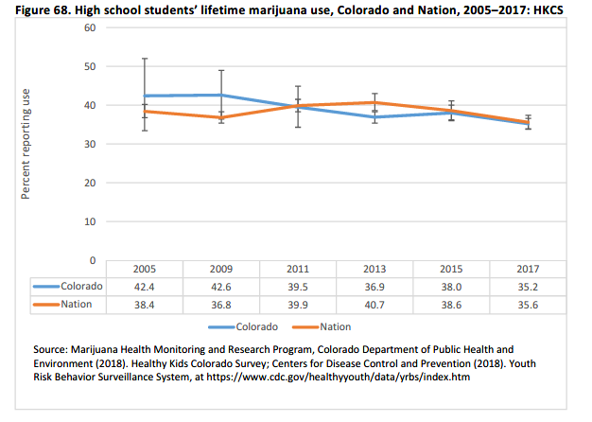
The proportion of Colorado high school students reporting using marijuana ever in their lifetime remained statistically unchanged between 2005 and 2017. Further, there was no statistically significant difference between Colorado student responses compared to national data.

Slide 33
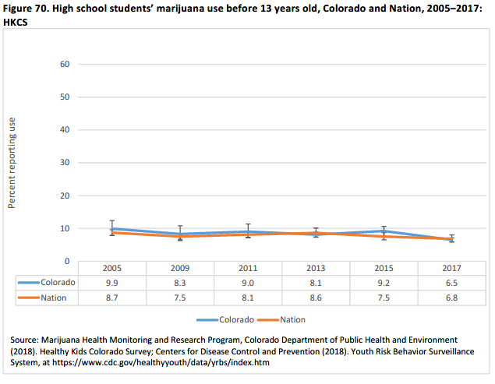

Slide 34
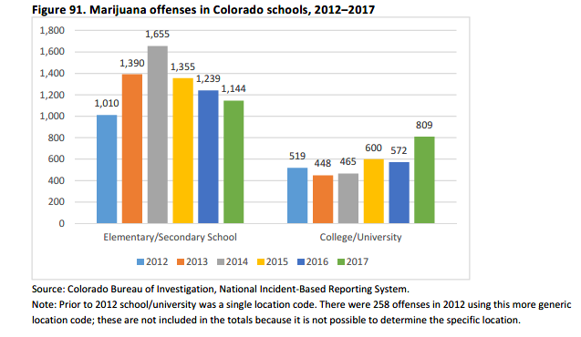

Slide 35
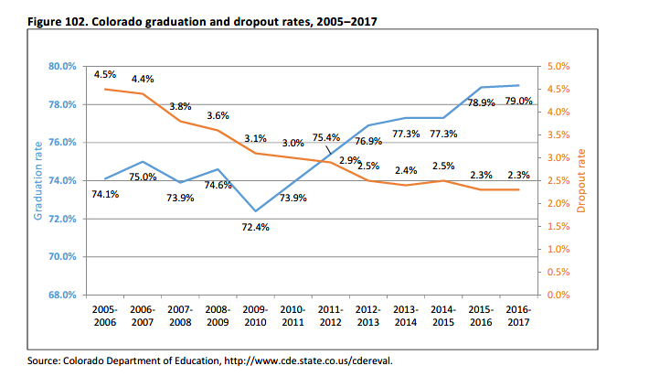
In sum, since legalization, reported discipline incidents due to drugs have not increased. It should be noted that recent declines in rates of suspension and expulsion, and fewer referrals to law enforcement, are likely associated with school reform efforts mandated in Senate Bill 12-046 and House Bill 12-1345. The bills adjusted the previous “zero tolerance” policies.

Slide 36
Decrease In Opioid Related Deaths
“After Colorado’s legalization of recreational cannabis sale and use, opioid-related deaths decreased more than 6% in the following 2 years.” Recreational Cannabis Legalization and Opioid-Related Deaths in Colorado, 2000–2015, American Journal of Public Health (AJPH) November 2017.
There is growing data that demonstrates that legalization has also helped Colorado diminish its reliance on opioids, leading to a decrease in prescriptions for painkillers and opioid-related deaths. The rate of positive opiates tests in Colorado is now half the national average, and a study from the University of Georgia found that states with medical marijuana laws had lower rates of opioid use. Also in Colorado, positive drug tests among the state's workforce have fallen since 2012.

Slide 37
Doug Friednash dfriednash@bhfs.com 303-223-1221
Albuquerque Atlantic City Carson City Denver
Las Vegas Los Angeles Orange County Reno
Sacramento San Diego Santa Barbara
Washington DC

